Slide 1
ICT Regulator Role on National Security and Critical Infrastructure Protection
ITU Workshop on “ICT Security Standardization for Developing Countries”
(Geneva, Switzerland, 15-16 September 2014)
Suliman A. Alsamhan
Electronic Evidence Supervisor, Communication and Information Technology Commission (CITC) - Saudi Arabia
ssamhan@citc.gov.sa

Slide 2
Communication and Information Technology Commission (CITC) Role
Communication and Information Technology Commission (CITC) recognized information security as one of its main responsibilities
Increasing the information security awareness level in the Kingdom of Saudi Arabia

Slide 3
Communication and Information Technology Commission (CITC) Role
Establishing National Computer Emergency Response Team (CERT-SA)
Enforcing security and privacy requirements on licensed operators
Contribution to the development of cybercrime law
Notes:
National Computer Emergency Response Team (CERT-SA)
To increase the information security awareness level
To coordinate national effort towards promoting IT Security best practices and creating trust among cyber community
To help managing information security attacks and incidents
To be the reference point in information security for the Cyber Community
To build Saudi talent and human capacity in the field of information security
To provide a trusted environment for e-transactions
to foster trust, cooperation and collaboration among our constituents and the general cyber community in the Kingdom

Slide 4
Presentation Outline
This presentation will focus on the following security programs:
National Information Security polices and procedures development framework for government agencies
Critical infrastructure protection program
National Threat Management program

Slide 5
National Information Security Policies and Procedures
CITC has developed information security policies and procedures development framework for government agencies
Assist the Government Agencies in Saudi Arabia in development of their customized information security policies and procedures in quick and effective manner
The framework can also be used by other public and private sector organizations

Slide 6
National Information Security Policies and Procedures
Government agencies must implement security polices and procedure to ensure:
Confidentiality,
Integrity, and
Availability of information
The framework allow agencies to develop their own policies internally to fit their needs rather than one size fits all methodology

Slide 7
National Information Security Policies and Procedures
Multiple Information security international standards are considered during the preparation of the framework.
The framework is prepared to comply with Saudi laws as listed below:
Saudi Laws
eTransaction Law
eCrimes Law

Slide 8
National Information Security Policies and Procedures
The framework also assists in:
Planning and developing information security policies and procedures
Selecting appropriate information security department placement option
Implementing the developed information security policies and procedures

Slide 9
National Information Security Policies and Procedures
Key components that will be used in rolling out the Government Agencies’ policies and procedures:
Repository of Common Policies.
Repository of System Specific Policies.
Repository of Common Procedures.
Information Security Department Placement Options.
Sample Awareness Plan.
Information Security Audit Process

Slide 10
National Information Security Policies and Procedures
The framework contains a web based portal to help government agencies producing policies, procedures and other component of security program.
CITC Organizes a one day workshop to explain the framework to government agencies and the usage of supporting tools

Slide 11
Critical infrastructure protection program
Why?
Increase on the number of DDoS attacks in the past two years
Increase on the traffic volume that is used to attack government and private agencies
Increase of dependency on the eServices such as e-government and e-banking services.
Potential financial loss and impact on the markets

Slide 12
Critical infrastructure protection program
The goal is to develop a program to protect critical infrastructure systems and networks from Distributed Denial of Services attacks (DDoS)
Enhance cooperation and coordination between data service providers, internet service providers and critical infrastructure owners
Implement DDoS protection centers and solutions

Slide 13
Critical infrastructure protection program
Program plan
Identify critical infrastructure owners in Saudi Arabia
Identify defense strategy
Identify constituents and their roles
Developing protection policies and procedures including escalation procedures
Periodic tests (response efficiency)

Slide 14
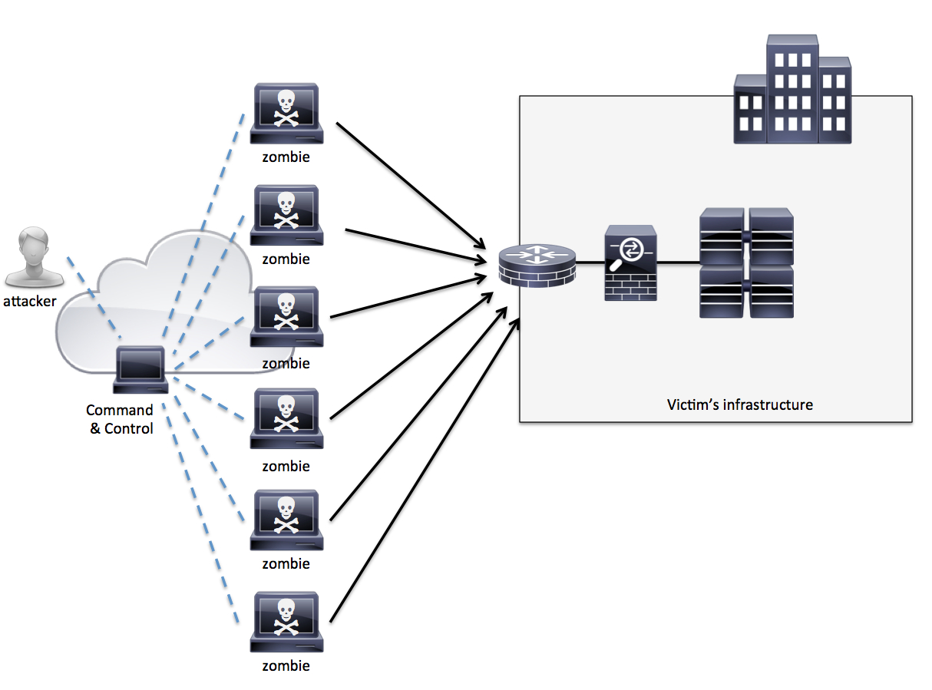
Critical infrastructure protection program
DDoS
Traffic passes through:
ISP
DSP

Slide 15
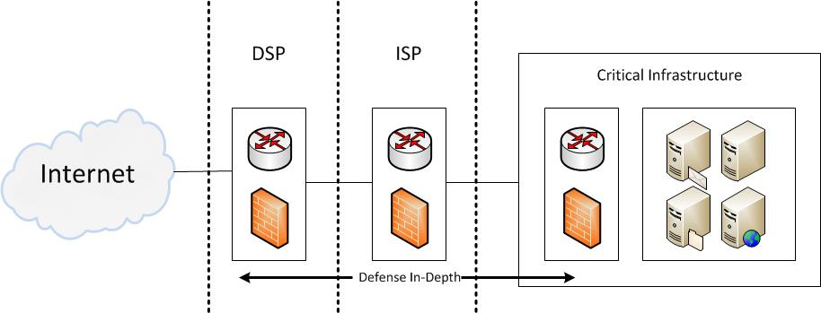
Critical infrastructure protection program
Defense Strategy

Slide 16
Critical infrastructure protection program
Defense Strategy
Monitoring Teams (minimizing detection time)
Establishing Scrubbing Centres
Up-Stream internet provider agreements
Rerouting traffic
Filtering out or limiting internet protocols

Slide 17
Critical infrastructure protection program
Defense Strategy
Effective cooperation, communication and coordination between constituents
Continues evaluation and testing

Slide 18
Threat Management Program
The program is designed to mitigate several threats:
Malware infection
Billions of systems are infected with malware around the world
Critical Vulnerabilities
Many internet systems are vulnerable and can be used to launch attacks
Compromised web site
Do you know if your web site is compromised?

Slide 19
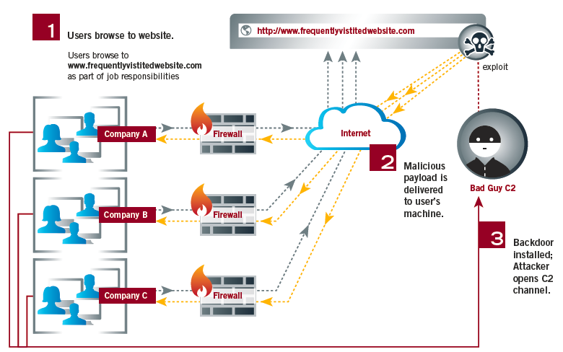
Threat Management Program
Malware infection, easy !!
Source: Mandiant Threat Report 2013

Slide 20
Threat Management Program
CITC/CERT-SA developed Threat Management System (TMS):
Utilizing the information produced by security community around the world to identify threats related to Saudi IP addresses.
Using google search API to detect compromised web site (e.g. keywords)
Alerting registered constituents about the threats and remediation steps.
Producing statistics about threats in Saudi Arabia

Slide 21
Threat Management Program
Threat Management System (TMS):
Government and private agencies must provide full contact information and IP addresses information to CITC/CERT-SA
The system parse received reports automatically and generates alerts to government and private agencies
The alert contains instructions for threat remediation
The system is developed internally as a web based system

Slide 22
Threat Management Program
Threat Management System (TMS):
Threat information Report
Infection Type
Source & Destination IP
Protocol Port
Time stamp
Geographical location
Types of threats
Viruses
Denial of Service attack - DOS
SPAM URL source
Botnet Command & Controller
Infected or suspicious URL
Open recursive DNS
Compromised web sites

Slide 23
Threat Management Program
Alerting
TMS
Fetch
Mail Account
Result
Process
Information Sources
correlate
Analysis
Normalize
Data Base
Match

Slide 24
Conclusions and Recommendations
Today’s cyber threats and risks show a strong need for international organization to set the internet policies and regulations in an enhanced cooperation fashion where governments get together, agree and implement an international public policy to counter cyber threats and threats
ICT Regulators can play major role to boost information security in the national level
Organizations needs help to address information security issues
Coordination, cooperation, and communication is key success to mitigate national information security threats
Awareness is the foundation for information security

