Slide 1

SMART & SUSTAINABLE CITIES
IMPACT MANAGEMENT

Slide 2


It is important for cities to identify the impact of their smart and sustainable city initiatives.
Notes:
1 - ICT for impact (move from enablement to impact)
2 - Not a govt initiative, city-wide focus
3 - Strategy built using top-down approach
4 - Originally, bottom-top initiative-based activities
5 - New balanced approach: Innovation + Strategy

Slide 3





Innovation + Strategy
Most smart and sustainable city initiatives require a balanced approach
Notes:
1 - ICT for impact (move from enablement to impact)
2 - Not a govt initiative, city-wide focus
3 - Strategy built using top-down approach
4 - Originally, bottom-top initiative-based activities
5 - New balanced approach: Innovation + Strategy

Slide 4




TERMINOLOGY / CONSTITUENTS
BUSINESSES
INDIVIDUALS
  Private sector businesses, start-ups and entrepreneurs based in or operating in Dubai, including Free Zone establishments.
  All individuals living in or visiting Dubai including UAE nationals and resident expats.
CONSTITUENTS
  Core segments addressed by cities’ transformation agenda. Strategic objectives are identified for each key segment including public and private sector and individuals.
GOVERNMENT
  Government leadership, decision-makers, and local and Federal government entities.

Slide 5

TERMINOLOGY / CONSTITUENTS
RESOURCES & INFRASTRUCTURE
  The digital, man-made and natural city resources and infrastructure that define our daily life.
RESOURCES
  Water, Energy, Air, Land
INFRA-STRUCTURE
  Water, Electricity, Roads, Drainage & Sewage, Buildings, Lighting, Waste, ICT

Slide 6
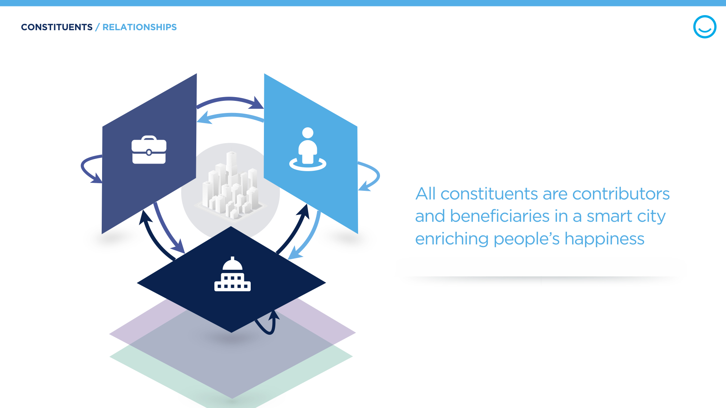

Slide 7
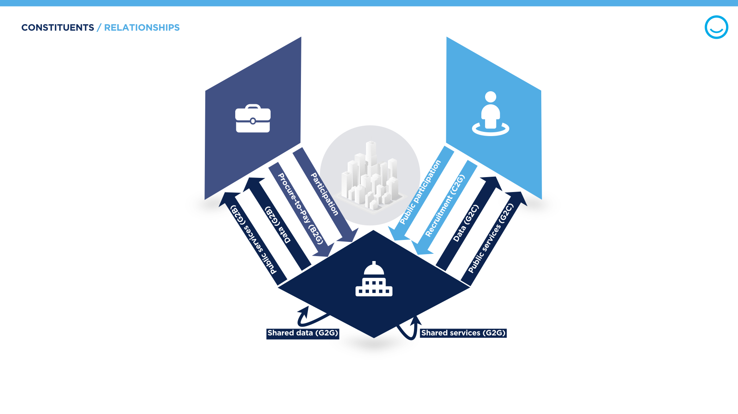

Slide 8





TERMINOLOGY / OUTCOMES
OUTCOMES
  Transformation with respect to city constituents will create outcomes, or impacts, in the city
CITIZEN IMPACT
  City services are more efficient and seamless, saving time and money while delivering delightful experiences.
FINANCIAL IMPACT
  Efficient city services enable cost savings in all industries while insights from data drive innovation and stimulate economic growth
RESOURCE & INFRASTRUC-TURE IMPACT
  City resources, energy and infrastructure are sustainable and resilient. Natural resources are protected through waste & pollution reduction.

Slide 9
TERMINOLOGY / IMPACT AXES
CITIZEN IMPACT
IMPACT AXES
BUILDING RETROFITS
CITIZEN: X% CITIZEN SATISFACTION
FINANCIAL: Y BN SAVINGS
RESOURCE: 20M mTCO2e SAVINGS
*
  Every strategic initiative, and program contributing to citywide transformation can be evaluated against impact axes, so that decision makers can focus time and resources on the most impactful projects.
FINANCIAL IMPACT
RESOURCE & INFRA. IMPACT
* Example for illustrative purposes only

Slide 10
IMPACT AXES / JOURNEY
2017
20XX

Slide 12
GOVERNMENT

Slide 13
CONSTITUENTS / GOVERNMENT
GOVERNMENT
CITY

Slide 14
Add targets for each ‘relationshoip' mentioned slide above
CONSTITUENTS / GOVERNMENT
Govt constituents will transform impact in data, core, back-office and public services
CITY
GOVERNMENT
ILLUSTRATIVE
G2B, G2C TARGET
X% Digital Public Services Enabled
Y% Digital Public Services Adoption
G2B, G2C, G2G TARGET
X% Open and Shared Data Availability
GOV TARGET
X% increased operational efficiency
CORE PROCESSES
DATA
PUBLIC
SERVICES
B2G, C2G TARGET
X% digital public participation
BACK OFFICE
B2G TARGET
X% Digital Supply Chain Processes
G2G TARGET
X% Eligible shared services adoption

Slide 15

CONSTITUENTS / GOVERNMENT IMPACT
X% CITIZEN SATISFACTION
ILLUSTRATIVE
GOVERNMENT
Y BN$ SAVINGS
X METRIC TONS CO2 EMISSIONS SAVINGS
YM TRIPS SAVED

Slide 17
BUSINESS

Slide 18

CONSTITUENTS / BUSINESS
ILLUSTRATIVE
BUSINESS
Economy Transformation
BUSINESS
X% Labor productivity increase
C2B
X% Enablement & Y% Utilization of entrepreneurship digital services
G2B
Y% Sharing Economy
COMPETITIVE SECTORS
ENTREPRENEURSHIP & INNOVATION
CIRCULAR ECONOMY
B2C, B2B, B2G
X Patents per 100,000 capita
G2B
X% of materials / assets reused
B2C, B2B, B2G
Y% R&D to GDP ratio

Slide 19
CONSTITUENTS / BUSINESS IMPACT
X% CITIZEN SATISFACTION
ILLUSTRATIVE
BUSINESS
Y BN$ SAVINGS
X METRIC TONS CO2 EMISSIONS SAVINGS

Slide 20
INDIVIDUALS

Slide 21




CONSTITUENTS / INDIVIDUALS
ILLUSTRATIVE
INDIVIDUALS
Social Transformation
C2C, B2C, G2C TARGET
X% Shared Vehicles
B2C, G2C TARGET
X% Electronic Health Records
G2C TARGET
X% Adult Literacy
C2C, B2C, G2C TARGET
X% of transportation with smart autonomous systems
ENHANCED MOBILITY
DAILY LIFE NEEDS - SOCIAL
SKILLS
C2C, B2C, G2C TARGET
X% public transportation usage

Slide 22
CONSTITUENTS / INDIVIDUALS IMPACT
X% CITIZEN SATISFACTION
ILLUSTRATIVE
BUSINESS
Y BN$ SAVINGS
X METRIC TONS CO2 EMISSIONS SAVINGS

Slide 23
RESOURCES & INFRASTRUCTURE

Slide 24




RESOURCES & INFRASTRUCTURE
ILLUSTRATIVE
RESOURCES
Resources and infrastructure empower all constituents
WATER TARGET
X% compliant with WHO guidelines
WATER & ENERGY TARGET
X% Consumption reduction
AIR TARGET
X% reduction in CO2 emissions per capita
WATER
ENERGY TARGET
X% renewable energy
AIR TARGET
Y% AQI
AIR
ENERGY
LAND
LAND TARGET
X% Green areas

Slide 25






RESOURCES & INFRASTRUCTURE
ILLUSTRATIVE
INFRATSTRUCTURE
Resources and infrastructure empower all constituents
WASTE TARGET
X% Unaccounted for Water
ICT ENABLEMENT TARGET
X% Targeted critical infrastructure ICT enabled
RESILIENCE TARGET
X% Completion of resilience plan for targeted critical infrastructure
ENERGY INFRA.
WATER INFRA.
PUBLIC LIGHTING
BUILDINGS
ROADS
WATER
PUBLIC IRRIGATION
WASTE TARGET
X% Waste treatment
WASTE
AIR
DRAINAGE & SEWAGE
ENERGY
LAND

Slide 26
CONSTITUENTS / RESOURCES & INFRASTRUCTURE IMPACT
X% CITIZEN SATISFACTION
ILLUSTRATIVE
BUSINESS
Y BN$ SAVINGS
X METRIC TONS CO2 EMISSIONS SAVINGS

Slide 27
TRANSFORMATION SUPPORT

Slide 28
CITY TRANSFORMATION SUPPORT
ILLUSTRATIVE
ICT & Emerging Technologies (Connectivity, IoT, Blockchain, AI, etc.)
Data
Legal & Policy Support
Security & Safety
Awareness & Community Outreach

Slide 29
CITY TRANSFORMATION
ILLUSTRATIVE
CITY OBJECTIVE 1
CITY OBJECTIVE 2
CITY OBJECTIVE 3
City Strategy
City Objective 1
KPI 1
…
City Objective 2
Tier I
….
St
City Objective N
KPI 1
KPI 2
…
Tier II
STRATEGIC
MEASURES
It is important to distinguish between enablement and impact KPIs (output and outcome KPIs or lead and lag KPIs

Slide 30




CITY TRANSFORMATION
KPI Target Value
Closed by Strategic Initiatives / Action Items
Innovation
Business Case Creation
Impact Analyses
Prioritization
Strategic Gap
Smart Financing
KPI Baseline Value

Slide 31
CITY TRANSFORMATION

Slide 32

THANK YOU

