Slide 1
women entrepreneurship in green industry
forum on „the gender dimension in ICT and environment through innovation and entrepreneurship“
Manizales, 4 April 2017

Slide 2
Two aspects of “decoupling”
Resource decoupling
Human well-being
Economic activity (GDP)
Resource use
Time
Environmental impact
Impact decoupling
Source: International Resource Panel-
Decoupling natural resources use and environmental impacts from economic growth ,2011

Slide 3
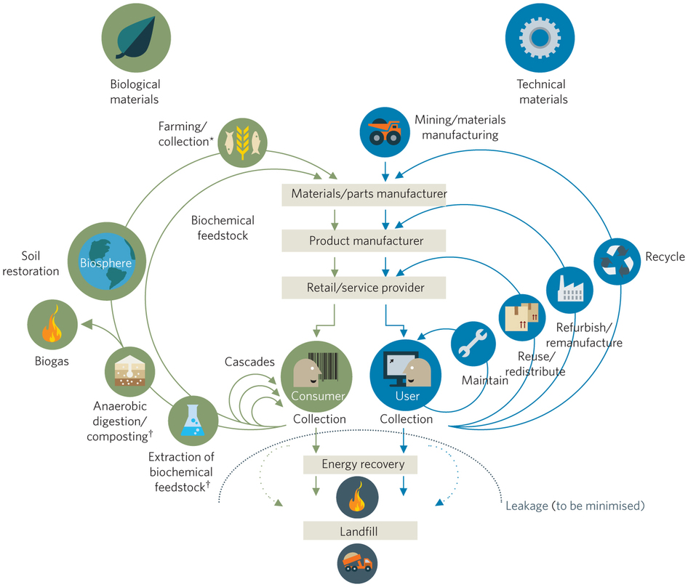
The Circular Economy

Slide 4
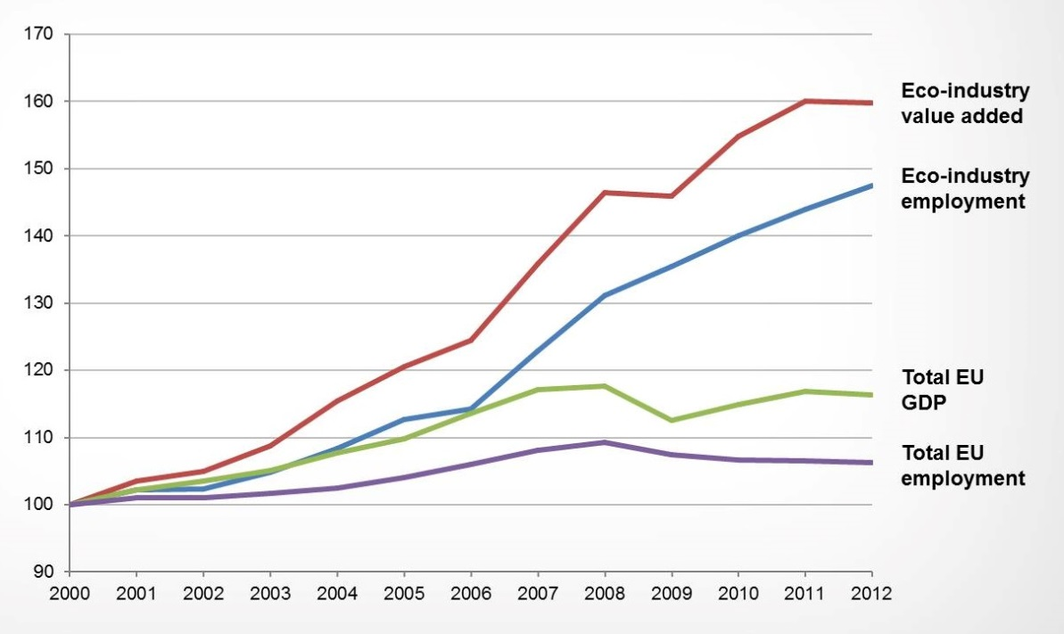
The green industry potential
Source: EEA, 2015, Eurostat data

Slide 5
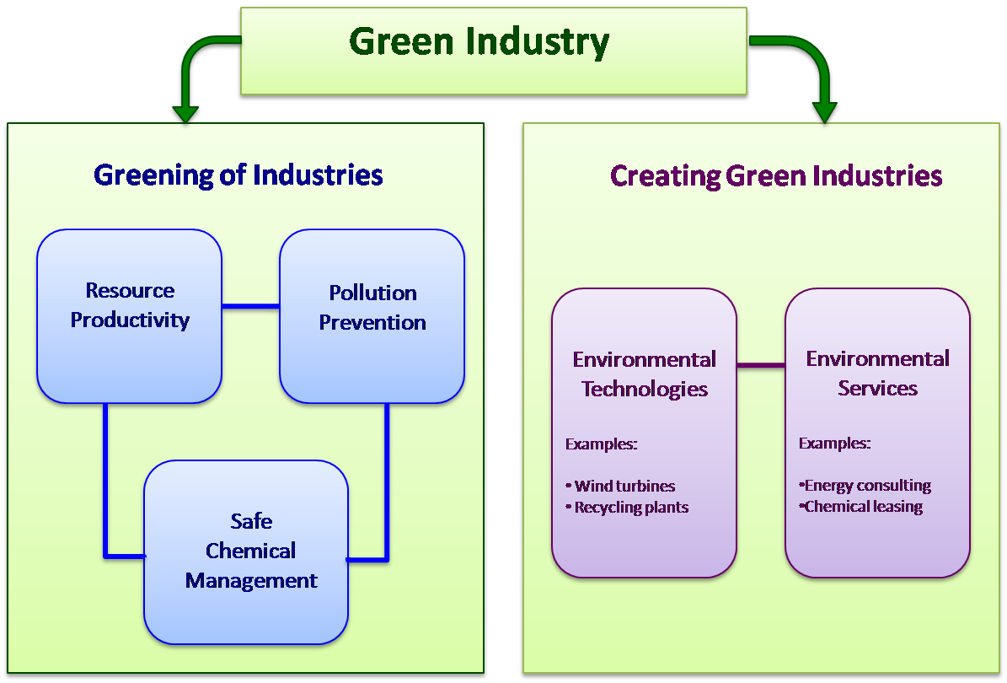
How to tap the green industry potential

Slide 6
Women, the environment and ICT
Pillar 2 of the green industry strategy – creation of new green businesses a priority and area that is currently underdeveloped, especially in LAC
Green businesses are highly innovative - importance of ITC for new and especially for innovative businesses
Success of the circular economy depends on mobilization of women entrepreneurship capacities
Yet many specific barriers exist

Slide 7
Women entrepreneurs and ICT
Affordable access: businesses need affordable and reliable internet in order to be innovative and to build trust with customers
Improving digital literacy and confidence: training for women on business software, raise awareness of internet based business models
Relevant content, apps and services: women entrepreneurs need to be encouraged through tailor made content, apps and software solutions, more web-communities of women entrepreneurs are needed
Related issues: internet business models require formal set ups, bank accounts, credit worthiness, etc.; women often face barriers to access these related services

Slide 8
Green businesses and ICT
Internet based business models
Digital currencies and funding mechanisms
Information and know-how based businesses:
  Market and sourcing information
  Business opportunities (e.g. waste exchanges)
  Technology information
  Quality standards and market requirements
Bioeconomy: a huge potential for LAC (www.bios.co )

Slide 9
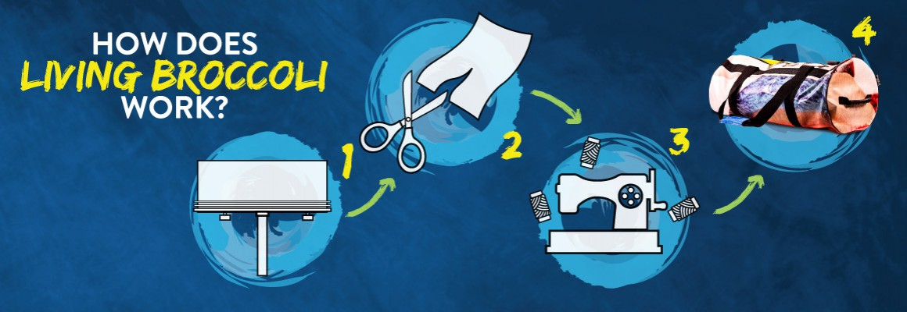

Case: livingbroccoli.com
Upcycling of old vinyl billboards
Founded by women entrepreneur Ana B; employing mostly women in design and production
Using and internet based business model

Slide 10
Some conclusions
There is a strong link between ICT, gender equality and the environmental agenda
Many success stories already exist, they need to be told more actively
Governments need to target the women entrepreneur more proactively, with tailor made solutions
Awareness, information, training, technology education for women are needed
More women leaders like Ellen MacArthur (www.ellenmacarthur.com ) are needed

