Slide 1
7th Green Standards Week
Manizales, Colombia, 3 - 5 April 2017
Contributing towards the achievement of Sustainable Development Goals through the National Adaptation Plans

Slide 2

SDGs set the direction for development
  Chart the way forward with focus on people, planet, prosperity, peace and partnership
  The goals and their targets are interlinked, and promote an integrated approach to development
  The Paris Agreement, expands on the SDG 13 on climate change by providing specific targets

Slide 3
The role on NAPs in contributing towards achievement of the SDGs
  Impacts of climate change are already affecting all facets of humanity and ecosystems – with extreme effects to those with low levels of economic development, inequalities, etc.
  Climate change adaptation is integral to development in all forms
  Established in 2010 under the UNFCCC, the process to formulate and implement National Adaptation Plans, serves as the vehicle for adaptation planning and implementation at national level
  It presents opportunities for countries to concurrently achieve the goals set both under the Paris Agreement and the 2030 Agenda for Sustainable Development

Slide 4
Objectives of NAPs, Paris Agreement global goal on adaptation
National Adaptation Plans, objectives ¹
To reduce vulnerability to the impacts of climate change, by building adaptive capacity and resilience;
Paris Agreement global goal on adaptation ²
Enhancing adaptive capacity, strengthening resilience and reducing vulnerability to climate change, with a view to contributing to sustainable development and ensuring an adequate adaptation response in the context of the global temperature limit of less than 2C.
To facilitate the integration of climate change adaptation, in a coherent manner, into relevant new and existing policies, programmes and activities, in particular development planning processes and strategies, within all relevant sectors and at different levels, as appropriate.
¹ UNFCCC decision 5/CP.17
² Article 7 of the Paris Agreement

Slide 5
National Adaptation Plans (NAPs)
The work involved
  Managing and maintaining the entire process
  Building long-term capacity for the essential functions of NAPs
  Etc.
  Formulation of a plan, periodic review and update
  Design and implementation of policies, projects and programmes
  Reporting, monitoring,
  etc.

Slide 6
NAP-SDG Integrative Framework (NAP-SDG iFrame)

Slide 7
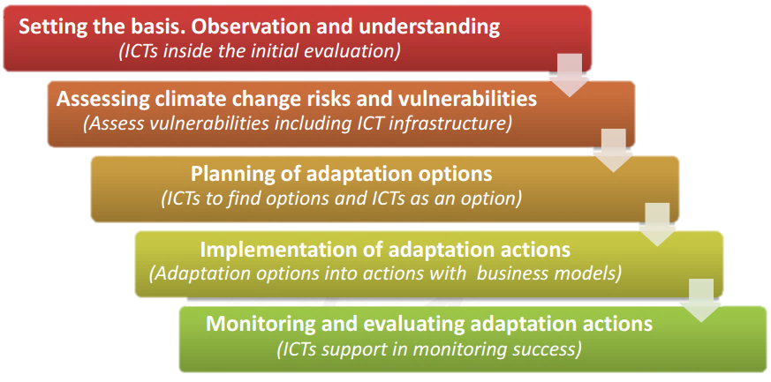
Bringing ICTs in NAPs
Framework to include ICTs in climate change adaptation in cities
Source: ITU (2015) Information and communication technologies for climate change adaptation in cities.

Slide 8
Bringing ICTs in NAPs
 | Engagement of ICT and adaptation communities ICTs in adaptation at NAP Expo 2016; led by ITU-T SG 5 Chair, Fujitsu, Ericson, D-Telekom Continue to build on such
 | Develop and promote tools Update the framework on role ICTs in adaptation Tools for specific application on adaptation planning and implementation
 | Capture and share best practices Success stories and sustainable development benefits of application of ICTs in adaptation Key systems, associated assessments, solutions

Slide 9
Thank you

