Slide 1
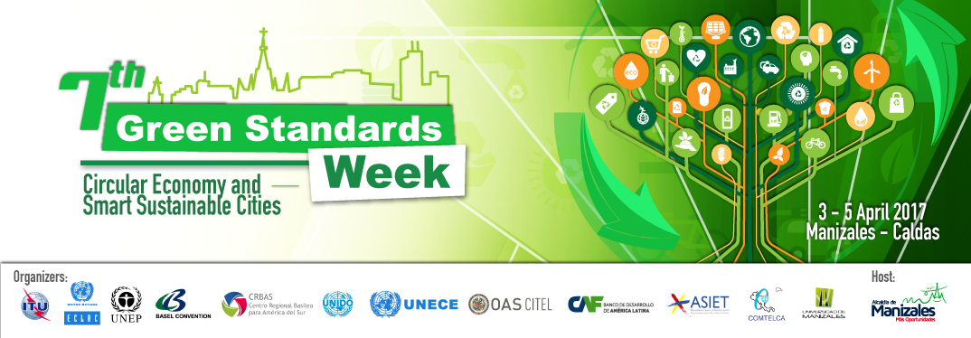

Concept of SMART SUSTAINABLE CITIES AND COMMUNITIES (SSC&C) in Developing Countries
HELEN C NAKIGULI
SENIOR OFFICER ENVIRONMENT MANAGEMENT
UGANDA COMMUNICATIONS COMMMISSION

Slide 2


Outline
Perception of smart cities in developed and developing countries
Challenges and opportunities of urbanization in developing countries
Requirements for transforming to SSC&C

Slide 3


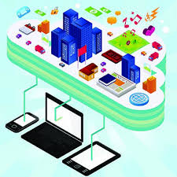
What are the key aspects that will support the transformation of cities of developing countries into SSC&C?
Can rapid urbanization in developing countries lead to SSC&C?

Slide 4


DEFINITION - ITU
A smart sustainable city is an innovative city that uses information and communication technologies (ICTs) and other means to improve quality of life, efficiency of urban operation and services, and competitiveness, while ensuring that it meets the needs of present and future generations with respect to economic, social, environmental as well as cultural aspects”

Slide 5
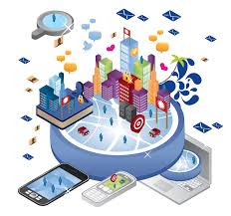
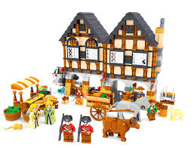
Perception of Smart Cities
For the developing countries, perceptions are still forming...
  Cities are still grappling to achieve
    access to basic needs- water, shelter, food (rural)
    Improved living conditions – education, health (urban)
    Economic growth
  This makes the smart cities concept challenging
For the developed World
    IoTs, AI
    Integrated management of operations
    Technology resilience
This makes sense to the developed countries but not yet quite realistic in developing countries

Slide 6
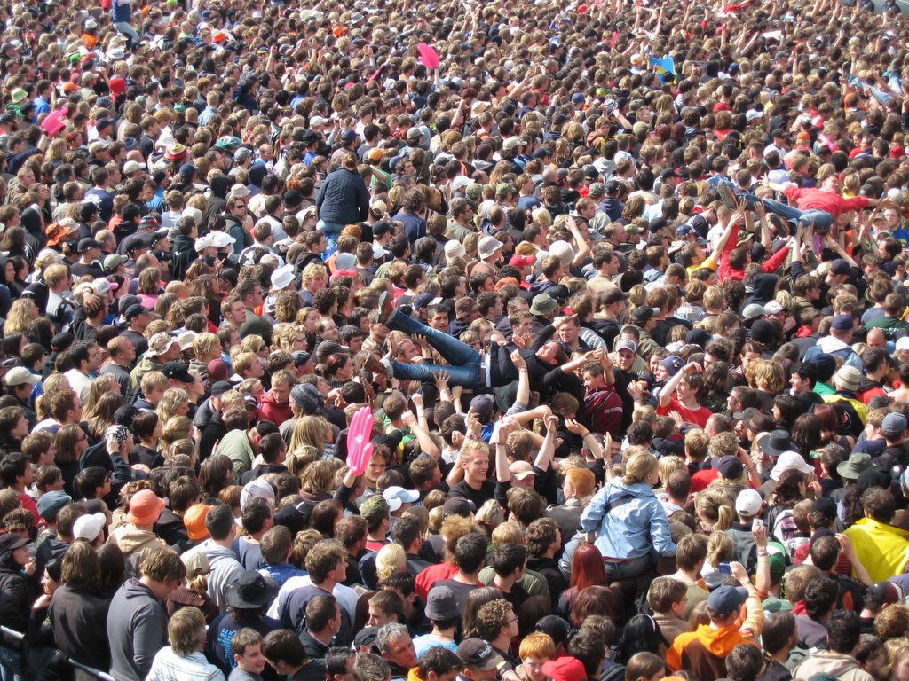
Urbanization in Developing Countries
Major rural-urban demographic shift
In 2014, 54% of the world population were leaving in the urban areas.
Anticipated that this will increase to 70% by 2050. 90% expected in developing countries,
In developing countries, urbanization presents a number of opportunities as well as challenges.
Challenges
Opportunities
Infrastructure and service shortage, mushrooming of slums, pollution, crime, unemployment, etc
Boosts economic growth,
Agglomeration for industrial and service sectors

Slide 7
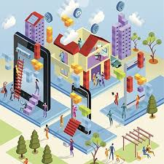








Key pillars for transforming to SSC&C in developing countries
Building on existing infrastructure
  Building blocks are already available – technological, physical, social
Interconnecting distinct sectors
Increase the enabling effects of ICTs
  Efficiency, substitution, support systemic effects
Coordinated package of essential infrastructure and services needed
Smart communities
Smart cities must start with the citizens’ need, not the technology.

Slide 8

Indicators of sustainability
Economical sustainability
Social Inclusivity
Environmental
Inputs: Policies, awareness, infrastructure, the will
Livable
Viable
Equitable

Slide 9

What is needed?
Political will
  Policies, framework and strategies
  Affordable access and availability of Broadband to all
  Even better infrastructure development- renewable energy sources (Africa is gifted), addressing the basic need
  Enhance intergovernmental/inter-sectoral collaborations
  Subsidies for adoption to “Greener ICT” solutions
  Investing in tech infrastructure
  developing incubators and innovation centres/hubs, R&D
Tech and entrepreneurship skills
Local content
accurate, appropriate, local relevance
Create more cities
spread the population

Slide 10


