Slide 1
6th ITU Green Standards Week
5-9 September 2016
Montevideo, Uruguay
ITU activities on EMF
Héctor Carril
Vice-Chairman of ITU-T SG5 “Environment and Climate Change”

Slide 2
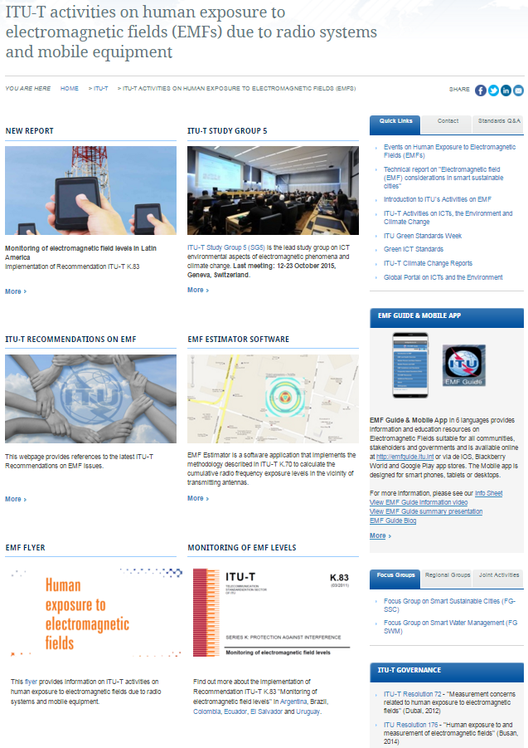
ITU contributions on EMF standards
ITU-T Study Group 5 has an active global group of around 100 experts focused on EMF
Key activities and study areas
EMF measurement and monitoring standards
EMF estimator software
EMF information
EMF mobile applications – (EMF Guide)
EMF management frameworks (technical aspects)
Link to EMF web page

Slide 3
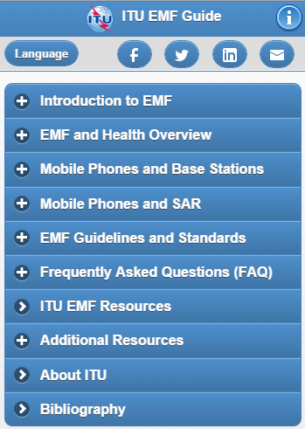
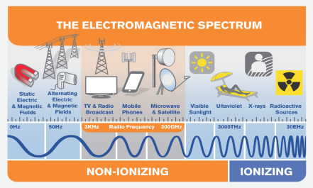



Communication with public on EMF
Key elements for successful public communications:
  Easily understood information
  Open and transparent dialogue
  Provide interested parties with reliable sources of information
ITU public information on EMFs:
  ITU EMF Guide – key source of information
  EMF website
Mobile application “EMF Guide” available online in
6 languages at http://emfguide.itu.int

Slide 4
Why is ITU working on topics related to communication with the public on EMF?
High level of social unrest due to the installation of antennas in various regions of the world.
Impossibility of ordered network deployment.
Investments suspended or delayed.
Impossibility of developing connectivity and bridging the digital divide
Notes:
Por ejemplo, en el 2010, en Perú, Nextel poseía un 50% de los equipos adquiridos que no podían ser instalados por este tema.
El Celular es la herramienta que tienen las clases de menor poder adquisitivo para reducir su brecha digital.

Slide 5
Consequences of problem
Mayors acting defensively as a result of pressure from the public and from NGOs and the opposition. Provincial governments do the same. The national government is generally absent.
Mayors promoting municipal regulations in the following manner:
  Without technical support regarding health protection.
  Discrimination between towers and antennas for cellular services and other services (broadcasting, amateur radio, etc.).
  Restrictive from the architectural standpoint, preventing the deployment of communication networks.
  Very bureaucratic, delaying authorization.
Notes:
Las RNI son fenómenos raros, poco comprensibles, cuyos problemas pueden escalar, generándose oportunidades de conflictividad política porque el argumento que “afecta a la salud” resulta un argumento fuerte.
Se generan normas que resultan prohibitivas pero sin un soporte para la protección a la salud, puesto que, en general, no existen especialistas en los municipios o alcaldías.
Terminan siendo normas que, paradójicamente, afectan a la salud. Por ejemplo, por alejar las antenas/radiobases, ya que los teléfonos celulares terminan emitiendo más potencia que antes y, por ende, mayor radiación en el entorno de la cabeza del usuario.
Además, no existe un criterio técnico de porque se alejan las antenas: 100, 200,…, 500 metros, ¿y por qué no más? ¿y por qué no menos?. Ejemplo: Municipalidad de Quilmes (Bs. As.)
Además, el Alcalde puede sacar las radiobases pero eso aumenta el conflicto (falta de cobertura, reclamo de usuarios ante empresas). Ejemplo: Municipalidad de La Plata (Bs. As.)
Se discrimina la telefonía móvil, básicamente, pero no la radiodifusión (que transmiten con mayor potencia y a menor frecuencia).
La restricción edilicia puede llegar a indicar que las torres deben estar en el medio del lote y a 6 metros de los linderos pero si los lotes son de 10 metros (que es un caso bastante común), no se puede cumplir pero lo instalan igual; resultado: se recurre a la justicia y aumenta el conflicto, en vez de solucionarlo.
Hay habilitaciones que pueden demorar más de 1 año.

Slide 6
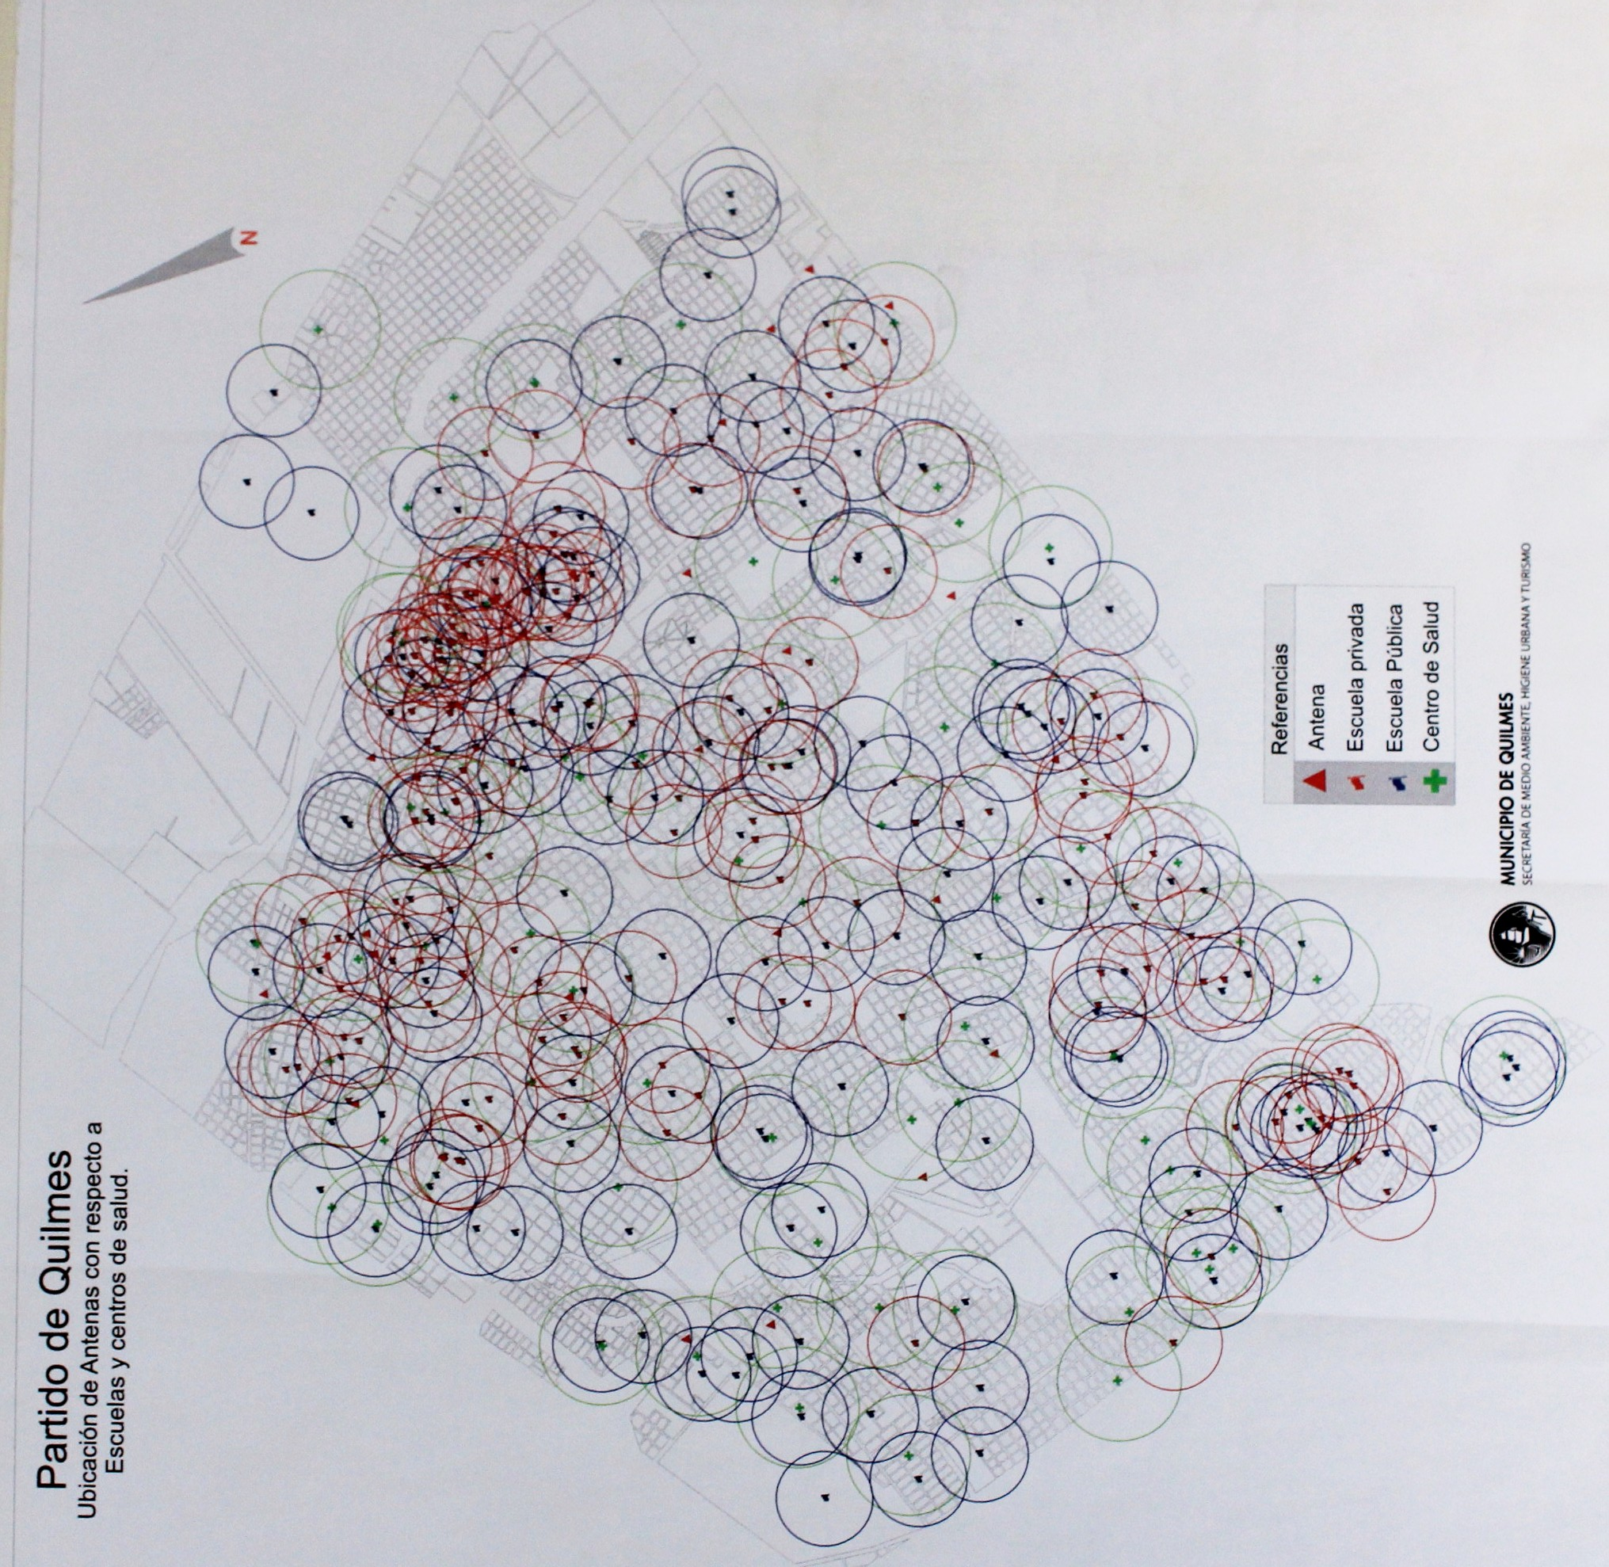
Quilmes district
Location of antennas in relation to schools and health centres
References
Antenna
Private school
Public school
Health centre

Slide 7
Effects
In most municipalities NO INSTALLATION complies with the standards in force (e.g. installations set up at night without municipal authorization).
Without authorized installations, companies do not pay municipal fees.
Legal disputes arise with the companies.
Impossibility of deploying networks in an orderly and legal manner (legal uncertainty). Investments delayed.
Impossibility for national authorities to require compliance in regard to coverage and quality of service.
Users dissatisfied with the service and fearful for their health because they do not understand what NIRs are and whether the state is protecting them.
Social/political conflict, with all parties losing.
Notes:
Termina siendo una industria informal!
Hay grupos de vecinos que recorren de noche para evitar las instalaciones.
Hay exigencias de cobertura y de servicios por parte del Estado Nacional, que presiona a las empresas. Esto aumenta la incertidumbre y genera mayor violencia, llegando a quemar torres e instalaciones y secuestrar ingenieros (ejemplo: Cutral-Có [Neuquén] y Bahía Blanca [Bs. As.]).
Los alcaldes dejan de cobrar y es lógico que quieran cobrar (no está mal en Latam) pero quieren cobrar todo lo que se pueda!. Una cosa es cobrar una tasa (que garantice que la torre esté bien instalada y no se caiga y cumpla estructuralmente) y otra cosa es que quieran cobrar por torre hasta US$ 10.000 por mes (se puede negociar, por ejemplo, US$ 1.000 por mes y se puede resolver el conflicto). Debe existir un equilibrio.

Slide 8

Analysis and proposal by ITU
Efficient and orderly deployment of mobile telephony infrastructure
Imperceptibility of EMFs
Distrust
Fear
Resolution 72 – World Telecommunication Standardization Assembly
Low-cost measurements
Communication
Cooperation
SG5
Continuous Monitoring System and Communication K.83
NIR Maps K113
  ITU EMF Guide – EMF Website
Notes:
La base está en la Res. 72 (2008) que pide que se trabaje en la cooperación, en la comunicación y en la simplificación de las recomendaciones y normas, para lograr sistemas de medición de bajo coste.
El sistema de Monitoreo Continuo y la Comunicación son las herramientas clave normalizadas con la Recomendación UIT-T K-83 “Supervisión de los niveles de intensidad del campo electromagnético”.

Slide 9
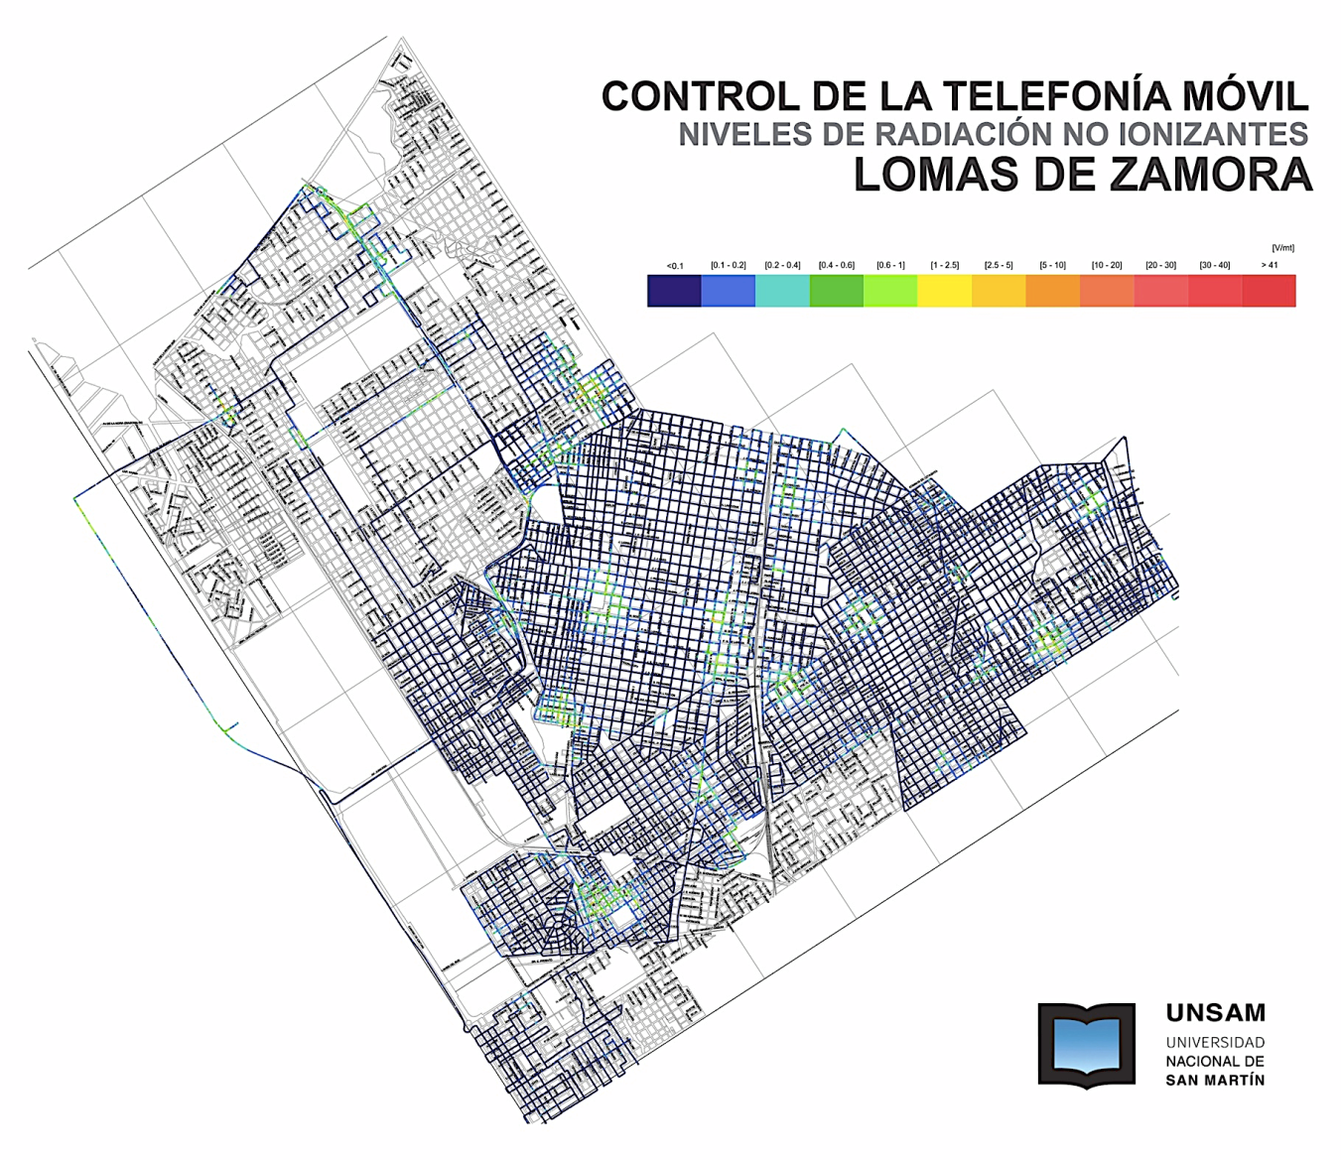
Dynamic Radiation Maps
K113
MONITORING OF MOBILE TELEPHONY
LEVELS OF NON-IONIZING RADIATION
Dynamic radiation maps or mappings are a tool providing a high degree of social communication.
They are based on street-level, per-second, isotropic, georeferenced measurements translated into colours on a map, providing a qualitative reflection of the population.

Slide 10
Continuous Monitoring System
K.83
Conceptual outline
Base station:
Permanent electromagnetic radiation
Monitoring equipment
Installed on specific locations
Continuous measurements
Control centre:
Receives and stores the measured data
Monitoring station
Cellular radio base station
Central monitoring node
Notes:
Es un sistema específico para lugares con alto grado de conflictividad.
Permite un control social de las RNI. Transmite las 24 hs por la red GSM (cuando envía datos, no mide)
Puede enviar un mail periódico de aviso de niveles medidos, para personas que participen del conflicto (ONGs, Directores de Escuelas, etc.)
El tiempo en que se hacen las mediciones es relativo, porque depende del tipo de conflicto y de los actores que intervienen.

Slide 11
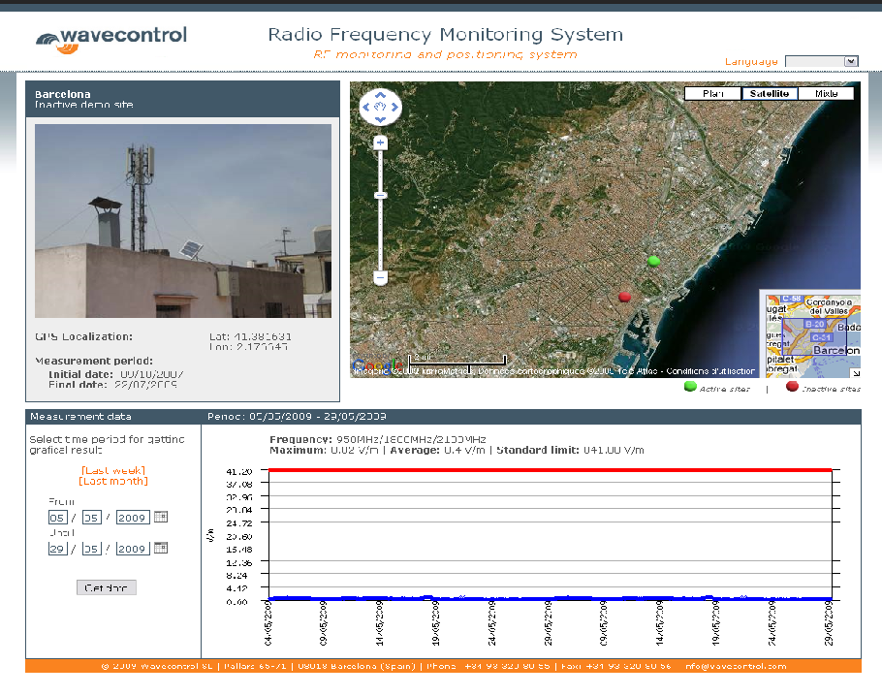
Continuous monitoring system
– Public link –
Proposed monitoring system
Easy to use
User-friendly
Easy to understand
Detailed information:
  Site
  Description
  Date and time
  Equipment
  Methods used
  Threshold levels
Notes:
Luego se ve el ejemplo del SATFAM de Argentina.
Otro ejemplo: Italia, Agenzia Regionale Prevenzione e Ambiente dell’Emilia-Romagna (http://www.arpa.emr.it/pubblicazioni/cem/generale_829.asp)
Para Bologna ver: http://www.arpa.emr.it/cem/webcem/bologna/

Slide 12
Similar NIR continuous monitoring systems installed recently
Colombia: Continuous monitoring system installed (40 monitors)
Ecuador: Continuous monitoring system installed (15 monitors)
Brazil: Continuous monitoring system installed (70 monitors)
Uruguay: Pilot project
Panama: Installation in 2016
Argentina: SECOM, with Resolution 11/2014, creates the National Continuous Monitoring System (not yet implemented)
In Central America (November 2012), ITU developed a Pilot Project in San Salvador with the San Salvador NIR Map and a Continuous Monitoring System. It included training in these systems for Representatives of the Regulators of
El Salvador, Panama, Honduras, Nicaragua and Guatemala, coordinated with COMTELCA (February 2013).

Slide 13
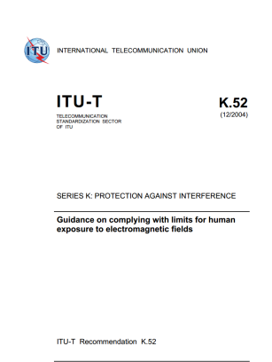
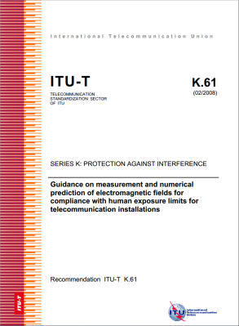
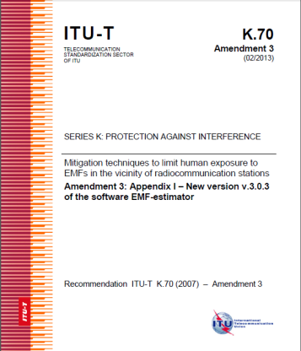
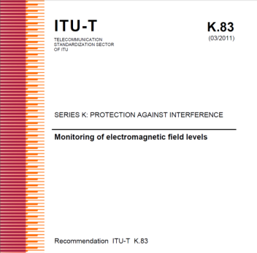
ITU-T Recommendations for EMF assessment
Recommendation ITU-T K.52 (2000/2014) – Guidance on complying with limits for human exposure to electromagnetic fields – includes “K.52 calculator software”
Recommendation ITU-T K.61 (2003/2008) – Guidance on measurement and numerical prediction of electromagnetic fields for compliance with human exposure limits for telecommunication installations
Recommendation ITU-T K.70 (2007/2014) – Mitigation techniques to limit human exposure to EMFs in the vicinity of radiocommunication stations – includes “EMF Estimator software”
Recommendation ITU-T K.83 (2011/2014) – Monitoring of electromagnetic field levels

Slide 14
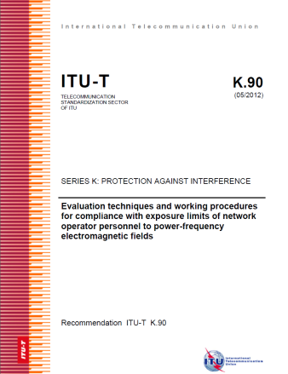
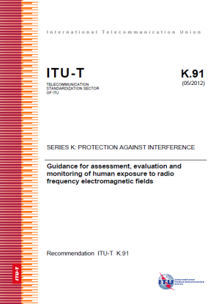
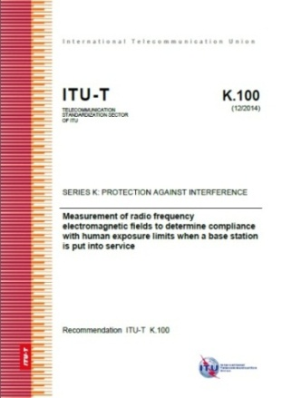
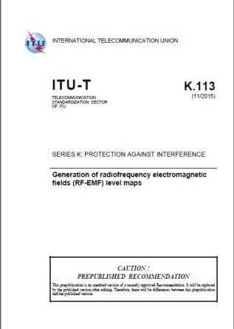
ITU-T Recommendations for EMF assessment
Recommendation ITU-T K.90 (2012) – Evaluation techniques and working procedures for compliance with limits to power-frequency (DC, 50 Hz, and 60 Hz), electromagnetic field exposure of network operator personnel – includes EMFACDC software
Recommendation ITU-T K.91 (2012/2014) – Guidance for assessment, evaluation and monitoring of human exposure to radio frequency electromagnetic fields – includes “Uncertainty calculator” and “Watt_Guard” software and Supplement “EMF-guide”
Recommendation ITU-T K.100 (2014) – Measurement of radio frequency electromagnetic fields to determine compliance with human exposure limits when a base station is put into service
Recommendation ITU-T K.113 (2015) – Maps of the RF EMF

Slide 15
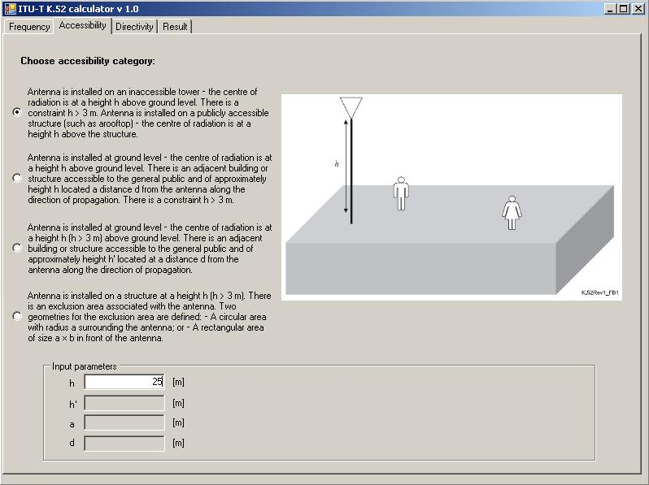
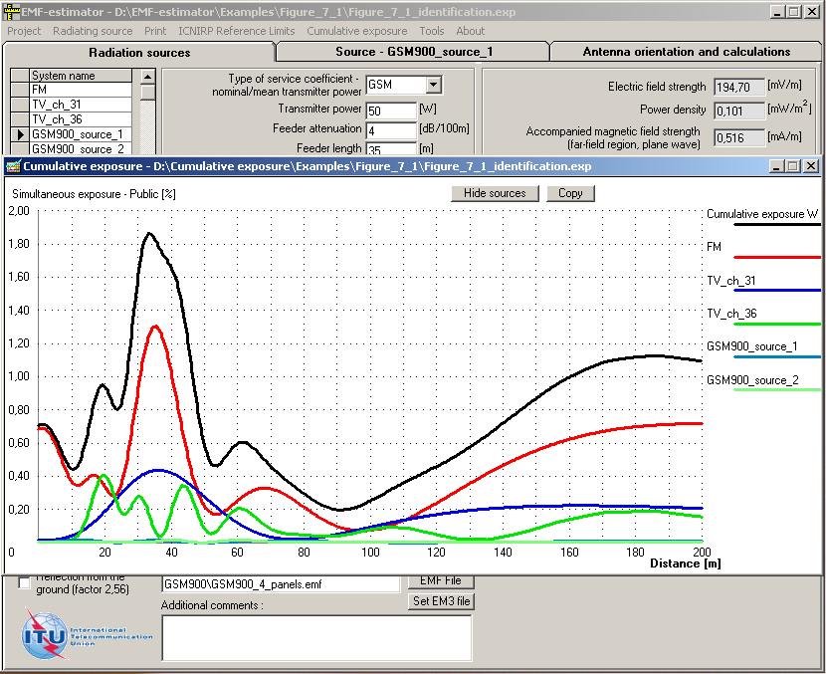
ITU-T Recommendations – Additional tools
Software:
  K.52-calculator (Recommendation K.52)
  EMF-estimator (Recommendation K.70)

Slide 16
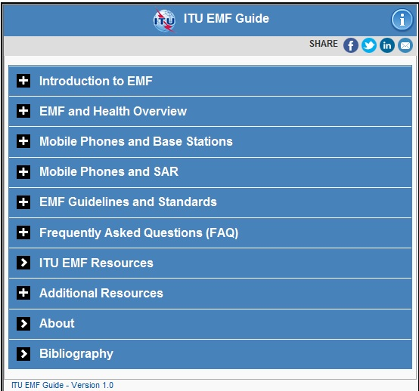
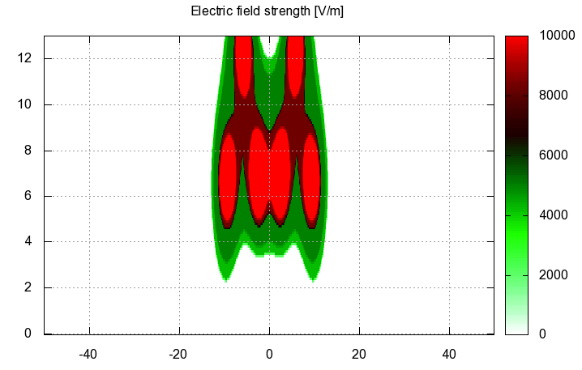
ITU-T Recommendations – Additional tools
Software:
  EMFACDC (Recommendation K.90)
  Uncertainty calculator (Recommendation K.91) and “Watt_Guard” (Recommendation K.91)
Application for smartphones and tablets on EMF: “Guide on electromagnetic fields and health”, Supplement 1 to ITU-T Recommendation K.91

Slide 17
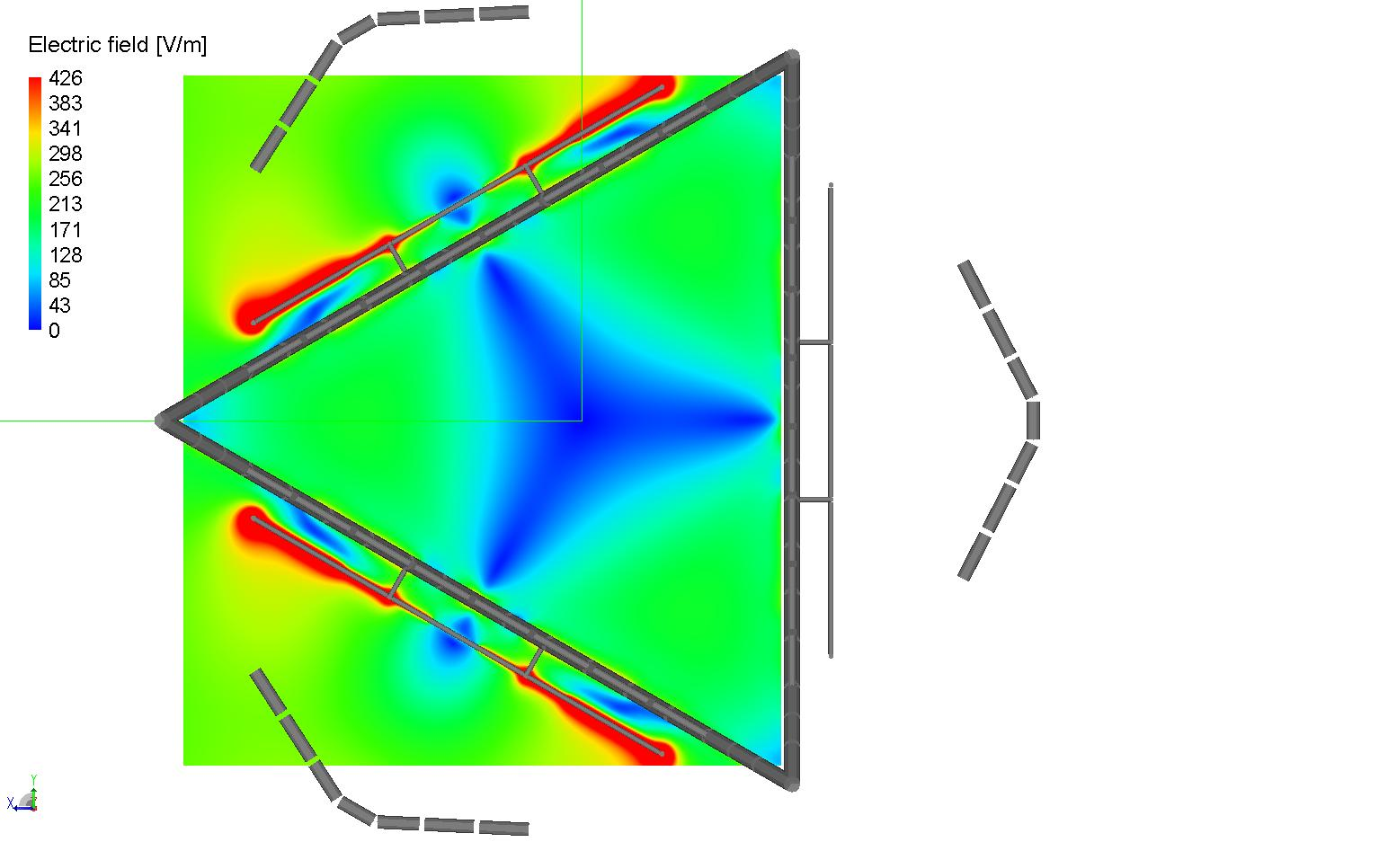
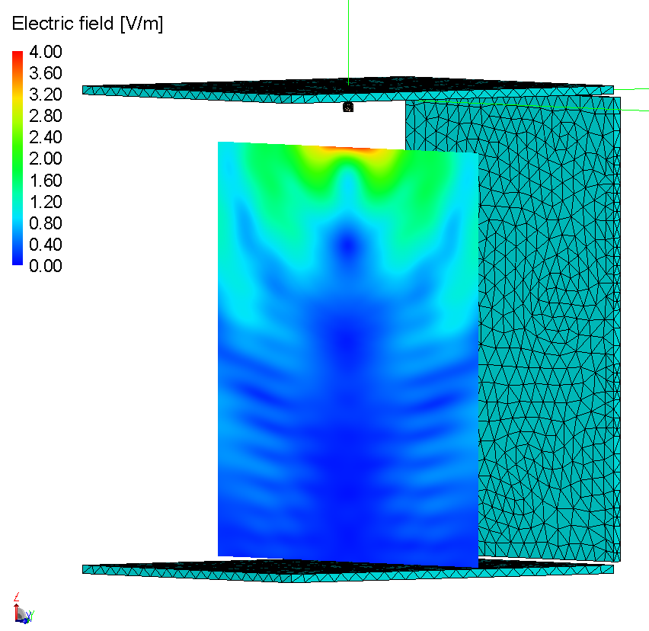
ITU-T Recommendations – Work in progress
Recommendation ITU-T K.env (planned for 2016) – Guidance on the Environmental Management for Electromagnetic Radiation from Radiocommunication Base Stations
Recommendation ITU-T K.emf (planned for 2017) – Exposure levels in the close proximity of the radiocommunication antennas

Slide 18
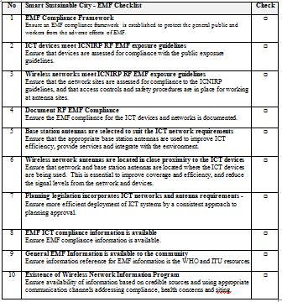
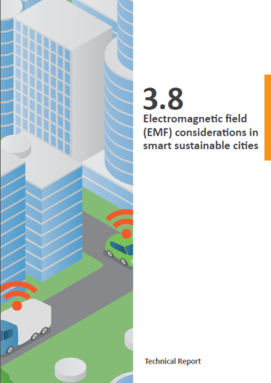
EMF considerations for city planners and developers
ITU has developed a Technical Report and a Checklist on EMF considerations for Smart Sustainable Cities (SSCs)
  Provides implementation guidelines, and promotes the efficient location of wireless networks in smart sustainable cities
  Contains a “Smart Sustainable City EMF Checklist”
  Designed to provide an easy-to-use reference for municipal authorities and planners to guarantee that SSC policies work efficiently and in compliance with EMF exposure standards
  References WHO materials, ICNIRP Guidelines, ITU-T Recommendations and IEC Standards
Wireless networks provide essential connections for SSCs
Efficient deployment of the wireless infrastructure reduces the power transmitted between networks and devices, reduces EMFs and enhances the efficiency of ICTs

Slide 19
Additional links and information
ITU-T Study Group 5 : http://www.itu.int/en/ITU-T/studygroups/2013-2016/05/Pages/default.aspx
  Next SG5 meeting from 10 to 14 October 2016, Geneva (including a special session on “Updated from WHO”)
Flipbook on Smart Sustainable Cities (chapter on EMF): http://wftp3.itu.int/pub/epub_shared/TSB/ITUT-Tech-Report-Specs/2016/en/flipviewerxpress.html
ITU-T activities on EMF: http://www.itu.int/en/ITU-T/emf/Pages/default.aspx

Slide 20
Thank you
Eng. Héctor Mario Carril
VC SG5 Environment and Climate Change. ITU-T hectormario.carril@ties.itu.int
(+54)-9-11-54817955

Slide 21



