Slide 1
IoT enabling
Smart Cities
Awareness
Roberto Saracco EIT Digital Trento Node Director
Notes:
More and more sensors are “percolating” into our cities and this is just a beginning. In the next 5 years will see a major increase in their number and, even more significant, we will see an increase in data availability to third parties. The sheer volume of sensors and sensors data will have a qualitative impact on our cities transforming them into aware entities. This, in turns, creates new challenges that municipalities and regulators will have to face.
The talk addresses both the technical evolution leading to the flooding of data and the resulting implications.

Slide 2
There’s plenty of sensors
Choosing sensors
Acustic
Elect/Magn
Optical
Radiation
Chemical
Mechanical
Thermal
Spatial
Bio
Material
Virtual
Use what’s already there
Piggy back on infrastructures
Go Virtual
Notes:
Although my walk through different types of sensors was not exhaustive I hope two messages came out clear: - there are plenty of technologies available for sensing a broad variety of parameters, and more will become available
cities should sense their environment because the more data they have available the smarter their choices
Re-reading what I wrote as possible use, in the smart city context, of the various types of sensors you should notice that a municipality has a broad range of choices. Suppose you want to get info on the traffic flow in your city. You can get a broad “sense” on the number and types of vehicles by placing microphones in several points across the city. This can provide rough data on traffic density and traffic jams. You can deploy magneto sensors at relevant crossing points providing a real time stream of data as vehicles go through the intersection. http://www.sensysnetworks.com/about?successes Alternatively, you can deploy optical sensors, video cameras, on those same intersection and have a software “looking” at the video stream to count the cars. The software could also identify each car by looking at its plate and “follow” its journey as it move from one intersection to the next one equipped with the video camera. This would provide better information on traffic flow but, of course, brings along privacy issues since now the Municipality is actually tracking its citizens… Notice that you can also try to use existing video cameras deployed by private parties for security monitoring, http://www.kiwisecurity.com/video-analytics-management-for-smart-cities/ and you can use the illumination infrastructure, light poles, as both places to hook the video camera (and power it) and as data transport infrastructure. http://www.ioti.com/smart-cities/why-iot-coming-street-lights You may enforce the use of transponders on cars (as it is the case in Singapore), and/or you can get data from the vehicle GPS, and you can track the vehicles as they get close to “gate” points by using radio signals (electromagnetic sensors). Given the radio coverage you get a better localization of vehicles and you can use this more refined pinpointing to offer services (or to charge for the use of city infrastructures, like roads and parking lots).
You may get data from the wireless operators and track the movements of cell phones (with varying degree of anonimity) and by analysing those movements the software can distinguish between traffic on foot, on a private vehicle and on public trasportation. You can also profile the vehicle (and the cell phone users) and provide services based on the traffic situation and on your expectation of direction (he is going to work, to school…). Privacy is at the forefront, of course. http://crowdsignals.io/blog/2016/07/21/using-smartphone-sensors-to-measure-metro-traffic-in-new-delhi/
In this example, but it can be told the same story for many other situations, I have offered 6 different types of sensors to monitor traffic flows. Hence the question: which is the right one to use? Answer: there is no such a thing as “the right one”. It depends on what you have and what you (and the citizenship) want to do. This is why different cities are taking different decisions. The crucial point for the decision maker is to be fully aware of what the alternatives are and of their present and future implications. This also requires a good understanding of technology capability and evolution.
As a rule of thumb I would suggest to start looking at the choices from the point of view of economics, hence:
try to use what is already available, both in terms of sensors and in terms of communicationssupport infrastructures. One thing that is surely available are the citizens, their vehicles and their smart phones. Try first to see what needs to be done to leverage from them.
piggy back on existing infrastructures, including communication infrastructures and their cabinets, their radio towers, the illumination infrastructure with its light poles, the public transportation infrastructure (e.g. you can easily place a video camera on every public bus and get video feeds that could be analysed to monitor the traffic flow).
go virtual, use as much as possible different sources of data and see what information can be extracted from them. Open up these data sets so that third parties can come up with new ideas for leveraging them
as a last resort start planning to deploy new sensors and try to be as general as possible. Rather than deploying a sensor that provides just one type of data look for something that can be programmed to deliver a variety of parameters and use it to become part of the city sensing infrastucture not just to serve a vertical application.
Does it make sense? (pun intended)

Slide 3
Infrastructures
Connectivity Infrastructure
Services Infrastructure
Regulation
Economics
Awareness Infrastructure
Perceptive Infrastructure
Notes:
There are several kinds of conceptual infrastructures that we should consider in our exploration of technology evolution applied to cities and citizens.
The first, and basic one, is the Connectivity infrastructure. Streets, roads, highways are the ones immediately coming to mind. Then, in the last fifty years telecommunications became an important connectivity infrastructure and more recently Internet (not the Web, that is part of the service infrastructure). Telecommunications started 150 years ago but for the first hundred years was a sort of service infrastructure, rather than a connectivity one since it was serving selected ones. It is only in the second part of the last century that it became a connectivity infrastructure for business first and then part of the universal service. For its pervasivity, wireless radio is today a worldwide connectivity infrastructure.
Connectivity infrastructures let people interact. This is the bases for aggregating a community. But to maintain the community you need to provide some basic services.
Services infrastructures are bringing water, getting rid of waste, provide transportation, more recently provide power (electricity, gas, petrol….). In the last decade the web has grown to become a fundamental service infrastructure for both thrift and social life. As the web grew, so grew service variety and support platform, like clouds, data centres. The creation of data, their accessibility and the ever more sophisticated data processing has resulted in a service infrastructure of its own, although it leverages on the web for access and on the connectivity infrastructure for transport.
More recently we have started to see the first signs of an awareness infrastructure. Today we have small islands of awareness, mostly embedded in our own devices, but over time we will see these islands grow and merge creating a full scale ambient awareness that will become an infrastructure of its own, and an essential component in what we call a smart city.
Above all these infrastructures we have the perception infrastructure that is basically made of people and it is mediated by the physical and more and more by the personalised service infrastructure. It interacts with the awareness infrastructure to better serve customisation.
All the above infrastructures are regulated by two forces, the economic force and the regulatory force. These can be seen as special kind of infrastructures on their own. They interact with all the other infrastructures both stimulating and constraining their evolution. Understanding their mutual interplay is essential in designing a smart city roadmap.

Slide 4
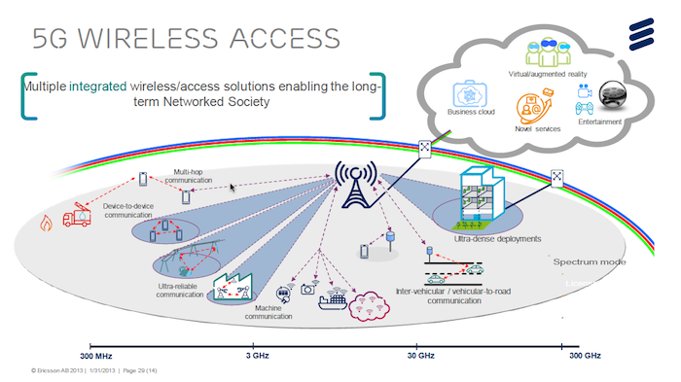
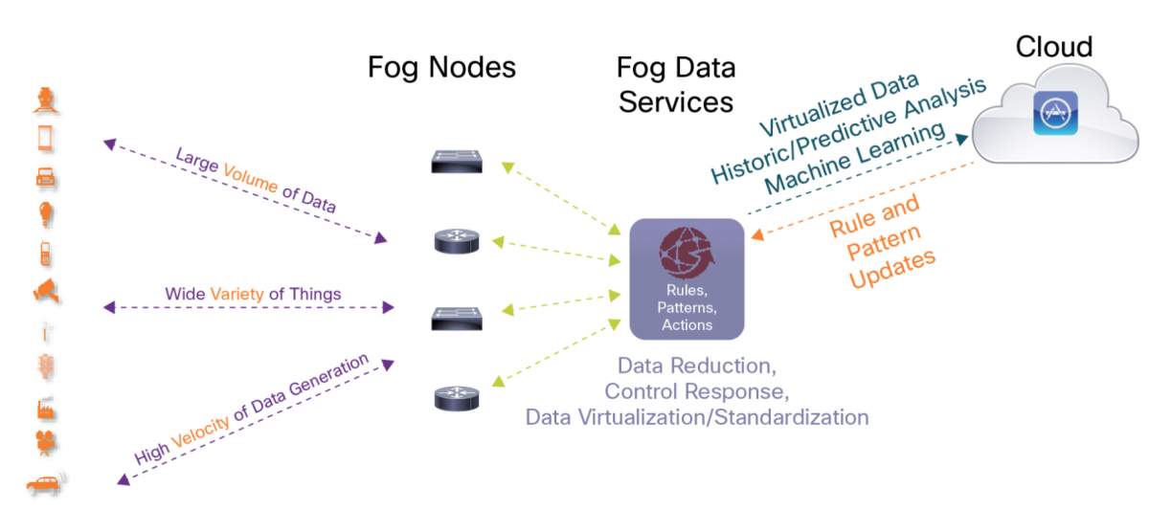
IoT fabric
5G
Fog
Ericsson - 5G Architecture
Cisco - Fog Architecture
Notes:
So 5G will be steered by the edges of the network and these edges will be networks of themselves. This is where “Fog” comes in.
The idea that the Network was the Computer, pushed by Sun in the nineties has, in a way, become true with the Cloud. The Cloud did not happen (nor was it designed) to make that prediction come true. The Cloud, by Amazon and Google, the two players that today are still leading the pack, happened because there was so much unused processing power and storage capacity that it made sense to find ways of sharing it and make money in the process.
That clearly demonstrated the possibility to decrease the cost for enterprises (and easy life to private users) and many other players, mostly system integrators and tlecom operators started to set up and offer Clouds in various shape and hues. Because these were Clouds built up from scratch they did not (are not) operate at marginal cost so life is thougher for these latter players than for Amazon and Google. Nevertheless there is possibility to attract clients and make some revenues.
The Cloud(s) also created new biz models for selling services (pay per use, subscription…) and created the culture that you don’t really need to “own” the physical stuff for doing processing and keep your data (although you still need quite a bit of processing capability and, as statistics on storage capacity sold to the mass market indicates, you may still want to keep your data at home). On the other hand, you absolutely need good, ubiquitous connectivity.
Fog is just the natural next step. Once you have accepted that you can have your data stored somewhere else and you can run services using processing power “out there” and you realise that there is plenty of processing power and storage capacity in devices around you, plus a much better connectivity in your surrounding then you are going for the Fog.
I will expect to see plenty of applications designed to support Fog, and I do expect Smart Cities planner to take the lead in this happening.
A city can start by offering its capacity (processing and storage) at marginal cost, using the systems supporting the city services, once they are built as open architectures (we are planning to do this as part of an EIT Digital project in 2017 in Malaga, Rennes and Trento using as kernel the FIWare platform);
A city can start coaching its citizens to share their ever bigger processing and storage resources to the benefit of the whole citizenship.
It won’t be easy and there are quite a few stumbling block on the way, most notably soving privacy issues and defining accountability but, at least to me, the trend is clear.
There are also technical issues to be addressed, like the one of massively distributed control. SDN (Software Defined Networking) is going to be an enabler (and the joint initiative of IEEE and EIT Digital can accelerate its impact). Neuromorphic computing, in the next decade, once it will land in smartphones and other “ambient” devices will be another possibile enabler.
Interestingly, these evolutions are in the direction of supporting the awareness infrastructure that I will be addressing later on.

Slide 5
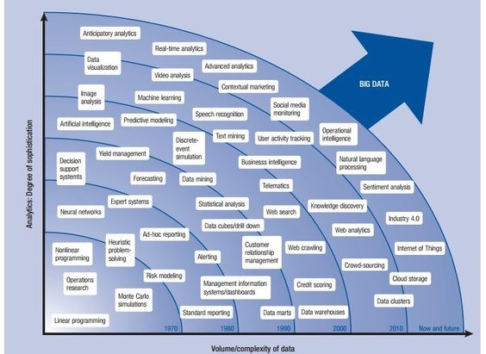
Buiding the Data Fabric
From the ExaByte Era
To the ZettaByte Era
Booz & Company

Slide 6
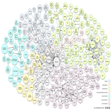
Data Fabric
Data Providers
Company A
Data Transformers
Data Platform
Traffic data
Open Living Data Platform
Data storage
Anonymization
Data aggregation
Annotation
Query Stream management
…
EIT Research partners
Company B
Telco data
SMEs
…
Service creation
Existing services
improvement
Business Intelligence
Industrial processes
optimization
…
Company C
Energy data
Open API
Public Authorities
Data Consumers
Public Transportation data
Citizens
PA
Health care
data
…
External Data Providers
(open data, SNs, web)

Slide 7
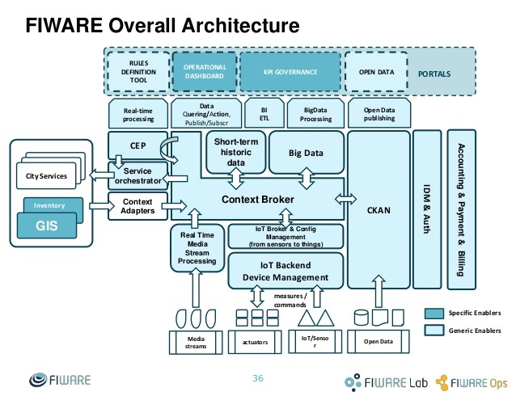
A City: an economy booster
Making Platform useful
Enabling a Service Infrastructure
SOA
FIWare
Notes:
An example of a SOA is FIWare.
FIWARE is the main result of the EU Future Internet Public-Private Partnership (FI-PPP) and of the EU commitment to help entrepreneurs thrive in Europe via the Startup Europe initiative, an investment of several hundred million euros over the last five years. FIWARE provides enhanced OpenStack-based cloud hosting capabilities and a rich library of components. These components, called the “Generic Enablers”, provide open standard APIs that make it easier to connect to Internet of Things devices, process data and media in real-time at large scale, perform Big Data analysis or incorporate advanced features to interact with the user, build applications easy to replicate in various relevant sectors. They allow developers to set the foundations of the architecture associated to their application. In FIWARE, Generic Enabler (GE) API specifications are public and royalty-free, supported by open source reference implementations. Thanks to that, alternative FIWARE providers can emerge faster in the market. FIWare is deploying all around Europe, and it is also getting ready to do so around the world, a set of FiWare Lab Nodes also including a Security Operations Centre (SOC) in order to address security issues on an organizational and technical level.
Service Developers can access the FIWARE catalogue
http://catalogue.fiware.org/
to deploy and use the City Enabler in a city. It is compliant and connected to other catalogues, namely the
ORION GEi, and
http://catalogue.fiware.org/enablers/publishsubscribe-context-broker-orion-context-broker
IDAS GEi
http://catalogue.fiware.org/enablers/backend-devicemanagement-idas
These will let the City Enabler support micro proxies to collect the data from IoT infrastructures installed in cities.
The FIWare Service Infrastructure facilitates the access to sensors (IoT) acting as a Context Broker managing a variety of protocols at the physical level letting the service operate at an abstract level. Hence a service can interact with a sensor/actuator by acting on its virtual representation in FIWare that will take care of the “implementation” of that interaction at physical level. This is particulalry useful given the variety of IoT in a city and their evoelution over time that would require, in absence of a virtualisation, a continuous update of the service.
These properties facilitate urban service providers and the Industry to rapidly develop micro proxies that are able to get data from IoT infrastructures and put them in the City Data workspace.
Clearly the City should move on a path to create a virtual representation of itself, as I will discuss when dealing with the Data Fabric.

Slide 8
Technology Forecast
for Smart Cities
eitdigital.eu/blog
roberto.saracco@eitdigital.eu
Skype: robertosaracco Twitter: @rsaracco

