Slide 1
5th ITU Green Standards Week Nassau, The Bahamas 14-18 December 2015
Security in the era of the Internet of Things
Jeff Greene,
Director & Senior Policy Counsel, Symantec
jeff_greene@symantec.com

Slide 2
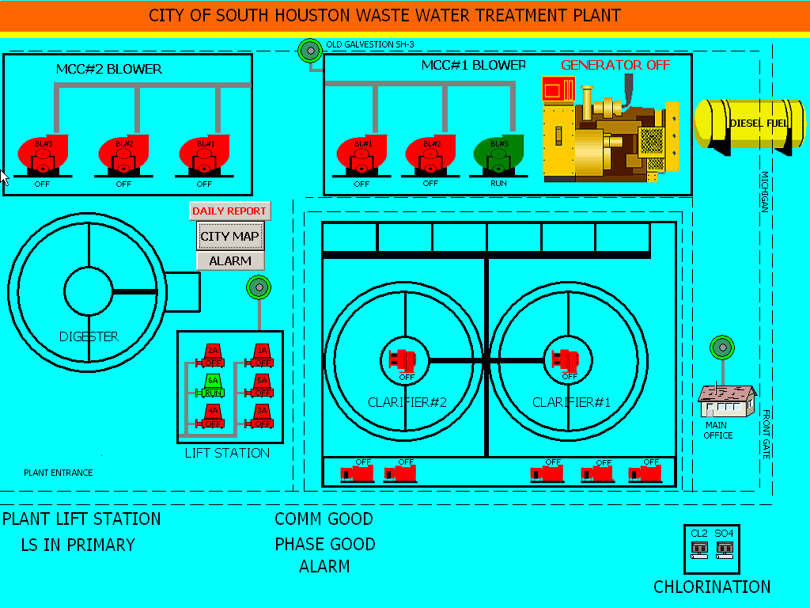
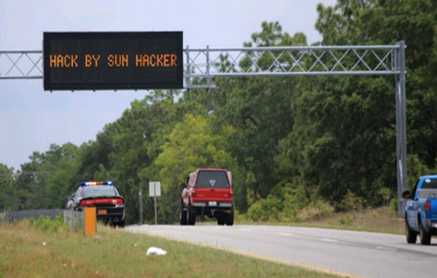
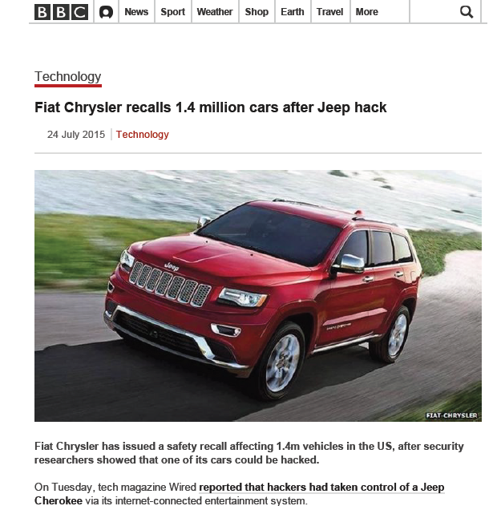
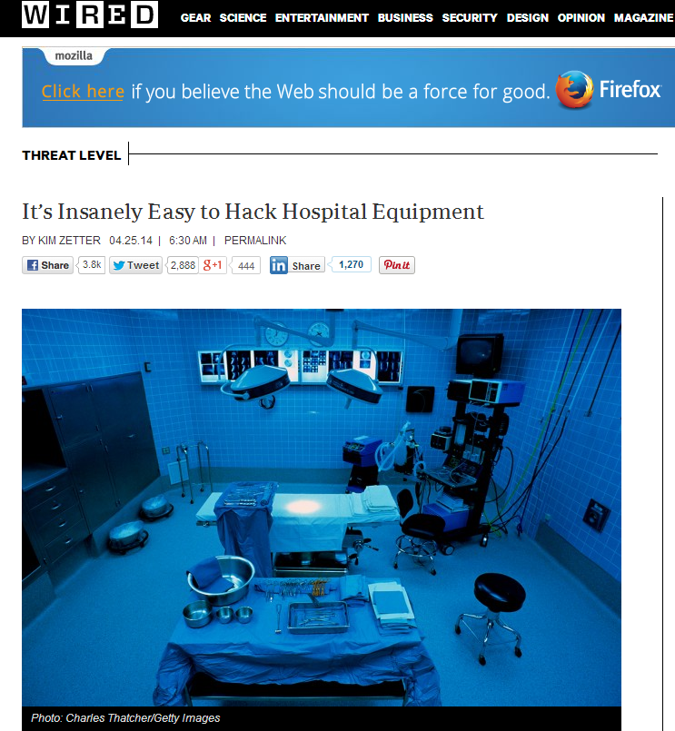
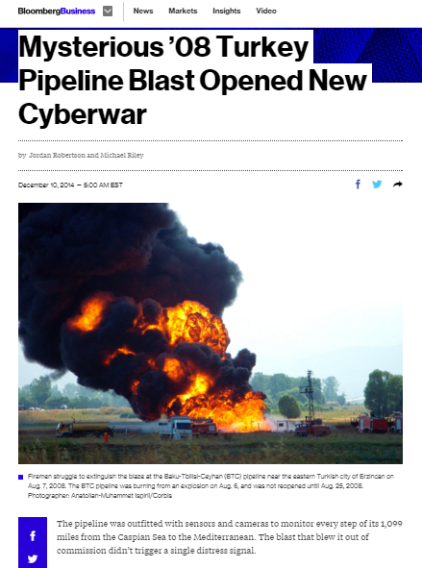
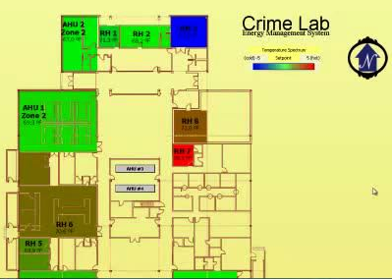
What could go wrong?

Slide 3
How is IoT different?
IT |  | IoT
Open | Openness | Closed
3 | Protocols | Thousands of Protocols
5 (Mostly Windows, Linux, OSX, iOS, Android) | Operating Systems (OS) | Dozens (Heavily fragmented by vertical)
20k seat enterprise | Scale | 100M “things”
All verticals have same Hardware/OS supply chain | Fragmentation | Each verticals has different Hardware/OS supply chain
2 | Chipset Architectures | Many
© Symantec Corporation
Notes:
However, the guidelines for “secure by design” need to be given in a realistic context.
…IoT is very different from traditional “Information Technology,” “IT.”
Both use Open Source extensively these days,
…but IoT products often reach customers much more “closed”
…where modification of the device voids warranty.
Such warranties can be “pesky” things on a home thermostat…
But for capitalized smart _industrial_ systems worth hundreds of thousands of dollars,
…or constrained by FDA regulations (such as medical devices),
…”customers doing mods themselves” simply isn’t a realistic option.
…Security must be baked in by the vendors building and selling the devices.
Of course, the differences between IT and IoT don’t end there.
…IT rides mostly on three mid layer protocols.
…Industrial systems have thousands with their own frame formats, clocking mechanisms, and the like.
Operating Systems are similarly fragmented, but scale is the part that I really enjoy.
…A few of us have built consumer facing cloud based services that serve hundreds of millions of customers,
…and we know firsthand how radically different that is from an IT shop serving just tens or even hundreds of thousands of employees.
Further complicating the degree to which the hardware supply chains and architectures differ so radically
…from 8-bit, 8 MHz chips to 32 and even 64 bit GHz speed ARM chips embedded in some wearables;
…security capabilities of these devices vary dramatically, and so do their “hardware backed” security capabilities.
With all of these challenges, it’s no wonder that a Security Reference Architecture for simplifying those challenges has been slow in coming.

Slide 4
So How do you Secure the IoT? Four Cornerstrones.
Manage Devices
Understand Your System
Cloud/Data Center
Cloud/Data Center
Gateway
Gateway
Devices
& Sensors
Devices
& Sensors
Protect the Device
Protect the Communications
© Symantec Corporation

Slide 5
Core Considerations
“Should it be connected” – NOT “can it be connected.”
Security in the IoT is a necessity and enabler, not a burden or a tax.
Manage your risk – don’t let it manage you.
Assume people will do wrong – consider how a device could be used, not just how you think it will or should be used.

