Slide 1
5th ITU Green Standards Week Jointly organized by ITU, UN-Habitat, UNESCO & UNEP The Bahamas 14-18 December 2015
IoT & Smart Cities: Balancing Risks & Rewards. What are the risks and what to do about them?
Ankush Johar,
Director, Wireless Federation
aj@wirelessfederation.com
Notes:
The role of Mobile Operators, Regulators and Legislators in realizing the promise of IoT

Slide 2
Index
The compelling need for Smart Cities
A Pragmatic approach to achieving Smart Cities
Why is mitigating security risks important?: Case Examples
Consumer Trust: #1 Priority. Key Challenges to building trust
Four pillars of success

Slide 3
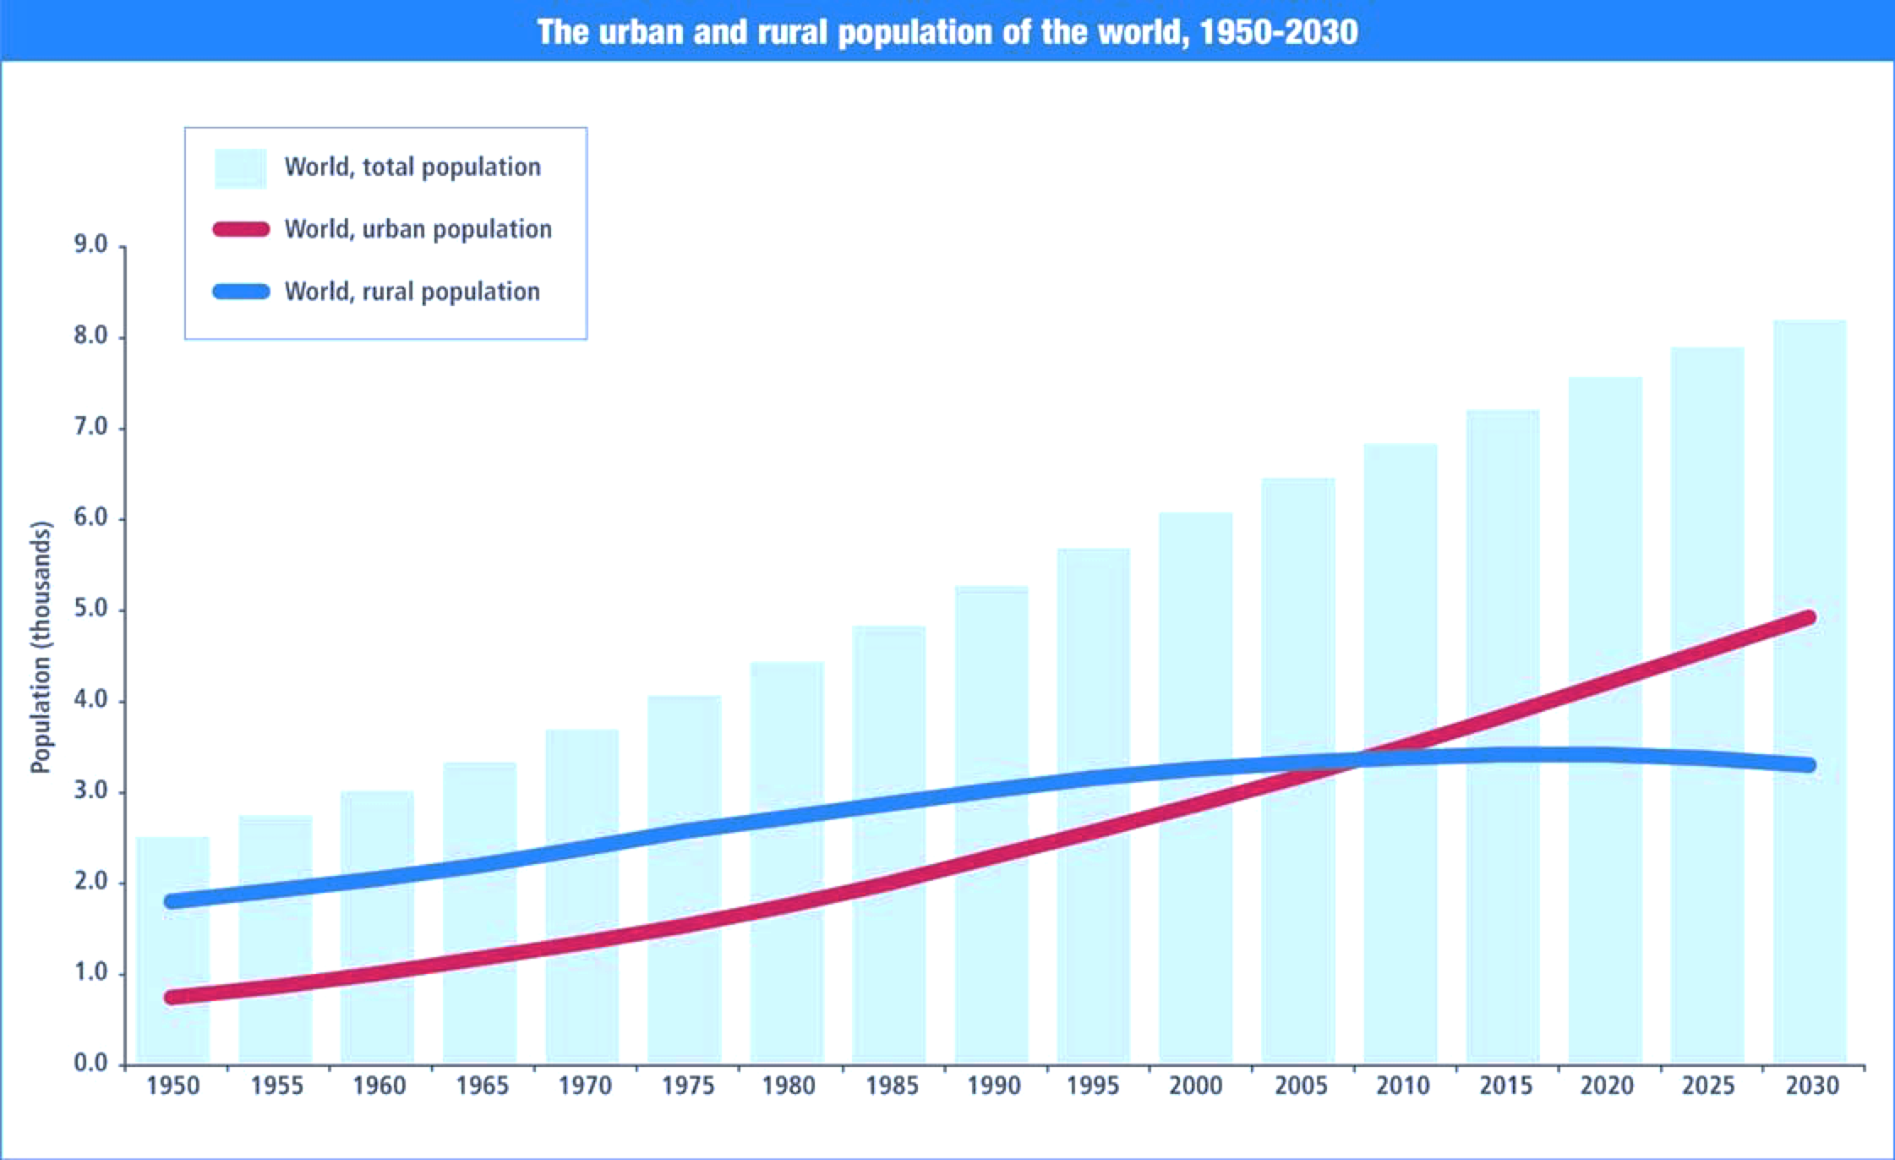
Need for Smart Cities
Urban Population is booming:
1950 - 30%
1990 - 43%
2014 - 54%
2050 - 66%
It was 746 million in 1950 to 3.9 billion in 2014. The world’s urban population is expected to surpass 6 billion by 2045
There is no choice but to have Smart Cities!
http://esa.un.org/unpd/wup/Highlights/WUP2014-Highlights.pdf

Slide 4
Pragmatic Approach to Smart Cities
WHAT TO DO?
FROM
TO
Nurture ‘Open Data’ platforms, that utilise ‘Smart Data’ as an asset in its own right, to create citizen centric innovations, driven & managed by ‘Smart City Stakeholder Groups’ can best address any city’s challenges and opportunities.
Closed & Un-connected vertical silos of functionally-oriented service providers
Innovative and Collaborative new models that connect these vertical silos.
GUIDING PRINCIPLES
ENERGY
TELECOM
WATER
TRANSPORT
HEALTH
HOUSING
ECONOMY
POLICING
EDUCATION
WASTE
ENVIRO SVCS
SOCIAL SVCS
ENERGY
TELECOM
WATER
TRANSPORT
HEALTH
HOUSING
ECONOMY
POLICING
EDUCATION
WASTE
ENVIRO SVCS
SOCIAL SVCS
SERVICE MANAGEMENT
Visionary
Citizen focussed
Digital
Open
Collaborative
BUSINESS MANAGEMENT
TECH. & DIGITAL ASSET MGMT.

Slide 5
Why is mitigation of risk important?
1. US Biometric Passports with RFID
US Govt issued biometric passports with an RFID chip
This chip could be read from 30 feet away with devices available easily online.
US acknowledged this and put an aluminum mesh in the covers to protect against such reading.
A state department official later stated that keeping the passport in a radio-opaque attenuation sleeve is safer still.
Even with the sleeve, the RFID chip is readable when the passport is opened.
2. Attack on Smart City Utilities is real
US Dept of Energy demonstrated in an experiment called the “ Aurora Generator Test” that it was possible to hack into a Power Plant Control System and completely disable a connected large 1 MW diesel electric generator. This vulnerability was later patched. BUT showcased that these vulnerabilities are real.
Dec 2012, an Asian hacking group was caught attempting to infiltrate a US Water Control System research project. It was caught because of a Decoy (or a Honeypot) being in place. Evidence showed that over a dozen of these honeypots spread across eight countries were subjected to over 70 malicious attacks, some of which successfully took control of the decoy systems.

Slide 6
Why is mitigation of risk important?
3. Attacks on Connected Health Devices
In 2012, a famous security researcher took control of an Insulin pump 300 feet away
He showed how he was in a position to exploit it by dispensing a fatal dose of insulin remotely.
He showcased how this exploit could be used on any wirelessly connected health device including pace makers.
In Oct 2013, US Vice president Dick Cheney stated in a televised interview that the wireless capability of his heart implant had been disabled to ward off against a possible hacking assassination attempt.
4. Malicious access to Smart devices
Jan 2014, A security company reported a phishing and spam email cyber attack powered by disparate smart devices
Approx 100,000 connected household appliances including Smart TVs, connected home hubs, home network routers and at least one smart refrigerator were among those compromised.
750,000 malicious emails were sent
WHY is this serious? No more than 10 emails were sent per device therefore making this kind of attack extremely hard to block!
Imagine the scale of the issue with 25 Bn connected devices.

Slide 7
Consumer Trust: #1 Priority
IoT poses key challenges to consumer security & privacy
Volume: Extensive & Ubiquitous data generation & collection
Misuse: Potential for misuse of generated & collected data & Misuse of sensors & controllers
Multi-point intrusion: Increase in security risk from additional intrusion points due to the connected nature
Ownership & Rights: Who owns the data that is generated? Can it be passed on to third parties?
Storage: Where and how the information that is created is transferred and stored? Data sovereignity & Residency
Security Level: What level of security is required to maintain privacy?

Slide 8
IoT success depends on these 4 pillars
Data Security:
Secure By Design: Include security at the design level, through to engineering rather than after the product is engineered.
Thorough testing before product launch
Use smart defaults in the customer experience
Incorporate encryption
Support products throughout their lifecycle to patch vulnerabilities as they get revealed
Minimization Of Data: Collect only whats necessary.
Privacy By Design: Anonymise data as much as the model allows feasibly + Establish access and authorisation rights to data as it is collected , and communicate these rights when data sets are moved or stored.
Consent + Opt-In/Out options: Data collection enables functionality, BUT will the data be shared with others? The consumer must be informed and specific consent must be seeked. (Example: Apple Apps seek spcific consent each time location or other sensitive information is shared with the app.)

Slide 9
Thank You Ankush Johar, Director, Wireless Federation aj@wirelessfederation.com +44 207 993 0067

