Slide 1
5th ITU Green Standards Week Nassau, The Bahamas 14-18 December 2015
IoT IN SMART SUSTAINABLE CITIES:
A NEW AGE OF SMARTER LIVING
Ronald J. Zimmer, CAE
President & CEO
CABA (Continental Automated Building Association)
zimmer@caba.org

Slide 2
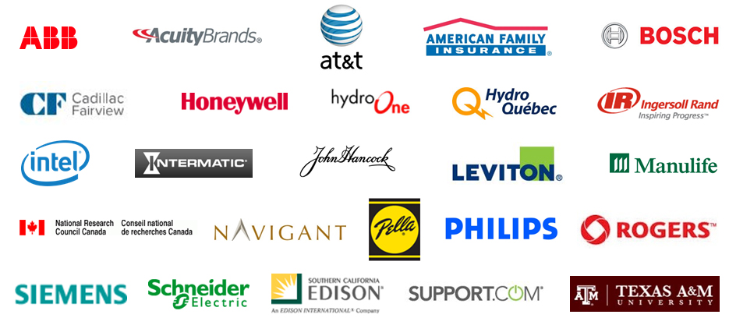
CABA Board of Directors
CABA Vision Statement
“CABA accelerates growth in the connected home and intelligent buildings sectors.”

Slide 3
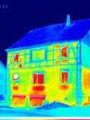
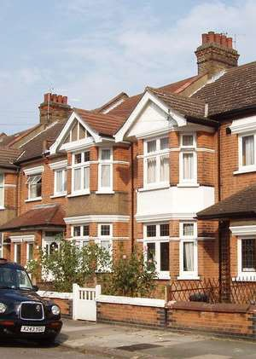
Three Key Figures
% of all Energy used in Buildings
Target for Reduction in CO2 Emissions by 2050
% of 2050 Building
Stock already built
40%
80%
80%
A very high proportion of energy savings will need to come from buildings
Much of this needs to come from buildings that already exist
3
Source: BSRIA - Market Trends and Generation-Z Expectations
for Smart, Reduced Carbon Buildings

Slide 4
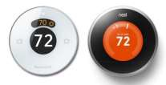
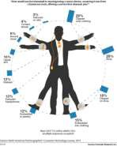
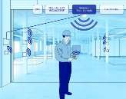
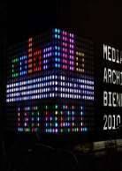
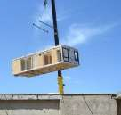
Trends for Smart Buildings
Controls on plant
– Cloud connected
Smart homes
Analytics / Cloud / Cybersecurity
IoT
IP Networks / Wireless Comms. Controls
Decentralization / Integration
Module / Off-site construction
Mobility / Apps
LED / Intelligent luminaires
Wearables
Source: BSRIA - Market Trends and Generation-Z Expectations
for Smart, Reduced Carbon Buildings

Slide 5
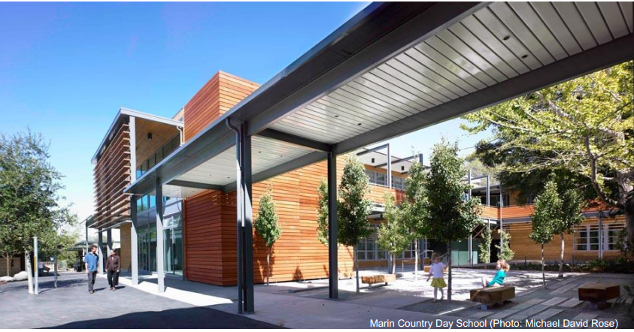
Background – Getting to Zero Net Energy Buildings
A Zero Net Energy (ZNE) building generates as much energy as it consumes annually. Also known as Net Zero Energy.
Zero = ‘nothing’
Net = On-site Energy Production (renewable) minus Energy Use, over 1 year
Energy = All energy (electric, gas, steam, liquid fuel etc.) consumed on site
Source: New Buildings Institute (NBI) - Zero Net Energy Building Controls Characteristics, Energy Impacts, and Lessons

Slide 6
Five Recommendations
Prioritize Passive Strategies – then layer in controls to optimize the whole building outcomes
Integrate the Controls Contractor – controls contractor needs to be a primary team member from design through occupancy
Increase Operator Training and Support – bring controls training and improved hand-off documentation to operators and ongoing access to the design team and controls contractor
Provide Occupants Control but Backup with Default Settings – occupants want some engagement and control access but a ‘hybrid’ system that returns controls to default settings and “Off” is necessary
Build Industry Awareness and Knowledge of Emerging Trends – of a) integrated, wireless and adaptive controls, b) feedback and dashboards, c) DC systems and renewable integration, d) utility load management, price and program issues, and e) ZNE policy drivers
Download the Zero Net Energy Buildings Controls – Characteristics, Energy Impacts and Lessons Report at: http://www.caba.org/CABA/Research/Zero-Net-Energy-Buildings.aspx

Slide 7
$8,000
US$3.5bn World BEMS*
Market growing at 14% CAGR
Global BEMS Market Value 2014
Total BEMS Market Value
$8,000
$7,000
$6,000
$5,000
$4,000
$3,000
$2,000
$1,000
$0
Rest of World, 764,
22%
EU, 1,550,
45%
Million US Dollars
USA, 1,158,
33%
* Building Energy Management Systems
Source: BSRIA – Quarterly Update – Dec 2014

Slide 8
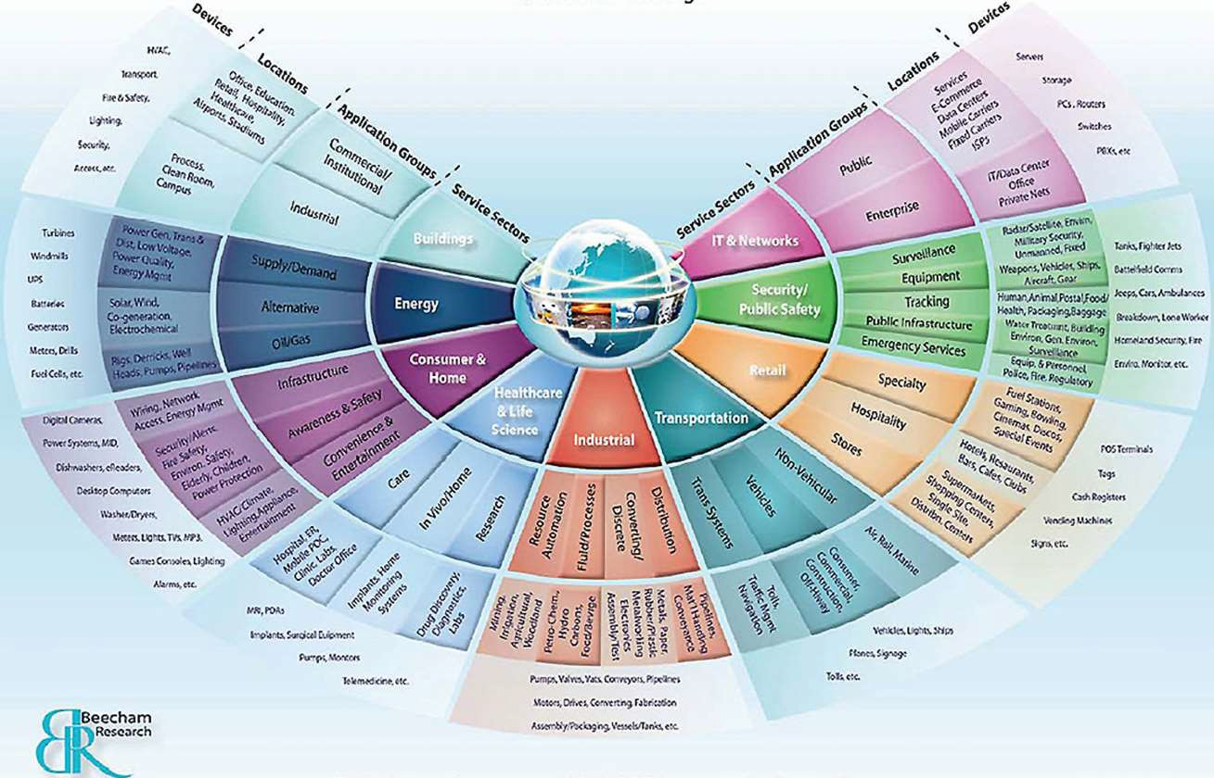
The Internet of Things (IoT)
…expected to grow at a CAGR of 31.72% to pass 17 billion 2014- 2019
(TechNavio)
25 billion devices connected to the Internet by 2015 and 50 billion by 2020 (Cisco)
IoE Creates $14.4 Trillion of Value at Stake for Companies and Industries (Cisco)
15 billion devices will be communicating over the network by the year 2015 (IDC)
Our IoT world is growing at a breath-taking pace -- from 2 billion objects in 2006 to a projected 200 billion by 2020 (Intel)

Slide 9
Contact CABA
Continental Automated Buildings Association (CABA)
1173 Cyrville Road, Suite 210
Ottawa, ON K1J 7S6
613.686.1814
Toll free: 888.798.CABA (2222)
Fax: 613.744.7833
caba@caba.org
www.CABA.org
www.twitter.com/caba_news
www.linkedin.com/groups?gid=2121884
Download the Life Cycle Costing of Intelligent Buildings Report at: http://www.caba.org/lccib

