Slide 1
5th ITU Green Standards Week Nassau, The Bahamas 14-18 December 2015
Forum on “Powering Smart Cities with the Internet of Things”
Session 2: IoT in Smart Sustainable Cities: A New Age of Smarter Living
17 December 2015
Harnessing IoT as a New Source of Growth
by,
Jesse Chooi
(chooitk@mdec.com.my)
Head, Strategy and Business Development
IoT Division,
Multimedia Development Corporation
Malaysia
Notes:
Job title, Organization & Email

Slide 2
MDeC
Develop, coordinate and promote Malaysia’s digital economy, information and communications technology (ICT) industry and the extensive use of ICT in Malaysia
Perintah Menteri-Menteri Kerajaan Persekutuan (No. 2), 2014

Slide 3
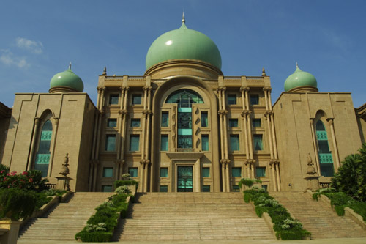
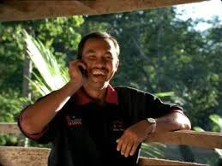
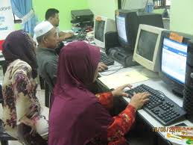
Digital Malaysia is a national agenda towards achieving Malaysia’s Digital Economy. It is built upon a vibrant domestic ICT industry, transformative use of digital solutions by government, businesses and citizens, as well as a robust enabling ecosystem.
Notes:
The digital age has enveloped us all. Economies around the world are being reshaped by seismic shifts in digital technology that offers global potential. Opportunity knocks for early adopters and those who are prepared for change by embracing the digital economy. The country’s digital transformation will hinge on mindset change and behaviour of businesses, citizens and civil service towards data driven culture and how well they respond to these opportunities and creatively harness the new waves of growth that the digital economy offers. This includes increasing demand-focused activities to enhance ROI; capitalising further on the internet for revenue generation; and continuing to nurture high-knowledge and skilled workforce. The journey ahead is tied to the rapid deployment of Digital Malaysia and the host of global opportunities that come with it​. Building upon the robust and vibrant ICT Industry in the country, Malaysia’s vision as a digital nation is a fully-developed country with a sustainable digital economy, and knowledgeable and skillful society.

Slide 4
A Vibrant ICT Industry
Transformative Adoption of
Digital Solutions
Digital Malaysia
Champions & Spearheads the National Digital Economy
Robust Enabling Ecosystem

Slide 5
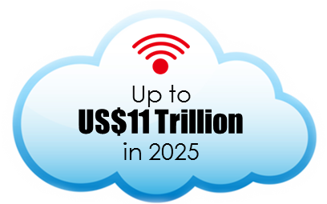
THE POTENTIAL GLOBAL IMPACT OF IOT WILL RISE
UP TO US$11 TRILLION
HOME
US$350 Bil
VEHICLES
US$740 Bil
OFFICES
US$150 Bil
CITIES
US$1.7 Tril
MANUFACTURING
US$3.7 Tril
LOGISTICS
US$850 Bil
RETAIL
US$1.2 Tril
HUMAN
US$1.6 Tril
WORKSITES
US$930 Bil
Source: McKinsey Global Institute, June 2015

Slide 6
IOT MALAYSIA IS AN INDUSTRY PLATFORM TO PROLIFERATE IOT ADOPTION IN MALAYSIA AND THE REGION
SUPPLY
DEMAND
Device Makers
Analytics Providers
Network providers
App Developers
Cloud Providers
System Integrators
Security Providers
Pilot Projects
Use Cases
Test-beds

Slide 7
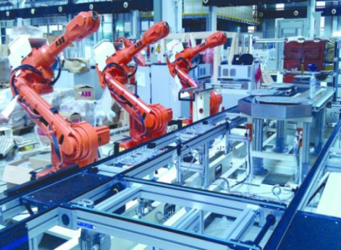
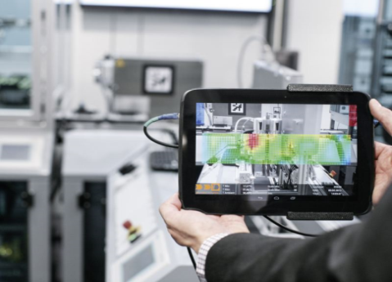
TRANSFORMING MANUFACTURING FACILITIES TO
FACTORIES OF THE FUTURE
OBJECTIVES AND IMPACT
Increases productivity and quality through higher automation
Optimise operational costs through data analytics
Strengthens competitiveness through agile manufacturing and integration with global supply chains
PARTNERS
TEST-BEDS
POTENTIAL SOLUTIONS
 | Automated Coagulant Mixing
 | Predictive Maintenance
 | Vision Inspection and Analytics
 | Integrated Machine Communications
 | Smart Connected Supply Chain
Rubber Glove
Semiconductors
Others

Slide 8
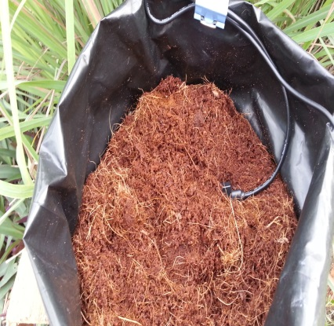
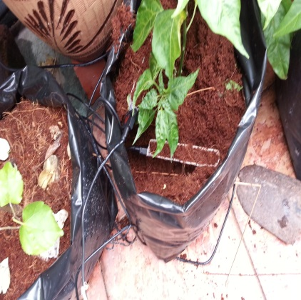
SMART AGRICULTURE CAN INCREASE CHILI FARMERS’
NETT REVENUE BY 129%
Farm in Semerbok, Negeri Sembilan with full sensor-based systems
64-acre with full sprinkler systems
45-acre for lemongrass (serai)
10-acre polybags for chili fertigation ready for sensor set-up
PROJECTED IMPACT
Increase of yield by 40% resulting in nett revenue per acre increase per year by 129%
Monthly revenue increase of RM4k/farmer*
Potential to reduce Malaysia’s dependence on imports from 33% to 7%, if all existing chili farms deploy this IoT system. An additional 552 acres would result in self-reliance
*Assumption: 1 farmer to 1 acre of chili plantation

Slide 9
CASE STUDY: MARRYING “GREEN” AND “SMARTNESS” MELAKA GREEN CITY ACTION PLAN

Slide 10
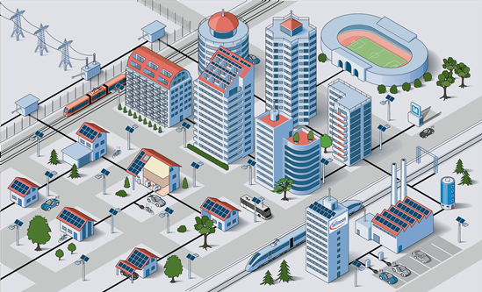
MALAYSIAN IOT SOLUTIONS FOR SMART SUSTAINABLE CITIES
Embedded wireless sensor for ubiquitous monitoring in retail
Embedded controller for dialysis system
Analytics and
Big Data
Payment router for retailers
Remote monitoring of man-made structures and earth environments
Digital signage kiosk for retail, indoor & outdoor
Intelligent transportation system
Self-run, self-monitored, self-recovery for HDCCTV
Advanced X-ray inspection system for automotive, telecommunication & medical industries
Automotive FPC (Full Programmer Cluster)
Interactive TV Set Top Box for hospitality & homes
Parking sensors for booking and navigation
Digital smart home and security system for homes & community
Smart electric bus controller system
Wireless energy monitoring system
Electric vehicle charging infrastructure solutions
Picture source: Reneon Technologies
Notes:
Automotive FPC (Full Programmer Cluster)

Slide 11
THANK YOU

