Slide 1
5th ITU Green Standards Week Nassau, The Bahamas 14-18 December 2015
Rethinking Smart Sustainable Cities from the Ground Up: Challenges and Opportunities
Daniela Torres, Eng. MSc
ITU FG SSC WG4 Coordinator

Slide 2
Content
Smart Sustainable Cities Challenges
Stakeholders for Smart Sustainable Cities
Building Smart Sustainable Cities

Slide 3
1. Smart Sustainable Cities Challenges

Slide 4
Smart Sustainable Cities Challenges
ICT tools enable lots of interactions among population & devices
Rapid urbanization increases demand for scarce resources
SMART SUSTAINABLE CITIES
1st time in history a urban initiative brings such a variety of stakeholders

Slide 5
Smart Sustainable Cities Challenges
SSC
Challenges
Achieving City Vision
Achieving Economic Success
Providing Infrastructure (inc. ICT)
Engaging Citizens
Widening skills and attract talent
Managing Environmental Quality
Managing Climate Change
Combating Inequality
Managing Scarce Resources
Notes:
1) Achieving a City Vision: Each city starts from a different baseline → SSC Key Performance Indicators are essential to quantify future improvements.
Cities must be holistic and inclusive → Traditionally, city management is divided into different departments with little cooperation between them.
2) Achieving Economic Success
Lack of funding are a common obstacle in cities → SSC projects find difficulties to advance and escalate.
Job creation and quality of life improvements → SSC give the opportunity to create new employment opportunities in cities
3) Providing ICT infrastructure
SSC require important changes in ICT infrastructure → widespread internet broadband & comprehensive mobile networks for communication or sensing.
New technologies should focus on → adaptability, scalability, accessibility, safety and flexibility of this infrastructure.
4) Engaging Citizens
Citizens must be engaged in city planning: → citizens participation improves city management, promotes social cohesion and reinforces political engagement.
Need of the integration of the perspective and opinions of city residents into local policies → this can support the adaptation of city services to their daily needs.
5) Managing Scarce Resources
Cities require improvements in basic city services infrastructure to deliver efficient services → ICT can play a crucial role in the efficient management of water and energy.
6) Managing Environmental Quality
City administrations are responsible for management of the environmental quality of the city (air, soil & water), waste management, sanitation, and pollution control → health related impacts
7)Climate change
Mitigating Climate Change: cities generate CO2 emissions in sectors such as transport, waste management, electricity.
→ Smart Services reduce CO2 emissions (Smart buildings, smart transport, smart grids, etc)
Adapting to climate change: cities will be vulnerable
Cities are called to become much more resource-efficient & resilient in the face of extreme weather events.
Infrastructure needs to be introduced to cope with rising sea level, floods, heat waves, and storms.
ICTs have roles to play in sensing, mitigation and adaptation.
8) Widening the skills of Professionals
Urban planners, technologists, economists, apart from being experts on their specific field, should gain a general knowledge of all the other aspects that define and shape cities.
An example is an urban planner that also understands how the Internet of Things (IoT) can be applied to cities and its ICT infrastructure
9) Combating inequality
A recent study by Oxfam* suggests that “almost half of the world’s wealth is now owned by just 1% of the population”.
→ Since SSCs strive for social sustainability it is important that the projects include all the levels of society.

Slide 6
¿How to respond to citizens and engage stakeholders?

Slide 7
2. Stakeholders for Smart Sustainable Cities
Technical Report:
“Setting the stage for stakeholders' engagement in smart sustainable cities”
Aims a broad identification and categorization of the stakeholders involved in smart sustainable cities initiatives and projects.

Slide 8
Proposed 3 Step Methodology
IDENTIFICATION
Take reference the list derived from the definition of SSC by ITU FCSSC
CATEGORIZATION
Assign a particular category to each stakeholder
DETAILED ANALYSIS
& ENGAGEMET
Identify individual characteristics & expected implications
Define a local non-exhaustive list of stakeholders
Study relationships between stakeholders: map of relations.
Foster stakeholder's engagement.
Validation of the list based on general classification of stakeholders.
Categorize listed stakeholders in a graph

Slide 9
Step 1: Identification of all Stakeholders Involved
Candidate stakeholders for participation in an SSC project include:
Municipalities and city administration
National and regional governments
City services companies
Utility providers
ICT Companies
NGOs
International, Regional & Multilateral Organizations
Industry associations
Academia, research organizations & specialized bodies scientific community
Citizens and citizen organizations
Urban Planners & Designers
Standardization Bodies

Slide 10
Step 2: Categorization of Stakeholders Involved
According to their role and participation in the development of SSC initiatives
Active: actors with resources and power to influence the initiative
Beneficiaries: they will directly benefit from the deployment of a SSC
Affected stakeholders: will be somehow affected by the deployment of the SSC
Both supporters and potential opponents
According to responsibilities as drivers or enablers of SSC processes and solutions:
Drivers of technology: incorporate technology and SSC solutions into their processes in city services or provision processes
Enablers of technology: provide the technology and/or the technological solutions
Enablers of the SSC: facilitate the technical & policy framework needed for SSC by using KPIs, infrastructure development, standardization, etc

Slide 11
Step 2: Stakeholder Mapping. Stakeholder Classification
Stakeholders
Active
Beneficiaries
Affected
Potential Supporters
Potential Opponents
DRIVERS
Municipalities & City Administration.
National & Regional Governments
Citizens & Citizen Organizations
DRIVERS
Citizens & Citizen Organizations
DRIVERS
Municipalities & City Administration
Citizens & Citizen Organizations
TECHNOLOGY ENABLERS
City Services Companies & Utilities
TECHNOLOGY ENABLERS
ICT Companies
City Services Companies & Utilities
TECHNOLOGY ENABLERS
City Services Companies & Utilities
ENABLERS → FRAMEWORK
ICT Companies
City Services Companies & Utilities
OPPONENTS
Locally an evaluation should me made
ENABLERS → FRAMEWORK
Academic & Scientific Communities

Slide 12
Step 3: Detailed Analysis of Stakeholders Involved
1. Analysis of roles & potential contribution
2. Analysis of stakeholder engagement progress
Scale and Sector (public or private)
Aims & Challenges
Potential
Constraints
Role and Contributions
Power perception
Efficient process
Exclusive process
Interaction Map
Stakeholder Core Values
Source: FG-SSC “Technical Report on Setting the Stage stakeholders engagement in Smart Sustainable Cities”, pages 12-14

Slide 13
Step 3.1: Detailed Analysis of Stakeholders Involved Map of Relations
ICT Companies
City Services Companies & Utilities
Municipalities & City Administration.
Urban Planners
Citizens & Citizen Organizations
Industry Associations
Academia, research organization and specialized bodies.
International Regional and Multilateral Organizations.
Standardization Bodies
National Bodies & Regional Governments
NGOs
Source: FG-SSC “Technical Report Setting the stage for stakeholder´s engagement on SSC”

Slide 14
3. Building Smart Sustainable Cities

Slide 15
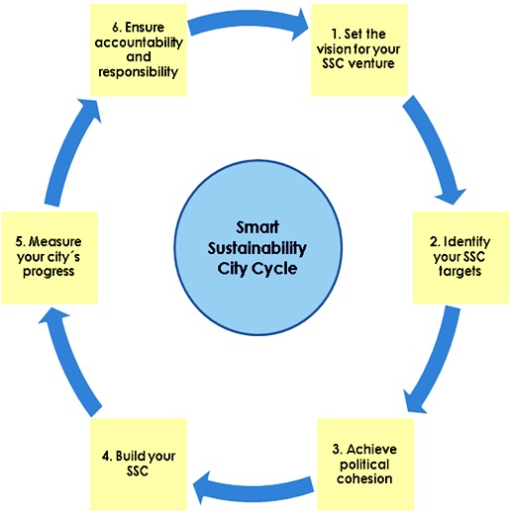
Stakeholders in Smart Sustainable Cities
SK identification is critical to design & implement SSC strategies and projects ( SSC CYCLE)
This methodology provides a general framework. Each city should carry its own analysis.
Cooperation among SSC stakeholders is needed to build resilient cities who are smart, sustainable & innovative.
This is applicable to SSC top down and bottom-up implementation models.

Slide 16
5th ITU Green Standards Week Nassau, The Bahamas 14-18 December 2015
Rethinking Smart Sustainable Cities from the Ground Up: Challenges and Opportunities
Daniela Torres, Eng. MSc
ITU FG SSC WG4 Coordinator - ITU Consultant
alisdaniela.torres@outlook.com
@alisdaniela

