Slide 1
Using ICTs for Climate Change Adaptation and Disaster Risk Reduction
by
Arthur W. Rolle

Slide 2
Definition of ICT
Information and Communication Technology (ICT) is a wide term that includes any communication device or application, for example, Internet, radio, television, cellular phones, computer and network hardware and software, satellite systems, and so on, as well as the various software services and applications associated with them (ICT and Virtual Organization, Carmen de Pablos Heredero, 2009). These products can store, retrieve, manipulate, transmit or receive information electronically in a digital form.
.

Slide 3
What are natural disasters (hazards)
Natural disasters (hazards) are naturally occurring physical phenomena caused either by rapid or slow onset events which can be geophysical (earthquakes, landslides, tsunamis and volcanic activity), hydrological (avalanches and floods), climatological (extreme temperatures, drought and wildfires), meteorological (cyclones and storms/wave surges) or biological (disease epidemics and insect/animal plagues).
International Federation of Red Cross and Red Crescent Societies

Slide 4
Applications of ICTs to Disaster Risk Reduction
Disaster Risk Reduction is defined as a conceptual framework of elements considered with the possibilities to minimize vulnerabilities and disaster risks throughout society, to avoid or to limit the adverse impacts of hazards, within the broad context of sustainable development (ISDR, 2008)

Slide 5
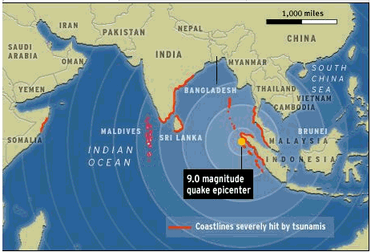
Notes:
from the 2004 tsunami,

Slide 6
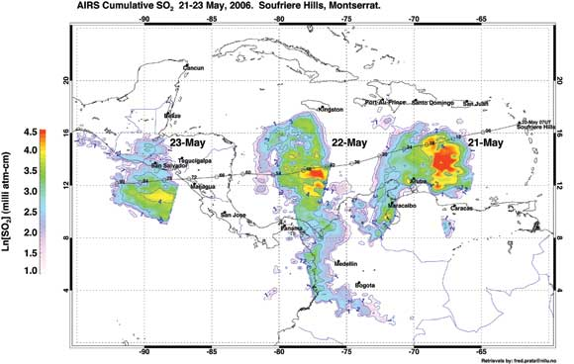
Notes:
Volcanic Hazard Monitoring

Slide 7
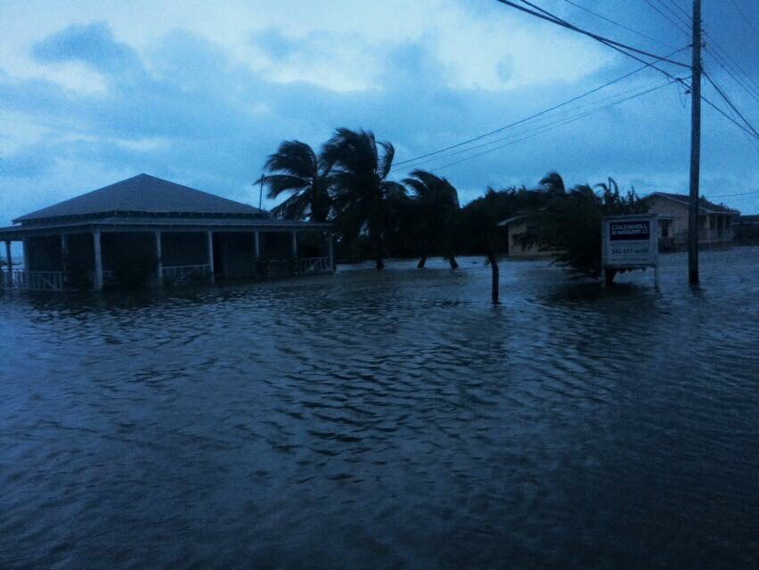

Slide 8
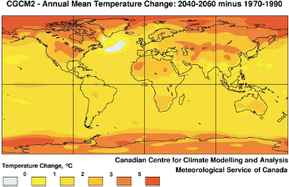

Slide 9
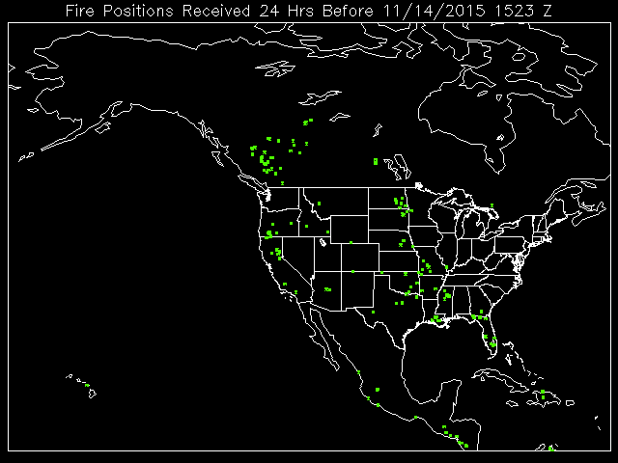

Slide 10
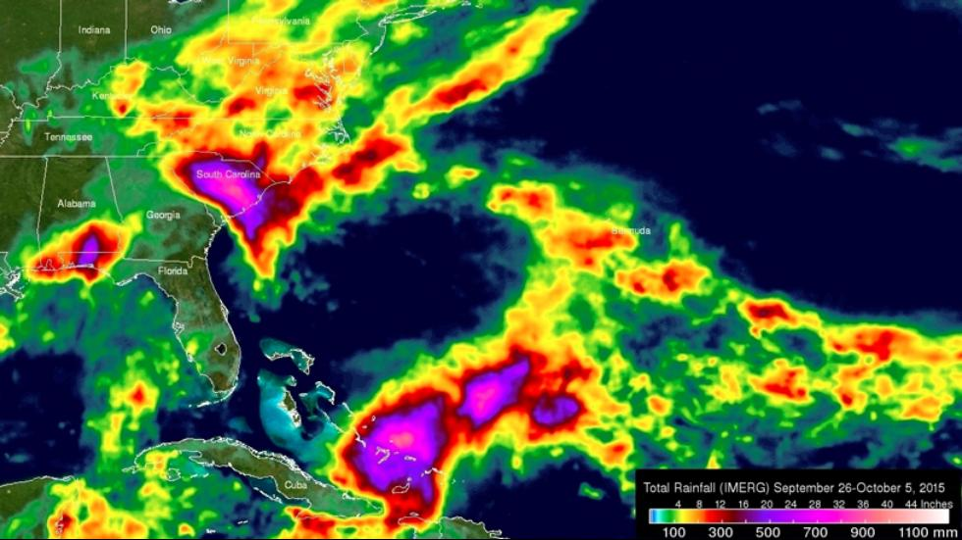

Slide 11
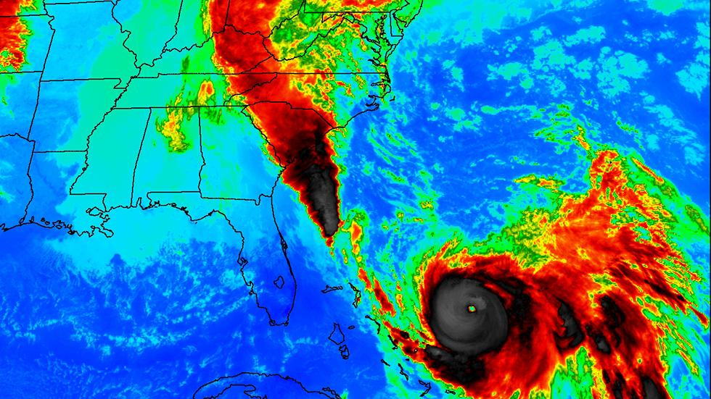

Slide 12
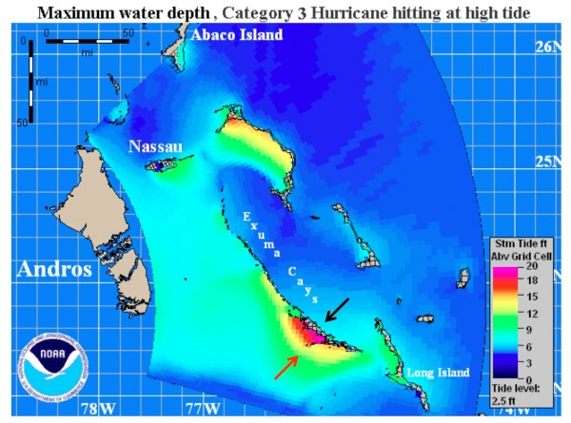
Notes:
Storm surge from Hurricane Sandy 2012

Slide 13
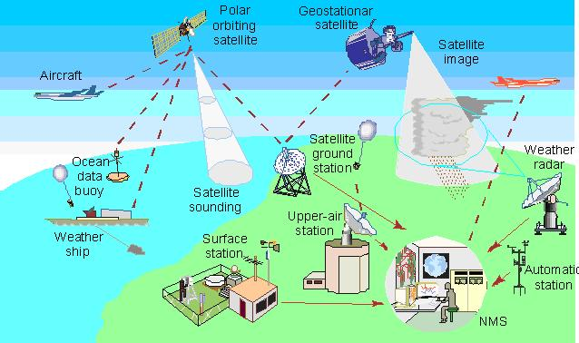

Slide 14
Bahamas Early Warning System For Tropical cyclones
The early warning system is a 24-hr operation designed to alert communities of a potential danger, to identify areas likely to be affected and to call the community to action by warning messages and recommendations of specific actions. A news item is issued to provide information to the media and preparedness authorities that a cyclone has formed. The information is contained in low-key statements issued three times daily to arouse initial interest and create a climate of expectancy should the system move within the area of warning responsibility. An alert is issued when the potential threat is 60 hours away. A watch is issued when a tropical cyclone that is likely to affect the community is 48 hours away. A warning is issued when a tropical cyclone that is likely to affect the community is 36 hours away. The authority for the issuance of the warnings is the Bahamas Department of Meteorology

Slide 15
Communication Channels used in Disaster Warning in The Bahamas
Radio and television- used widespread therefore quick in spreading warning
Telephones- quick message delivery
Satellite radios- high reachability
Internet/email- interactive (accuracy could be checked)
Amateur radios- excellent for rural and remote areas
Emergency Managers Weather Information Network (EMWIN)
Sirens

Slide 16
Applications of ICTs to Climate Change Adaptation
Climate Change Adaptation (CCA) is defined as adjustments in natural or human systems in response to actual or expected climatic stimuli or their effects, which moderates harm, or exploit beneficial opportunities (IPCC, 2007)

Slide 17
What is Climate Change?
Climate Change according to the IPCC is any change in climate over time whether due to natural variability or as a result of human activity. It is considered by many scientists to be the most serious threat facing the world today.
The UN's Intergovernmental Panel on Climate Change (IPCC) concludes that global warming is "unequivocal" and that human activity is the main driver of this warming.

Slide 18
Potential Sectoral Impacts of Climate Change in The Bahamas
Marine Ecosystems ( coral reefs, mangroves, sea- grasses,
Terrestrial Ecosystems (forests)
Biodiversity (population size, species distribution, habitats and ecosystems)
Water Resources (change in soil moisture, siltation and contamination of water supplies)
Agriculture (reduction in soil moisture & decrease in crop yield, sea water intrusion for coastal soils)
Fisheries (habitat loss)
Coastal Resources (coastal erosion, saline intrusion, flooding)
Infrastructure & Settlements (More than 50% of the pop. live within 2 km of the increasing density of populations living in coastal areas has made The Bahamas more vulnerable to natural disasters
Human Health (heat strokes, vector– borne diseases- malaria, dengue, yellow fever)

Slide 19
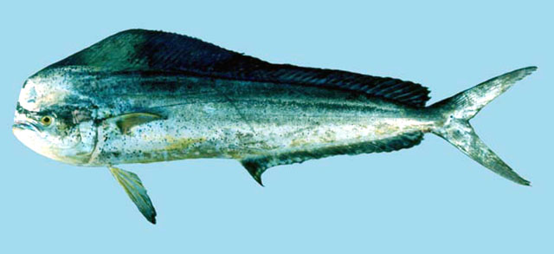
Likely impact on Dolphin resulting
from a 1°C
rise in Sea Temperature
Habitat becomes less favourable
Dolphin fish
+1°C

Slide 20
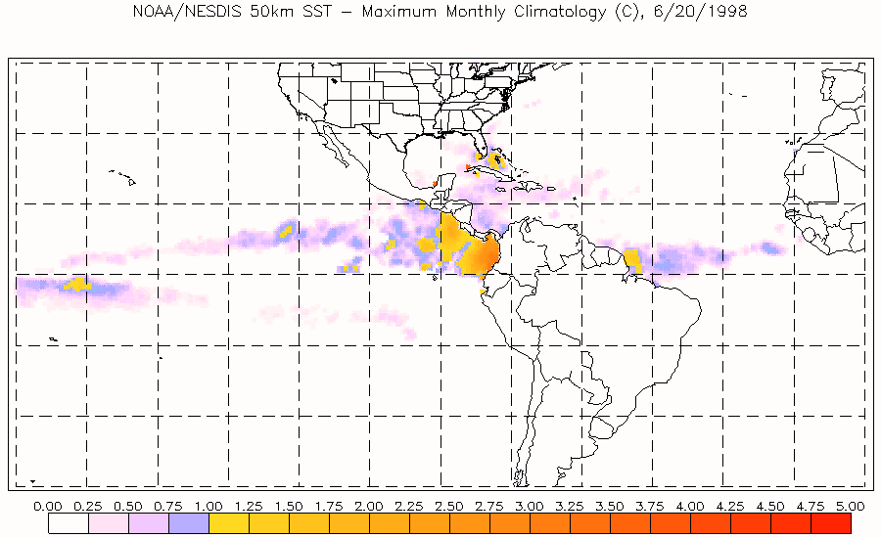

Slide 21
ADAPTATION STRATEGIES
Improved understanding of the early warning systems; disaster preparedness; and risk reduction strategies.
Partnerships with the Financial/Insurance sector to develop schemes to spread risks, reduce insurance premiums, expand insurance coverage and increase financing for post-disaster reconstruction and rehabilitation.
Cooperation among other small island developing states for dissemination of best practices and lessons learnt could also be explored/strengthened.
Mainstream adaptation and risk reduction strategies into policy development into key sectors (agriculture, tourism, water resources, health and fisheries);
Sustainable development planning should include,
disaster prevention and management, integrated coastal management, and health care planning;
Develop new and review existing legislation, development standards and building codes;
Improve public education and awareness programmes

Slide 22
MITIGATION STRATEGIES
Land use planning, building codes and public education;
Retrofitting or improved standards at the development stage could achieve considerable reductions in emissions;
A shift from fossil fuel to renewable sources of energy where possible;
More stringent efficiency standards and a compulsory energy rating scheme could be employed in hotel buildings

Slide 23
The future we want
Measures included in the Paris Agreement as follow would help us in securing the future we want:
• To peak greenhouse gas emissions as soon as possible and achieve a balance between sources and sinks of greenhouse gases in the second half of this century
• To keep global temperature increase "well below" 2C (3.6F) and to pursue efforts to limit it to 1.5C
• To review progress every five years
• $100 billion a year in climate finance for developing countries by 2020, with a commitment to further finance in the future.

Slide 24
I THANK YOU FOR YOUR ATTENTION

