Slide 1
CLIMATE CHANGE CHALLENGES & THE VISION OF THE CITY OF NASSAU, BAHAMAS
ITC Sector Commitment: Transition To A Low Carbon and Climate Resilient Community in the Bahamas
PRESENTED
By
Philip S. Weech, Director
BEST COMMISSION
16 DECEMBER, 2015

Slide 2
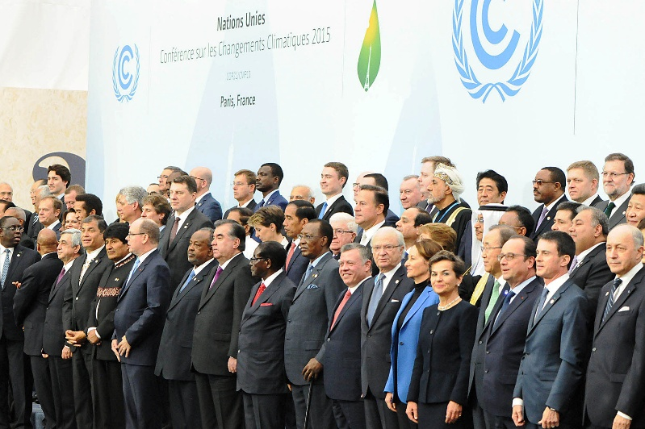
CLIMATE CHANGE CHALLENGES & THE VISION OF THE CITY OF NASSAU, BAHAMAS
How does the Paris Agreement on Climate Change Impact Connect 2020 road map for The Bahamas
The Paris Agreement for the first time brought all nations together toward a common cause based on their historic, current and future responsibilities.
The Universal agreement’s main aim is to keep a global temperature rise this century well below 2⁰ C and to drive efforts to limit the temperature increase even further to 1.5⁰ C above pre-industrial levels.
The 1.5⁰ C limit is a significantly safer defense line against the worst impacts of a changing climate, especially of SIDs like The Bahamas.

Slide 3
CLIMATE CHANGE CHALLENGES & THE VISION OF THE CITY OF NASSAU, BAHAMAS
Paris Agreement to Drive Climate Action Forward:
Mitigation – reducing emissions fast enough to achieve the temperature goal
A transparency system and global stock-take – accounting for climate action
Adaptation – strengthening ability of countries to deal with climate impacts
Loss and Damage – strengthening ability to recover from climate impacts
Support – including finance, for nations to build clean, resilient futures

Slide 4
CLIMATE CHANGE CHALLENGES & THE VISION OF THE CITY OF NASSAU, BAHAMAS
Lima to Paris Action (LPAA) at COP21
Scale of global Action Agenda is unprecidented, part of which is captured through Nazca and the LPAA:
Over 7,00 cities, including the most vulnerable to climate change, from over 100 countries with a combined population with one and a quarter billion people and around 325 of global GDP.
Sub-national states and regions comprising one fifth of total global land area and combined GDP of $12.5 trillion.
Over 5,000 companies from more than 90 countries that together represent the majority of global market capitalization and over $ 38 trillion in revenue.
Nearly 500 investors with total assets under management of $25 trillion

Slide 5
CLIMATE CHANGE CHALLENGES & THE VISION OF THE CITY OF NASSAU, BAHAMAS
Does the Roadmap developed under Connect 2020 Agenda meet the expectations of the Bahamas under Paris?
Connect 2020 Agenda is characterized by four (4) goals:
GOAL 1: Growth - enable and foster acces to and increased use of telecommunications/ICTs. Increased access to and use of ICTs
GOAL 2: Inclusiveness – Bridge the digitial divide and provide broadband for all. Increasing broadband coverage and access, and promoting ICT Inclusiveness. Importance of equal opportunities
GOAL 3: Sustainability – Manage challenges resulting from telecommunciation/ICT development. Increase ICT resilience
GOAL 4: Innovation and Partnership – Lead, improve and adapt to changing telecommunication/ICT environment. Environment Conducive to Innovation. Effective Partnerships

Slide 6
CLIMATE CHANGE CHALLENGES & THE VISION OF THE CITY OF NASSAU, BAHAMAS
Bahamas
According to the Road Map of Connect 2020 –
“We (The Bahamas) are committed to provide a specified basic level of electronic communications services to all populated areas at affordable prices, and free of charge to certain institutions of social and educational importance.”

Slide 7
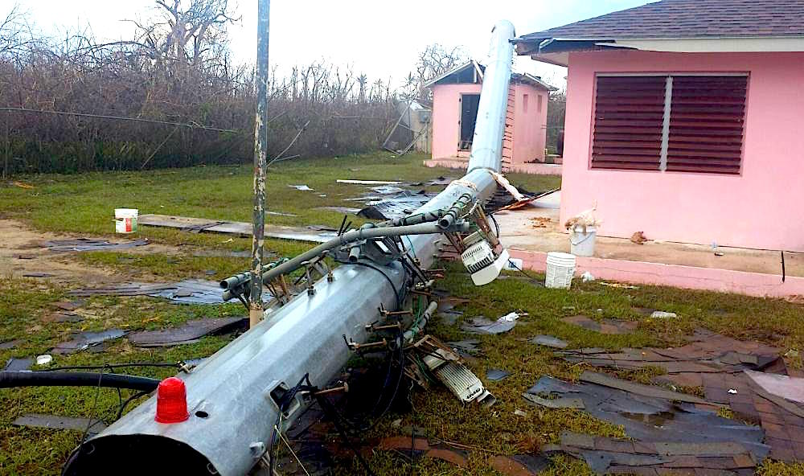
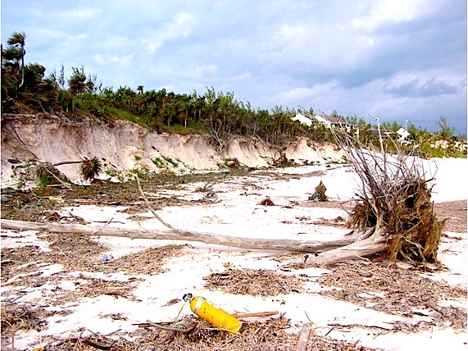
CLIMATE CHANGE CHALLENGES & THE VISION OF THE CITY OF NASSAU, BAHAMAS
Point of Discussion
“A smart sustainable city is an innovative city that uses information and communication technologies (ICTs) and other means to improve quality of life, efficiency of urban operation and services, and competitiveness, while ensuring that it meets the needs of present and future generations with respect to economic, social, environmental as well as cultural aspects”.

Slide 8
Thank You!

