Slide 1

5th ITU Green Standards Week
Nassau, The Bahamas 14-18 December 2015
Creating Sustainable Recycling Business Models
Consuelo Velarde
Business Development Manager of Latin America
Belmont Trading Company Inc
consuelov@belmont-trading.com

Slide 2

USA MEXICO COLOMBIA BRAZIL HONG KONG
UNITED KINGDOM SWEDEN CZECH REPUBLIC UAE RUSSIA

Slide 3

Background
Belmont Trading was founded in 1988 in Chicago, IL USA, as an electronics component trader company.
In the early 90’s, Belmont found the opportunity to expand its range in the value of obsolete electronics thus diversifying its business model and becoming a recycling company dedicated to precious metal recovery.
During the same decade Belmont started the expansion of its footprint into Europe, Asia and Latin America driven by the demand of service capacity
UAE and Russia have been the latest addition of the organization over the last 5 years.

Slide 4
Sustainable Business Models
Take
Back
E-waste Recycling
Buy Back

Slide 5
Focus on Value Recovery
Maximizing the value of obsolete and used electronics by finding new markets and applications.
Recycling of materials ( separation, classification by type) to reuse and recover components.
Development of trade in programs

Slide 6
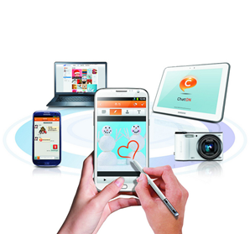
Buy Back
Buy back is a program designed to buy used electronic devices that are in a good condition and are candidates to be resold in a secondary market.

Slide 7

Buy Back
Trade Online Trade In Store
CONSUMER BRINGS ITS USED MOBILE DEVICE FOR TRADE IN
CONSUMER RECEIVES A CREDIT OR BONUS FROM STORE/WEBSITE/ TRADING COMPANY
CONSUMER USES THE BONUS TO UPGRADE ITS CELL-PHONE, TABLET, LAPTOP ACCESSORIES, ETC.
The most common trade in programs are created for cell phones towards the purchase of a new smart phone.

Slide 8
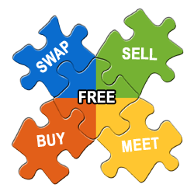
BENEFITS FROM BUY BACK
Helps the consumer to get value out of unwanted, used electronic devices.
Create a secondary market for unwanted electronic devices that are in a good condition
Supports recycling business models by increasing revenues.
Increases business for manufacturing brands, operators, and resellers.

Slide 9

Take Back
Take back programs are a solution to collect broken electronics in order to recycle them and recover part of the raw materials that they are made from of such as plastics, low grade metals, precious metals,
batteries, etc.

Slide 10
What can we recover from used Electronic Devices?
Complete Device
Cellphone
Parts Recovery
LCD
Digitizer
Metals recovery
If we can’t recover the parts or complete unit, we can still recover metals thru a smelting process
Tablet
Laptop
Gaming
Camera
Microphone
Boards
Components

Slide 11


E-Waste Recycling
Don’t let your old electronics to go to waste.
If you can’t sell your old and used electronic devices, donate them for recycling.
Electronic devices contains toxic chemicals. Don’t let them go into the ground or water

Slide 12


