Slide 1
5th ITU Green Standards Week
Nassau, The Bahamas 14-18 December 2015
Transition to digital terrestrial TV (DTT) and electronic waste (e-waste) standards and management in the Caribbean
Cleveland Thomas
ITU Representative for the Caribbean
ITU Caribbean Office
Cleveland.thomas@itu.int

Slide 2
Outline
Objectives
Danger of No Policies
International Experience
Limitations: developing countries
Main Findings: e-waste
Main Findings: e-waste in the Caribbean
Main Findings: DDT
Recommendations: e-waste management
Recommendations: DDT devices

Slide 3
Objectives
To formulate model policies related to:
  Mechanisms to control the import and/or production of TV devices that do not conform to the digital TV standard
  Provide a rational and environmentally safe process for recycling and disposing of e-waste
To provide recommendations for an effective framework that would optimize environmental policy when switching to digital terrestrial TV in the Caribbean region

Slide 4
Danger of no Policies
Cathode Ray Tubes (CRTs) are the largest component of analogue TVs.
CRTs require special recycling process because they contain significant levels of lead.
If lead is leaked, e.g., broken glass of a CRT TV screen, there is a significant risk of contamination for the human health and the environment.
Without e-waste policies in place, these dangerous components will overwhelm landfills presenting a danger to the nearby environment and those living or working nearby.
E-waste dump in Ghana
Source: Environmental Investigation Agency, System Failure: The UK’s harmful trade in electronic waste

Slide 5
International experience
According to research, most developed countries have a type of Extended Producer Responsibility (EPR) system in place to deal with e-waste.
The table below includes some countries and what they have in place currently in regards to e-waste management:
Location | Responsibility for e-Waste | Financing Method | Recycler Ownership | Government Influence
Europe
France | Individual Extended Producer Responsibility | Manufacturer Tax | Third Parties | Collect fees from manufacturers, approve recycling facilities
Germany | Individual Extended Producer Responsibility | Manufacturer Tax | Manufacturer’s choice: Ownership, Collective, or Outsource | Set targets, collect funds from manufacturers
Spain | Individual Extended Producer Responsibility | Manufacturer Tax | Third Parties | Register recyclers, set targets
Switzerland | Individual Extended Producer Responsibility | Advanced Recycling Fee | Manufacturer Collective Organization | None
Asia
China - Guiyu | Government | Manufacturer Tax/Municipality General Fund | Third Parties | Very little
China – Tianjin, Taicang, Ningbo, Taizhou, and Zhangzhou | Government | Manufacturer Tax/Municipality General Fund | Government | Very little
Source: Review of International practices relating to the control of imports/production of TV devices and e-waste management practices and standards in the Caribbean. Telecommunications Management Group, Inc. 2015.

Slide 6
Controls to the import and/or production of TV and other regulation
From fourteen countries, five included some type of regulation on imports, sales, or labeling of TV sets or set-top-boxes that do not comply with the digital standard:
  Two countries, the United States and Uruguay, had specific regulation to control the imports and production of TV
  Four countries, the United States, Poland, Australia, and Uruguay, included sales restrictions
  Four countries, the United States, Australia, Colombia, and Uruguay, included labeling regulation

Slide 7
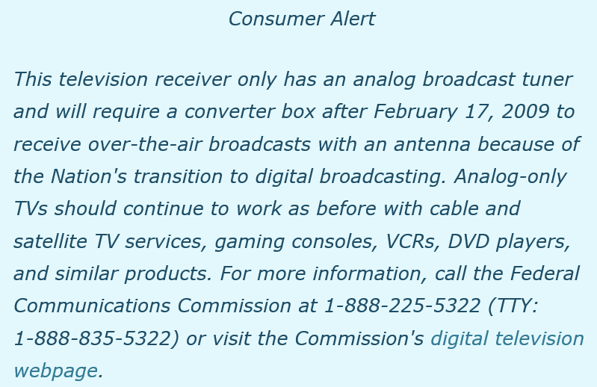

Labeling Regulation for
Some countries have labeling regulations to inform consumers if the TV complies with the digital standard.
Label regulations require that all receivers imported or manufactured after a certain date, indicate whether or not they can receive digital signals alone, or need a converter to do so.
Below are examples of labels in the United States and Colombia:
Source: Federal Communications Commission, www.fcc.gov/guides/dtv-enforcement.
Source: Communications Regulatory Commission of Colombia, Resolution 4672, 2015.

Slide 8
Controls to the import and/or production of TV and other regulation
From fourteen countries, five included some type of regulation on imports, sales, or labeling of TV sets or set-top-boxes that do not comply with the digital standard:
  Two countries, the United States and Uruguay, had specific regulation to control the imports and production of TV
  Four countries, the United States, Poland, Australia, and Uruguay, included sales restrictions
  Four countries, the United States, Australia, Colombia, and Uruguay, included labeling regulation

Slide 9
Limitations:
Developing Countries
Main limitations for developing countries to develop e-waste policies and programs, among others:
Lack of Adequate Treatment Facilities: most countries do not have the facilities to meet the expecting surge in e-waste, but this can be combated through market based incentives, exporting e-waste, or establishment of public-owned entities
Manufacturers not located within the Caribbean: In the Caribbean countries do not manufacture their electronic goods domestically. Local retailers and distributors buy electronics from either foreign manufacturers or an importer for resale on the local market. An EPR system would designate these importers as the responsible parties for the products’ e-waste management.
Orphan Products: about 30% of products lack identification of a manufacturer which means the responsibility is assumed by the government
Informal Sector: while not necessarily illegal, the informal sector contains unregistered and unregulated entities which means they can employ dangerous and environmentally unsound methods for recycling or final diposal

Slide 10
Main Findings: e-waste
Many countries have implemented policies and regulations, made agreements, and developed other solutions, all with varying success.
The ITU has developed examples of best practices and recommendations related to e-waste, which analyzes different methods focusing on the switch from analogue to digital television signals.
After analysis, it was found that countries have different legal frameworks for processing e-waste which assigns different parts of the e-waste disposal chain to different entities.
There are also different ways to finance e-waste recycling systems, but the better the structure, the more environmentally friendly products.

Slide 11
Main Findings: e-waste in the Caribbean
Lack of policies to address the increasing volumes of e-waste at all levels in the Caribbean.
Existing policies in the Caribbean are based on hazardous waste regulation with no specifics or infrastructure regarding e-waste.
Lack of policies and regulations for management leads to an informal recycling sector, which can lead to negative human and environmental consequences.
For example, Dominica currently has no regulations regarding e-waste and countries like Belize and Jamaica only have hazardous waste regulations, which are not effective for e-waste.

Slide 12
Main Findings: (DTT)
E-waste policies are needed regardless if the DTT transition has begun since e-waste dumping has begun by other countries that may affect the area.
There is no single overarching solution for the Caribbean since all countries are at different levels of the DDT transition and are in need of area specific regulations and policies.
Correct timing is also required for the DDT transition to stay smooth.

Slide 13
Recommendations: e-waste management
Estimate the amount of existing e-waste:
  This is critical for developing effective policies, for classification, definition, and logistics
Policy for e-waste management system should include:
  Clear definition and classification of different types of e-waste
  Extended Producer Responsibility (EPR)
  Sustainable Financing Model
  Orphan e-waste
  Informal Sector
  Awareness raising
  Monitoring and auditing
  Control of Transboundary movements

Slide 14
Recommendations: e-waste management
Involve all relevant stakeholders in the policy making process
  To provide input, feedback, and can help policies become better tailored to meet the specific local needs
  To engage and allow stakeholders to agree to develop a system among all affected sectors
Regional coordination:
  Necessary especially in regards to smaller countries without the economic capacity to have complete treatment programs
  Could include the establishment of local hubs to store e-waste and transportation to separate areas of disposal

Slide 15
Recommendations:
DTT Devices
Restrict the imports of analogue CRT TV sets and monitors
  To reduce the environmental impact of the hazardous materials
  To reduce the high volumes of CRT TV sets that will have to be discarded
Import and Manufacturing Restrictions:
  To help reduce the DTT transition period by reducing the prevalence of non-compatible devices
  Would mandate new or refurbished TV broadcast receivers to have digital TV tuners

Slide 16
Recommendations:
DTT Devices
Labeling Regulation:
  To protect consumers since retailers would have to clearly indicate whether the item being sold can receive digital sign transmitted by broadcasters in the country
  While labels will be required at first, after import regulations remove all non-digital receiving devices, retailers can choose whether to continue the labels
Awareness Raising Campaign:
  To include a description of the label design so consumers can distinguish between digital receiving and analogue devices
  Inform the general public about the DTT transition plan

Slide 17
Recommendations:
DTT Devices
Sales Restrictions:
  Would restrict sales to only devices capable of receiving free-to-air broadcast signals
Timetable for implementing regulations:
  All the above recommended regulations should be implemented on specific dates according to the timetable

