Slide 1
5th ITU Green Standards Week Nassau, The Bahamas 14-18 December 2015
Radiocommunication and climate change
Vadim Nozdrin,
Study Group Counselor,
Radiocommunication Bureau,
International Telecommunication Union

Slide 2
ITU-R activity

Slide 3
Scope of ITU-R studies for CC

Slide 4
Understanding of CC

Slide 5
Weather forecast
Estimated benefits of weather forecast in the EU 27- €61.5 billion/year (Ratier, 2014)
WRC-2015:
- passive bands protection
- telecommand links
- new allocation for active sensing
- space weather spectrum

Slide 6
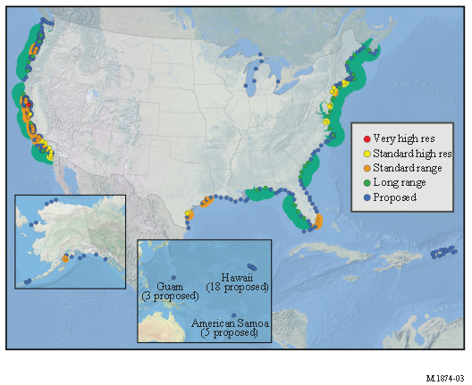
Weather forecast
Lightning losses of $4-$5 billion per year (NLSI, 1999)
WRC-12 worldwide spectrum:
- 24-hour thunderstorm detection system
- oceanographic radars

Slide 7
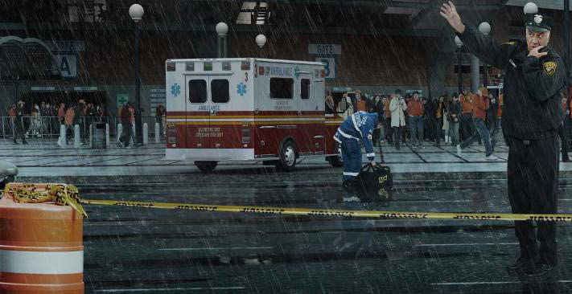
Adoptation and mitigation
economic benefits to US agriculture (by altering planting decisions) US $ 265-300 million/year (NOAA, 2012)
savings in the electricity and natural gas 2.56 billion US$ -in 2017 (NASA, 2013)
WRC-15:
- global spectrum for WAIC- A380 ↓ 206 kg CO2/hour
- harmonized PPDR bands

Slide 8
Adoptation and mitigation
Res.60 (RA- 2015)
Reduction of energy consumption for environmental protection and mitigating climate change by use of :
best practices to reduce energy consumption within ICT systems;
development and use of radio systems to reduce of energy consumption in non-radio sectors;
effective systems for monitoring and predicting climate change

Slide 9
QUESTIONS?

