Slide 1
5th ITU Green Standards Week Nassau, The Bahamas 14-18 December 2015
ICTs for Climate Change Adaptation in Cities
Building Smart, Sustainable & Climate Resilient Cities
Daniela Torres, Eng. MSc
ITU FG SSC WG4 Coordinator
ITU Consultant

Slide 2
Content
Global Initiatives on Climate Change Adaptation in Cities
ICTs for Climate Change Adaptation in Cities
Making it Real: Framework of Integration of ICTs into City Policies

Slide 3
1. Global Initiatives on Climate Change Adaptation in Cities

Slide 4
1. Climate Change Adaptation in Cities Cities are impacted directly & indirectly
Direct Effects in Cities
Increased Temperature
Heatwaves
Sea Level Rise
Droughts
Heavy Rains Floods
"Adaptation is the only means to reduce the now-unavoidable costs of climate change over the next few decades”
Nicholas Stern, October 2006.
Indirect Effects in Cities
Agriculture Production
Water supply
Disease spread
Population migration
Infrastructure damage
City Infrastructure and services may be affected including ICT Infrastructure
Source: ITU Technical report on “ICTs for Climate Change Adaptation in Cities”

Slide 5
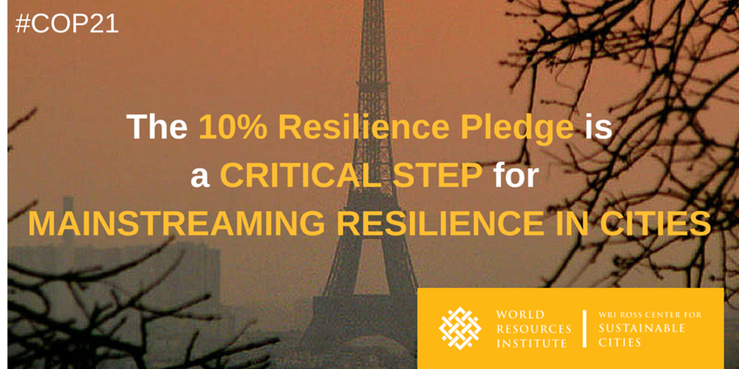
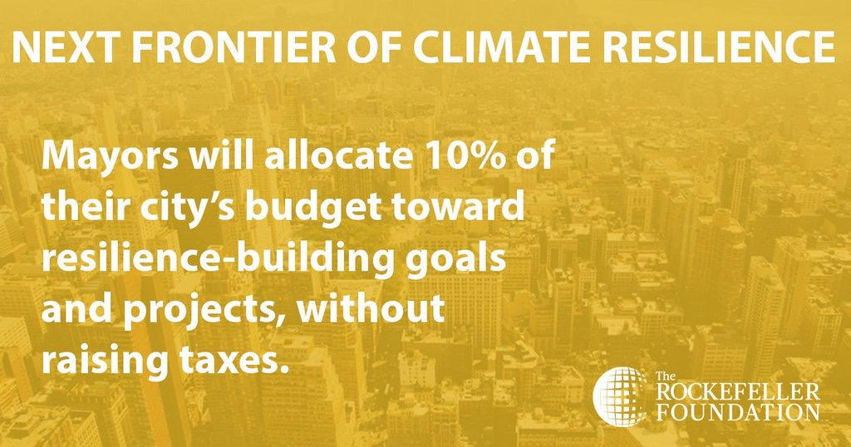
1. Climate Change Adaptation in Cities Cities Initiatives World Wide

Slide 6
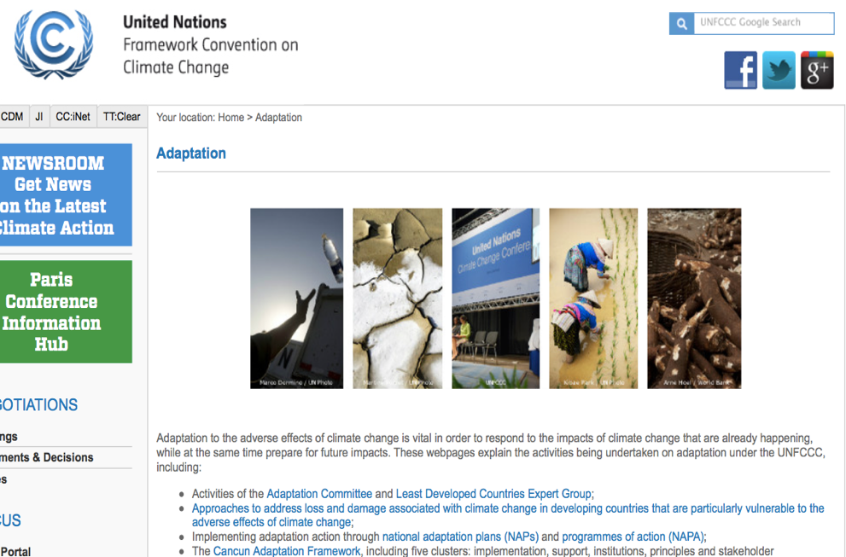
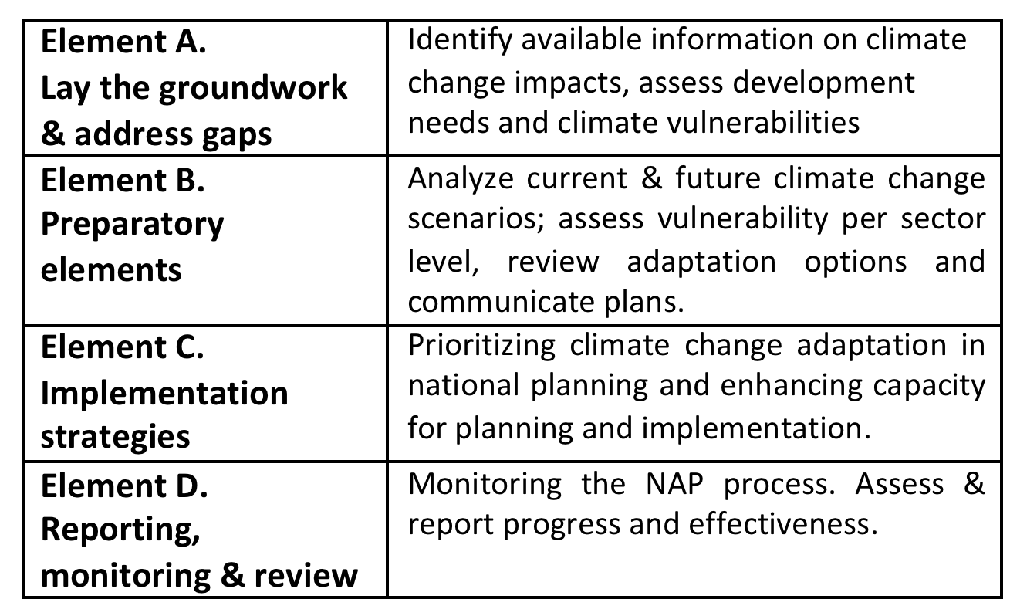
1. Climate Change Adaptation in Cities UNFCCC Initiatives & Leadership
The UNFCCC established a process to enable countries to formulate and implement National Adaptation Plans, as a means to address medium- and long-term adaptation needs
“Elements of the process to formulate and implement NAPs”
More information: http://unfccc.int/6057

Slide 7
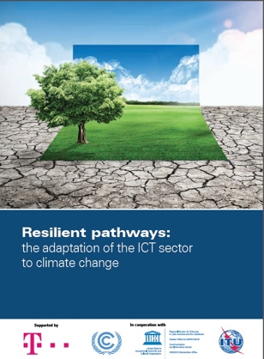
1. ITU Initiatives on CC Adaptation in Cities The ICT Sector Response
Standardization Activities
ITU-T SG5 Q15 on ICTs & Climate Change Adaptation
ITU-T L.1500 Series
- ICTs for Countries Adaptation
- ICT Infrastructure Adaptation
- ICTs for Cities Adaptation
Technical Reports
ICTs and Climate Change Mitigation & Adaptation. Case of Ghana
Resilient Pathways: The Adaptation of the ICT Sector to C. Change
FG Smart Sustainable Cities:
Technical Report on ICTs for Climate Change Adaptation in Cities

Slide 8
2. ICTs for Climate Change Adaptation in Cities

Slide 9
2. An Unique ITU Technical Report “Information & Communications Technology for Climate Change Adaptation in Cities” (March, 2015)
Aligned to SG5 - Question 15/5
Effort of the ICT Sector and UNFCCC
Examples of ICTs for c. change adaptation
WG2 – ICT Infra to be impacted by climate change

Slide 10
2. ICTs for Climate Change Adaptation in Cities
ICTs for Climate Change Adaptation in Cities
1) ICTs for Enhanced Disaster Risk Management
2) ICTs for City Resilience & Adaptive Capacity
3) ICTs for Informed Adaptation Decision Making
ICTs for City & City Sectors Adaptation
ICT Sector Self Adaptation

Slide 11
2.1 ICTs for enhanced Disaster Risk Management (DRM)
DISASTER PREVENTION (Prediction and detection)
EMERGENCY PREPARDNESS & RESPONSE (Alerting)
RECOVERY
(Relief)
DRM Phases
Earth exploration-satellite services
Geographic Information Systems (GIS)
Blogging, web 2.0 & social networking
Broadcasting services terrestrial & satellite (radio, TV, etc.)
Fixed services terrestrial/satellite
Mobile services (land or satellite)
Earth exploration-satellite services
Mobile emergency & recovery networks
Blogging, web 2.0 & social networking
EXAMPLES
ITU-T Standards for DRM
ITU Common Alerting Protocol (CAP) – general format to exchange all-hazard emergency alerts. Increase warning`s effectiveness & simplify warning tasks.
ITU-T E164 assigns the country code 888 to the UN Office of the Coordination of Humanitarian Affairs (OCHA)

Slide 12
2.1 ICTs for enhanced Disaster Risk Management (DRM)
Colombo - Sri Lanka
Disaster Early Warning Network (DEWN)
- Provide timely, reliable& cost­effective mass­scale disaster early warnings.
- Via Cell Broadcast (CB) & short messages (SMS)
Mexico City - Mexico
Virtual Centre on Climate Change (CVCCCM)
- Decision making tool disaster early warnings
- Metropolitan hydro.meterological monitoring (fires, native crops recovery, etc)
Source: Technical report on “ICTs for Climate Change Adaptation in Cities”. Box 1, page 15-16 &
Sri Lanka http://www.wmo.int/pages/prog/amp/pwsp/documents/CAPWKSHP-2014-01-07-DMC.pdf
México http://www.cvcccm-atmosfera.unam.mx

Slide 13
2.2 ICTs for City Resilience & Adaptive Capacity
Brest - France
ClimSAT (UNDP) – TASK (UNEP)
- Climate Scence & technology hub for local & global support
- Satellite-based technology to monitor & model c. change effects.
- UNEP Territorial Approach to Global Change Services & Knowledge → TASK
Can Tho - Vietnam
Real Time Monitoring for responding saline intrusion (CVCCCM)
- City surface water system used for food & crops . Municipal water supply affected by sea level rise.
- Installation of real time salinity monitoring points linked to public warning systems via salinity maps
Source: Technical report on “ICTs for Climate Change Adaptation in Cities”.
CanTho: http://training.i-s-e-t.org/wp-content/uploads/iset_vietnam_casestudy_cantho_salinity_1304181.pdf

Slide 14
2.2 ICTs for City Resilience & Adaptive Capacity
ICTs for Climate Change Adaptation in city agriculture sector. Miyagi (Japan)
- Fujitsu has worked with farmers to provide sensing network, cameras and cloud service system for environmental monitoring
- System to control GHG temperature, humidity, etc
ICTs for urban planning & climate change adaptation. Wuppertal (Germany)
- SUDPLAN Web-based planning, prediction & training tool to support long term urban planning.
- Facilitated 3D models to simulate the surface drainage during a heavy rain event, allowing climate planning.
Source: Technical report on “ICTs for Climate Change Adaptation in Cities”. & Germany SUDPLAN: http://sudplan.eu/results/workshop/sudplan-workshop/sudplan-workshop-on-climate-change-and-urban-planning-1.26065

Slide 15
2.2 ICTs Sector Self-Resilience & CC Adaptation
Information Technology & Telecommunications Network Resiliency New-York (USA)
- After Sandy the city decided “A stronger more resilient NY”
- Program to guarantee telecommunications services resilience planning & preparation. All Telecom Operators collaborate
Telecommunications Networks Climate Risks Management – Lima (Peru)
- Telefonica has worked to manage the rainy season in Peru which affects mobile networks base stations with floods.
- Risk management and preparation in other counties of South America
Source: Technical report on “ICTs for Climate Change Adaptation in Cities”.
New York: http://www.nyc.gov/html/doitt/html/citywide/citywide.shtml

Slide 16
2.3 ICTs for Informed Adaptation Decision Making
Vivo-Clima: Real time rain monitoring & pubic information delivery. Maua Town (BRAZIL)
- Vivo Clima is a platform M2M that receive rain information in real time. Captured in web for pubic access
- Pluviometers installed in cell sites of Telefonica. Captured SMS are sent through mobile network (3G/GPRS)
Social Media for Rising Temperature Adaptation Eldoret (Kenya)
- To raise public awareness about how to adapt to climate change & raising temperatures
- Receive information on temperature through Facebook page and SMS in their phones
Source: Technical report on “ICTs for Climate Change Adaptation in Cities”.
Eldoret: http://www.trust.org/item/20130716085920-k63xg/?source=spotlight
Notes:
Vivo Clima is a platform M2M that receive rain information in real time;
Pluviometers (rain gauge equipment) installed in telecommunication sites of Telefônica that are located in risk areas. The data captured are sent through the mobile phone network (3G/GPRS)
Data is sent to the information platform of the National Natural Disaster Monitoring (CEMADEN), which is part of the Ministry of Science, Technology and Innovation.
The government acquired 1,500 pluviometers that are going to be connected in the network 3G/GPRS by the end of 2014 in all provinces.

Slide 17
3. Making it Real: Framework to include ICTs in Climate Change Adaptation Policies in Cities

Slide 18
Framework to include ICTs in Climate Change Adaptation Policies
Setting the basis. Observation and understanding (ICTs inside the initial evaluation)
Assessing climate change risks and vulnerabilities
(Assess vulnerabilities including ICT infrastructure)
Planning of adaptation options
(ICTs to find options and ICTs as an option)
Implementation of adaptation actions
(Adaptation options into actions with business models)
Monitoring and evaluating adaptation actions
(ICTs support in monitoring success)
Notes:
Setting the basis: Observation and understanding: City planners should consider the role of ICTs in climate change adaptation as a new alternative in their local adaptation plans. They should take stock of existing measures, opportunities and challenges on the integration of ICTs in climate change adaptation.
2) Assessing climate change risks and vulnerabilities: This should involve an assessment of how ICTs can support to identify adaptation options to climate change, as well as to carry out an assessment of the specific risks and vulnerabilities on ICT infrastructure.
3) Planning of adaptation options: For planning of the adaptation process, it is important to define the role of ICTs in identifying adaptation options for cities, as well as those options that would allow for the use of ICTs for impacts of climate change. Once the potential adaptation options are identified, an assessment should be carried out to determine which of them suit the cities specific context. The approach is based on prioritizing those ICTs that would best support adaptation options in a given city context, including the evaluation of social, environmental and economic variables. This step also involves the prioritization of adaptation options for the ICT infrastructure.
4) Implementation of adaptation actions: This step relates to the development of an implementation plan to convert adaptation options into action. It involves the integration of ICTs in the design of implementation strategies for identified/prioritized adaptation options, together with the implementation of specific adaptation options for the city's ICT infrastructure.
5) Monitoring and evaluating adaptation actions: This step consists of a monitoring system and evaluation of the role on ICTs in climate change adaptation, to ensure the focus and effectiveness of adaptive actions. ICTs have the capacity to support this process in various ways including (but not limited to) usage of software tools to enable modelling, monitoring and analysis of climate change impact in cities. A smart sustainable cities' adaptation checklist is also provided in the last chapter of this report, to enable cities mayors to evaluate the degree of inclusion of ICTs in their cities strategic responses, and assist them in improving relevant adaptation interventions.

Slide 19
The way forward..
ICTs can support this process but is important to include them in early stages of climate change adaptation planning.
Stakeholder collaboration is needed to integrate ICTs in adaptation plans: central government, cities and citizens
There are lots of initiatives on ICTs and climate change adaptation to learn from
Cities and the ICT Sector must work together

Slide 20
THANK YOU
ICTs for Climate Change Adaptation in Cities
Building Smart, Sustainable & Climate Resilient Cities
Daniela Torres, Eng. MSc
ITU FG SSC WG4 Coordinator - ITU Consultant
alisdaniela.torres@outlook.com
@alisdaniela

