Slide 1
Green ICT : Recommended Practices in the Use of ICT Equipment for Energy Savings
Prof. Sekhar Kondepudi, National University of Singapore ITU-T Focus Group on Smart Sustainable Cities (FG SSC) September 22 2014 Beijing

Slide 2
Importance of ICT Loads

Slide 3
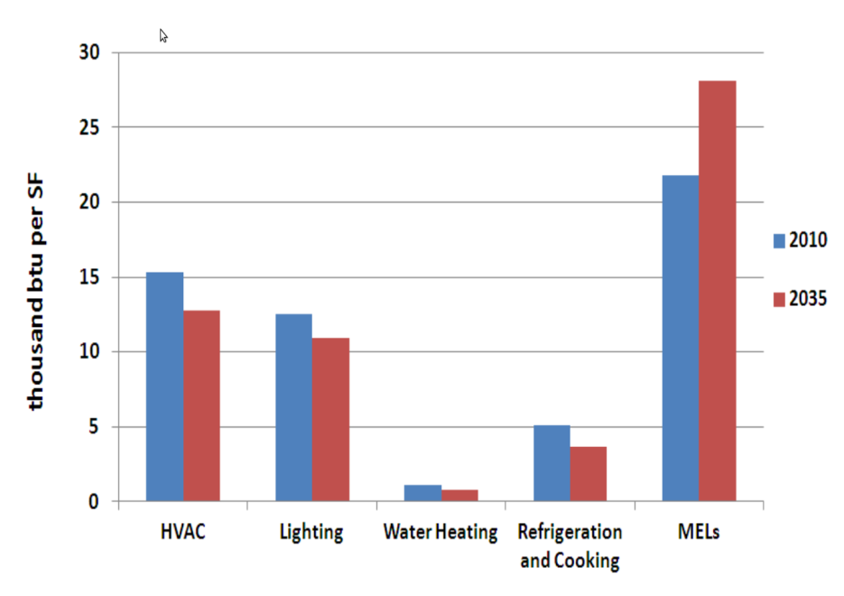
MELs (Miscellaneous Electric Loads)
MELs account for more than 20% of the primary energy used in commercial buildings and this is expected to rise to 40% by 2035.
As can be seen the electrical loads by traditional uses is expected to decline, while the same for MELs is increasing rapidly.
MELs are transforming into dominant electrical loads

Slide 4
Motivation
A study measuring consumption of MELs in a controlled environment in University of California in San Diego revealed that MELs category of ICT equipment accounts for:
70% of the electrical loads during peak hours
80% of the electrical loads during off-peak hours
Therefore energy audit focusing on ICT equipment is very important, when minimizing the energy foot-print of a building.

Slide 5
Questions - Typical ICT Devices in an Office Building
What are the different power (plug load) behavior of different ICT devices ?
What are the different ICT device lasses ?
Can these plug loads and its related parameters be characterized ?
What is the transient behavior of these devices – moving from one state to another
Are there similar patterns within a device class?
How to manage increasing ICT loads in next-gen smart buildings ?
Can we develop Predictive Algorithms for Disaggregating Multiple Loads from a Single Measurement
5

Slide 6
Goal & Approach
Goal
To develop Best Practices on the Use of ICT Devices in the University Campus using the School of Design & Environment (SDE) as a proxy (3 Departments, 3 Buildings)
Quantitative
Detailed Inventory of ICT Devices
Measurement of Individual ICT Devices
Field Measurements & Monitoring
Qualitative
Surveys and interviews with users and facility managers

Slide 7
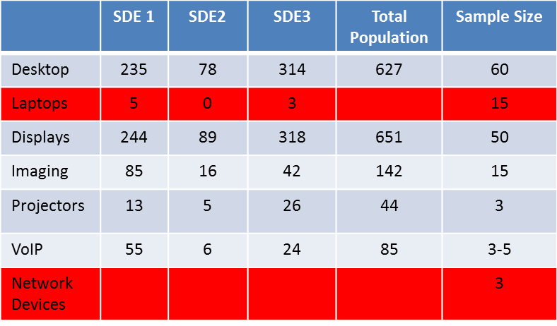
Inventory : 225 rooms with 1,534 ICT devices
Desktop PCs + Displays = 1300
Imaging (Printers, Scanners, MFD) = 150
VoIP Phones = 85
Projectors = 44;
Faculty offices = 108, predominantly in SDE1-L4&L5 then in SDE3-L2&L3
Admin Staff = 104, predominantly in SDE1-L3&L5 then in SDE2-L1&L2
Limited Laptops – Not permanently attached ( only 5 )
Desktops: 41%
Display Monitors: 41%
Imaging equipment: 8%
VoIP, projectors, external LCD screens:10%

Slide 8
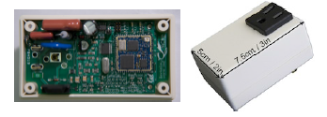
Measurements
Energy Metering Hardware
Employed smart power outlets or smart plugs to sandwiched in the middle of the socket and electrical appliance plug to measure their consumption.
These motes sample the current, voltage, active and apparent power of the attached load.
They include a low-power processor, radio and integrated antenna.
Developed drivers in Java for parsing the measurements and storing them in a database for statistical analysis, similar to smart homes concept.

Slide 9
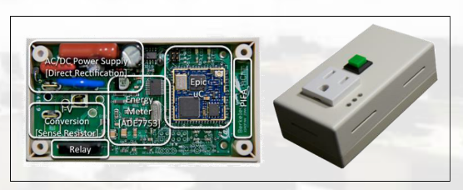
ICT Devices Sample Test Matrix
Monitor | Projector | Printer | Desktop | Laptop
ON-Low Brightness | OFF | OFF | OFF | OFF
ON-Med Brightness | SLEEP | OFF – BOOT UP – IDLE | OFF to ON | OFF to ON
ON-High Brightness | ON | IDLE – PRINT – IDLE (6 Single sided) | ON | ON
STANDBY | SLEEP TO ON | IDLE – PRINT – IDLE (3 double-sided) | ON-app | ON-app
OFF | ON TO SLEEP | IDLE – SCAN – IDLE (3 page) | ON to SLEEP | ON to SLEEP
 |  | IDLE – COPY – IDLE (6 single-sided) | ON-app to SLEEP | ON-app to SLEEP
 |  | IDLE – COPY – IDLE (3 double-sided) | SLEEP | SLEEP
 |  | SLEEP - IDLE | SLEEP-app | SLEEP-app
 |  | IDLE | SLEEP to ON | SLEEP to ON
 |  | SLEEP | SLEEP-app to ON | SLEEP-app to ON
 |  |  | ON to HIBERNATE | ON to HIBERNATE
 |  |  | ON-app to HIBERNATE | ON-app to HIBERNATE
 |  |  | HIBERNATE | HIBERNATE
 |  |  | HIBERNATE-app | HIBERNATE-app
 |  |  | HIBERNATE to ON | HIBERNATE to ON
 |  |  | HIBERNATE-app to ON | HIBERNATE-app to ON
 |  |  | ON to OFF | ON to OFF
 |  |  | ON-app to OFF | ON-app to OFF
 |  |  |  | CHARGING
9

Slide 10
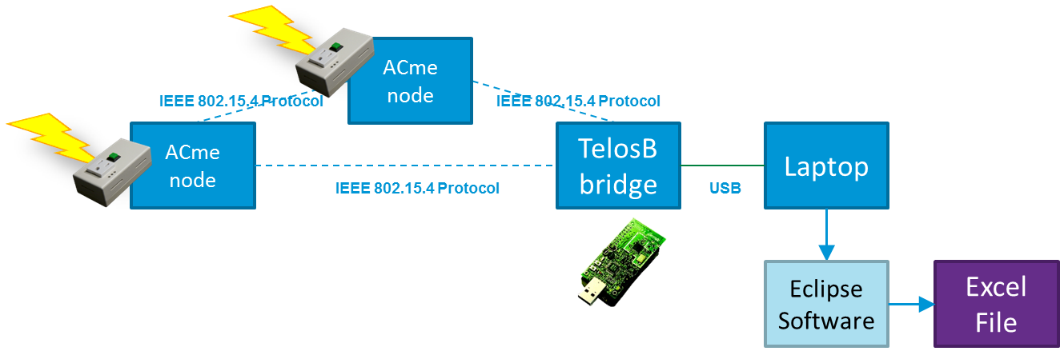
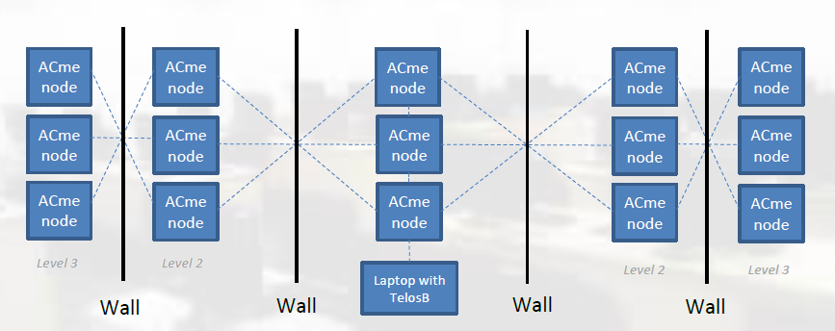
Field Deployment ( Faculty Offices)
Desktops
Laptops
Monitors
Printers
VoIP Phones
10

Slide 11
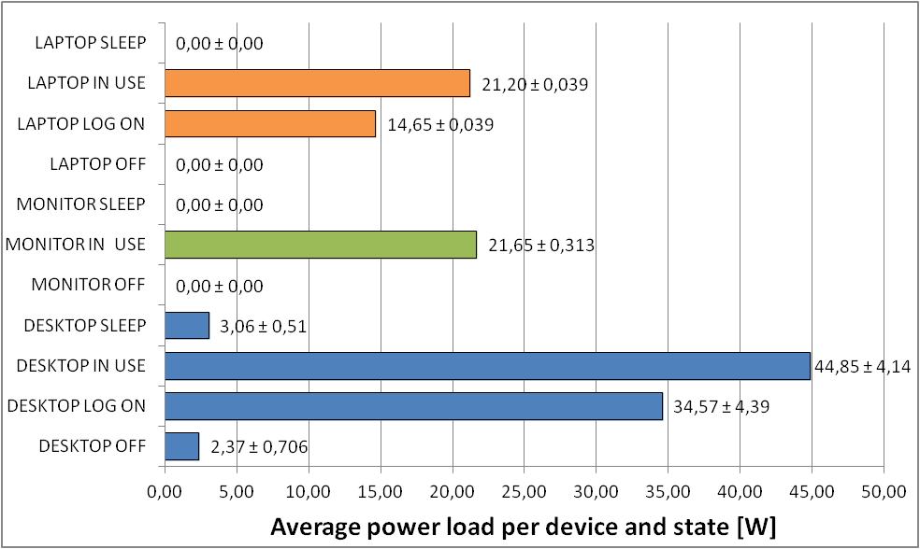
Some Average Measurements
11

Slide 12
Desktops Transient Power Behavior (From Hibernate, Sleep, Off ) to ON
OFF to ON
12

Slide 13
Desktop Transient Current Draw
SLEEP to ON
HIBERNATE to ON
OFF to ON
13

Slide 14
MFD Printers (Desktop, Monochrome)
Spike every 40 seconds (keep the drum warm ?)
Spike lasts for 7-8 seconds
Consumes up to 500W during that small timeframe
Trend similar with Other MFD printer
Snapshot of Field Data
Captured at 15 sec intervals over multiple weeks
Range between 50 and 60 W
Energy Consumption Consistent with Detailed Per Second Data
Assume 50 W for 12 hours a day X 365 Days X $ 0.25 / Kwh ~ $ 55.00 / year / printer
At least 3000 such printers on NUS Campus = $ 165,000 savings annually
14

Slide 15
Good Practice : Use Laptops over Desktops
Laptops consuming 25% less power than desktops in ON mode and 50% less power during SLEEP mode.
Our measurements show heat produced by desktops is 4 times more than laptops. Each laptop needs 3000 btu/nr less than a desktop to cool office space.

Slide 16
Popular Approaches for the Power Management of Desktops
Wake-on-LAN : send packets on network to make machines sleep on wake up depending on network activity.
SleepServer : transition to low-power sleep while maintaining network presence of all connected machines by a proxy mechanism on one server.
LiteGreen : virtualize the desktop environment, migrating it between the user’s physical machine and virtual server.

Slide 17
Good Practice : Power Management of Desktops (1)
Assigning power settings, more suited to the intended use of the computing devices.
Many users of our building were not sure whether they should set their laptop in hibernate or sleep mode when they had to leave for lunch or home.
When ON, consumption is 34 times more than in SLEEP and 116 times more than HIBERNATE.
SLEEP consumes more power than HIBERNATE but enables a faster waking up time of the desktop.
However the difference is quite tolerable
20-65 sec, 0.46 Watts in Sleep
40-80 sec, 0.08 Watts in Hibernate

Slide 18
Good Practice : Power Management of Desktops (2) Sleep vs. Hibernate
Laptop
Running NO applications. For less than 44 minutes and 30 seconds, it is better that a laptop is in SLEEP. For longer, hibernate is preferred.
Running applications. For less than 59 minutes and 39 seconds, it is better that a laptop is in SLEEP. For longer, hibernate is preferred.
Desktops
The tradeoff (independent of running applications or not) is 126 minutes and 3 seconds. Less than this time, it is better to put the desktop to SLEEP. More than this time, it is more practical to HIBERNATE.
Dilemna – Due to a large trade off of over two hours, the user is better off switching the desktop OFF when leaving it idle for over two hours.

Slide 19
Good Practice : Switch Printers OFF at night
Common Printers & Multifunctional Devices (MFDs) in labs as well as those in the personal spaces of academic staff, remain IDLE/ SLEEP at night time.
Especially at Night, there is no need to have the printers/ MFDs ready for tasks so these devices should be powered off, after hours.
Between $ 50 and $ 75 savings per printer per year

Slide 20
Good Practice : Single vs. Double Sided Printing
Is double sided printing is more efficient compared , to single sided (in addition to the savings of paper ?
YES – Always better to print double sided
Single sided printing consumes 2.13 times more power than double sided.
0.124 Kwh compared to 0.058 Kwh for 6 pages.

Slide 21
Good Practice : Scan+Email vs. Copy
Is it better to Scan + Email or make a Physical Copy ?
YES – Always better to Scan + Email : Energy + Paper savings
Sample of 6 pages scanned vs. 3 doublesided copies.
Copying needs 9 times more energy and 3 times more the time.

Slide 22
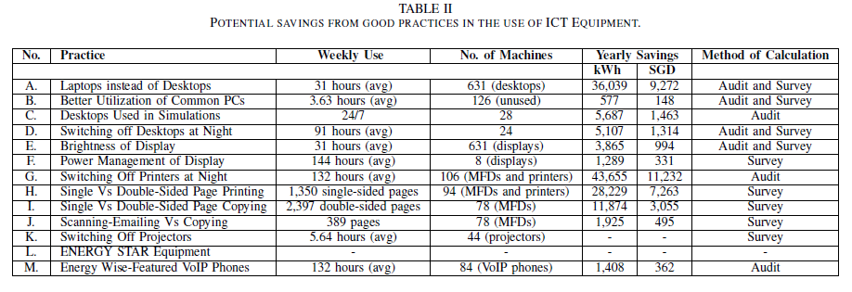
Estimations of Potential Savings
Almost $ 50K per year in School of Design & Environment
University Wide – probably can extrapolate to $ 500 – 750 K per year

Slide 23
In Summary
Great Potential to implement Best Practices which not only save energy but also money. Win-Win
Areas of future work
Audit power consumption of ICT infrastructural devices
Increase the duration of the study for greater than 6 months to identify temporal patterns for saving.
Still not clear whether to involve building users more for energy savings or use automation. We support at least some education and training which is essential for users to perceive how to use their ICT devices.

Slide 24
4th ITU Green Standards Week
sekhar.kondepudi@nus.edu.sg
+65 9856 6472

