Slide 1
Green ICT Actions in China
Guo Weixiang
China Academy of Telecommunications Research of MIIT

Slide 2
Content
ICT and Environmental Impacts
Our Actions for green ICT

Slide 3
ICT and Environmental Impacts

Slide 4

ICT and carbon emissions
The manufacture, use and disposal of ICT equipment contribute around 2% of global emissions of carbon dioxide.
As the use of ICT grows, its emissions are likely to increase despite improvements in efficiency. It is estimated that ICT will be responsible for 3% of global emissions by 2020.

Slide 5

Energy use in the ICT life cyle
Energy efficiency in ICT have mostly focused on consumption while in use. However, a large part of the environmental impact of a device comes during its manufacture and disposal.
From cradle to grave

Slide 6

ICT and carbon emissions reduction
ICT can also be used to increase energy efficiency and reduce emissions in other sectors.
It is thus suggested that the use of ICT can cause an overall reduction in emissions even if its direct emissions increase.

Slide 7
ICT in other sectors
Several reports have pointed out that the use of ICT in
other sectors has the potential to reduce carbon emissions by far more than ICT’s direct contribution. Such as:
  Smart industry
  Intelligent transport
  Smart buildings
  Smart grid
  Network video conference
  Online shopping
  Online banking

Slide 8
Green of ICT & Green by ICT
Green of ICT
Green by ICT
Environmental load caused by ICT
Environmental load reduction achieved by ICT services
ICTs have both positive and negative aspects on the environment. The negative factor is the environmental load caused by ICT devices and equipment. On the positive impact side, ICT services can make lifestyle and business operations more energy efficient. Towards constructing a sustainable society from an environmental viewpoint, we should act to minimize the negative factors of ICT and maximize the positive ones.

Slide 9
Our Actions for green ICT

Slide 10

Integration of informatization and industrialization
The Ministry of industry and information technology Of China have published policy to promote the deep integration of informatization and industrialization, and strengthen the role of information and communication technology on energy saving and emission reduction of traditional industry.

Slide 11
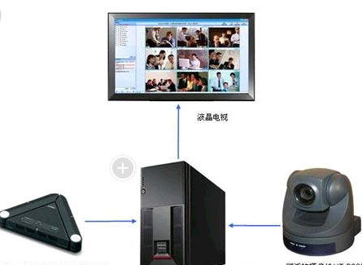
Encourage the application of ICT
Encourage the application of ICT to promote energy-saving and emission reduction of economic and social fields. These ICTs include Electronic commerce, mobile office, video conferencing, video surveillance, etc.

Slide 12
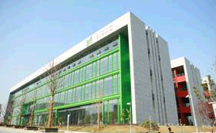
Green Data Center
More and more energy saving technologies are used in IDC
Many old IDC are reformed to meet the energy saving requirements
The PUE of a lot of IDC is less than 1.5

Slide 13
HVDC for Telecommunication
HVDC is more efficient, reliable, Energy-saving, Cost-efficient compared with traditional UPS
High-voltage Direct Current(HVDC) Power Supply System for Telecommunication has been applied in some telecom operators of China

Slide 14

Green communication base station
More and more energy-saving technologies make the communication base station more efficient, such as smart energy-saving technology for main equipment, smart air-condition technology, no house base station, etc.

Slide 15
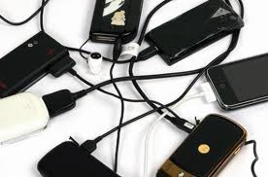
Universal Power Chargers

Slide 16
Universal Power Chargers
Normally every ICT device has at least one power charge, power adapter or power switch unit
At the end of life, ICT devices and its power units are kinds of e-waste
A universal power adapter and charger solution will reduce the number of power adapters and chargers by widening their application to more devices and increasing their lifetime. Then more energy and material will be saved.

Slide 17
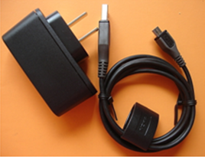
Standardization
With the promotion of industry, government and users, most of the mobile phones in China market are using universal power adapters with USB A port and Micro-USB B port.

Slide 18
Conclusions
ICTs have both positive and negative aspects on the environment, we should act to minimize the negative factors of ICT and maximize the positive ones
In China, a lot of laws and standards about environmental protection have been published
Some actions have been made in China ICTs Industry to improve our environment

Slide 19
Thank you for your attention
guoweixiang@catr.cn

