Slide 1




4TH ITU Green Standards Week
Beijing, China, 22- 26 September 2014
Forum on “Green ICT for a Sustainable Resource Efficient Economy” 22 Sept. 2014
Session 3: Green ICT Standards – A Path to Environmental Sustainability
UNIDO PRESENTATION
4th ITU Green Standards Week

Slide 2
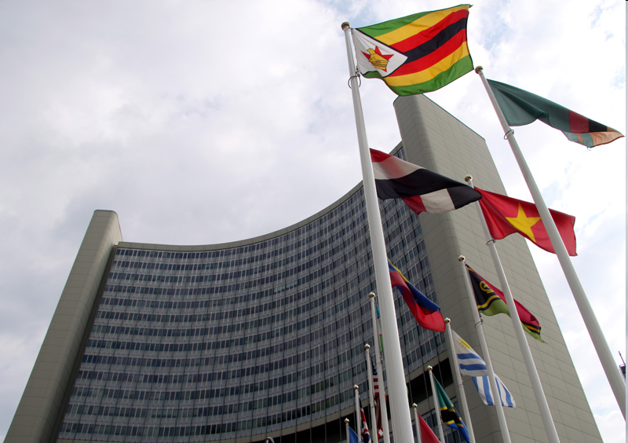
UNIDO as driver of the Third Industrial Revolution
International solutions for E-Waste Management

Slide 3
UNIDO mandate
Industrial Development for poverty reduction,
inclusive globalization and environmental sustainability
Productive
Capacity
Building
Trade
Capacity
Building
Environment
and Energy
Inclusive industry
Competitive Industry
Green industry

Slide 4

Inclusive & Sustainable Industrial Development (ISID)
Global level
(Govts, dev. partners,
Industry)
Global Forum
Dialogue and negotiations
for inclusive and
green industrial
development
Technical Assistance
Supporting industrial
capacity building,
policy advice,
technology transfer.
Country level
(Govts, Industry,
civil society)
Regional
(RECs, Industry,
Intermediary Orgs.)

Slide 5
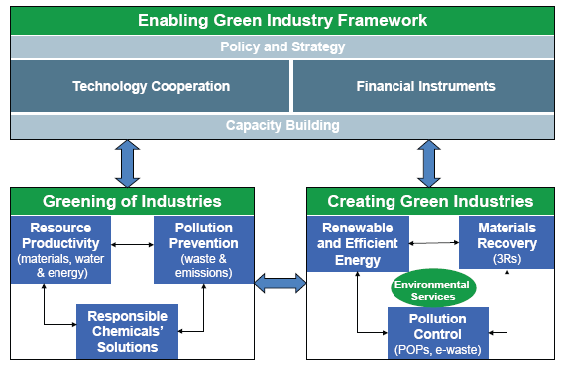
The Green Industry Initiative

Slide 6
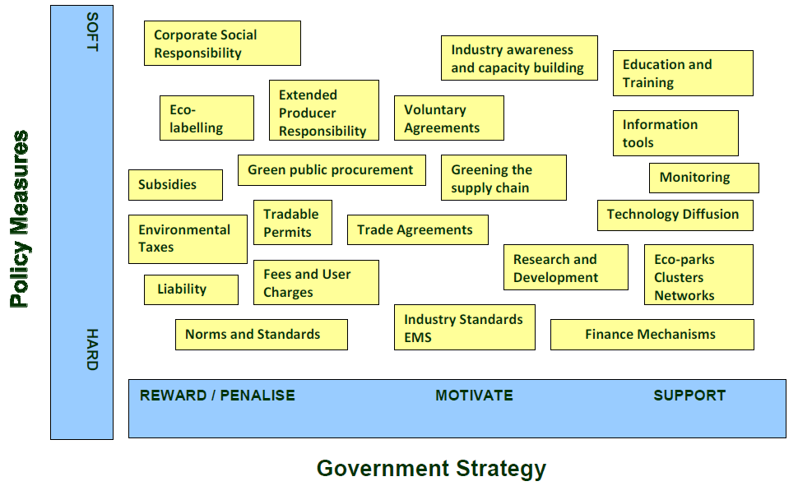
Policy Matrix for the Greening of Industries
Policy Measures

Slide 7
Green Industry: Flagship Programmes
Resource Efficiency | Water Efficiency | Industrial Energy Efficiency | Chemicals Management
Resource Efficiency & Cleaner Production (RECP) | Transfer of Env. Sound Technologies (TEST) | Energy System Optimization | Persistent Organic Pollutants Phase-out
Environmental Management Standards | Mercury Programme | Energy Management Standards | Ozone Depleting Substances Phase-out
Corporate Social Responsibility – REAP 26000 | Large Marine Ecosystems (LME) |  | Chemical Leasing
 |  |  | E-waste Management

Slide 8
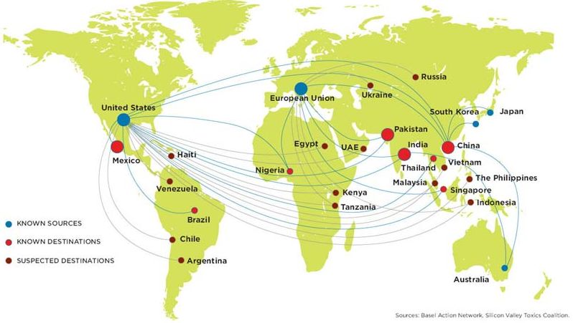
E-waste flows to developing countries
Accra
Lagos
Source: Basel Action Network, Sillicon Valley Toxics Coalition
Generation of E-waste in 2030 (forecast):
developing countries discarding 400 - 700 million obsolete PC/year
developed countries 200 - 300 million

Slide 9
Complex mix of elements
Hazardous materials
  Environmental and health risks
Valuable metal resources
  40-800 times more gold in 1t of PWB than in 1t of ore

Slide 10
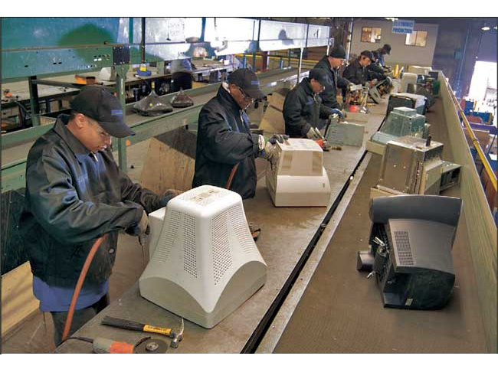
UNIDO Approach for e-waste management
Inventory
Manual dismantling facility
Non Hazardous Outputs
local/ regional treatment
Units in stock
Units in use
Current e-waste flows
Future volumes of e-waste
Etc.
(incl. refurbishment)
Collection system
permanent collection points and awareness building to reduce stock and ensure future input in dismantling facility
Hazardous Outputs
International integrated smelter

Slide 11
Projects on e-waste management
Ongoing:
Uganda: Establishment of a manual dismantling facility for WEEE
Tanzania: Component on E-waste management (One UN Programme)
Ethiopia: E-waste Management Project
Cambodia: Creating job opportunities & effective e-waste management
Pipeline:
Regional e-waste project for Latin America
Regional e-waste project for Eastern & South-Eastern Asia
Regional e-waste project for West Africa

Slide 12


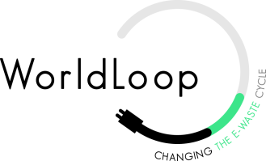









Partnerships
UN
Conventions
Business
Platforms
NGOs

Slide 13
Legislation
Consumer / user
health and safety
Environment
CE Marking
E.g. packaging, WEEE,
RoHS, cadmium
ISO 26000, GRI, Global Compact
Social / fair
trade labels
SA 8000 / OHSAS
Codes of
conduct
ISO 9000 certificates
EN / IS0
standards
Eco labels
IS0 14001
Quality
Social accountability
Environment
Buyer requirements
Notes:
OHSAS – Occupational Health and Safety management systems
RoHS – Restriction of Hazardous Substances Directive

Slide 14
Confronting and benefiting from sustainability standards in global markets
The basic steps for greening enterprises in developing countries are also relevant for the commercial challenge of attempting to enter – or remain in – world markets, and having to meet an increasing number of environmentally-related standards to do so. These standards require enterprises to reconfigure their products and/or processes to meet the requirements of their international customers or the laws of the countries to which they wish to export, and to certify that they have done so.
In other words, they must be able to:
  Redesign their products so that they meet any pertinent environment-related product standards;
  Reconfigure their processes so that they meet any pertinent environment-related process (technology and management) standards;
  Certify that their products and/or their manufacturing processes meet these standards.

Slide 15







Quality Assurance Infrastructure
International Governance
Public
Metrology
Accreditation
Standards
Legal Framework
Metrology Institute
Accreditation Board
Standards Body
Institutions
Calibration
Testing
Inspection
Certification
Public and/or Private
Calibration Services
Testing Services
Services
Inspection Bodies
Competent Authorities
Products
Processes
Personnel
Volume
Pesticide Residues
Temperature
Mass
Etc.
Chemical
Microbiological
Etc.
Source: UNIDO
Value Chain: Producers / Exporters / Consumers

Slide 16
Trends
Dynamic relationship between technical regulations and private standards
  Many standards in the area of consumer health and safety have evolved into legislation. On the other hand, many legislative requirements have translated into stricter private requirements (that can be illustrated by the organic products labeling.)
Transparency and traceability across the value chain
  Higher transparency within the value chain and traceability of products – the pressure to comply with private standards is transmitted down the value chain.
New sustainability concerns: water and energy efficiency
  In the past few years, many new demands related to climate change and the sustainable use of resources, such as energy and water, have emerged as a result of international concerns about sustainability. Buyers are responding to these concerns by already factoring energy, water and carbon into their codes and requesting their suppliers to take certain mitigating measures.
Notes:
As development of such ‘meta standards’ has been found to be more difficult than expected, several benchmarking schemes have been set
up aiming at the creation of reference tools which describe emerging best practice. The ISEAL Alliance, a global association for social and
environmental standards, has been developing a Code of Good Practice for Setting Social and Environmental Standards which was first launched in 2004. It has also been involved with brokering Mutual Recognition Agreements (MRAs) between its founding members, such as the International Federation of Organic Agriculture Movements (IFOAM) and the Fairtrade Labelling Organization (FLO). There is still a significant amount of diversity, however, since negotiating Mutual Recognition Agreements between different schemes is an overwhelming task given the number of interests involved and the variation in weight and resources brought to the negotiating table by the different actors.

Slide 17


Let‘s work together on realizing the Third Industrial Revolution!
Thank you for your attention!
Contact Brussels:
Florian Iwinjak
Rue Montoyer 14
f.iwinjak@unido.org
Contact Vienna:
Smail Alhilali
s.alhilali@unido.org
Notes:
17

