Slide 1
THE INNOVATION IMPERATIVE FOR THE ICT SECTOR
ITU Green Standard Week
Guillaume Mascot
September 2014

Slide 2
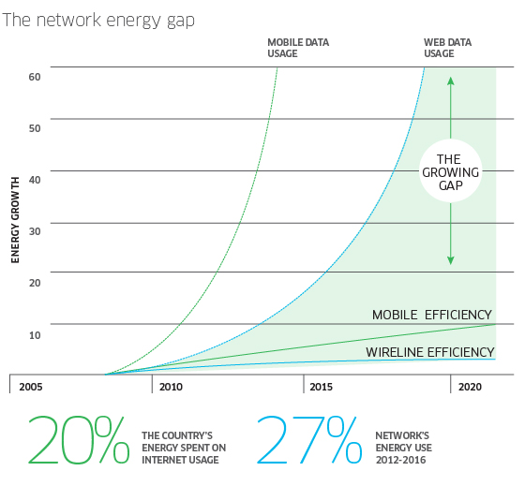
the ICT Sustainability Conundrum
ICT consumed 6% of global energy in 2013, at approximately 108.4 Gigawatts;
As of 2013, worldwide telecommunications networks consumed approximately 69 gigawatts (1GW is the typical capacity of 1 nuclear power plant), the equivalent of 12 New York cities;
Energy costs account for 10-15% of the total network operating expenses (OPEX) and can reach up to 50% in developing markets with a high number of off-grid sites, or where only a poor quality electricity grid is available;
Smartphones and tablets will drive mobile traffic to grow up to 89 times by 2020 from 2010, causing energy use to grow exponentially.

Slide 3
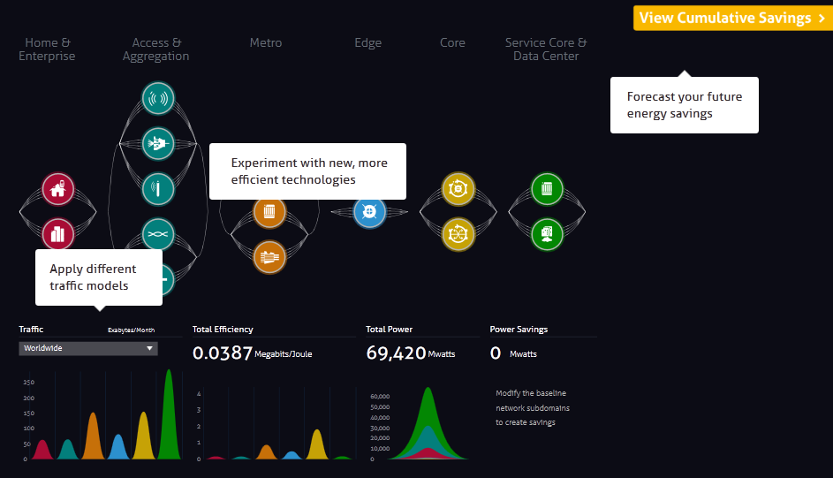
NETWORK ENERGY CHALLENGES AND SOLUTIONS gwatt - a mind sharing internet application
GWATT Key Features
NETWORK DOMAINS
FORECAST YOUR FUTURE
ENERGY SAVING
An interactive application
to visualize new technology impact and relative benefits on network energy consumption
Forecasts trends in energy cost, consumption and carbon footprint
For network operators, architects, engineers and commercial decision makers
EXPERIMENT WITH NEW, MORE EFFICIENT TECHNOLOGIES
APPLY DIFFERENT TRAFFIC MODELS
RELATIVE ENERGY EFFICIENCIES
BREAKDOWN OF POWER CONSUMPTION
alcatel-lucent.com/bell-labs/GWATT
POWER SAVINGS RELATIVE
TO BASELINE

Slide 4

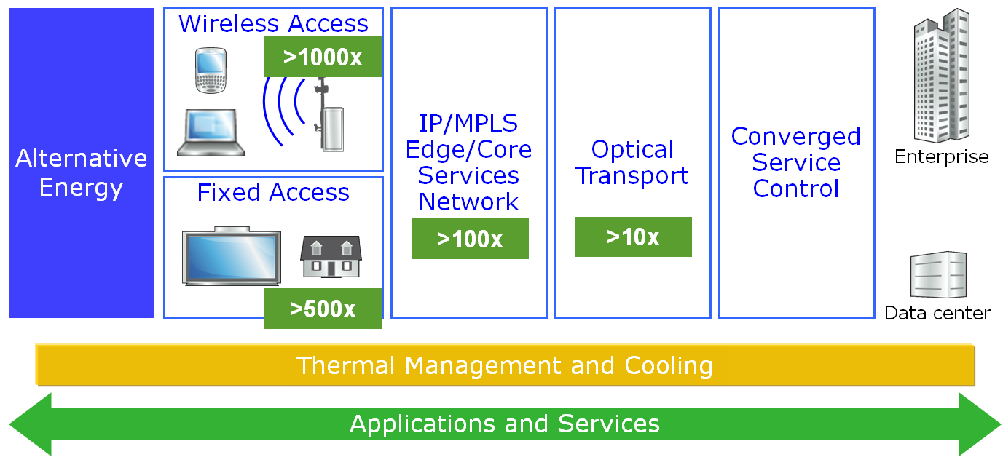
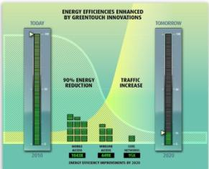
RESEARCH AND TECHNOLOGICAL INNOVATION
GREENTOUCH FOR ECO-SUSTAINABILITY AND ENERGY EFFICIENCY
SIGNIFICANT IMPACT FOR SERVICE PROVIDERS
PORTFOLIO OF TECHNOLOGY ASSETS FOR FUTURE NETWORKS
48 MEMBERS and 350+ SCIENTISIS
RAISING BAR FOR ICT INDUSTRY ON ENERGY INNOVATION
2013 PROGRESS & RESULTS
90% REDUCTION IN NETWORK ENERGY CONSUMPTION POSSIBLE WITH 2020 TRAFFIC GROWTH ACCORDING TO GREENTOUCH CONSORTIUM LATEST STUDY
greentouch.org

Slide 5
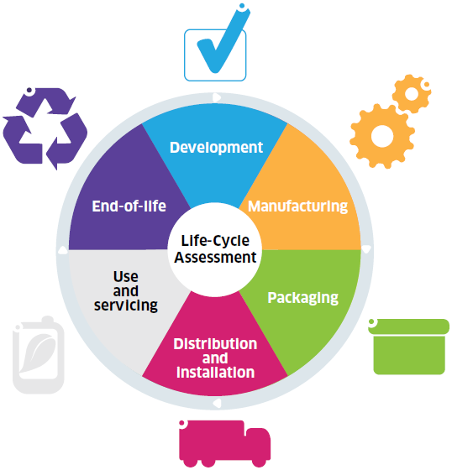
ALCATEL-LUCENT ORGANIZATION & BEHAVIOR INNOVATION
HOLISTIC LIFECYCLE APPROACH FOR ECO-SUSTAINABLE NETWORKS
Take-Back / Recycling /
Reuse
Design for Environment
Network
Optimization
Product
Stewardship
Alternative
Energies
Smart
Manufacturing
Energy
Efficient
Operation
Eco
Packaging
Efficient Transport
Notes:
5
Alcatel-Lucent applies a full lifecycle approach to eco-sustainability.
(Clic1) We design products using a life cycle assessment approach to help us better understand the environmental impact at each product stage. This way, we continually improve design, material selection and operating characteristics, such as energy efficiency and alternative energy sources.
We:
Ensure our products comply with environmental regulations and standards,
Avoid and substitute materials of concern with more eco-friendly materials,
Source our materials from environmentally and socially responsible suppliers, and
Apply strict Environment, Health & Safety (EH&S) processes throughout.
(Clic2) Minimizing hazardous substances in the design process and manufacturing is not only good for the environment, it also makes it easier for products to be remanufactured or recycled at end-of-life in an environmentally-appropriate way.
We provide our customers with eco-declarations, a summary of the environmental characteristics of our product portfolio.
In many countries, we collect competitors’ end-of-life equipment, as well as our own, through a comprehensive product take-back program which helps minimize waste and maximize reuse.

Slide 6
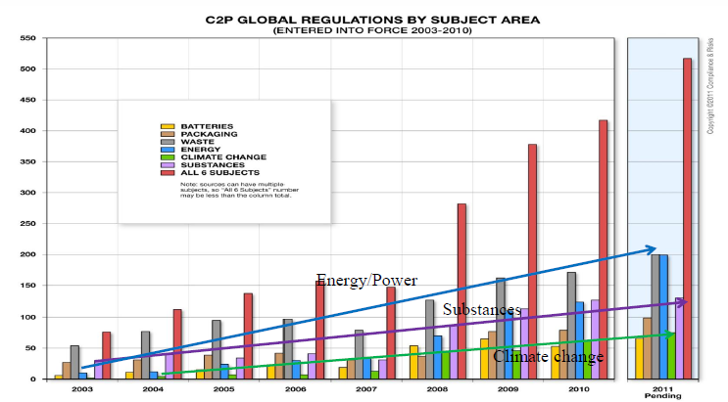
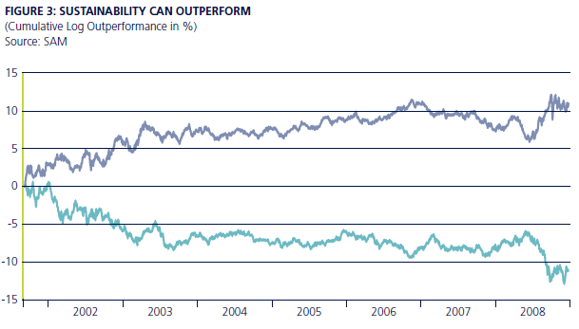

Life Cycle Assessment
Drivers and challenges
Why do we perform eco-impact life cycle assessments (LCA)?
  Customers, analysts, legislators and NGOs want it
  Gauge progress, measure impacts / benefits, assess eco-opportunities
But…
  Eco-impact LCAs are complex and data / time intensive
  LCA data gaps and method inconsistencies needed to be addressed
Regulatory
Actions
SAM: “Alpha from Sustainability”
Alcatel-Lucent tackled these challenges and defined an industry leading approach to LCA
Notes:
Eco-opportunities → e.g. supply chain improvements, transport optimization, energy efficiency in product usage, end-of-life treatment options

Slide 7
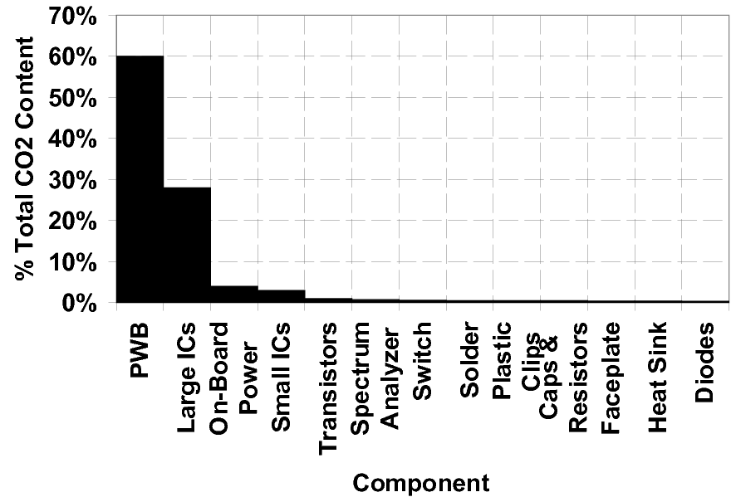


ALCATEL-LUCENT’S ECO-IMPACT ESTIMATION METHODOLOGY
Each component category has its eco-impact contribution characterized by its key materials and manufacturing processes
Typically yields the largest eco-impact
Bell Labs pioneered the technique of LCA estimation by component categorization*
*Estimating the carbon footprint of telecommunications products: a heuristic approach. Published in the Journal of Mechanical Design, September 2010, Vol. 132 / 094502-1

Slide 8
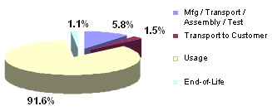
Alcatel-Lucent LCA ESTIMATOR
Carbon footprint estimation for new products
Full Life Cycle Stage Estimation
(Example - % of Total eco-impact)

Slide 9




LCA - LEADERSHIP & INDUSTRY STANDARDS DEVELOPMENT
Alcatel-Lucent leadership and partnering activities
Leadership within ICT sector guidance development
Co-author – Telecom Network Services LCA Methodology section
Joint development of L.1410 – LCA methodology for ICT goods, networks and services
Partnered in the eco-assessment pilot of a service provider’s broadband service
Results helped shape EC’s current initiative for developing Product Environmental Footprint Categorical Rules (PEFCR)

Slide 10
Alcatel-Lucent Materials Management
Materials efficiency and selection
    Materials efficient product designs
      Increasing functionality (e.g., more capacity, service, performance) per unit of electricity consumed
      Occupying less physical space, weighing less and using fewer types of materials
        Example:
      7750 SR - delivers faster service while using 50% less power and reduced cooling needs; and takes up 30% less space → meaning fewer components and raw materials used*
    Improved materials selection
      Optimal materials selection during the design phase delivers increased efficiency in material usage while offsetting other materials/ energy needs and their eco-impacts
        Example:
      Aluminum (~65% recycled content) employed in lieu of painted steel (~30% recycled content) for a product chassis / cabinet
        Reduces raw materials extraction needs (due to higher recycled materials content)
        Produces a light-weight product that uses less energy in shipping, installation and end-of-life treatment
        Needs fewer materials for corrosion and finish protection
* than other / previous generation products

Slide 11
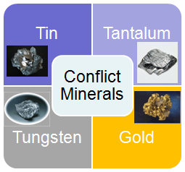
Alcatel-Lucent Materials Management
Conflict minerals traceability
The issue: mining of minerals financing armed groups resulting in extreme violence and human rights violations in some regions
  These minerals may become part of products after being smelted
  The US law requires companies to report on their efforts to track the origin of the metals used
Alcatel-Lucent conflict minerals program:
  Conflict Minerals Policy highlighting our commitment
  Cooperation with industry associations to:
    develop traceability tools
    Engage the upstream supply chain (smelters)
  Identification of impacted commodities and suppliers
  Survey suppliers on conflict minerals and drive traceability improvements
  Establish Alcatel-Lucent’s conflict minerals status
  Provide Alcatel-Lucent conflict minerals information to customers and authorities
  Offer stakeholders opportunities to review data and provide comments

Slide 12
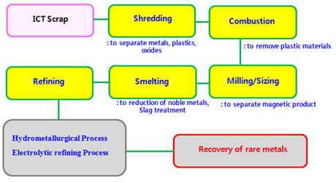
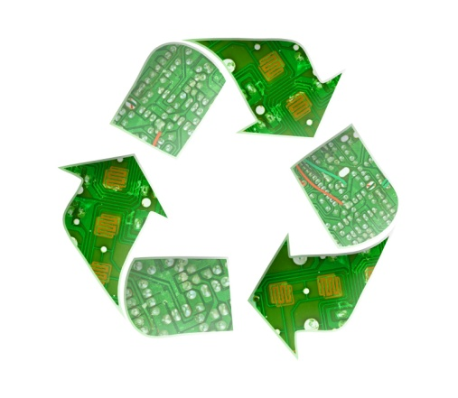
Alcatel-Lucent Materials Management
Recyclability / end-of-life management
Alcatel-Lucent offers a complete take-back and recycling program for its customers and any telecommunications products that reach end-of-life
  Very high recycling /reuse rate (97%) for EoL processed products /materials
    7463 tonnes of electronic wastes handled in 2013
    90% processed via approved global recyclers
    7% remanufactured / resold / reused
    1% treated via incineration
    < 2% disposed via secure landfill
Working with our approved recyclers to achieve more efficient recycling and with increased strategic materials recovery – especially precious / semi-precious metals, rare / rare earth metals

Slide 13

Responsible Business Innovation
OUR COMMITMENTS ECO-SUSTAINABILITY
Developing eco-sustainable networks
Innovative products, services and solutions that implement energy efficiency criteria to ensure eco-responsible end-to-end networks and enhanced network performance
Holistic lifecycle approach (from design to end of life, materials management, packaging)
Bell Labs Research, involving worldwide +50 scientists and collaborations with other companies, research institutes & universities
Breakthrough energy efficient solutions: Photonic Service Switch, Extensible Routing System, lightRadio
Reducing our carbon footprint
LEAD
RESPONSIBLE BUSINESS
INNOVATION
Carbon emissions tracking & reporting : 3 phase plan to reduce our footprint by 50% by 2020
Living our best practices : electricity consumption, tele-working and commuting
Managing resources: reducing paper and water use, emissions, discharges and waste
Raising employee awareness
Leading the telecoms industry
GreenTouch is a Bell Labs initiated Global Research Consortium creating a technology roadmap to make telecoms networks up to 1,000 times more energy efficient
Over 48 member organizations with 350+ leading scientists
Leading Green ICT cooperation with other organizations such as GeSI, ITU-T, GreenGrid, Carbon Trust, ITRS
Recognized by World Economic Forum as an industry-led best practice toward sustainability

Slide 14
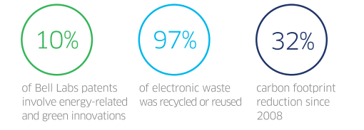
ECO-SUSTAINABILITY
2013 KEY PERFORMANCE HIGHLIGHTS
Our Bell Labs Research programs focus on dramatically improving end-to-end network energy efficiency and high energy and power consumption challenges
We maintain high product stewardship and factor eco-impact of our products through full life cycle from design to end of life reuse and recycling
Since 2008, we have reduced the carbon footprint associated with our operations by 32% — more than 267,000 metric tons of CO2 equivalents — slightly more than halfway to our ultimate goal of 50%.
alcatel-lucent.com/sustainability/environment

Slide 15
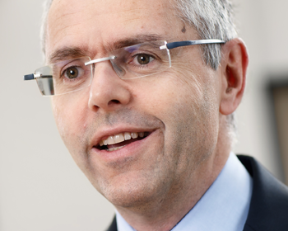



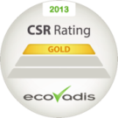





Responsible Business innovation: Raising the bar
“MY AMBITION IS FOR ALCATEL-LUCENT
TO BE THE RECOGNIZED LEADER IN SUSTAINABILITY AND RESPONSIBLE BUSINESS INNOVATION FOR THE TECHNOLOGY INDUSTRY.”
MICHEL COMBES,
ALCATEL-LUCENT CEO
    Learn more: www.alcatel-lucent.com/sustainability
    Video: https://www.youtube.com/watch?v=MSsnwe41R9c
    Read our Report: www.alcatel-lucent.com/sustainability
    Tweet @Alcatel_Lucent
    Contact us: sustainability@alcatel-lucent.com

