Slide 1
Patent Landscape Report on
E-Waste Recycling Technologies – Key findings and focus on Asia
Beijing
23 September 2014
Irene Kitsara, Project Officer
Patent Information Section, Access to Information and Knowledge Division

Slide 2
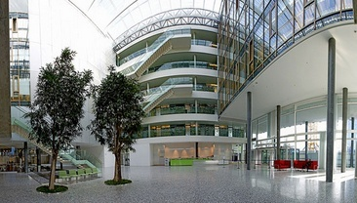
The World Intellectual Property Organization (WIPO)
Specialized UN Agency with 187 Member States
Based in Geneva, Switzerland
Global forum for intellectual property services, policy, information and cooperation.
www.wipo.int

Slide 3
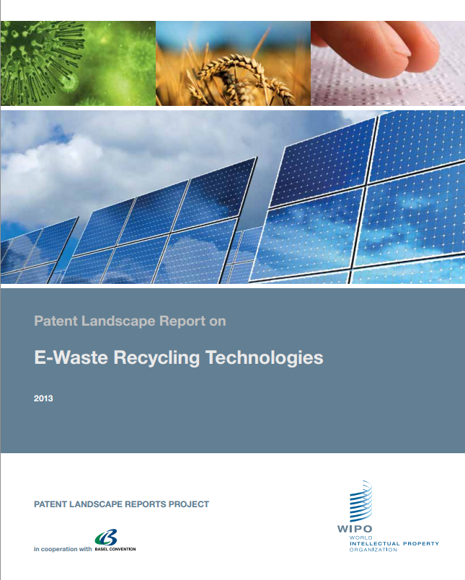
E-Waste Recycling and Intellectual Property Rights (IPR)
Fact: Innovation and IP protection are directly linked to the development of new ICT Technologies and Equipment
Question: What is the role of technology, innovation and IP in E-waste management?
WIPO Patent Landscape Report looks into the IP aspect of E-Waste Recycling

Slide 4
A. The ICT industry’s perspective
Prioritization of R&D areas and investment
Acquisition of IPR – which ones and where?
Collaborations
Commercialization of the product/process
Patent Portfolio Management (patents to keep/abandon/sell/license)
IP acquisition
Business name/
Trademarks/
Domain names
Patents/Designs/
Trade Secrets
Products/
Processes
IP exploitation/
Commercialization/
Technology transfer/
Amortization
of investment/Profit
Research/
Innovation

Slide 5
B.The policy maker/regulator perspective
ICT/Environmental/E-waste/Trade Policy: complex cross- sectoral effort, involving many aspects:
Policy/prioritization issues and intersection with other policy areas (Public Health, Environment…)
Regulatory framework and related obligations
Relevant market definition and analysis, competition
Economic/financial aspect
Risk assessment (environment, economy, health….)

Slide 6
The Quest for Information
Informed decisions: do you have all pieces of the puzzle???
IP perspective – often overlooked, but important:
Identifies technical solutions to technical problems
Facilitates environmental sound management of related environmental challenges
Tool for supporting policy discussions and decisions
Patents: intangible assets. Increasingly, technologies addressed through patents form a market with enormous economic and trade national potential
Equally, offer information and increase national potential for research, technology transfer, local manufacturing and trade collaborations

Slide 7
Principles of patent protection
Patent is the exclusive right granted for an invention (product or process) that provides a new way of doing something, or offers a new technical solution to a problem
Patentability criteria: novelty, inventive step, industrial applicability
Patent excludes others from exploiting the invention without the consent of its owner
20 years protection on average
Territoriality of the protection: the patent owner is only protected in the countries where protection was sought
Disclosure in exchange to exclusivity: related information on how the invention works included in patent documents
Information published – available to public
Public domain: feel free to copy!

Slide 8
Primary and Secondary Depositories of Patent Information
Primary sources of patent information:
National (Patent) Gazettes, Publications (patent applications/granted patents), National Patent Registries
Patent Registries in some jurisdictions accessible/searchable online
Secondary sources → Patent Databases
Free of charge vs. fee-based
National/regional patent offices vs. Commercial databases
Free of charge: WIPO , EPO ,
Google Patents (US patents)
SIPO Patent Search JPO
Fee-based:
TR , LexisNexis ,
Orbit

Slide 9
WIPO PLR Project Framework
Challenge: Access to and utilization of the relevant patent information
WIPO Patent Landscape Reports (PLR):
Development Agenda Project « Developing Tools for Access to Patent Information » launched in 2010 (mainstreamed as of 2014) to lessen the knowledge divide and contribute to economic development and growth of developing countries
Expected output: preparation of Patent Landscape Reports in the areas of public health, food and agriculture, climate change & energy, and disabilities

Slide 10
Further related WIPO services and tools
Access to Research for Development and Innovation - www.wipo.int/ardi
~20,000 journals, books, and reference works for 117 developing countries at no cost or at nominal price
Access to Specialized Patent Information - www.wipo.int/aspi
Access to commercial patent databases (PPP)
Technology and Innovation Support Centers (TISC) – www.wipo.int/tisc
E-Tutorial on Using and Exploiting Patent Information http://www.wipo.int/tisc/en/etutorial.html
Capacity Building (patent information, licensing, technology transfer, negotiation for policy makers etc)
Guide on Negotiating Technology Licensing Agreements
(also in Chinese) available

Slide 11
Patent Landscape Reports
Standardized practice in industry for decision-making (Business Intelligence/Strategy, Competitive Intelligence, IP Analytics, IP Management teams)
Patent based search and analysis of various areas of technology providing information about patterns of patenting activity (who is doing what? what is filed where?) or patterns of innovation (innovation trends, diverse solutions for a technical problem, collaborations)
Results presented in structured and friendly for policy and decision makers not experts in IP/subject matter (graphs and visualizations)

Slide 12
Collaboration with the Basel Convention Secretariat:
Basel Convention Partnership Programme: active involvement of industry, business organizations, NGOs necessary to reach Basel Convention goals
In the MPPI and PACE framework, 2 Technical Guidelines:
Guideline on Material Recovery and Recycling of End-of-Life Mobile Phones (MPPI)
Guideline on Environmentally Sound Material Recovery and Recycling of End-of-Life Computing Equipment (PACE)
Objective of the PLR: provide IP Perspective of the topic and complement the Guidelines

Slide 13
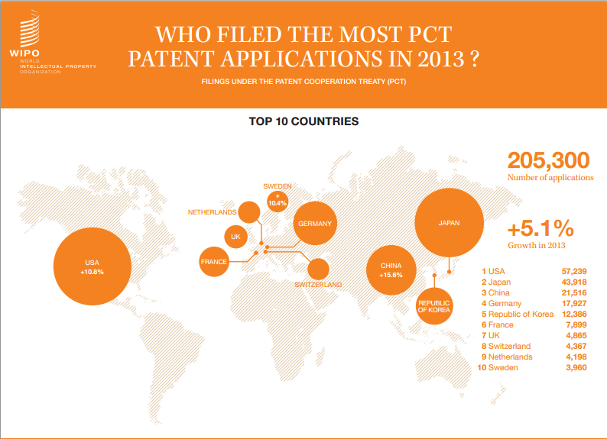
Patenting Trends in 2013

Slide 14
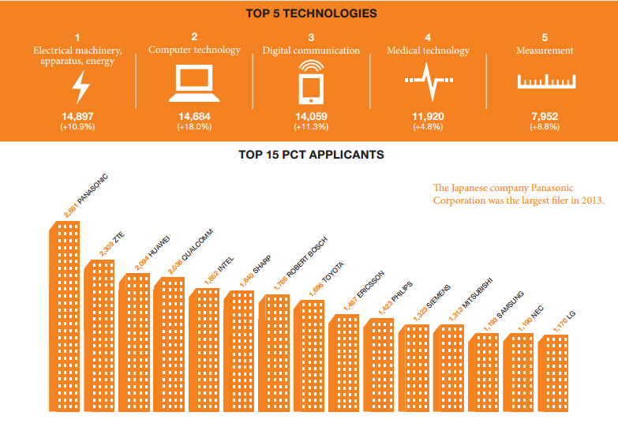
Top PCT patent applicants and technologies in 2013

Slide 15
Key findings of the E-Waste Patent Landscape Report
General trend: Rapidly growing interest in E-Waste Recycling Technologies:
Nearly 9000 identified patent families
30% of the patenting activity: last 5 years of the report’s timeframe
Number of patent families over time

Slide 16
Geographical distribution of e-waste recycling technologies patent protection: an Asian affair
Overall number of patent families per major office of first filing since 1980

Slide 17
E-waste recycling innovation: Asian dominance and evolution over the last years
Emergence of China and South Korea (23% and 19% compound annual growth rate, respectively)
Plateau of Japan
Other OFF:
Latin America represented only by Brazil (26 patent applications in the dataset) and Mexico (4)
Africa represented by South Africa (4 applications)

Slide 18
Subsequent patent filings – a strategic choice
Patent filing in each jurisdiction: additional costs
Filing in multiple jurisdictions: investment and indication of interest in certain areas/markets
Trends:
France and UK: most extroverted patenting behaviour
Asian countries: mainly patent only locally (foremost China)
Average family size per Office of First Filing (OFF)

Slide 19
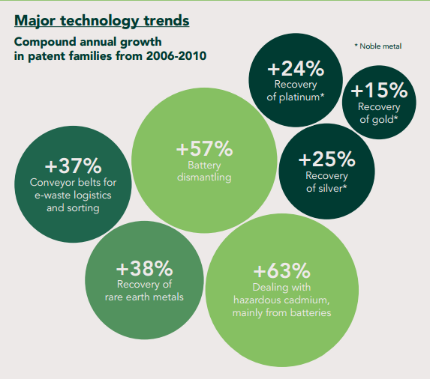
Technology trends in E-Waste Recycling
Categories with >100 Patent Families; Annual Growth 2006 to 2010

Slide 20
Emerging trends reflecting market needs and regulatory frameworks
Clear trend: increased interest in rare earth (neodymium, lanthanum etc) and noble metals material (gold, silver*, platinum) recovery
Rare earth scarcity (90% of primary rare earth extraction in CN)
* Particular interest in silver, maybe due to EU solder regulations banning the use of lead
Compound Annual Growth or Decline between 2006 and 2010 by Subject Matter

Slide 21
Areas of special interest by country
CN focus: mainly on component level. Indication that once arriving in CN, E-waste already dismantled
US focus: rare earth extraction. US in this field top applicant
Taiwan, Province of China: decontamination of e-waste
Russia: extraction of non-ferrous (lead, copper and nickel)
UK: dissassembly

Slide 22
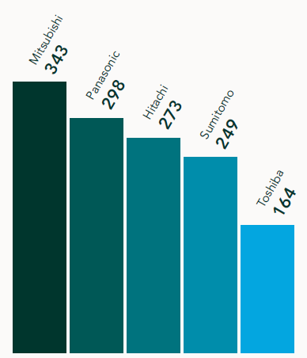
Key players in E-Waste patenting activity
Top applicants from Asia Pacific
Top applicants with filings in at least 5 jurisdictions
* The report includes business data about key players with largest portfolios

Slide 23
Areas of interest of key players from the ASPAC Region
- Plastic seems to be the area of major concern of JP electronic consumer goods in e-waste

Slide 24
Research and academia’s share in patenting activity:
Research & academia: 9% of the patenting activity
Recent growth rate: faster than commercial entities
Top 30 research and academia institutes: based in Asia
Largest patent portfolio entity: Japanese AIST
Chinese public institutions’activity: most rapidly growing (CN Utility model)
Korean KIGAM Institute of Geoscience and Minerals activity: shows importance of material and mineral recovery
First Non-Asian entitities: German Fraunhofer and French CNRS

Slide 25
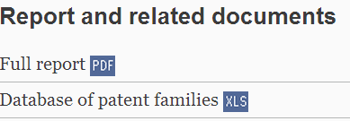
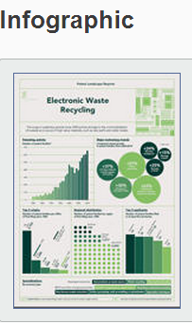
Dedicated Patent Landscape Report website
http://www.wipo.int/patentscope/en/programs/patent_landscapes/reports/ewaste.html

Slide 26
Additional data to the report – the related patent dataset (.xls)
Hyperlinks to the full patent documents of the search results
Information on profile of patent applicant, geographical distribution of patent protection and existance of a patent grant

Slide 27
Additional data to the report – the related patent dataset (.xls)
Document classification by Processes, Products/Items and Recovered Materials involved
Information can be sorted by criteria of interest

Slide 28
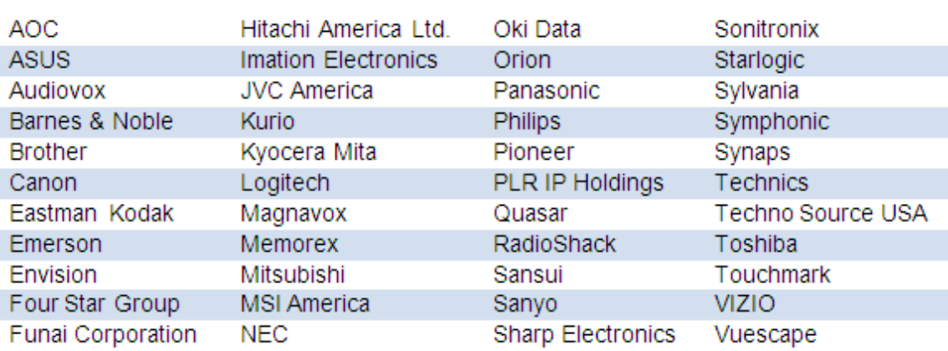
Annex A: Business data for major patent portfolios
Information on interests, approach, practices and initiatives of main patent applicants of e-waste recycling technologies
Example: Electronic Manufacturers Recycling Management Company, LLC, (MRM) to foster the efficient management of recycling over 35 companies. In 2009: national recycling infrastructure

Slide 29
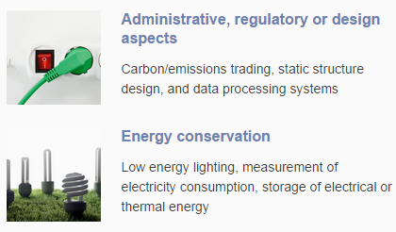
WIPO Green – get involved! www.wipo.int/green
WIPO GREEN:an interactive marketplace for green technology providers and seekers of innovative solutions to combat environmental challenges.
2 Components:
Database: search for green technologies and needs
Network: identify experts and cooperation partners
Register, upload your technology or need, or search for cooperation partners, experts and solutions

Slide 30
Thank you! Feedback, questions, suggestions? Irene.Kitsara@wipo.int http://www.wipo.int/patentscope/en/programs/patent_landscapes/index.html

