Slide 1



World Ocean Council
Smart Ocean / Smart Industries:
Industry Leadership & Collaboration
In Data Collection and Sharing
International, Cross-Sectoral Business Leadership Alliance
Paul Holthus
CEO
World Ocean Council
paul.holthus@oceancouncil.org
The international business alliance
for “Corporate Ocean Responsibility”

Slide 2
World Ocean Council
International, Cross-Sectoral Business Leadership Alliance
Bringing ocean industries together, e.g. shipping, oil/gas, fisheries, aquaculture, tourism, offshore renewables, etc.
Catalyzing leadership and collaboration in addressing ocean sustainability - “Corporate Ocean Responsibility”
Goal A healthy and productive global ocean and its sustainable use, development and stewardship by a responsible ocean business community
Creating business value for responsible companies
Access and social license for responsible ocean use
Synergies and economies of scale in addressing issues
Stability and predictability in ocean operations

Slide 3
World Ocean Council: Members
Almi Tankers S.A. | Global Trust Certification | Ocean Nourishment
A.P. Moller-Maersk A/S | Golder Associates | Ocean Peace Inc.
Arctic Fibre | Guangxi Penshibao Co., Ltd | OceanNetworks Canada
Baird Publications | Heidmar, Inc. | OneOcean
Battelle Memorial Institute | Hepburn Biocare | PanGeo Subsea
Beveridge & Diamond, P.C. | Holman Fenwick Willan LLP | Powerboat P1
BigBlueStuff | Hull Surface Treatment | RightShip
Birds Eye – Igloo | Hydrex | Rio Tinto
Blank Rome | Intl Chamber of Shipping (ICS) | Royal Greenland A/S
BP | Intl Tankers Owners Pollution Fed. (ITOPF) | Sanford Limited
Cape Breton University | JASCO Applied Sciences | Shell
Cape Cod Commercial Hook Fishermen’s Assn. | L3 MariPro | Shipping HK Forum Ltd
Caris USA Inc. | Lloyds Register | Sinclair Knight Merz
China Navigation Company/Swire Pacific Offshore | Louisbourg Seafoods | Southall Env’tal Assoc (SEA)
CSA Ocean Sciences Inc. | M3 Marine (Offshore Brokers) Pte Ltd | SubCtech
Det Norske Veritas (DNV) | Manson Oceanographic | Tai Chong Cheang (TCC) Steamship Co HK
EcoStrategic Consultants | Marinexplore | Teck Resources
EDP Renewables | Marine Acoustics, Inc. | TierraMar Consulting
Eniram | Mitsubishi Heavy Industries | TOTAL
ESRI | Nautilus Minerals, Inc. | Total Marine Solutions
Executive MBA in Shipping/Logistics | Noble Group Limited | Twin Dolphins
ExxonMobil | N America Marine Env’t Protection Assn. | Univ. Texas Marine Science Inst.
FOB |  | Zodiac Maritime

Slide 4
Priority Areas for Collaboration
1. Ocean Governance
  Convention on Biological Diversity (CBD); UNCLOS
2. Marine Spatial Planning (MSP)
  EU; US; Australia; international waters
3. Operational Environmental Issues
  Sound and Marine Life
  Biofouling and Marine Invasive Species
  Marine Mammal / Industry Interactions
4. Regional Ocean Business Councils
  Arctic; Trans-Atlantic; Mediterranean ; Arab Gulf; SE Asia
5. Smart Ocean / Smart Industries
  Observations and Data from Ships/Platforms of Opportunity
6. Sea Level Rise/Extreme Events
  Port/coastal infrastructure adaptation

Slide 5
1. Ocean Governance
Convention on Biological Diversity (CBD)
Ratified by 193 countries
Conference of Parties (COP) every 3-4 years
Conservation and sustainable use of species / ecosystems
Primary vehicle for marine conservation policy-making for EEZs and Areas Beyond National Jurisdiction (ABNJs)
COP 7 and 8 developed targets for conservation of at least 10% of each of the world’s marine / coastal ecoregions
COP 9, 10 and 11 approved and advanced work on
  Ecologically / Biologically Significant Areas (EBSAs)
  EIA for human activities in international waters

Slide 6
Ecologic./Biologic. Significant Areas
2007 Expert Workshop on Ecological Criteria and Classification - No industry presence
2008 COP 9 adopted scientific criteria for identifying EBSAs in need of protection and scientific guidance for selecting MPA network - No industry presence
2009 Expert Workshop on Scientific and Technical Guidance in Identification of Marine ABNJs in Need of Protection - WOC is only industry presence
2011 COP 10 decision to accelerate identification and protection of EBSAs in high seas - WOC is only industry presence
2011-12 CBD regional workshops to identify EBSAs using CBD criteria - No industry presence; many EBSAs proposed
2012 Preparatory Meetings/COP 11 - WOC presence; many EBSAs approved

Slide 7
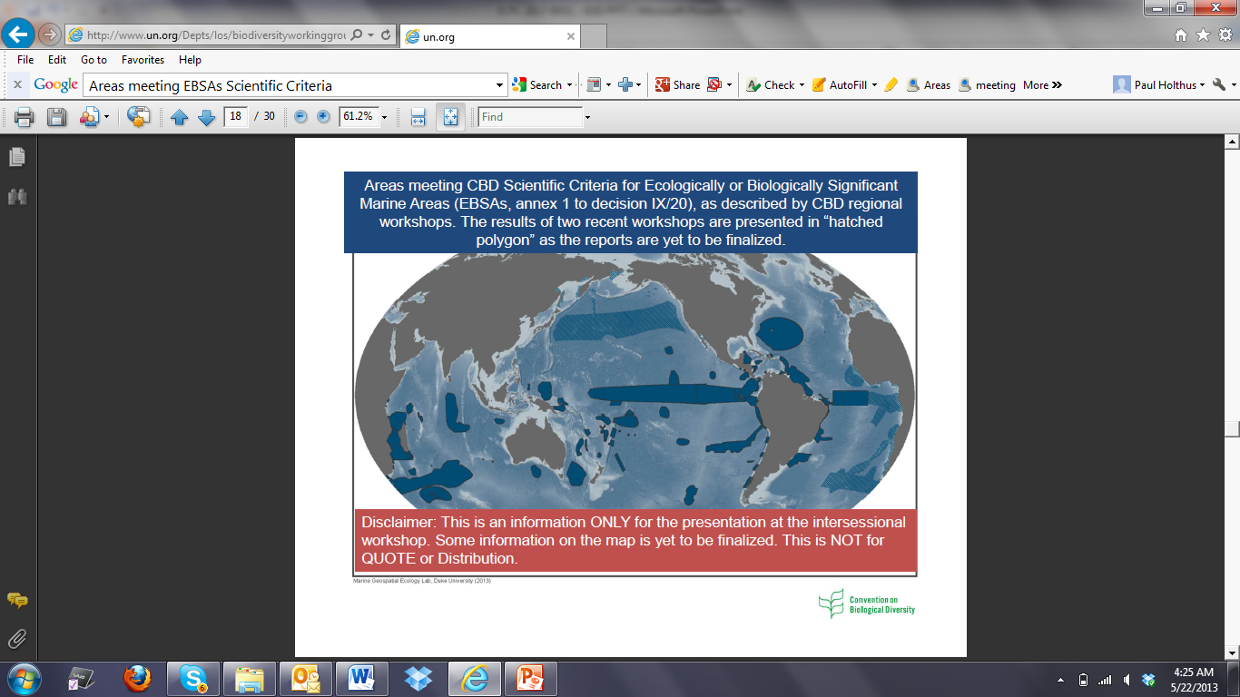
Ecologic./Biologic. Significant Areas
Areas meeting CBD criteria for EBSAs and proposed for
inclusion in EBSA register
e.g. Sargasso Sea
Alliance

Slide 8
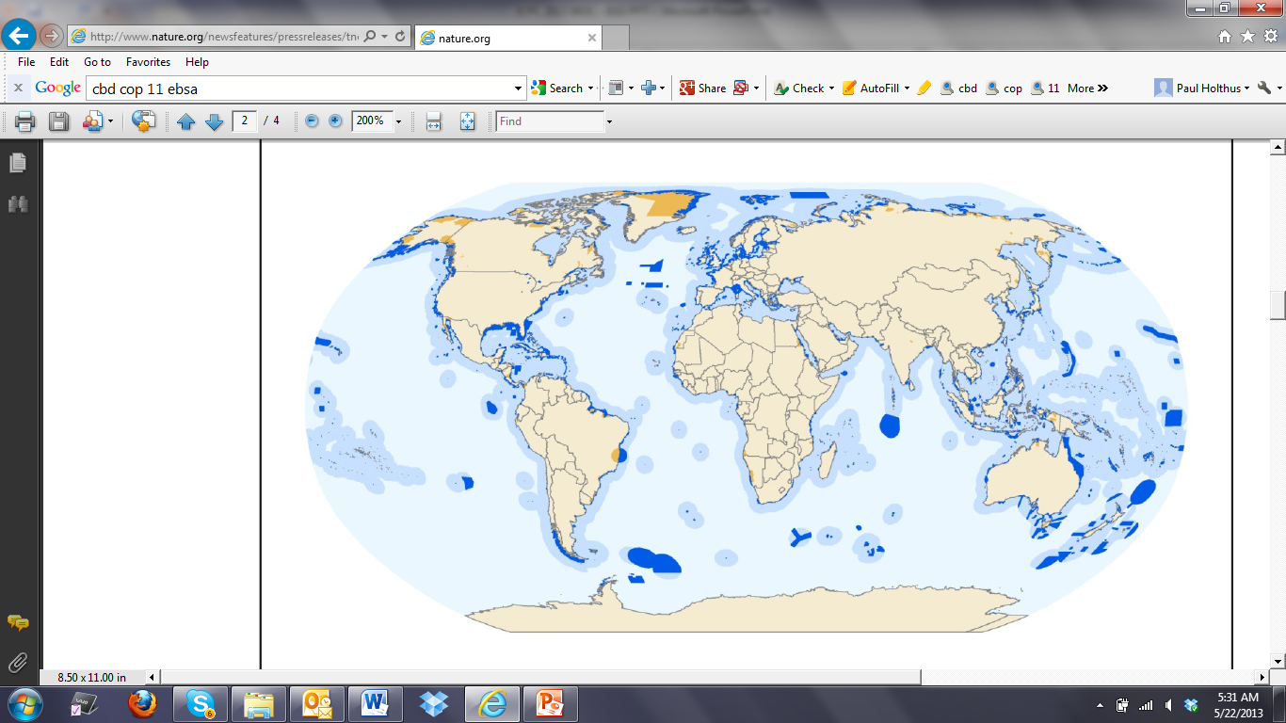
Marine Protected Areas
  The high seas/deep seabed ocean governance agenda is moving rapidly
  Significant implications for ocean industries
  Targets of 10-40% of marine environment for protection

Slide 9
EIA for Activities in Marine Areas
  Impacts of Human Activities on Marine/Coastal Biodiversity
Governments have developed guidelines for biodiversity in EIAs in marine and coastal areas to:
Minimize and mitigate the specific and cumulative negative impacts of human activities on biodiversity
Identify and assess threats to marine biological diversity
Stop the degradation and loss of important habitats
Prevent significant adverse effects by unsustainable human activities in marine and coastal areas
Support the maintenance of the conservation status of EBSAs and MPAs and avoid their degradation or destruction

Slide 10
CBD UNGA UNCLOS
UN General Assembly (UNGA) ad-hoc open-ended, informal Working Group on conservation/sustainable use of marine biodiversity in ABNJ (BBNJ)
Before the end of UN General Assembly 69th Session:
Urgently address conservation and sustainable use of BBNJ
Decide on the development of an international “implementing agreement” under UNCLOS to address:
  Establishing of MPAs
  Conducting of EIAs in ABNJ
  Ensuring access and benefit sharing of marine genetic resources
Consideration of:
  Identification and selection of conservation measures for EBSAs
  Regional groups identification of MPAs in ABNJ
  Activity types to be regulated; establishing enforcement measures

Slide 11
2. Marine Spatial Planning (MSP)
  Allows a more strategic, pro-active approach to planning
  Promotes rational use of marine space and resources and sustainable development of maritime regions
  Involves all stakeholders and maps their interests and uses
  Coordinates among sectors/users to achieve agreed upon goals and objectives
  Seeks to balance economic use and conservation
  Enables early identification of potential conflicts before considerable investment or damage has occurred
  Provides greater certainty in acceptable locations for different types of use
  Improves understanding and consideration of the cumulative effects of different activities

Slide 12
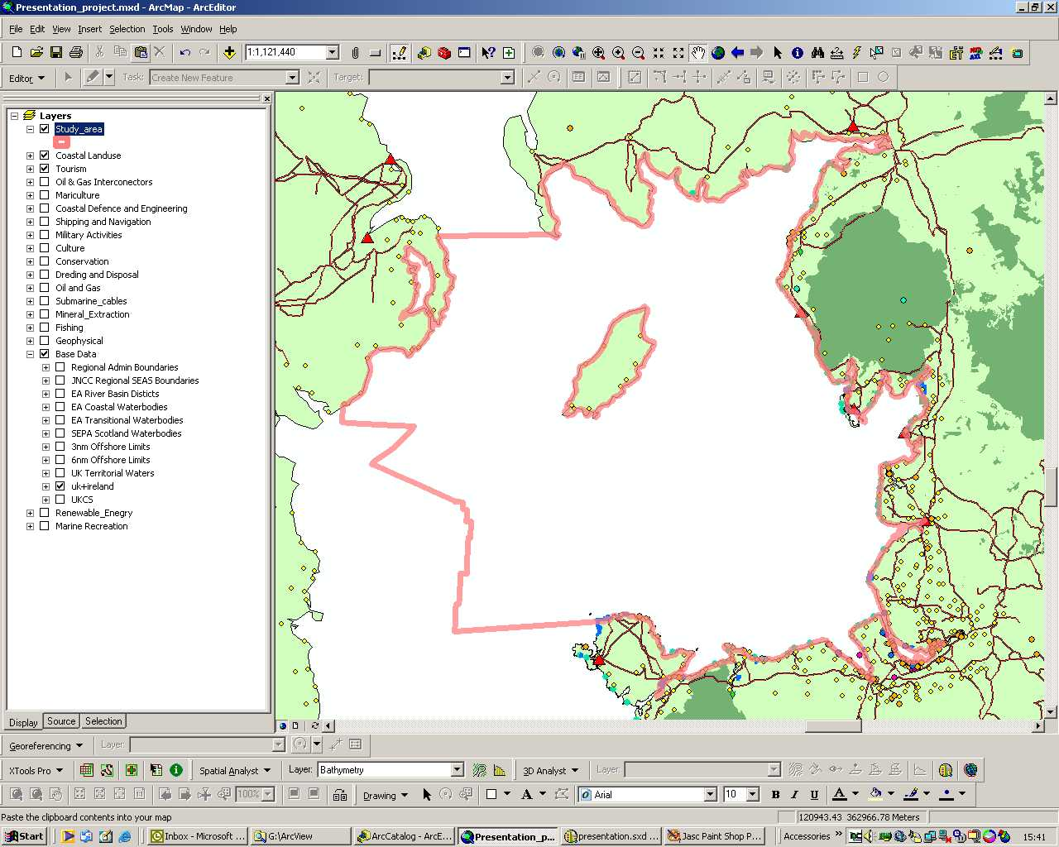
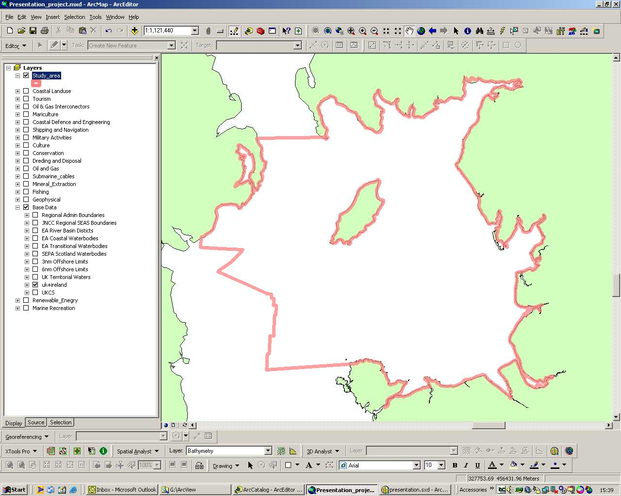
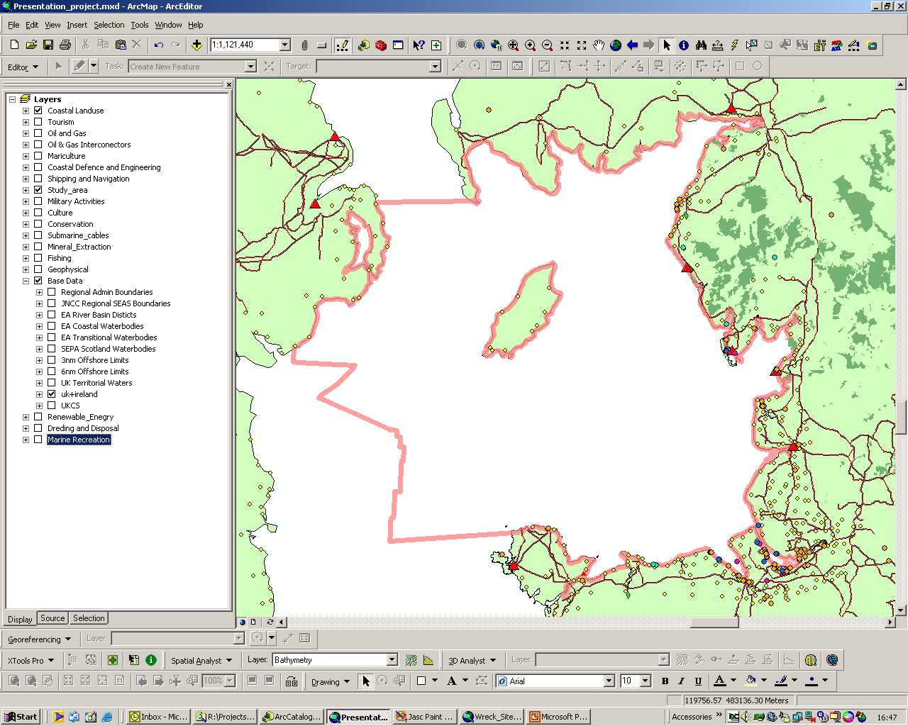
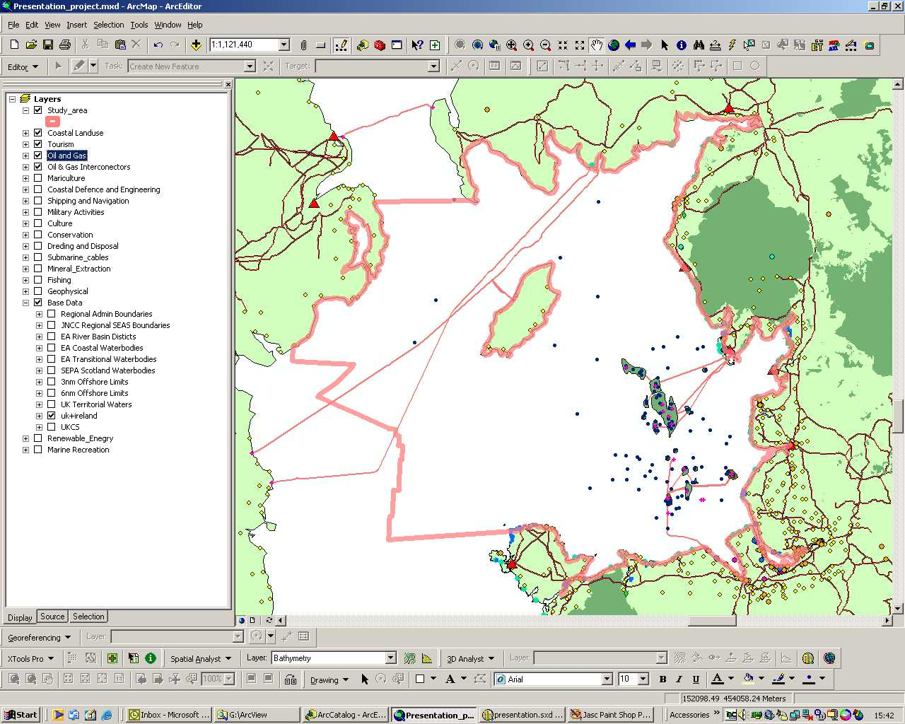

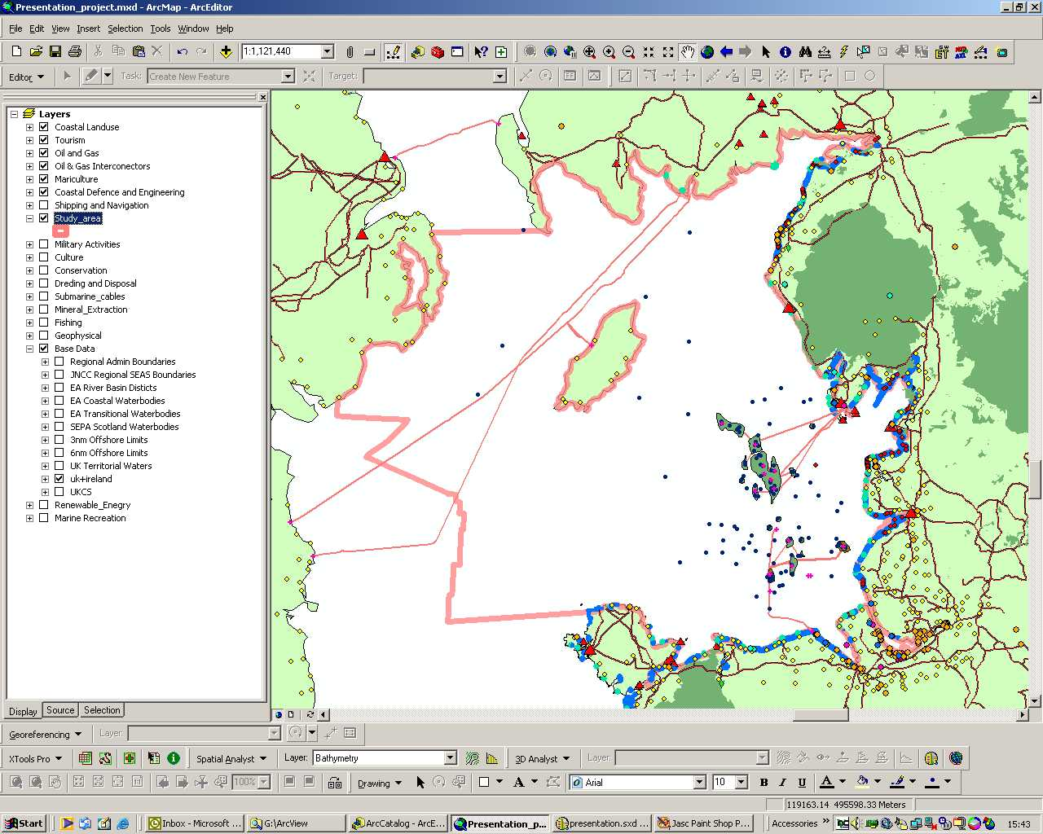
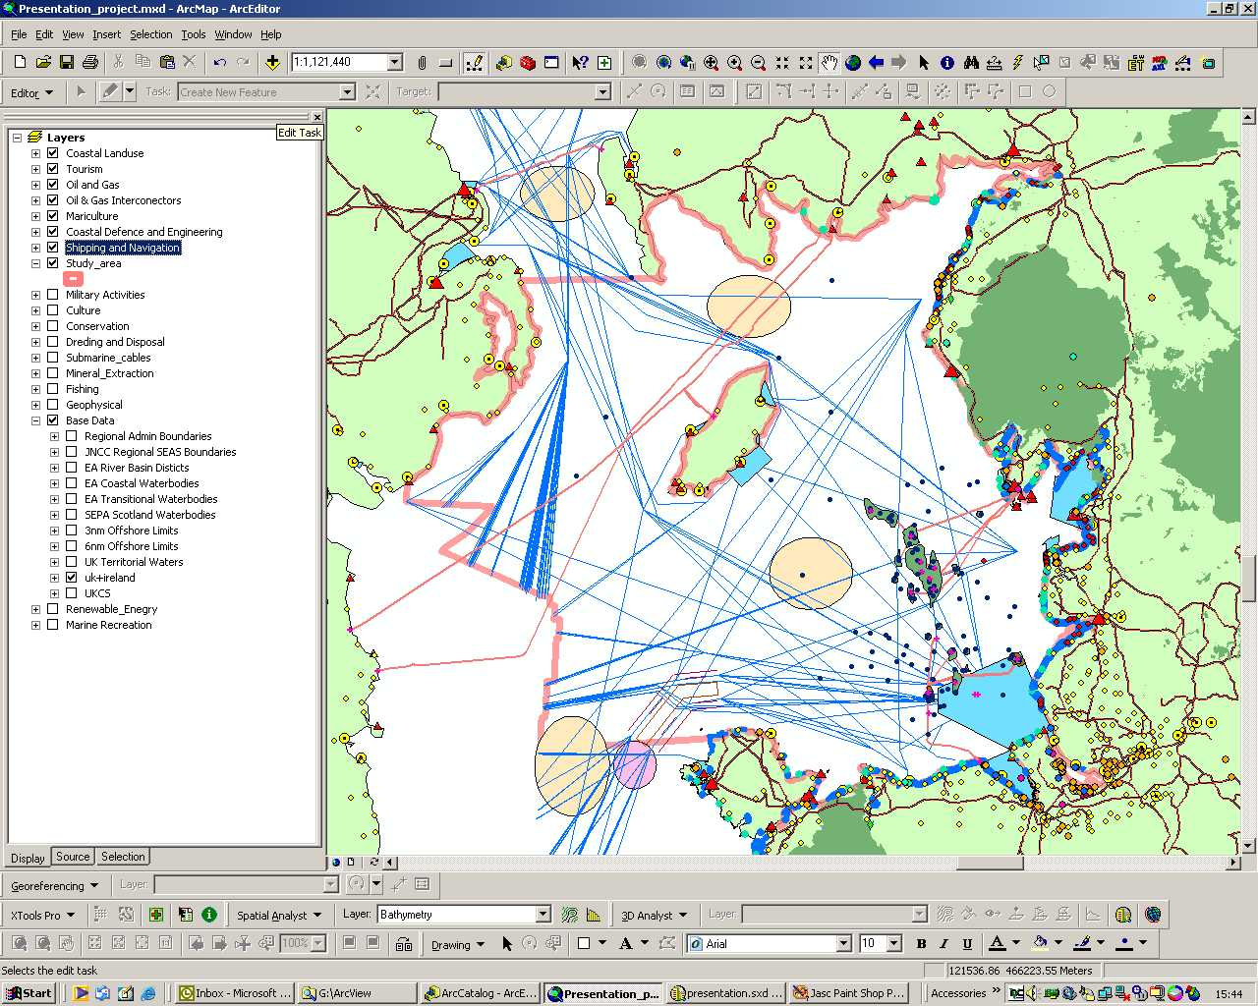
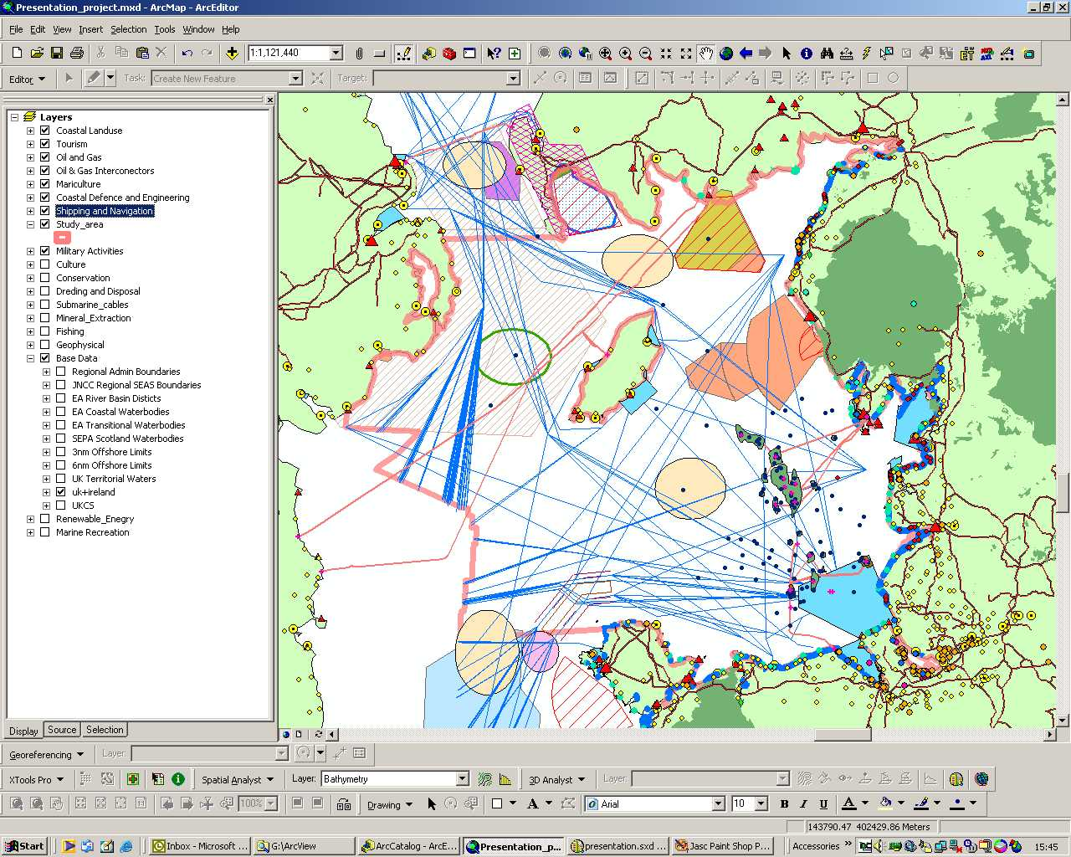
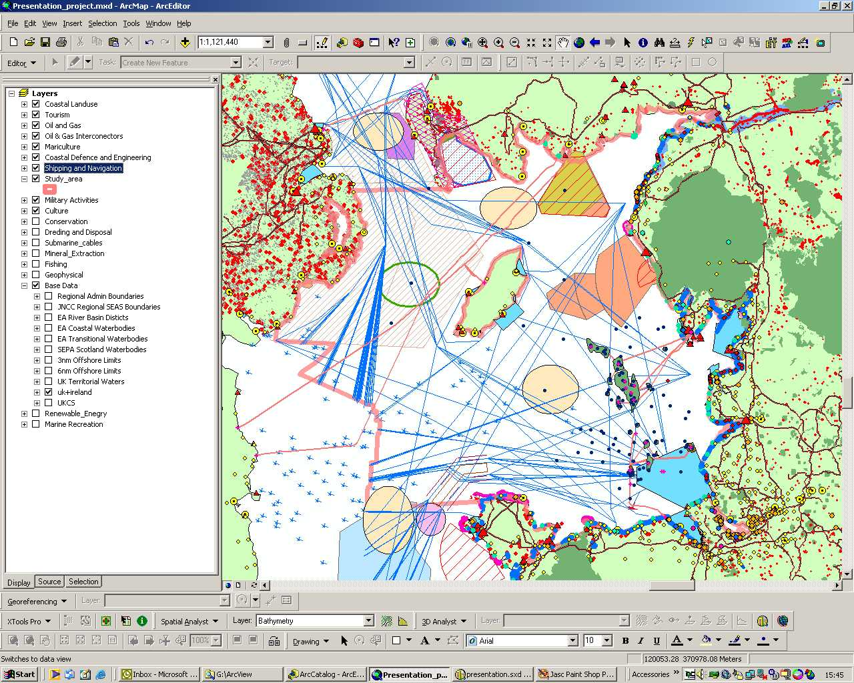
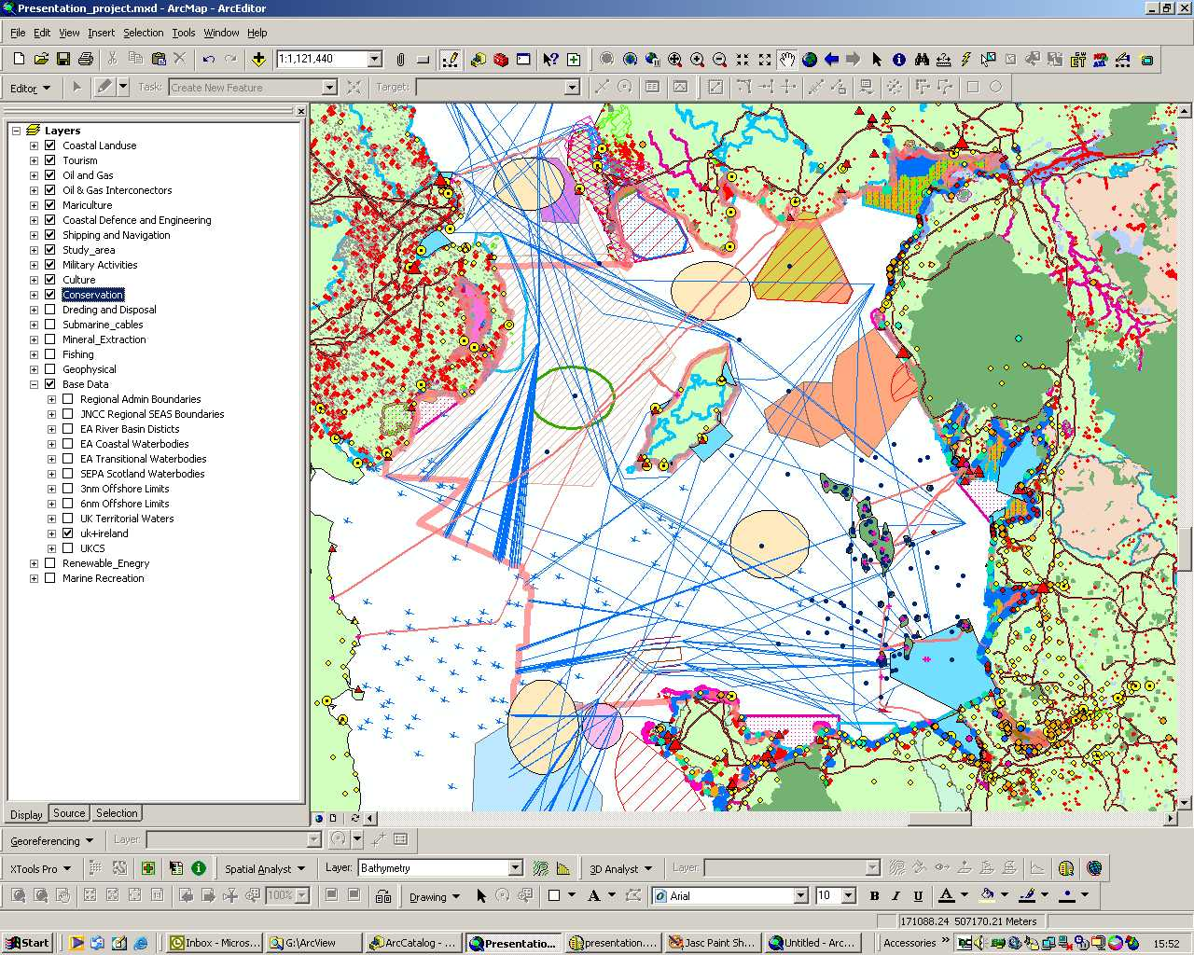
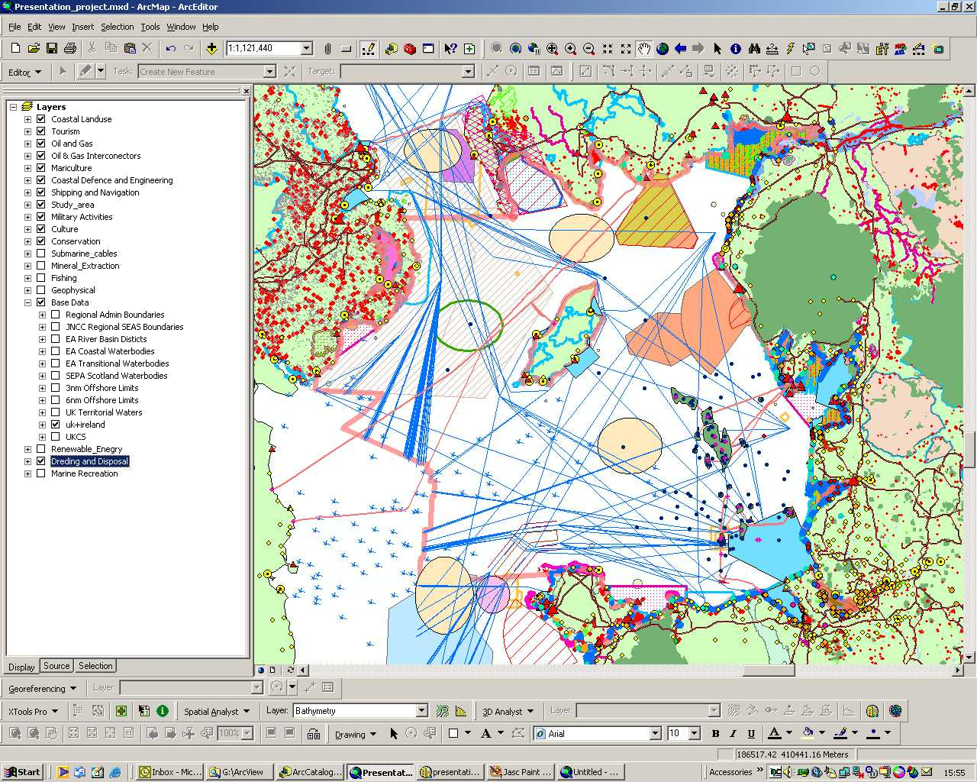
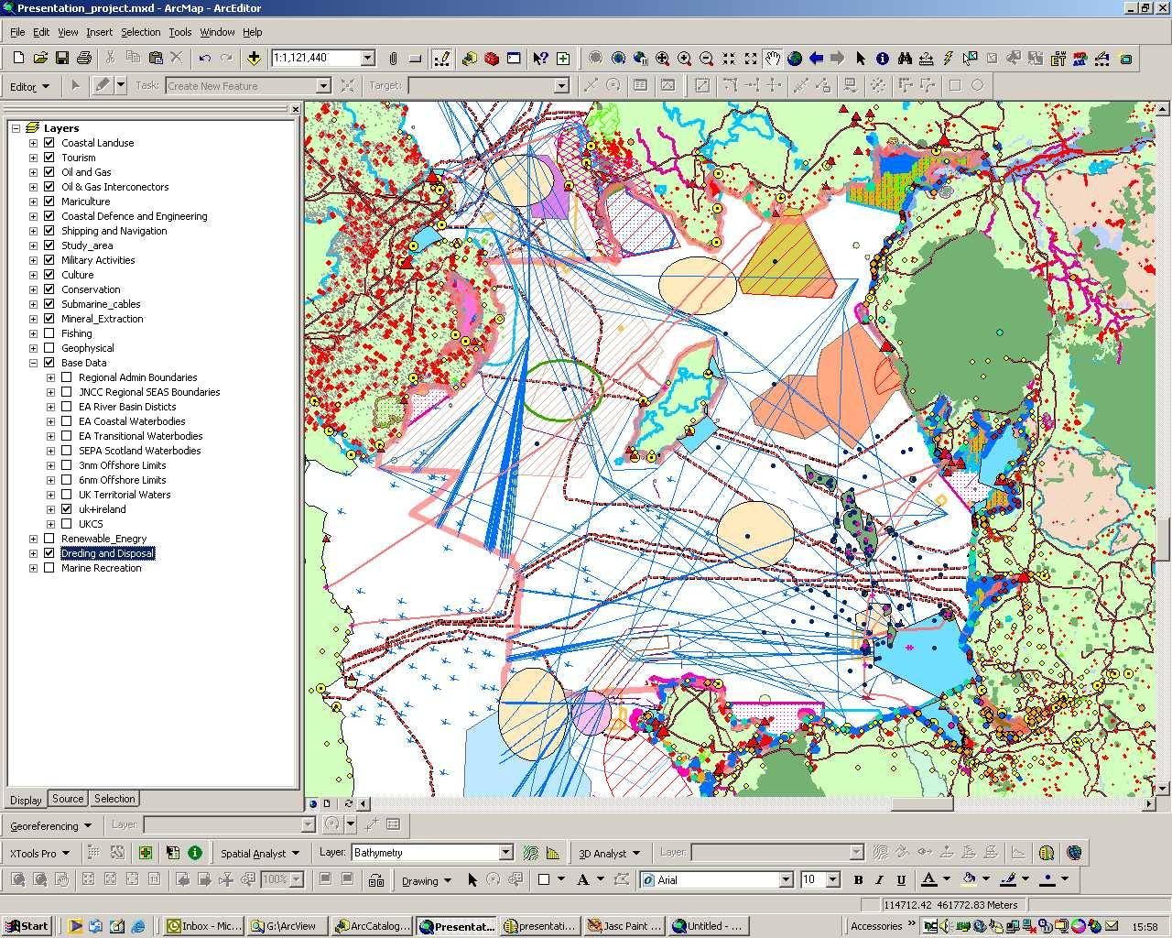
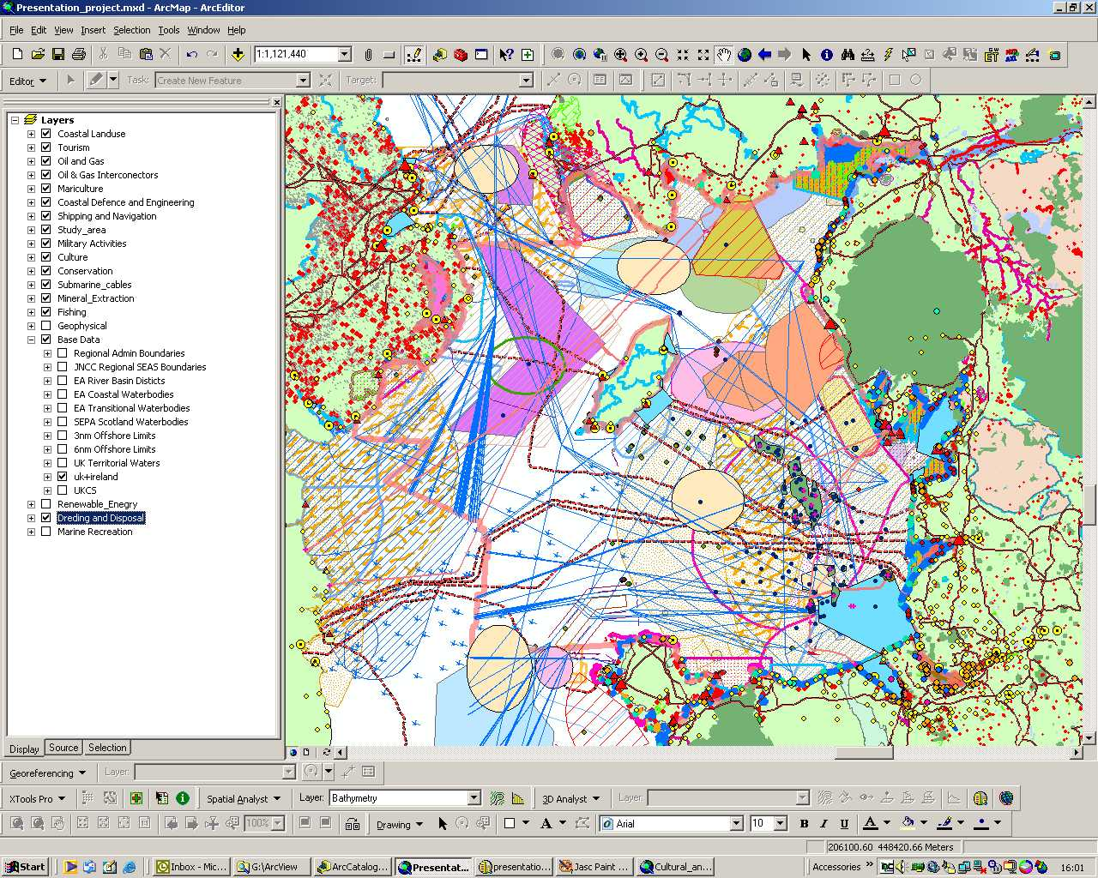
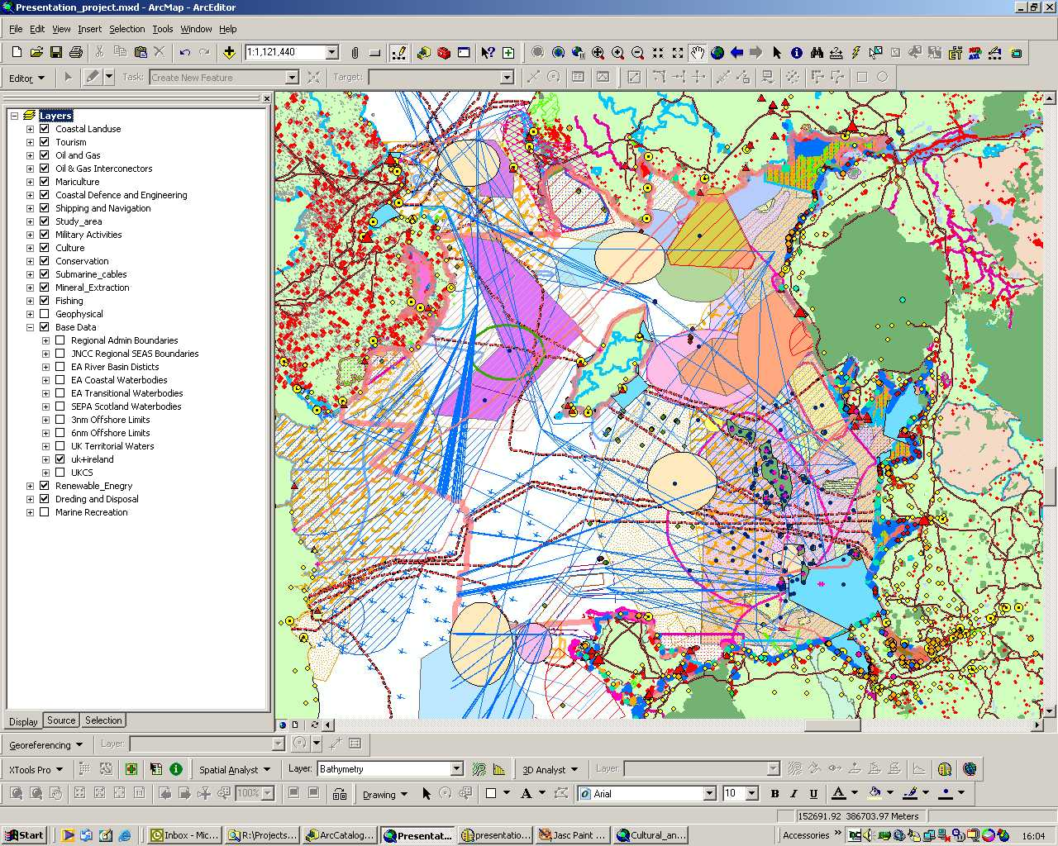
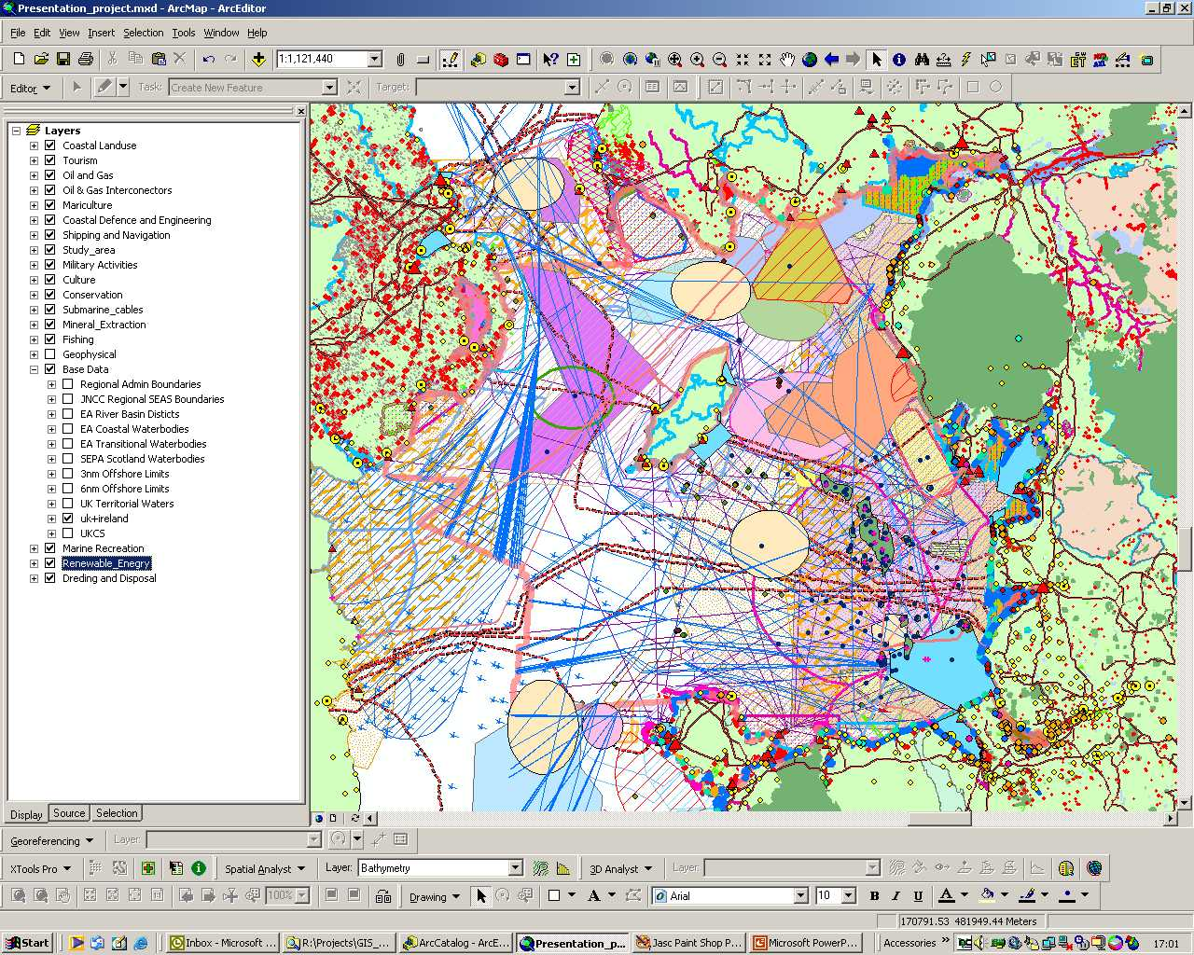
The sea is a busy place with many stakeholders
Tourism
Oil & gas
Mariculture
Coastal defence
Ports & navigation
Military activities
Culture
Conservation
Fishing
Submarine cables
Renewable energy
Marine recreation
Dredging & disposal
12
Mineral extraction

Slide 13
Competition for Seabed Space
Seabed congestion is increasing with more stakeholders vying for the ‘best’ seabed space due to:
  Increasing development of submarine cable infrastructure
  Continuing development of offshore energy on the continental shelf and into deeper water
  Offshore renewable energy development
  Development of offshore power grids
  Growing impacts from subsea minerals mining
  Coastal infrastructure developments
  Marine parks
  Protection of marine habitats and designated sites of habitat concern

Slide 14
Competition for Seabed Space
There are multiple levels of stakeholders with conflicting interests
  Economic interests
  Regulatory objectives
  Political considerations
  Environmental interests
Resolving issues requires:
  Knowing stakeholders to engage with
  Early engagement with stakeholders with the objective of
  Cooperation rather than competition

Slide 15
Resolving Stakeholder Conflicts
Resolving stakeholder conflicts requires effective engagement with all interested parties
The ICPC through working groups and subcommittees has been effective in initiating engagement with and resolution of issues
The World Ocean Council working with the submarine cable industry could provide an effective way to:
  Identify priority areas for interaction with other ocean industries
  Develop and action plan for addressing these priorities
  Implement the specific activities for the submarine cable industry to engage with other ocean industries

Slide 16
3. Operational Environmental Issues
Sound and Marine Life
  Marine mammals
  Other marine life behavior and life cycle
Marine Invasive Species
  Ballast water
  Biofouling
Marine Mammal Interactions
  Ship strikes
Water Pollution/Waste Discharge
  Port waste reception facilities
  Produced water and other discharges
  Solid waste

Slide 17
5. Smart Ocean / Smart Industries
Ensure a wide range of industry vessels and platforms are:
Providing routine, sustained, standardized information on the ocean and atmosphere
Contributing to describing the status, trends and variability of oceanographic and atmospheric conditions
Improving the understanding, modeling and forecasting of oceanic ecosystems, resources, weather, climate variability and climate change
  Establish a program to:
  Expand the number of vessels and platforms that collect standardized ocean, weather and climate data
  Improve the coordination and efficiency of data sharing and input to national/international systems
  Build on “ships/platforms of opportunity” programs

Slide 18
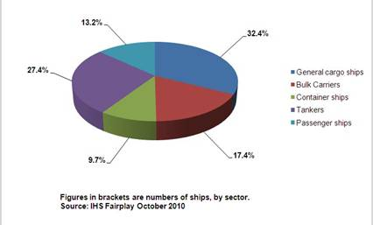
Opportunities of Ships
Number of ships - by total and trade
as of October 2010
Bulk Carriers: 8,687
Container ships: 4,831
Tankers: 13,175
Passenger ships: 6,597
TOTAL: 50,054

Slide 19
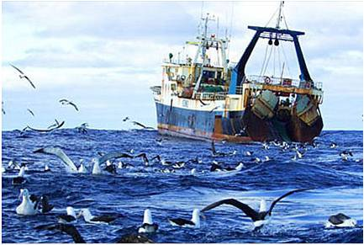
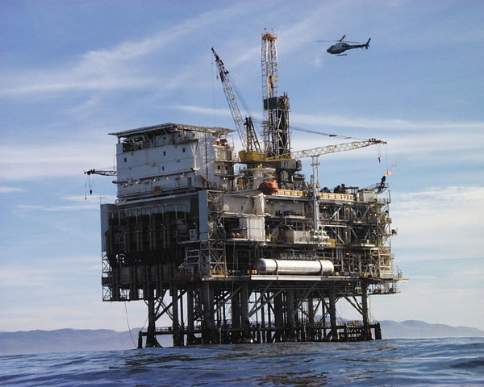
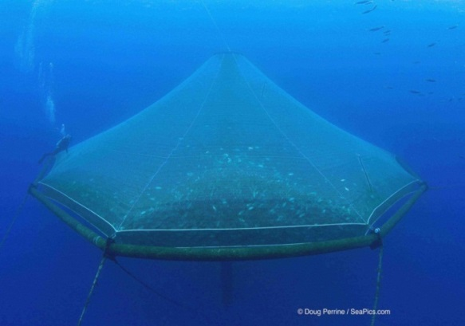
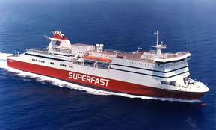
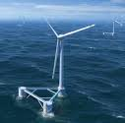
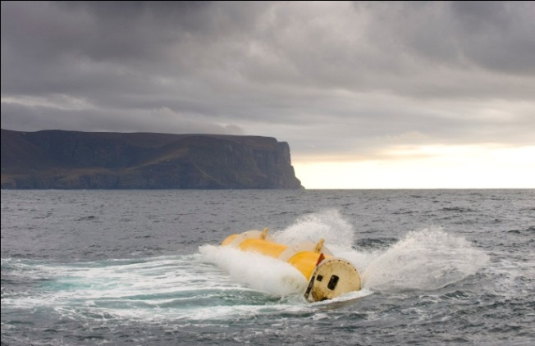
Other Ship and Platform Opportunities
Fisheries
Offshore oil/gas
Aquaculture
Ferries
Offshore wind energy
Wave/tidal energy

Slide 20
Identifying Resources: Strategy
Global multi-industry program/partnership: “Smart Ocean/Smart Industries”
Link to society priorities and economic value, e.g.
  Extreme weather events in coastal areas
  Tsunamis
Link to international science needs, e.g.
  Ocean acidification
Link to international issues, e.g.
  Ocean acidification
  Climate change adaptation
  Deep seabed ecosystem assessment and monitoring
Link to international treaty commitments by governments, e.g.
  Convention on Biological Diversity (CBD)
  Climate Change Convention (UNFCCC)
  Law of the Sea (UNCLOS)

Slide 21
Identifying Resources: Landscape
Bilateral
  Link to government priority locations and issues
Multilateral organizations
    Link to existing program priority locations and issues
    World Bank/International Finance Corporation
    Global Environment Facility (GEF):
      - GEF invests approx USD 1.3 billion in > 170 projects in 149 countries
      - Int’l Waters program leverages USD 7 billion in managing shared waters
Private foundations
    Link to priority locations and issues
    IT industry foundaions
Consortium/Platform funding

Slide 22
Submarine Cable Industry Collaboration
WOC and the submarine cable industry can collaborate to create efficient, cost effective means for the sector to:
Collaborate to identify resources for “Green Cables” as part of broader “Smart Ocean/Smart Industries”
Identify the priority areas for interaction with other ocean industries.
Develop an action plan for address these priorities.
Implement the specific activities for submarine cable companies to engage with other ocean industries.

Slide 23
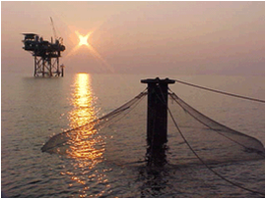
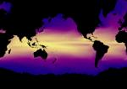
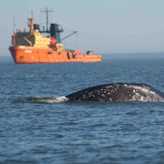
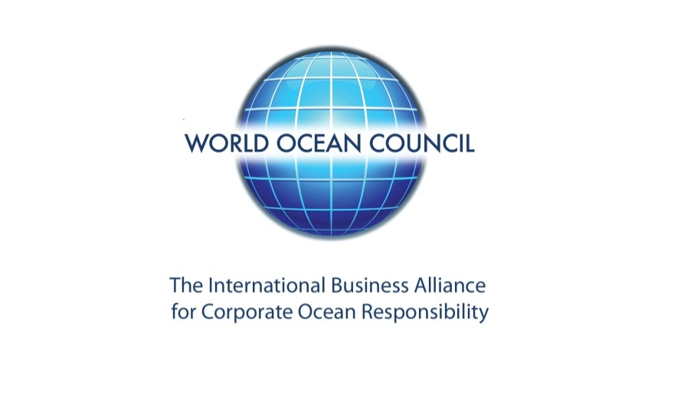
Thank You !
Paul Holthus
Executive Director
World Ocean Council
paul.holthus@oceancouncil.org
www.oceancouncil.org

