Slide 1
E-Waste: Huawei Action
Paolo Gemma

Slide 2
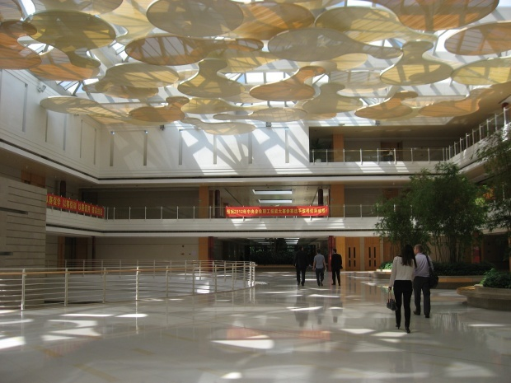
Most people are thinking how to impact the world, but we are engaging to reduce the impact to the world!
-From HUAWEI Reverse Team

Slide 3
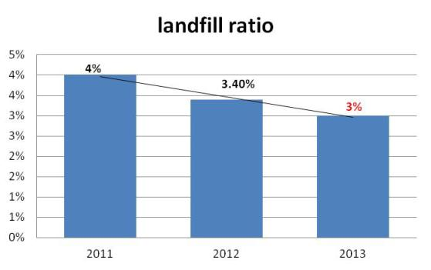
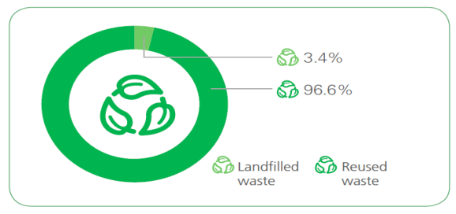
Huawei Waste Management
Huawei established waste scrap disposal centers in Latin America, Europe, Africa, Asia Pacific, and China to provide one-stop services to dissemble and recycle telecom equipments. This ensures sustainable utilization of resources.
HK
Ship to HK
country scrap model
Region scrap model
Waste reuse rate is up to 96.6% in 2012.and will increase to 97% in 2013
Recycling

Slide 4
Huawei product reuse and Recycle Model(Based on the CE model)
Huawei
Customer
Huawei reverse
Huawei
Huawei Agency
Scrap supplier
Production
internal reuse（Spare part, R&D）
Delivery
Key 1：Reduce the waste
Return(EOL or contact return)
Reverse analysis center
Production return
Test, Maintenance or Repair
Key 2：Reduce the waste
Consumer BG
Resell
Key4：Reduce production waste
recycling
Key 3：Reduce the landfill
Raw material
landfill

Slide 5
HUAWEI Internal Reuse Project in Carrier and Enterprise Business Group
Huawei reuse project Target: HUAWEI reduce about 300 ton (6.4M USD ) scrap when improve 1% reuse ratio
2015
2014
Reuse ratio:80%
Reuse ratio:78%
2013
Reuse ratio:76%
Extend life cycle through find the reuse opportunity, and reduce the waste continuously;
And Find second hand life cycle through the marketing demand based all the social Circular Economy
2012
Reuse ratio:74%
2011
Reuse ratio:68%

Slide 6
Huawei Reuse opportunity in 2013-2015
Life cycle Management
Design for Reverse
Strategy inventory for EOP material to extend the life cycle;
For the return material, go through the spare part channel globally, in the plan phase, consider the reverse inventory(long term for 5-8 years reuse)
In the design phase, consider the reverse request, easy to reuse dismantling, easy to upgrade and repair, and easy to reuse, and reduce the scrap in the phase of return process.
Reuse
opportunity
2rd Life cycle Management
Design for Environmental
Second hand life cycle: B2B/b2C platform for extend the life cycle, find more marketing reuse channel(agency )based on the Circular Economy
according to the 3R request, reduce the impact to the environmental

Slide 7
HUAWEI Consumer BG reuse Case
In 2013 January to July, Consumer BG resell amount is About 20 ton (13M USD),which also bring some revenue to HUAWEI.
Return(2012)
Return(2013)
Reverse analysis& review center
Reverse analysis& review center
Reuse(50%)
Scrap(50%)
Reuse(50%)
Resell(15%)
Scrap(35%)

Slide 8
HUAWEI Reverse center Map-Quick reuse Channel
NL HUB
ERC
SZRC
MRC
XiaXue
Reverse Center
Repair Center
Huawei reverse set up a globally reverse operation Platform, and this reverse center function as below, Now we have Shenzhen RC,HK reverse center, European reverse center and Mexico reverse center
1: All the regional return offset, goods receiving and repacking, and ship to the designated location;
2:the owner of the regional reverse inventory, Quick return, quick reuse;
3:Have repair and testing ability. Shenzhen Xiaxue will cover the globally repair, and ERC will cover all the EU region.

Slide 9
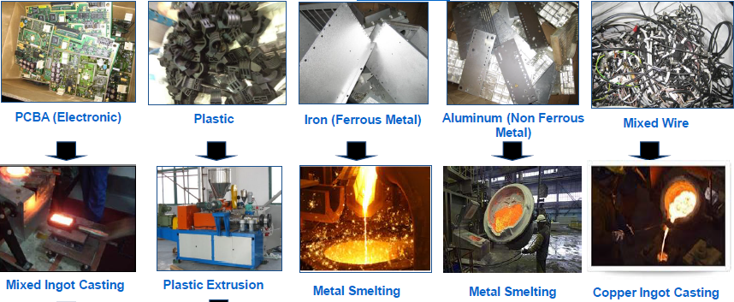
Reduce Landfill ratio Waste management example-cooperate with TOP recycling supplier
A case in Singapore
In Singapore, Huawei’s waste service provider transforms circuit boards into raw materials for future products through crushing and refining. The sludge is then transported to Singapore’s public waste incineration plants which transform heat generated from burning the sludge into electricity.
This process has reduced the proportion of buried waste to only 0.04%.

Slide 10
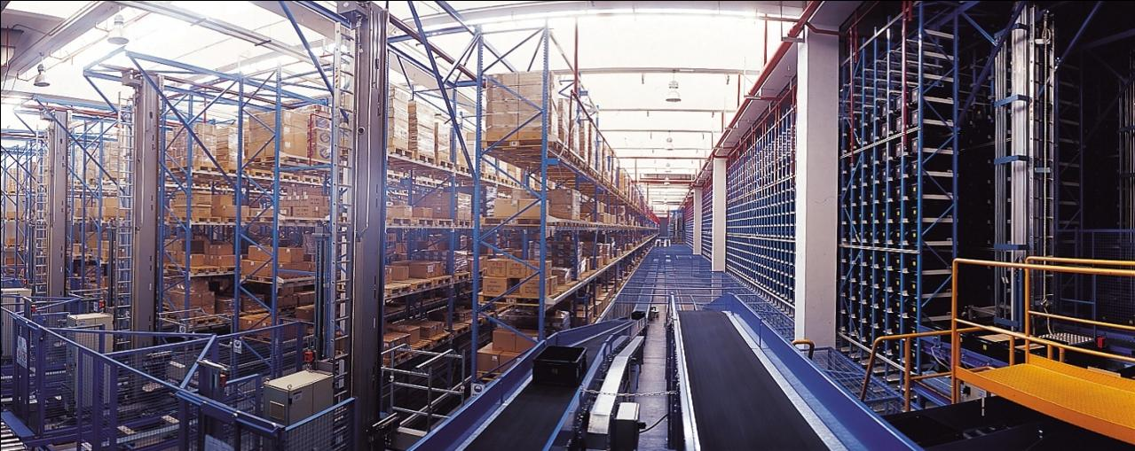
Internal activity on “waste” reduction

Slide 11
Energy Saving Plan for the Next Five Years
Area | Energy Conservation Activities | Power Savings (10,000 kWh/year)
Dongguan Production Base | 4 million kWh solar powered, clean energy projects | 420
 | Optimization of temperature and humidity control systems of factories to reduce device load | 514
 | Project of improving energy conservation of humidifiers in factories | 79
 | Group control of wind machines for the process cooling tower and air-conditioning refrigeration tower (optimization) | 18
 | Renovation of energy-saving lights in indoor and outdoor lighting systems | 400
 | Air compressor energy conservation through joint control technology and waste heat utilization | 137
 | Replacement of obsolete equipment on the production line | 251
 | Implement the reducing dross spot machine to reduce tin scraps
 | Efficiency improvement of SMT equipment and testing equipment through technical renovation and management optimization | 81
 | Reduce the industrial wastes which it come from production lines (About 8%)

Slide 12
Huawei Green Packaging
In first half of 2013, Huawei green packaging total shipments reached 49273 pieces, have reached a half of 2012 and the level in 2011; saving about 9666 cubic meters of forest wood and reducing carbon dioxide emissions about 7000 tons.
Green packages quantity/PCS
Saving forest wood /cbm

Slide 13
Our LSP Performance
Take Maersk Line for example:

Slide 14
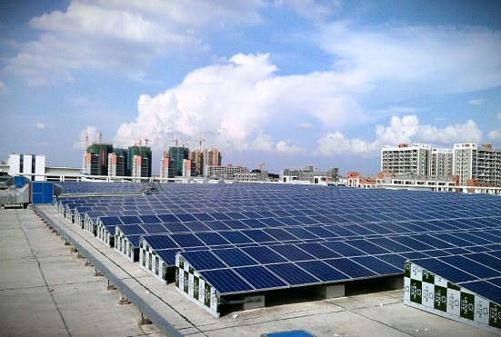
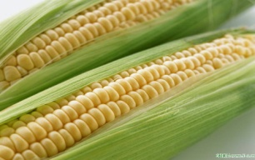
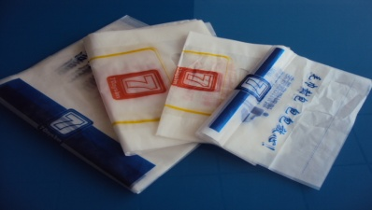
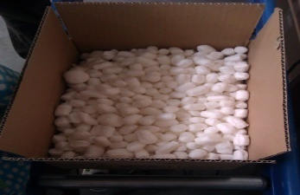
End to End improvement - Next steps
Reduce 1,000 ,000kWh per year in Dongguan production base
Continuously introduce and implement economic and rational design ideas into packaging design/deploy process
Introduce new environmental friendly packaging materials
Reduce 10% CO2 emissions through green logistics

Slide 15
Thank you

