Slide 1






WEEE Management Model:
a Challenge / a Reality
José Pérez García
CEO Recyclia
Madrid, 16 September 2013

Slide 2
Scheme
Presentation of Recyclia
The management challenge
Management model
Advantages
Conclusions

Slide 3




Who is Recyclia?
RECYCLIA is the environmental Platform that brings together the experience, knowledge and human team of Integrated Management Systems.
Under the legal form of Economic Interest Grouping (EIG), Recyclia is a non profit organization that encompasses the following foundations:
  Founded in 1998. The responsible response from the batteries and accumulators sector to the need to adequately manage used batteries and accumulators.
  Founded in 1999. Pioneering initiative of telephone and communications equipment financed by the major manufacturers.
  Founded in 2002. Custom solution for computer equipments promoted by the main manufacturers of the sector.
  Founded in 2005. It allows the rest of manufacturers of electrical and electronic equipments (IT, photography, healthcare, gaming machines, surveillance and control, etc..) to comply with Royal Decree 208/2005
For over 14 years, we contribute to the collection and responsible recycling of WEEE and used batteries in Spain.

Slide 4
The WEEE management challenge
Electrical and electronic devices are used more and more and their obsolescent rhythms are increasingly fast:
  A European citizen generates 14 kilos of "technological trash" and this amount will double in 2017
Benefits derived from WEEE recycling:
    Recovery of scarce and valuable raw material. URBAN MINING.
    Saving energetic and natural resources
    Waste management to minimize the potential impact on the environment and health, by adequately closing a life cycle of these products.

Slide 5
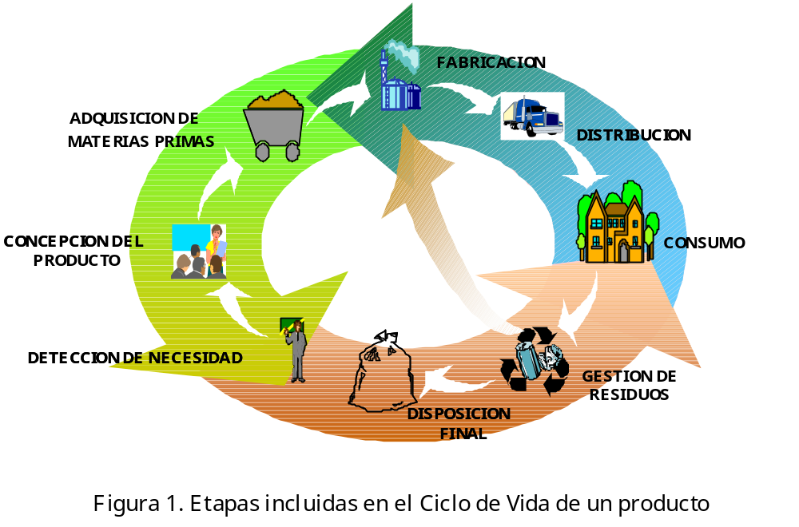
Change of approach
“Polluter pays” principle
Extended producer responsibility
Shared responsibility
Transfer of responsibility from the Holder or the Administration
Consumers
Economic agents responsible for placing products on the market
Public Administrations
New Role
to the “Producer” of the product that becomes waste at the end of its useful life
“Producer”= First commercial agent (manufacturer, importer, distributor)
‘Life Cycle Thinking’

Slide 6

Challenge/ Reality: IMS. Characteristics
Several producers decide to join efforts to organize waste management. Collective System.
Facilitates delivery of waste by users in collection points for that purpose, regardless of brands.
All economical agents involved (producers, distributors, recyclers, users and Administration) take part in the System.
Costs optimization.
Economies of scale thanks to the volume of waste management.
Unique voice before Administrations.

Slide 7
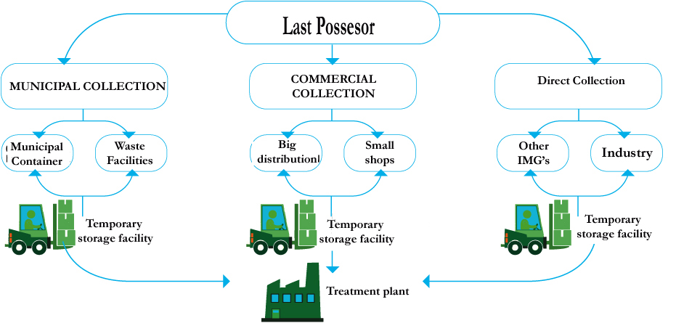
Our operational model
National coverage for WEEE and used batteries collection from domestic, industrial and professional origin.
Custom collection in areas with significant stockpiles of waste
Network of Temporary Waste Storage Facilities (TWSF) for the delivery and consolidation of small stockpiles of waste.
Collaboration agreements with logistic agents as well as treatment plants specialized in WEEE and batteries recycling.

Slide 8
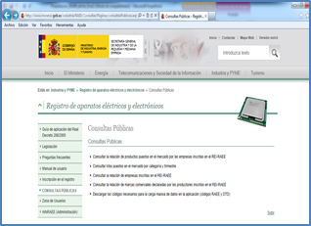
The context of WEEE and spent batteries management in Spain
Spanish Register of EEE producers (REI-RAEE)
Spanish Register of Batteries Producers (REI-RPA)
Public consultation of registered companies (2.000) and brands.
Information on invoices on registration numbers mandatory.
Web-based platform www.minetur.es
- MEMBERS’ REGISTRATION
- QUARTERLY SUBMISSION OF INFORMATION
QUARTERLY ALLOCATION OF MARKET SHARES FOR EACH PRODUCER ON B2C APPLIANCES COMMERCIALISED
Logistic partners
Treatment plants
Municipal collection points
Regional Governments (Autonomous Communities, competent bodies on waste management)
Authorise
Contract
Compliance schemes
Annual report on WEEE/batteries managed
Web-based platform
Entrusted with WEEE/spent batteries management under collective system’s supervision and Regional Governments authorisation as waste managers
QUARTERLY DECLARATIONS:
EEE commercialised in kgs per category and type of equipment
Batteries sold in units and grams per type of battery
FINANCIAL FLOW:
- Membership fee
- Quarterly contribution (per kg sold)
Producers

Slide 9
Managed Waste : WEEE
    During 2012, the WEEE Foundations managed more than 15 million kilograms; 10% more than in 2011.
    Reaching collection and valorization ratios much higher than those established by the law.
Large household appliances
Small household appliances
IT and telecomm equipment
Consumer equipment
Electrical and electronic tools
Toys, leisure and sports equipment
Medical devices
Monitoring and control instruments
Automatic dispensers
  More than 90,000 tons managed from 2001
Distribución de equipos de informática y telecomunicaciones por fundaciones

Slide 10

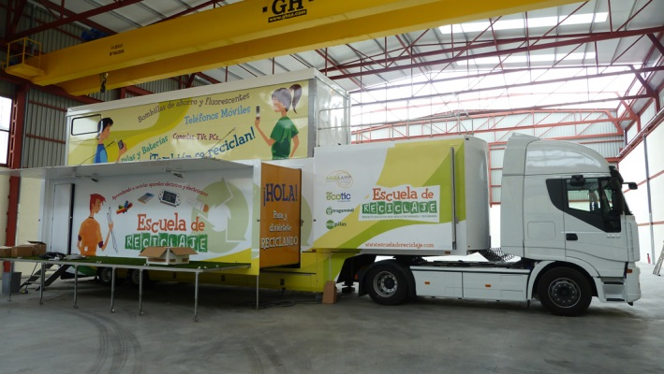
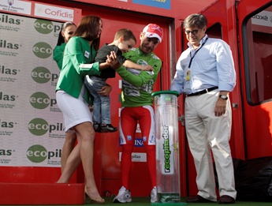
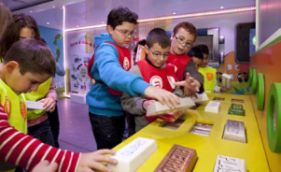




Communication and awareness actions
THE TOUR OF SPAIN (LA VUELTA)
RECYCLING SCHOOL
Agreement Tragamovil and ADENA for the recovery of autochthonous forests
ECO Awards Ecofimática Distributors
Guide CETMAR and industrial batteries brochure

Slide 11
Conclusions
The challenge of WEEE management has a solution
The IMS has been proven as the most effective solution
The future challenge is to control all flows
The Ecodesign will be a good ally in the cost optimization

Slide 12



Thanks for your attention!
www.recyclia.es
@recyclia
https://www.facebook.com/Recyclia.es
www.ecopilas.es
@ecopilas
https://www.facebook.com/EcopilasFundacion
www.ecofimatica.es
https://www.facebook.com/EcofimaticaFundacion
www.ecoasimelec.es
www.tragamovil.es

