Slide 1






Industry Support and Potential Partnerships
Nigel Bayliff
Huawei Marine Networks

Slide 2
Vendors have reduced costs dramatically
Commercial pressures – rise of free internet
Significant price erosion for international carriers
Cu/Fe rises causing margin squeeze for vendors
Twin route LON-NYC 1999; close to $1bn > 2.4Tb
2012, Same Scope; conservatively $400M > 60Tb
Cable developers want to minimise build costs
“no pot of gold to fund science and research”

Slide 3
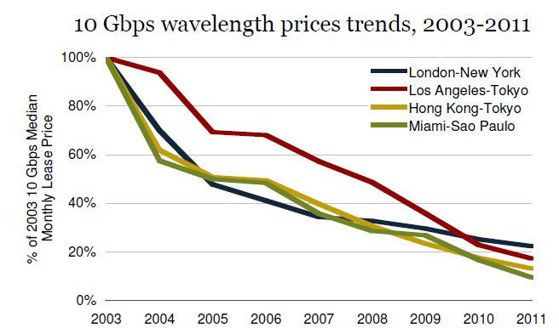
The price paid for capacity is tending to zero!
Source: Telegeography
Median Monthly 10 Gbps Lease Prices, Q4 2011-Q4 2012

Slide 4
Challenge of Enrolling a Developer
Technical risk is not zero, but definable
Bringing data back on-shore is a key factor
Loss of in-band capacity is a huge revenue threat
Out-of-band could be ‘something for nothing’
Low impact will enhance chances of acceptance
“Money is the key issue, again – what contribution”

Slide 5
Maybe a Universal concept will work
UJ™ consortium – majority of cable repair joints
Core design is standard, with end-specific variants
Vendors funded for collaboration and cooperation
Universal fund? Suitable systems with options
Standardised design – functional specification
Proprietary mechanicals and data-relay

Slide 6
If I were developing an oceanic system today . .
I would . . .
“Route for Revenue” – capture major traffic flows
“Divert to Developing” – pass under-served countries
“Branch for Oil&Gas” – near-continent fields & assets
“Host the science” – funded sensors included
Projects may already be happening, but this is what I believe will be needed to prove the business model

Slide 7
Where is some of the money?
“It is good to be green & good to be seen”
Philanthropists? – regional development funds
World Bank –funds for inter-regional activities
Development Banks – life-saving, green project
Green credentials attractive – Oil & Gas companies
Need to study these potential sources formally and build a ‘desire to fund’ from this community

Slide 8
Challenge for the JTF & Community
Define the ‘cost of science’ vs potential funding
Seek consultants who help develop potential projects
Coordinate and collaborate for a universal solution
Continue to raise awareness and publicise
Green credentials attractive – seek Oil & Gas companies
“A small group of thoughtful people could change the world. Indeed, it's the only thing that ever has.” – Margaret Mead, 1981
It is also not necessarily the world that needs to change – maybe we need to change; as an industry, as companies and as individuals

Slide 9

Thank you

