Slide 1
Marine Surveillance System LoVe Project
Guillen Lopez
Inge Vintermyr

Slide 2
Presentation overview
LoVe Description
System Overview
Subsea Distribution Unit (SDU)
Umbilical cross section
Project aims
Sensors

Slide 3
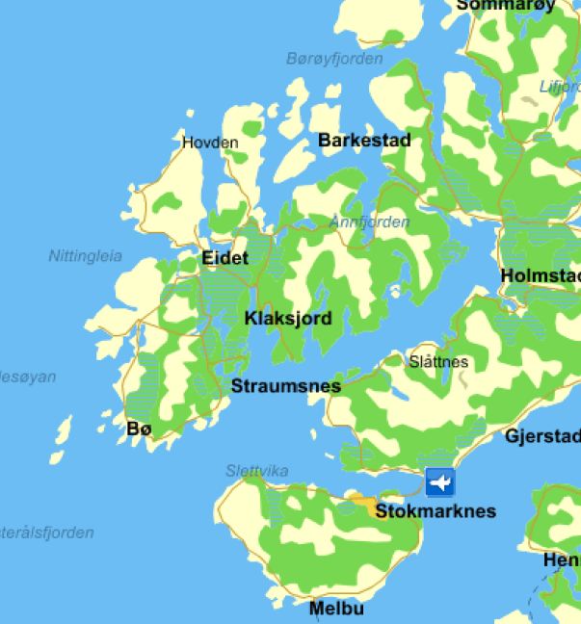
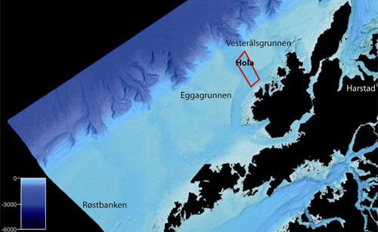
LoVe project
Ocean Observatory (a lander) on the seabed in Hola
Approx. 16 km off the coast of Hovden, Vesterålen
Umbilical length: 21 + 0,5km
Water depth at the area for the infrastructure: 250-280
Lofoten – Vesteralen (LoVe) region in northern Norway

Slide 4
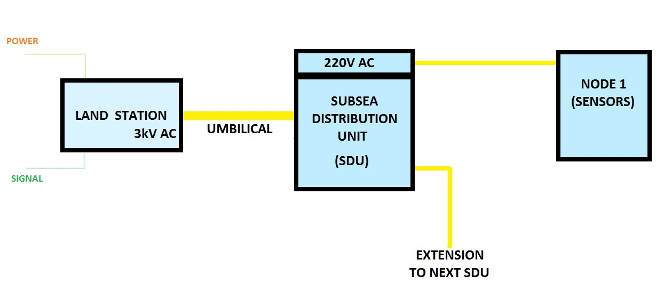
LoVe project - System overview

Slide 5
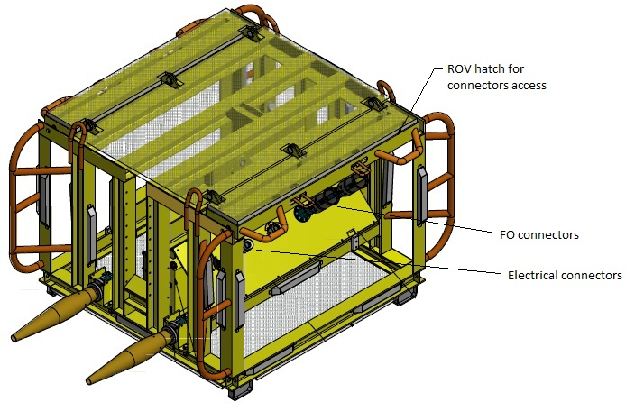
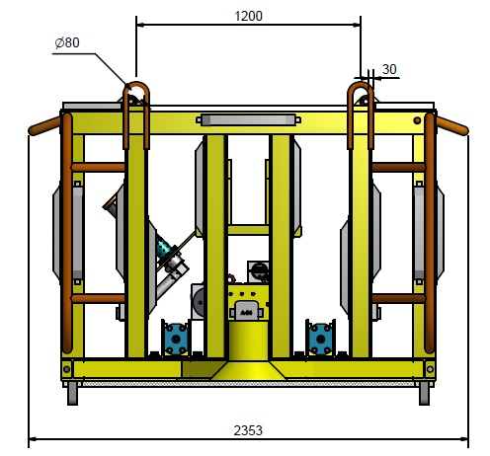
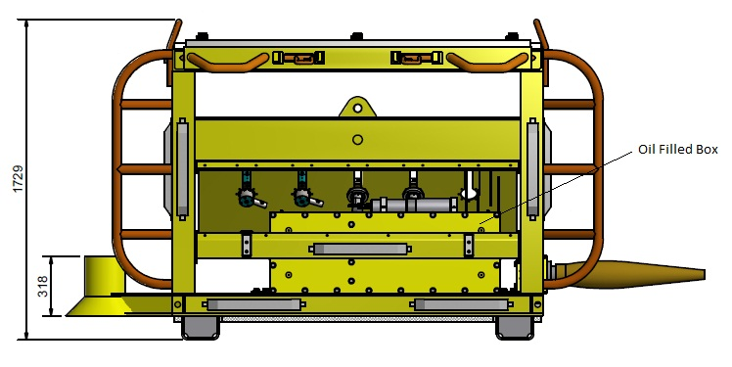
LoVe project - Subsea Distribution Unit (SDU)
Subsea Distribution Unit (SDU)
SeaCon Connectors
Electrical Connectors
Transformer

Slide 6
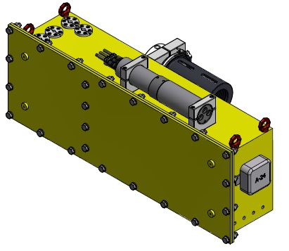
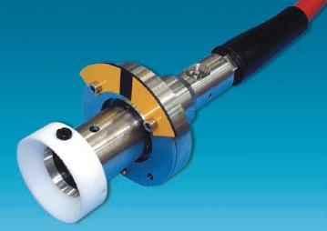
LoVe project - Subsea Distribution Unit (SDU)
Oil Filled Box (OFB) inside the Subsea Distribution Unit (SDU)
Umbilical Termination
Pressure Compensated
Transformer inside 3kV / 220V
Electrical Connector
1 kV
Wet-mateable

Slide 7
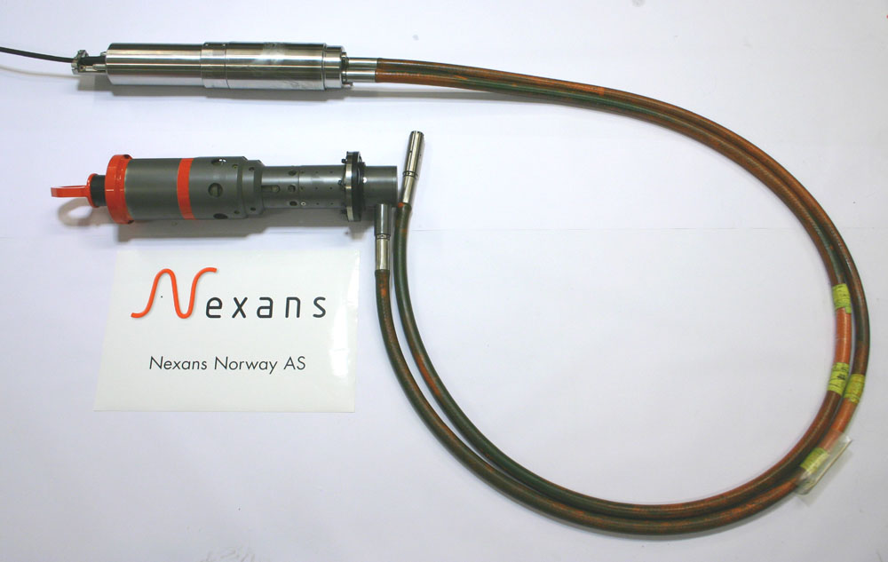
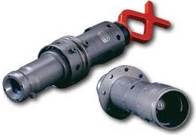
LoVe project - Subsea Distribution Unit (SDU)
Fiber Optic Termination Unit (FOTU)
16 fiber termination
FO Connector
8 fibers
Wet-mateable

Slide 8
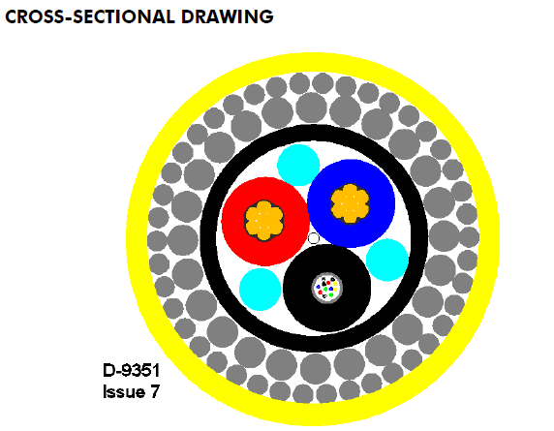
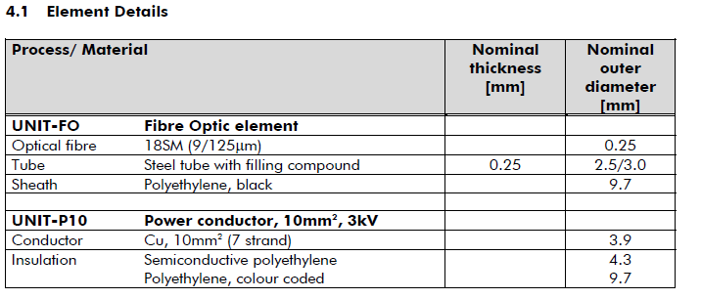
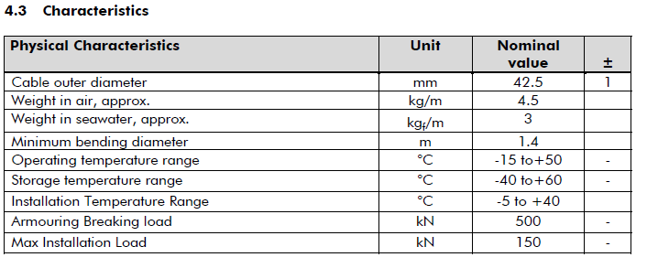
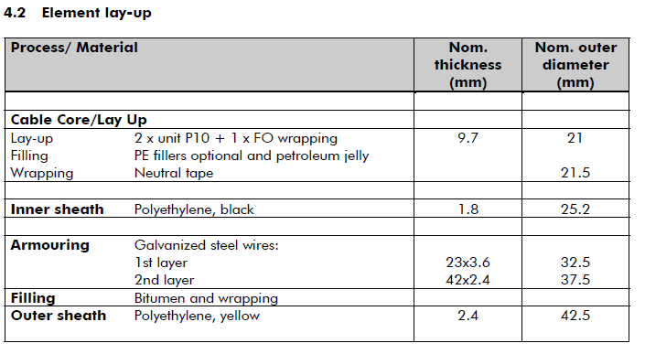
LoVe Umbilical - Cross Section

Slide 9
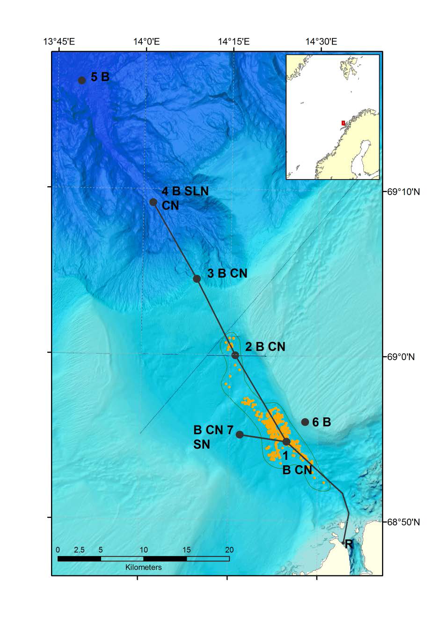
LoVe Project - Aims
Ecosystems
Marine Resources
Biological Processes
Geological Processes
Chemical Processes
Clima
Early warning systems
for geo-hazards

Slide 10
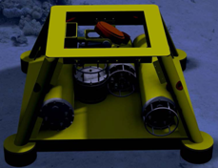
LoVe Project - Sensors
Conductivity, temperature, pressure, practical salinity, density
Current, turbidity
Phytoplankton biomass, chlorophyll concentration.
O2, CO2, PH, Nitrate, CH4, Mass Spectometer
Broadband seismometer, tiltmeter, pressure sensors wave height monitoring, piezometer
Echosounders, camera, hidrophones

Slide 11
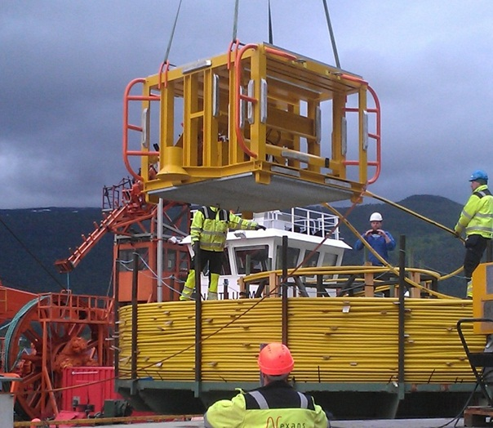
LoVe Project

Slide 12
Thank you

