Slide 1
BOMA BEST Energy & Environment Report
Benchmark Environmental Data for Canadian Commercial Real Estate
John Smiciklas
Director, Energy & Environment
BOMA Canada

Slide 2
Who is BOMA Canada
Building Owners and Managers Association (BOMA) Canada is the voice of the Canadian commercial real estate industry. A national not-for-profit association, with strong regional association in each major region in Canada, BOMA Canada is comprised of over 3,200 members, representing close to 2.1 billion square feet ( 200 million m² ) of commercial space in the country.

Slide 3
2013 BOMA BESt Energy and Environment Report
Environmental performance data on 455 Buildings across Canada

Slide 4
Data Sets
Includes:
Office buildings
Open Air Retail
MURBs
Enclosed Shopping Centres
Light Industrial
This sample represents approximately 98.1 million square feet of Canadian commercial real estate.

Slide 5
Key Findings
Average energy use intensity for BOMA BESt certified office buildings is 30.76 ekWh/ft2/yr (or 1.19 f GJ/m2/yr) with a median of 27.84 ekWh/ft2/yr – a 16% improvement on the National Resources Canada national average

Slide 6
Key Findings
Average water consumption intensity for BOMA BESt certified office buildings is 0.6 m3/m2 – a 70% improvement on the national average of 2.03 m3/m2.

Slide 7
Key Findings
Sub-metering is extremely helpful for identifying energy saving opportunities as well as facilitating ongoing commissioning practices, but this technology is still not commonly found in buildings. Sub-meters are especially
critical for building managers seeking to understand the energy performance of individual buildings within an office complex or to investigate the differences in individual tenant consumption patterns.

Slide 8
Key Findings
Building performance can be influenced by a # of factors:
1. Age of the building;
2. Size of the building;
3. Efficiency features of the buildings;
4. Management practices including operations, monitoring and on-going commissioning; and
5. Occupant engagement.

Slide 9
Key Findings

Slide 10
Key Findings

Slide 11
Key Findings
Increased use of ICT = better performance

Slide 12
Key Findings
Increased use of ICT = better performance

Slide 13
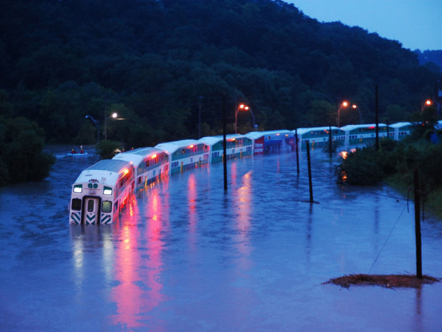
Future Areas of Work
Climate Change Adaptation Risk Assessment Module
(Losses from 2 major Canadian severe weather events exceeding CAD 4 Billion)
Data Centre Assessment Module
HealthCare Assessment Module

