Slide 1
The Connected Cities
Alberto Zilio, Director – Public Affairs, AT&T Europe

Slide 2
Creating Smart Sustainable Cities
Information and Communication Technology solutions — comprising hardware, software, and broadband and wireless technologies — can enable people, businesses, and governments to make more energy-efficient choices and reduce environmental impact and costs by:
Moving work to people rather than people to work
Connecting rather than traveling
Managing business remotely and in real time
Improving transportation and distribution systems

Slide 3
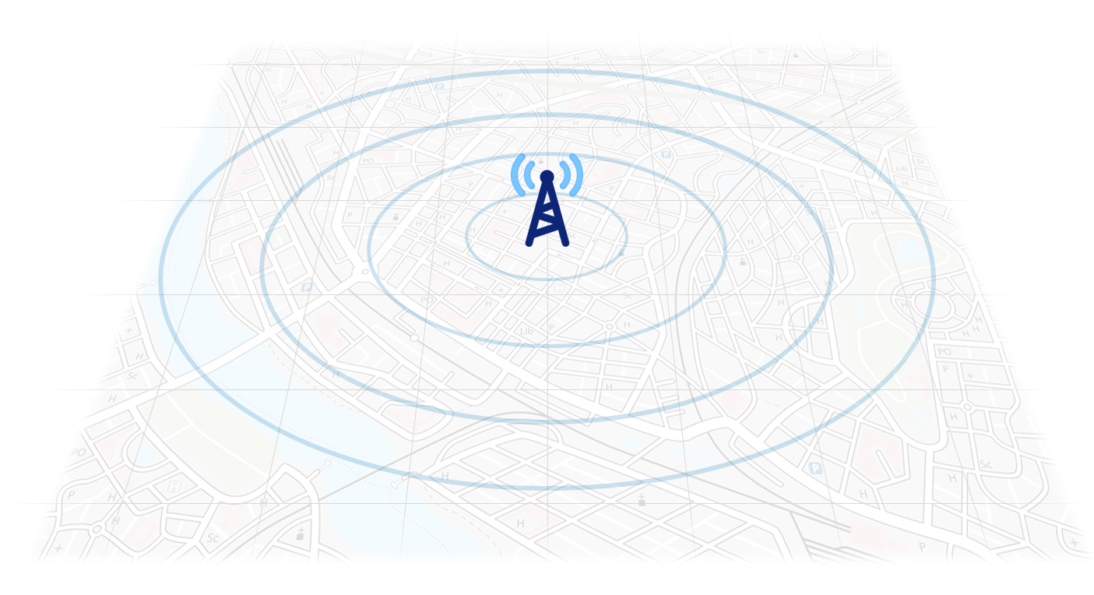
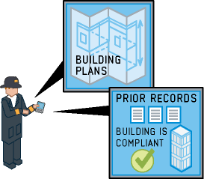
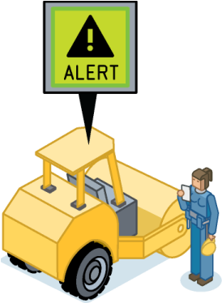
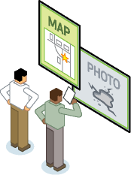
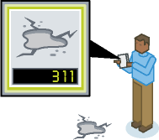
Connecting Business & Government
Mobile Internet: A public enterprise or economic
development engine?
Building citizen engagement, collaboration, and government transparency with Mobile Internet
Growing the creative economy through mobile Internet innovation
Embedding smart technologies in key operations like smart meters.
Sustainable technology, including mobile fleet management, to create a lighter carbon footprint.
Connecting to urban residents who are socially connected, opinionated, and always mobile
Creating efficiencies with mobile Internet applications like field services automation.
Securing ports through creative mobile solutions including video surveillance.
Securing critical infrastructure with mobile Internet applications asset tracking.
Enabling a mobile workforce through Internet technologies.

Slide 4
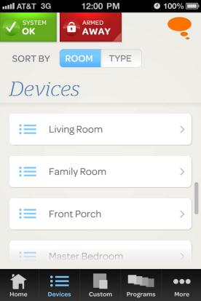
Connecting Consumers – AT&T’s Digital Life

Slide 5
Customers and the entire industry benefit from regulatory models that don’t struggle to play catch-up with new technologies, but actively pave the way for them.

Slide 6
Thank you

