Slide 1
Huawei Solutions for Smart Cities
Eliseo T. Sánchez

Slide 2
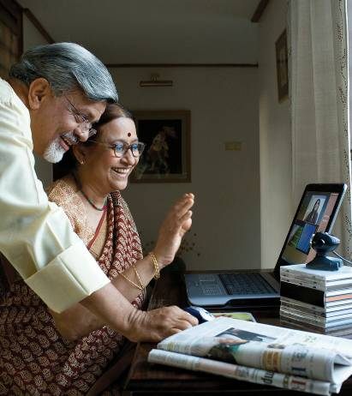
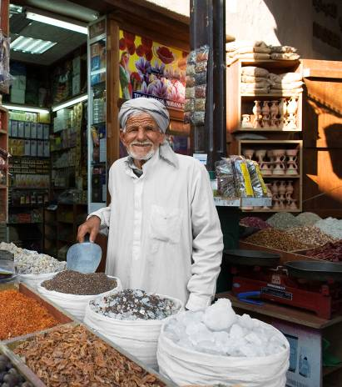
Four Megatrends that are changing the World
Developed Countries’ Labor Forces Substantially Age and Decline
Population Growth Increasingly Concentrated in Emerging Countries
Economic Power Shifts to Developing Nations
World’s Population Becomes Urbanized
The world around us is undergoing a major transition, those environmental impacts of this massive urbanisation are significant.

Slide 3
A Technology Model for the Smart City
Emergency Command
Security Video
Surveillance
Digital Police
Safe & Orderly Society
Internet
Surveillance
e-ID
Vehicle
Management
e-Passport
Government
OA + Portal
Digital scenic spot
Smart City
Green &
Sustainable Economy
Intelligent Kids
(SCS)
Happy & Healthy Life
Government
Hotline
Intelligent Traffic
Digital post (e-Post)
Digital patrol
Tourism
Environment monitoring
Digital Health care
Intelligent Meter
E-Education

Slide 4
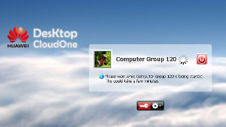
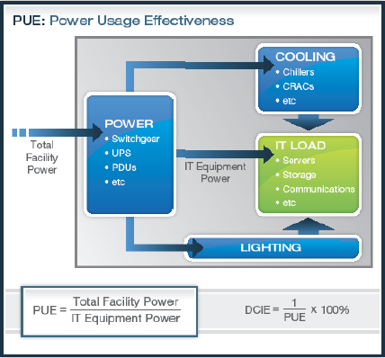
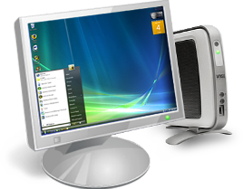
A green e-City requires the eficient use of DC and Desktop
Virtual Desktop
Green data center
Source: Green Grid
213 W/h
32 W/h
35-45 Degrees Celsius
Room Temperature
50db
<10db
The high temperature and noise pollution problems encountered in the working environment with many PCs running could be easily solved applying Virtual Desktop technologies.
PUE
Source: www.42u.com

Slide 5
An example of Energy Efficiency collaboration project
49 kWh/EA
5%
10%
20%
20%
30%
Energy Manage OSS
20%
20%
34 kWh/EA
Free Cooling Solution
Smart Metering & Management
Free-Cooling
Temperature Optimization
5%
BTS Power Saving
Power Savings Features
More Efficient Infrastructure
High Efficiency Power
Selective Switch-Off
Green Self-Generation and Others
Hybrid Power Solution
2009
2015
Source: 1st Telefonica Energy Efficiency Workshop, Madrid, Sep, 1st, 2010

Slide 6
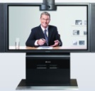
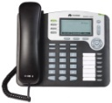
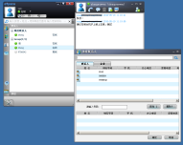
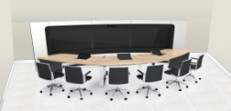
More efficient Government using UCC technologies
PC Client
Mobile Client
Thin Client
SD/HD Terminal
IP Phone
Telepresence
Office Collaboration
Unified Communications
Convergent Meeting
Telepresence Meeting
Unified Messaging
Collaborative Meeting
Convergent service flow
Mobile Office
Collaborative office
Office Integration
Mobile office
Voice Terminals

Slide 7
Having a Happy and Healthy Life
Hospital surveillance
Multimedia Patient room
Collaborative Office
Emergency Call Center
Hospital Info Display
Collaborative Communication
Remote Training
Emergency Command
Remote Healthcare
Healthcare Management
Healthcare Cloud
EHR
EMR
Remote Consultation
Community Healthcare Kiosk
Regional Sanitation
Remote Medical Education
General Management
Public Service
Collaborative Healthcare
Family Healthcare Terminal
Hospital
Government
Citizen

Slide 8
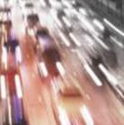
Video surveillance implementation rise several problems
Low definition
Difficult data transmission
Low definition and low frame rate.
Failure to meet HD video surveillance requirements for key scenarios.
No balance between high requirements on bandwidth and quality and low investment and data transmission costs.
Expensive to lay out cables in remote areas.
Need of CPEs using wireless data transmission.
Difficult to cover all sites in the old urban area.
Direct connection to optical transceivers, wasting a lot of optical fiber resources.
Low search efficiency
Few storage space
Data leakage
Multiple formats of videos and isolated video surveillance systems.
Massive video data and low search efficiency.
Poor capability of the intelligent analysis and search engine.
Explosive data growth and difficult resource allocation.
Low storage resource usage and serious waste of storage resources.
High investment and maintenance costs.
The public network is vulnerable to external attacks.
The internal network lacks sufficient security protection.
Videos not encrypted are vulnerable to leakage.

Slide 9
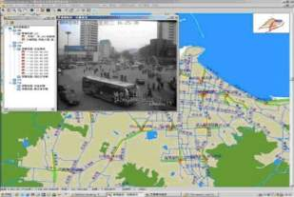
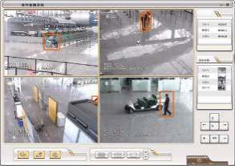
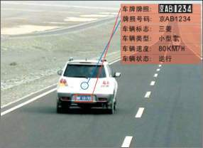
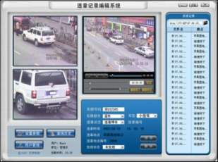
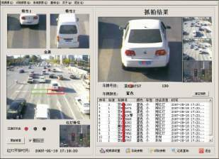
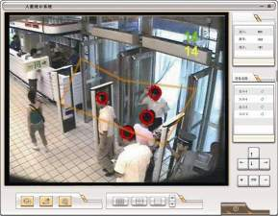
High requirements to provide intelligent behavior analysis
Real-time Monitoring
Event Detection
License Plate Recognition
E-police
Detection of violation vehicles
People Count and Record
Notes:
随着园区入驻企业的不断增多，带来的问题包括公共安全和紧急事件，这些问题需要管理部门快速响应，并协调多个政府部门进行处理。
一个现代化的指挥中心能够帮助管理调度部门灵活应对各种挑战。通过集成地理信息系统、呼叫中心和GPS定位服务，指挥中心能够在各个部门之间协调必要的资源，从而作出快速的响应，最终提升核心竞争力。
With the rapid development of Industrial Park, the increasing enterprises brings many problems to the management and dispatch of public security and emergency events. These safe problems need quick response of our park management department and collaboration of different departments.
A modern large screen command center can help park management department to flexibly face various challenges. With integration of GIS, Call Center and GPS service to provide intelligent service, command center can help to make a quick response and collaborate with different departments, then improve core competition power.

Slide 10
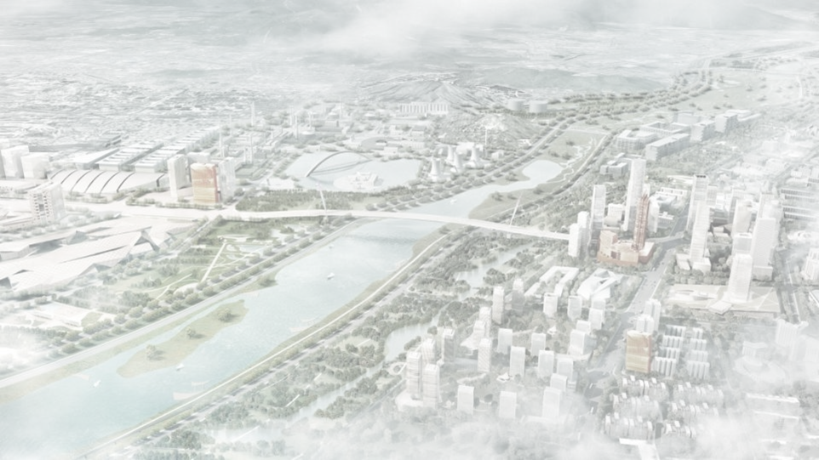
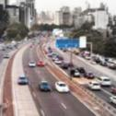
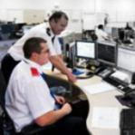
Video surveillance: building a better and safer city
HD
Easy data transmission
High search efficiency
Data protection
Large storage space

Slide 11
Some Huawei cases as examples
Solution | Cases
e-Government
Safe City
e-Education
e-Health
Others
China Govt. External Private Network
Maldives e-Gov
Ghana e-Gov Phase 2
Kenya e-Gov Phase2
Cameroon e-Gov
Ecuador Trunking Network
Sudan e-Police
Dubai Police MW
Poland Justice Bureau TP
Baghdad Safe City
China CERNET 2
Italy GARR DWDM
UK Janet DWDM
Turkey Fatih e-learning
China MoE e-Learning
Shanghai Health Cloud
China Ningbo Regional Health
China Zhengzhou Telemedicine,
China Fujian Telemedicine
Poland Zus Campus Network
China Nangnin Foxconn Smart Park
Netherlands Overijssel Campus Network
Sochi Olympic Park
Langfan ITS, China

Slide 12
Thank you

