Slide 1
Eco rating schemes and Consumers – What do they care?
Casper Jorna / Vodafone

Slide 2
Eco rating schemes and Consumers – What do they care?
September 17th , 2013 / Casper Jorna / Vodafone

Slide 3
Some background….
Vodafone launched Eco rating in 2011
Live in 11 countries in Europe and Oceania
Rated over 200 devices
Currently up to the third version

Slide 4
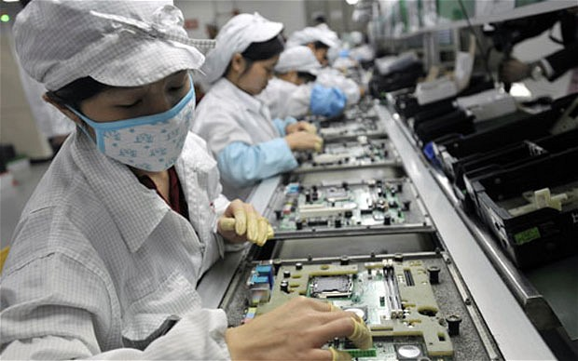
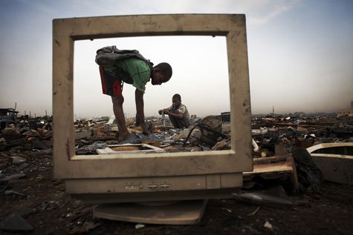
“yes I think sustainability is important. But what is it about?”
Environmental
Climate Change
Pollution
E-Waste rrrrrrrrrrrrrr
……
Social/Ethics
Child labour
Worker conditions
Conflict minerals
……

Slide 5
“I want a new phone, but do I the consider Environmental & Social impact important?”
7 % -10 %
25 % -27 %
… But sustainability comes far behind importance of price, features, brand

Slide 6
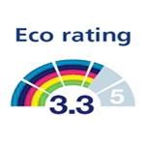
“So an eco rating is interesting, but which one should I use?”

Slide 7
We need to educate the consumer, make it relevant to them, and standardize!
Notes:
In order to drive improvements in the industry and support innovation with an eco rating:
We need to educate customers about the broad impact of a device, so not just ecological but also social, not just negative, but also the positive impact
We need to make the rating relevant to our customers in order to allow them to further adopt it and drive innovation
We need to take away the confusion in the market place, and the only way we can do that is by standardizing eco rating, which is why we are here

Slide 8
Thank you

Slide 9
Thank you

