Slide 1
ORANGE Environmental Labeling of mobile devices
Elisabeth Dechenaux

Slide 2
ORANGE Eco labeling
The objective is to calculate the environmental performance of products sold by Orange :
To provide a clear information to consumers about the environmental impact of products they use
To help customers to make the appropriate choice when purchasing
To evaluate & influence manufacturers to deliver more environmental-friendly products
The methodology has been developed with WWF and BIO Intelligence Service
The information is based on data provided by suppliers and analyzed with ORANGE R&D and BIOiS

Slide 3
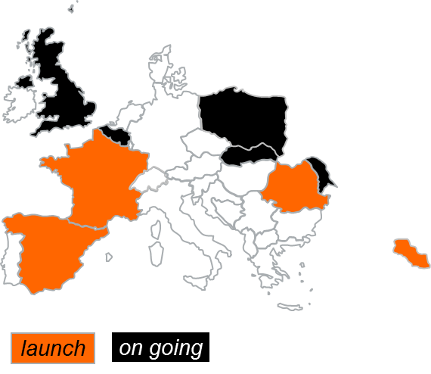
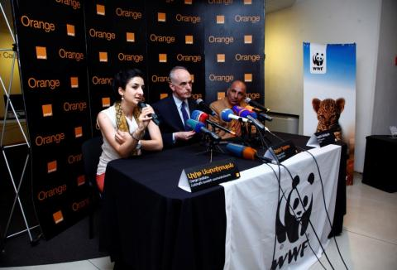
Milestones
Oct. 2008, a pilot project has been launched in France
19th Nov. 2009, France has launched eco-rating (93% of their mobiles covered and 100% of their fixed phones covered)
2nd Dec. 2009, Spain has launched eco-rating for mobiles (76% of their handsets covered)
17th Dec. 2009, OBS (on their French footprint) has launched for mobiles
14th Dec. 2010, Romania has launched for mobiles
26th June. 2012, Armenia has launched for mobiles

Slide 4
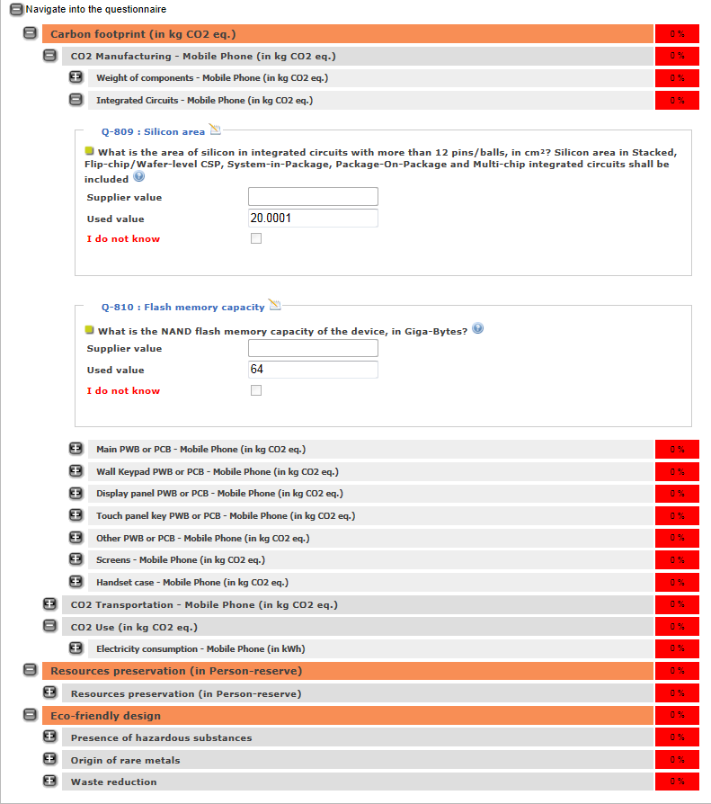
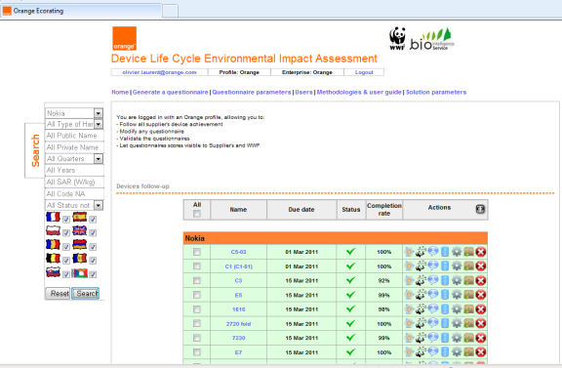
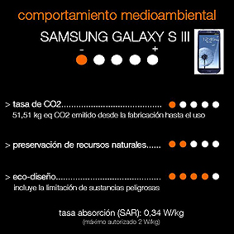
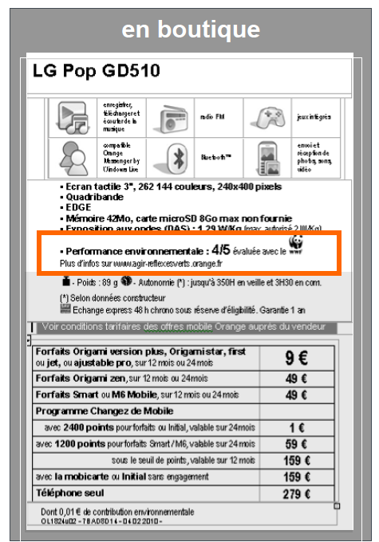
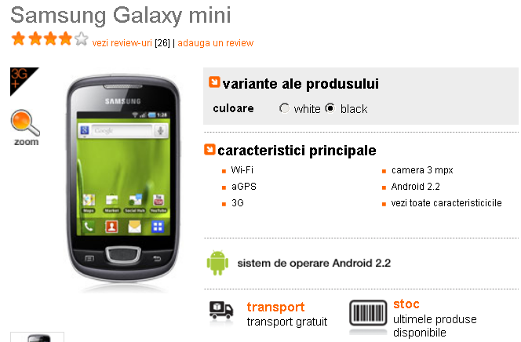
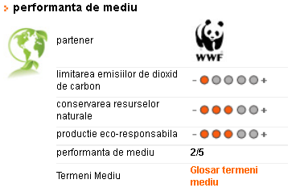
An industrial process
In ORANGE shops
The methodology defines & determines the criteria and the questions that enable each indicator to be calculated
On a web tool, we create a questionnaire for each selected device
The answers, are checked, validated by our experts then proceeded to the calculation
The final rating is then communicated to countries for communication on the web and in shops
Carbon footprint (CO₂ limitation)
Amount of CO₂ produced during all product life cycle
Resources preservation
actions taken by manufacturers to limit sensitive & non-renewable substances
Eco-friendly design, of which hazardous substances
highlights specific actions from manufacturers to reduce the environmental impact of their devices
All these indicators form an overall score, called the "environmental score".
The higher the score of environmental performance, the best is the device for the environment.

Slide 5
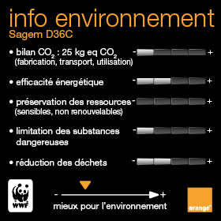
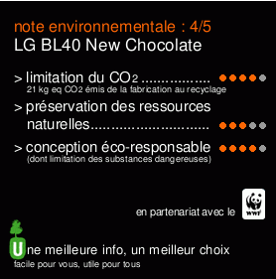
Evolution of the French Eco label
2012 Sofres survey: 59% of French people (similar to Orange’ customers) are concerned with the impact of Telecoms on the environment, +4% compared to 2010 but in the purchasing behavior, the environment is far behind prices and quality.
35% consider that ORANGE provides enough information on environmental labeling.
Consumers want a simple label
- Simple information may be incorrect or misleading,
- Precise and complex information is incomprehensible to the consumer,
- Taking into account only a few components can lead to a label with the same score for the same type of product
Notes:
Update of ratings online time consuming and tedious
Survey in 2012

Slide 6
Key success factors & main achievements
A partnership with a recognized NGO (WWF) to give initial credibility to the project
A gradual integration of the project with Group processes ensuring scalability
The establishment of a trust relationship with device manufacturers ensuring reliability of the answers provided
A contribution to French & European initiatives to share and promote our best practice
A new methodology published each year (now the CO₂ indicator is harmonized with SFR/Vodafone)
The development of an automatic web tool, managed by ORANGE
The implementation of audit for 14 suppliers with quite reliable results (PWC)
In total, 325 mobiles & 121 DECT have already been rated from all the suppliers (Apple excepted)
Our GSMA and ITU contribution to define a unique solution for 2015
Notes:
In total, 325 mobiles & 121 DECT have already been rated from all the suppliers (Apple excepted) with 92.51% completion rate for the questionnaire (feedbacks to every suppliers to improve their answers)
Apple wants to control its communication

Slide 7
RECOMMANDATIONS for an ITU STANDARD on ECOLABELING for Telecom Devices
The needs:
Coherence and coordination with the existing labeling requirements
Compliance with European laws and the rules of international trade
Utilization of public databases, consensual and free, developed in cooperation with stakeholders, and a calculation tool available to companies
An harmonized format of label to facilitate understanding by consumers and product comparisons
Consistency with European work
The EC has launched an experimentation (PEF) to identify sectorial approaches to measure the environmental footprint of products and organizations.
There are differences between European and French ADEME/AFNOR methodological standards.
Some difficulties have to be taken into account:
Labeling is costs and time consuming
The generic databases currently available are incomplete (IC, OLED screen…) and the accuracy unknown
The information given by the manufacturers are difficult to control : audits are required and there might be conflicts of interest.
Taking into account only a few components and using only secondary data can lead to a label with the same score for the same type of product
Notes:
In total, 325 mobiles & 121 DECT have already been rated from all the suppliers (Apple excepted) with 92.51% completion rate for the questionnaire (feedbacks to every suppliers to improve their answers)
Apple wants to control its communication

Slide 8
Thank you
Questions:
Elisabeth Dechenaux R&D expert for ORANGE
LCA Goods and services elisabeth.dechenaux@orange.com

