Slide 1






Mobile Devices ::
A New Product Sustainability Standard
William F. Hoffman III, Ph.D.
Distinguished Member of Technical Staff
UL Environment

Slide 2

WE ARE A GLOBAL FORCE
FOR GOOD
At UL, our mission of working for a
safer world since 1894 is at the core of
everything we do.
Advancing safety through careful research and investigation
Preventing or reducing loss of life
and property
Promoting safe living and working environments for all people
2

Slide 3





Safety is Evolving; So Is UL
With the definition of safety constantly advancing, UL has expanded our focus to include an unparalleled breadth of offerings across five business units.

Slide 4
Timeline
March – July 2010:: Stakeholder outreach and discussions
July 31, 2010:: ANSI PIN filed
September 2010:: Pilot begins
  ULE Science team engaged 5 manufacturers, along with Sprint, to discuss the standard requirements
  3-4 rounds of feedback were provided; ISR finalized in December
  Each manufacturer submitted a phone to be evaluated and certified
February 2011:: Draft Standard Released for Comment
  First certifications announced

Slide 5
Going from Outline of Investigation to ANSI Standard
The Finalized UL Standard served as the starting point for the development of an ANSI standard
A Standards Technical Panel (STP) has been assembled, combining ULE Science Team, Manufacturers, Retailers, NGOs, and others
No single interest group can make up more than 1/3 of panel
International participants are welcome
GEC/EPEAT is also actively working to include UL 110 as part of the registry

Slide 6
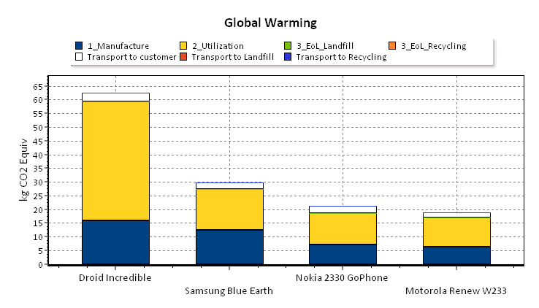
Life Cycle GHG Emissions
1 2 3 4
 | Sustainable | Business as Usual
Smart | 2 | 1
Feature | 4 | 3

Slide 7
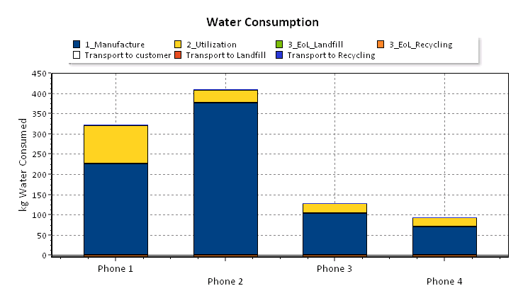
Life Cycle Water Consumption
1 2 3 4
 | Sustainable | Business as Usual
Smart | 2 | 1
Feature | 4 | 3

Slide 8
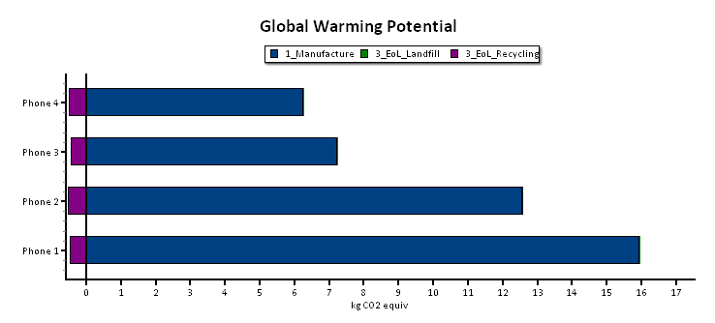
Influence of Recycled Content
 | Sustainable | Business as Usual
Smart | 2 | 1
Feature | 4 | 3

Slide 9
Categories of Criteria
Categories are a combination of life cycle stages and key performance areas beyond traditional LCA impact categories
  Environmentally sensitive materials
  Energy management
  Health and environment
  Product stewardship
  Packaging
  Manufacturing and operations
  Innovation

Slide 10
Overall Scoring
Mobile Phone Sustainability Achievement Matrix
Title of Section / Requirement Description | Points (max)
Materials | 15
Energy Use | 24
Health and Environment | 27
EOL Management and Life Extension | 12
Packaging | 13
Manufacturing and Operations | 18
Total | 109
Innovation | 10
Level of Achievement | Points Required
Certified | 55% of available (60 points)
Platinum | 73% of available (80 points)

Slide 11
Contact Information
Bill Hoffman Senior Scientist T: 847-664-1112 bill.hoffman@ul.com

Slide 12
Open Questions and Discussion

Slide 13

Thank you

Slide 14

UL Environment Mission
  UL Environment works to promote global sustainability, environmental health, and safety by supporting the growth and development of environmentally preferable products, services, and organizations. We help companies achieve their sustainability goals—and help purchasers, specifiers, retailers, governments, and consumers find products they can trust.

Slide 15

WE PROVIDE GLOBAL MARKET
ACCEPTANCE
Our Marks are on more than 23 billion products worldwide, per year, signaling
peace of mind to consumers, customers, businesses and governments.
15

Slide 16
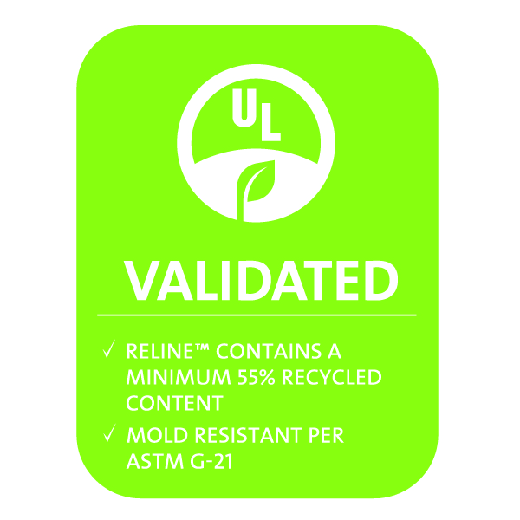
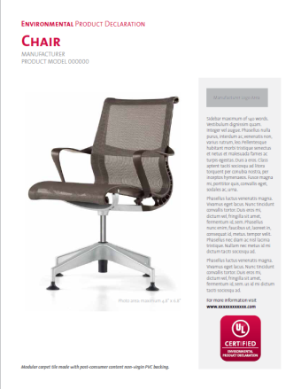

Service Offerings Overview
Sustainable Products Certification (SPC)SM
Description: a certification program for existing environmentally preferred product standards (both UL Environment developed and other 3rd party )
Environmental Claims Validation (ECV)SM
Description: a validation program for environmental claims on attributes of the product, can be single attribute or a combination of attributes related to a product or process
Environmental Product Declaration
Description: a third-party means of declaring environmental impacts, based on Life Cycle Assessment.

Slide 17


UL Environment Family
EcoLogo Certification
Description: a certification program for existing EcoLogo standards
GREENGUARD Certification
Description: a certification program for indoor air quality, human health impacts and building construction

Slide 18
Environmentally Sustainable Materials
Materials acquisition
Known substances of concern
Specific supply chain issues
Recycled content
Prerequisites | Section/ Paragraph Reference | Title of Section / Requirement Description | Points (max)
Materials
 | 8.1 | Conflict Minerals | 1
 | 8.2 | REACH SVHC compliance | 5
 | 9.1.1 | Recycled or bio-based plastic in the product housing | 5
 | 9.1.2 | Recycled or bio-based content in the housing of the power supply | 4
 |  | Total | 15

Slide 19
Energy Use
Product energy use or performance
Charging systems
Potential energy savings
Prerequisites | Section/ Paragraph Reference | Title of Section / Requirement Description | Points (max)
Energy Use
 | 10.1 | Charger connector | 2
 | 10.2 | External Power Supply energy use | 20
 | 10.3 | Handset Connector | 2
 |  | Total | 24

Slide 20
Health and Environment
Specific restricted substances
Product and accessories
Prerequisites | Section/ Paragraph Reference | Title of Section / Requirement Description | Points (max)
Substance Restrictions
Required | 11.1 | RoHS Compliance | Required
Required | 11.2 | Extractable Nickel | Required
 | 11.3 | Elimination of PVC | 3
 | 11.4 | Phthalates | 2
 | 11.5 | Low Halogen PWB | 2
 | 11.6 | Low Halogen Handset | 3
 | 11.7 | Low beryllium content | 2
Required | 11.8 | Low Cadmium and Mercury batteries | Required
Required | 11.9 | Low Pentachlorophenol, dibutyltin and dioxcyltin, azo dyes, dimethylfumarate in accessories | Required

Slide 21
Health and Environment
General toxicology review
Documented process ULE 113
Focused on most likely source of exposure for mobile products – dermal contact
Prerequisites | Section/ Paragraph Reference | Title of Section / Requirement Description | Points (max)
Toxicology Review
 | 12.1 | Dermal contact toxicology review | 3
 | 12.2 | Acceptable profile | 5

Slide 22
Health and Environment
Overall performance of product
Link key impacts with corporate performance and planning
Prerequisites | Section/ Paragraph Reference | Title of Section / Requirement Description | Points (max)
LCA
 | 13.1.1 | LCA | 3
 | 13.2 | Independent review of LCA | 2
 | 13.3 | LCA results reflected in CS plan | 2
 |  | Total | 27

Slide 23
Product Stewardship
All EOL topics including recycling and life extension
Design feature that improve disassembly or separation of materials
Design features that encourage life extension
Prerequisites | Section/ Paragraph Reference | Title of Section / Requirement Description | Points (max)
EOL Management and Life Extension
 | 14.1 | Take-back program | 2
 | 14.2 | Recyclability | 5
 | 14.3 | Replacement Parts | 1
 | 14.4 | Recycler auditing | 1
Required | 14.5 | Battery removal | Required
 | 14.6 | Easy disassembly | 1
 | 14.7 | Common plastics for whole product | 1
 | 14.8 | Memory erasure capability | 1
 |  | Total | 12

Slide 24
Packaging
Could include both POS and transport
POS Design for recyclability in municipal systems
Prerequisites | Section/ Paragraph Reference | Title of Section / Requirement Description | Points (max)
Packaging
 | 15.1 | Fiber based Packaging | 3
 | 15.2 | Plastic packaging recycled content | 2
Required | 15.3 | No Expanded polystyrene packaging | Required
 | 15.4 | Fiberboard content, recycled material, certified, chlorine free, rapidly renewable. | 3
Required | 15.5 | Low Cd, Pb, Hg, Cr(VI) packaging | Required
 | 15.6 | Non-petroleum based ink | 1
 | 15.7 | Glue free or water based adhesive | 1
 | 15.8 | Packaging volume | 3
 |  | Total | 13

Slide 25
Manufacturing and Operations
Facilities performance
Corporate Social Responsibility
Supply Chain management for social issues
Prerequisites |  | Section/ Paragraph Reference | Title of Section / Requirement Description | Points (max)
Manufacturing and Operations
 | 16.1 |  | CSR Action Plan | 4
 | 16.2 |  | Publishing of CSR report | 2
 | 16.3 |  | Third party validation | 1
 | 16.4 |  | Supplier or ODM compliant with CSAP | 2
Required | 17.1 |  | Publicly available EHS policy | Required
 | 17.2 |  | Formal EMS program and certification | 2
 | 18.1 |  | Supply chain impacts | 5
 | 18.2 |  | Final assembly manufacturing site certification to ISO 14001 or EMAS | 2
 |  |  | Total | 18

Slide 26
Innovation
Innovative ways to reduce impact that are not covered in the standard
  Energy offsets
  Applications that reduce environmental impact
  Alternative materials use
Must be able to show genuine sustainability benefit using LCA or other
tool for assessing sustainability of the product.

Slide 27
Detail for End of Life Criterion

Slide 28
End of Life Management and Extension of Useful Life
Required – Mobile phone take back program
  A take-back program for the mobile phone, power supply and accessories shall be provided in OECD markets in which the product is being certified against this Standard. The program shall be promoted to the end user through the manufacturer’s recycling web site and either an in box promotion, user manual or other similar means. The program shall also be free to the consumer at the time of service / recycling.
Optional - Mobile Phone Refurbishing and reuse program
  If the take-back program in 13.1.1 reuses 30% of the phones accepted in the recycling program as a whole or components of the phone as part of the program rather than recycling of material, an additional two points will be awarded. Point value: 2.

Slide 29
Mobile Phone Recyclability Rate
Optional
The mobile phone recyclability rate shall be awarded points based on levels defined in Table 13.1.
Table 13.1 Mobile Phone Recyclability Rate Points Recyclability Points Awarded
Recyclability Rate | Points
>60 | 1
>70 | 2
>80 | 3
>90 | 4

Slide 30
Recyclability Calculation
Procedure
1) Weigh handset including battery and battery door; record in the data table below.
2) Disassembly
a) The goal of disassembly is to sort the parts into the following fractions of material:
1) Batteries;
2) Metal;
3) Glass;
4) Plastic;
5) Mixed electronics (PWB, wire, flex, displays (LCD’s); and/or
6) Non-recyclable.

Slide 31
Recyclability Calculation
Plastic Part Recyclability
Plastic parts are considered recyclable if they meet the following criteria are met:
    <10% of the surface area is coated with paint, metalization, glue, or other non-plastic materials;
    <5% of the part or assembly is made of a different material or different type of base plastic; and
    There are no metal inserts that are not easily removed with a quick pull of a tool;. If these criteria are not met, the plastic goes to the non-recyclable fraction.

Slide 32
Recyclability Calculation
Alternative Plastic Recyclability
    Less than a 50% reduction in room temperature impact strength of the original resin specifications using either the unnotched Izod or unnotched Charpy.
    Both coated and uncoated plastic that have been exposed to the same number of thermal molding cycles should be tested.
    A minimum of 10 each of coated and uncoated plastic samples should be tested.
    If inclusions or imperfections in the test samples cause more than a 50% decrease in impact strength in any of the test specimens made from plastic with the coating the coated part under test is considered to have failed completely and is not recyclable. If all the test specimens are within 50% of each other and less than a 50% decrease in impact strength the coated sample is considered recyclable.

Slide 33
Other End of Life Considerations
Optional – Availability of Replacement Parts
    At a minimum, replacement parts and/or product service shall be provided by the manufacturer or authorized third party for batteries, external power supply, headphones, and cables, LCD, and housing.
  Required – Primary Recyclers Certified to R2, e-Stewards or Equivalent
  Required – Removable Battery
    Primary batteries of mobile phones shall be removable by a technician for separate treatment to be recycled at end of life.
  Optional – Ease of Removing External Housing of Mobile Phones
    All connections required to open the mobile phone housing shall be disassembled from the same direction
Optional – Use of Similar or Compatible Plastic Materials

Slide 34
Battery Removal
Required – Battery Removability
    All batteries shall be readily removable by the user without the use of proprietary tools. Adhesives used to secure the battery within the phone shall be low adhesion, removable with hand force and no additional heat
  Optional – Battery Replaceable by Consumer
  Main battery shall be replaceable by the consumer with the use of standard torx, phillips, blade drivers, or without the use of any tools. Adhesives used to secure the battery within the phone shall be low adhesion, removable with hand force and no additional heat. Battery shall not be soldered to the PWB. The following points shall be awarded:
    No tools: Point value: 8
    Standard torx, phillips or blade drivers: Point value: 5
    Battery Not User Replaceable: Point value: -2

Slide 35
Ease of Disassembly
Optional – Ease of Disassembling Mobile Phones
  Use standard torx, phillips , blade drivers, or non-proprietary tools, to allow access to the screen, primary circuit board, and battery by a qualified service technician without causing damage to the phone. Adhesives shall not be used to prevent removal of the display assembly, outer case, screen protector / glass, battery, or primary circuit board. Adhesives used elsewhere in the enclosure of the phone shall be heat sensitive and removable by heating to no more than 275°F. The following points shall be awarded:
  Required - Ease of Removing External Enclosure of Mobile Phone
  Phones shall not have an external housing which is glued or solvent welded to form the completed product without the use of reversible connections (e.g. screws or snaps). Included are adhesives with a softening point above 275°F.

Slide 36
Extending Lifetime of Phone
Optional – Feature to Erase User Data from Mobile Phone
Required - Public Availability of Repair Manuals
  Exploded diagram of parts, compatibility charts, step-by-step disassembly instructions with required tools, product specifications, maintenance procedures, and troubleshooting information. This documentation should be available both as HTML and The Open Manual Format, and licensed under the Creative Commons (CC-BY 3.0) or compatible license.

Slide 37
Criterion 11.2 – Extractable Nickel
Specific test method
Clear threshold for compliance
11.2 Required - Extractable Nickel - Exterior surfaces of the mobile phone shall not release nickel in excess of 0.5 µg/cm²/week as determined by Reference test method for release of nickel from products intended to come into direct and prolonged contact with the skin, EN 1811, and Method for the simulation of wear and corrosion for the detection of nickel release from coated items, EN 12472. In lieu of testing data on free nickel, the manufacturer may provide documentation regarding the materials used in the manufacture of the exterior surface that sufficiently demonstrates that nickel has not been used. Such data includes, but is not limited to, formulations of specific components and design specifications.
11.2 Required - Extractable Nickel - Exterior surfaces of the mobile phone shall not release nickel in excess of 0.5 µg/cm²/week as determined by Reference test method for release of nickel from products intended to come into direct and prolonged contact with the skin, EN 1811, and Method for the simulation of wear and corrosion for the detection of nickel release from coated items, EN 12472. In lieu of testing data on free nickel, the manufacturer may provide documentation regarding the materials used in the manufacture of the exterior surface that sufficiently demonstrates that nickel has not been used. Such data includes, but is not limited to, formulations of specific components and design specifications.
Alternative methods that don’t require testing

Slide 38
Criterion 16.1 Optional – Corporate Sustainability (CS) Action Plan
16.1 Optional - Corporate Sustainability (CS) Action Plan - The manufacturer shall adopt a Corporate Sustainability (CS) Action Plan which the company is actively pursuing. Evidence of completion of the criteria shall be in the form of a CS report and/or documentation of action team meetings, meeting notes and action plans shall fulfill the requirements of the criteria. Point value: 4.
The Action Plan shall include:
a) Clear statement of scope and boundaries.
b) Statement of company governance, commitments, and engagement including stakeholder engagement and external initiatives.
c) Consideration of the following performance indicators in the report with reporting on progress for the indicators chosen from the list below of potential indicators which are material for a given company:
1) Environmental:
2) Human Rights:
3) Labor Practices and Decent Work:
4) Society:.
5) Product Responsibility:
6) Economic:

