Slide 1






Review of Mobile Handset
Eco-Rating Schemes
John Smiciklas
Principal, MJRD Assessment Inc

Slide 2
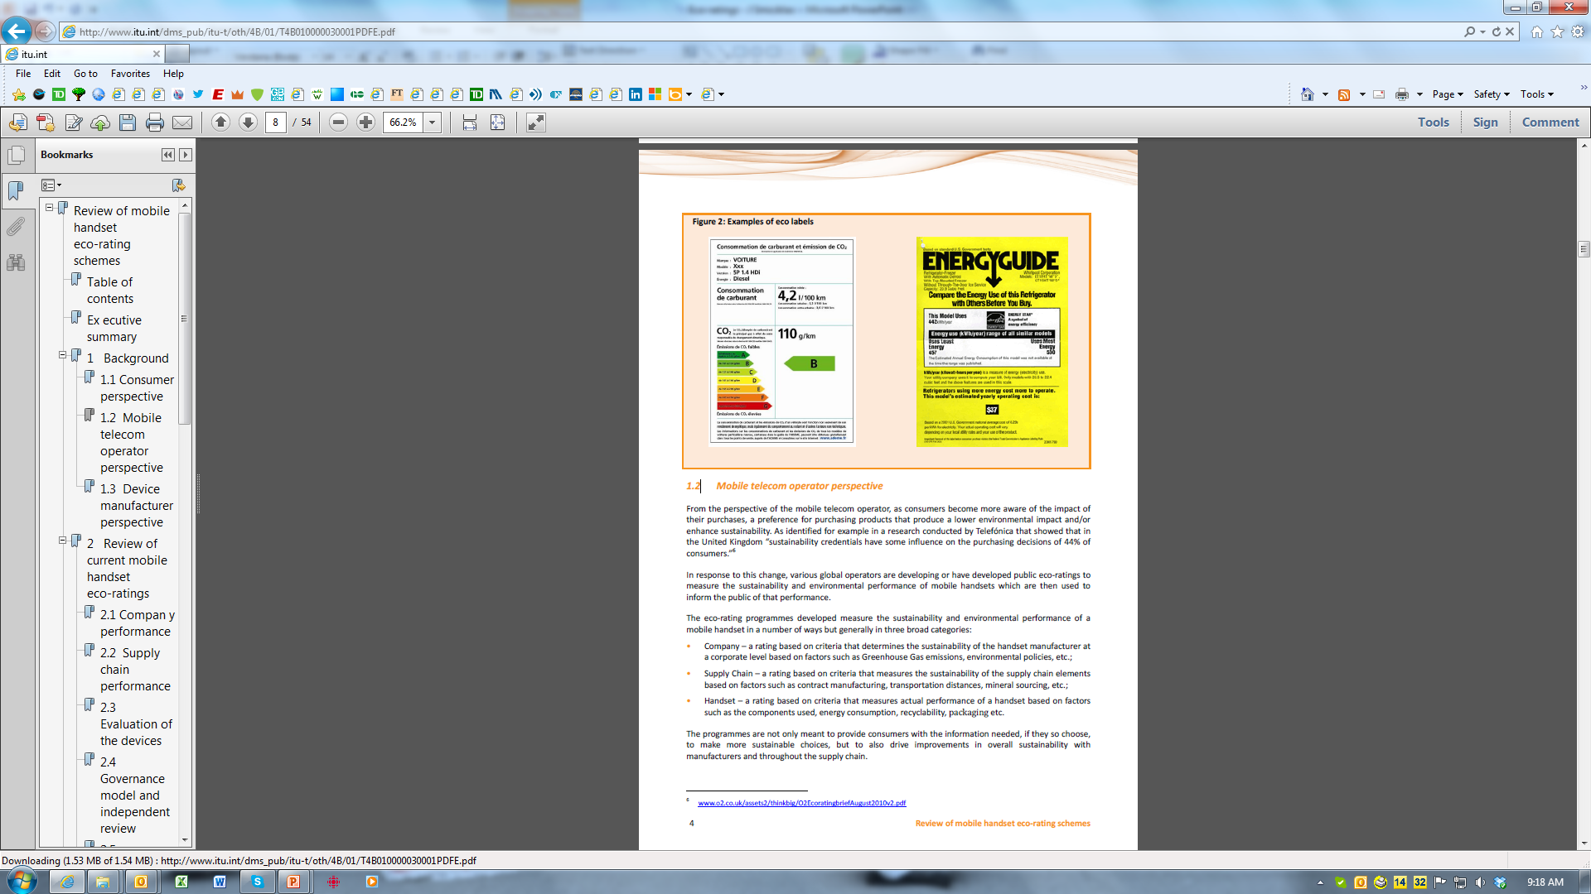

Background
Sustainability issues are increasingly becoming more visible and significant
  Climate Change
  Ethical Supply Chains
  Toxic Materials
  Resource Scarcity
  Management of Waste
Range of industries have developed sustainability rating schemes

Slide 3
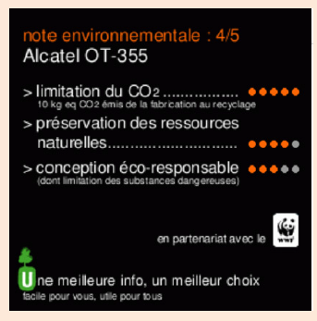
Background
Mobile telecom operators and other organizations have developed various eco-rating schemes to communicate the sustainability performance of their products to consumers

Slide 4
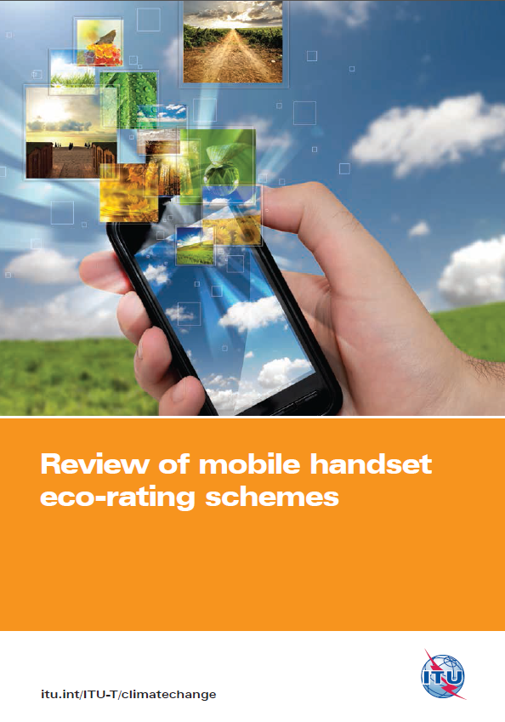
Background
ITU-T undertook study in 2012 to review the various initiatives
Determine a potential framework for a global standardised methodology for eco-labels
Consistency of information
Reduction of effort for all parties

Slide 5
Study Format
Review current eco-rating programs
Analysis of similarities and differences
Baseline performance
Best practices
Contribution to ITU-T Study Group 5 “Environment and climate change”

Slide 6
Review of Current Eco-Ratings
AT&T
France Telecom/ Orange
Telefonica / O2
Sprint
Vodafone
Underwriters Laboratories
Bell Canada

Slide 7
Review of Current Eco-Ratings
Current Eco-Ratings measure performance based on:
  Company Performance
  Supply Chain Performance
  Handset Performance

Slide 8
Eco-rating Study Findings
Areas of Focus within Company Performance
Measured with respect to policies and performance related to:
Greenhouse Gas (GHG) Performance
Environmental Performance
Social, Ethical, Labour, Health and Safety Performance
As it applies to the handset brand organisation

Slide 9
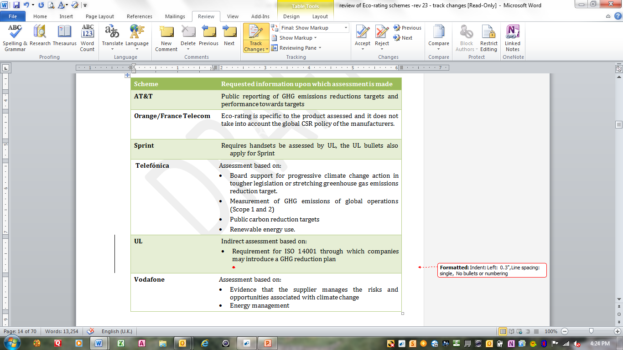
Eco-rating Study Findings
Areas of Focus within Company Performance

Slide 10
Eco-rating Study Findings
Areas of Focus within Supply Chain Performance
Measured with respect to policies and performance related to:
Greenhouse Gas (GHG) Performance
Environmental Performance
Social, Ethical, Labour, Health and Safety Performance
As it applies to the supply chain

Slide 11
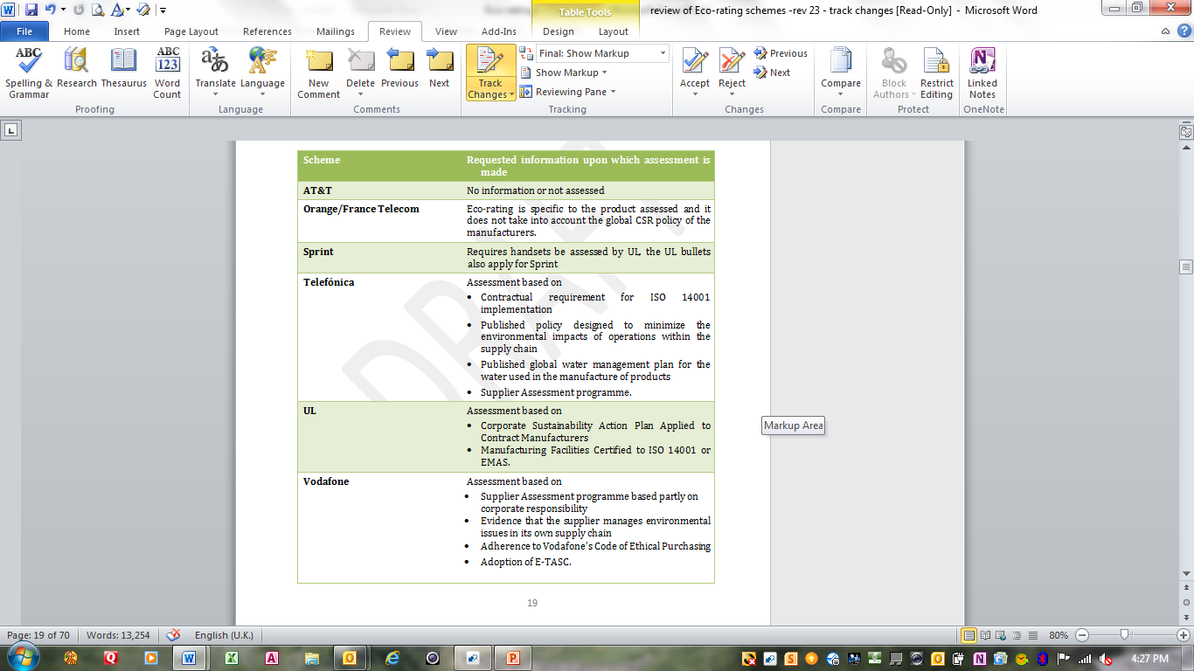
Eco-rating Study Findings
Areas of Focus within Supply Chain Performance

Slide 12
Eco-rating Study Findings
Areas of Focus within Handset Performance
Carbon Footprint
Materials
Hazardous Materials Management and Elimination
Packaging
Energy Efficiency
Innovation, Enabling Effect and Dematerialization
Device Life and Recycling
Life Cycle Assessment
The sum of these measures provides an overall view of the sustainability of the handset

Slide 13
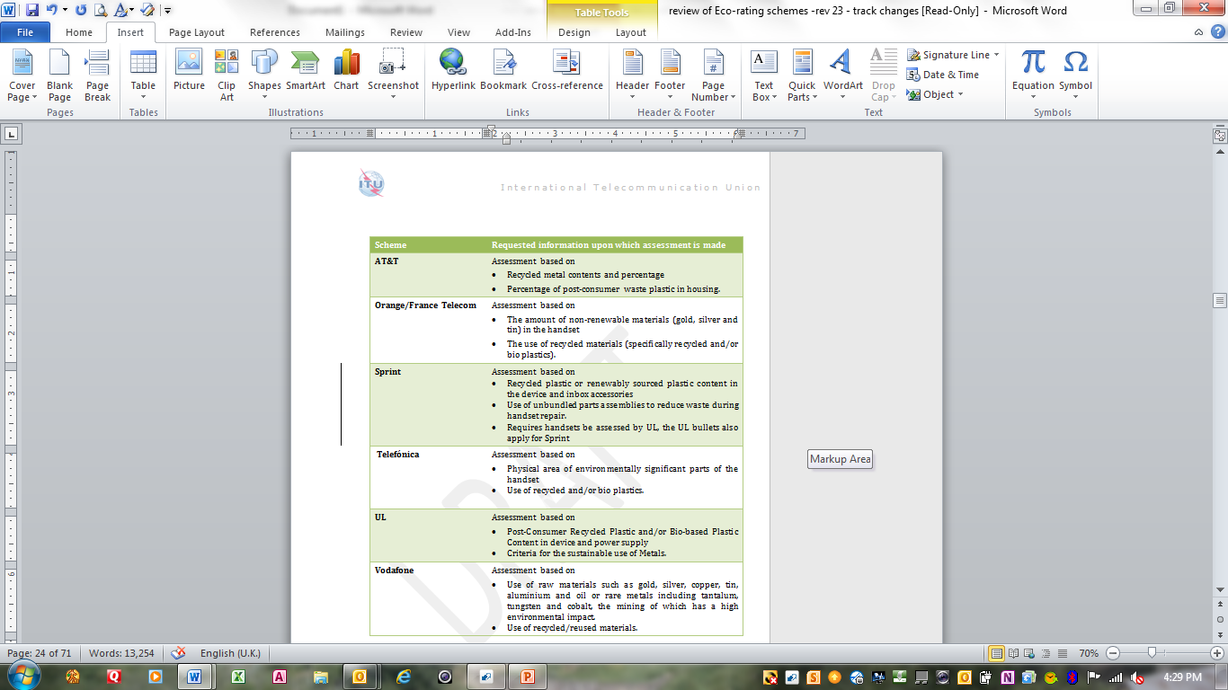
Eco-rating Study Findings
Areas of Focus within Handset Performance

Slide 14
Eco-rating Study Findings
Baseline and Best Practices
Suggested Baseline (Minimum Performance Expectation)
  An evaluation of resource management (using less material to produce a device with the same functionality).
Suggested Best Practice (Highlights for Better Performance)
  Best practice should be to highlight and provide better scores for those devices that also minimize the use of resources that are particularly scarce. In particular, the evaluation of the use of rare earth metals is appropriate as it impacts both financial and sustainability issues.

Slide 15
Eco-rating Study Findings
Governance Model and Independent Review
In any eco-rating scheme that wants to communicate the environmental performance of a product or service to the consumer, it is essential that there be a solid scientific basis for the evaluation and some manner of external consultation, evaluation and verification.
Consultation examples
O2/Telefonica – Forum for the Future
Vodafone – SKM Enviros
Verification example
France Telecom - PricewaterhouseCoopers

Slide 16
Potential Basis for a Standardised Eco-Rating Mobile Handsets
Provide a comprehensive and comparative ranking of the sustainability of a mobile handset through the analysis of the company, supply chain and handset sustainability performance.
Demand mandatory minimum requirements within each area to ensure minimum sustainability performance within the company, supply chain and handset aspects.

Slide 17
Potential Basis for a Standardised Eco-Rating Mobile Handsets
Have a scoring point system that provides for additional credit for superior performance within each area of evaluation. Be based on an overall life cycle approach.
Be simple to complete and to understand for all stakeholders.
Provide for incentives for manufacturers to improve performance.
Provide for innovation in sustainability to be scored and promoted.

Slide 18
Standardised Eco-Rating - Mobile Handsets
Potential Benefits
Consistency in messaging to the consumer and other interested stakeholders
Reduction in effort for manufacturers to compile data
Reduction in effort for mobile operators to develop and maintain internally developed eco-ratings
Provide direction to the entire design, manufacturing and supply chain functions, steering them to common sustainability goals as set out by the tool.
A single global eco-rating scheme should build upon the current work developed by mobile carriers and manufacturers.
The inclusion of Recommendation ITU-T L.1000
The inclusion of Recommendation ITU-T L.1410

Slide 19
ITU-T Study Group 5
Next Steps
Areas for ITU-T Study Group 5 to consider:
Define what a successful outcome would be
Agree on the areas of evaluation or the questions that would form the basis for an eco-rating scheme
Join forces with active alignment initiatives (GSMA Eco rating working group, UL working group and other interested stakeholders)
Agree on a methodology for scoring or ranking
Agree what attributes of a mobile handset should be mandatory minimum attributes
Coordinate the work stream
Maintain ownership of the tools developed and the accompanying data.

Slide 20
Thank you
Report can be downloaded at :
http://www.itu.int/dms_pub/itu-t/oth/4B/01/T4B010000030001PDFE.pdf
Questions:
John Smiciklas
Principal, MJRD Assessment Inc.
Oakville, Ontario Canada
john.smiciklas@sympatico.ca

