Slide 1






Forum on Greening Mobile Devices: Building Eco-Rating Schemes
Daniela Torres
Global Head of Green ICT & Environment, Telefónica S.A
Associate Rapporteur ITU-SG5 Q16

Slide 2


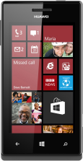
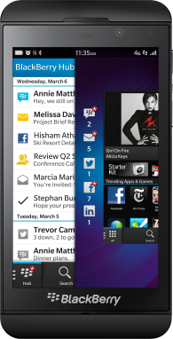
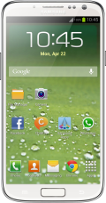

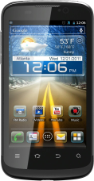
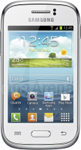

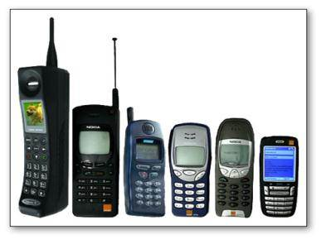


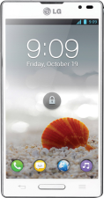

Mobile phones have made a revolution in our world
Mobile
subscribers surpassed 6.4 Bn...
Smartphone users reached
1.1 Bn...
Smartphone users
rose by 42%...
24/7
...reaching
90% o/Pop
...but only 17% of mobile subscribers.
...>90% keep mobile 24h/7d
Eco-efficiency of mobile phones has improved since 80`
Internet users grew
up to 2.4 Bn...
...90% of growth from emerging markets
...4 kg to 0,1kg of weight
Source: Telefónica S.A, GSMA, ITU

Slide 3
Eco-Rating Schemes for Mobile Phones
PAST
Different eco-rating programs & schemes
PRESENT
ITU-T Q16 on Environmental Sustainability of ICTs
FUTURE
Towards a unified eco-rating system for mobile phones
Draft Recommendation Highlights

Slide 4


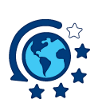


Eco-Rating Schemes for Mobile Phones
THE PAST
2011
Individual efforts of Eco-Rating programs
& schemes
2012
ITU Report on Eco-Rating Schemes
GSMA Group on Eco-Rating & Assestment
2012
Creation of Q16 on ITU-T SG5
Establishment of the need for a Recommendation
2013
Drafting of the new Reccomendation

Slide 5
Individual efforts in designing Eco-Rating schemes
THE PAST
ICT Organization decision to develop a program
Definition of technical & comparison criteria (LCA Approach)
Definition of rating & scoring criteria
Request and evaluation of information
Communication of results (internal of external)
1
2
3
4
5
STEP
RESULT
ECO-SPECIFICATION CRITERIA
ECO-RATING CRITERIA
ECO-LABEL

Slide 6
Individual efforts in designing Eco-Rating schemes
THE PAST
RESULTS
Different eco-specifications & rating criteria
Large processes of gathering & processing information
Different results of programs
Different information to the user

Slide 7

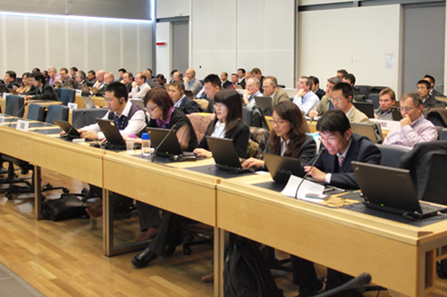
ITU-T Study Group 5
THE PRESENT
3 WORKING PARTIES
WP1/5: Damage prevention and safety
Responsible for studies relating to ICT,
environment and climate change
WP2/5: Electromagnetic fields
Development of methodologies for
evaluating the ICT effects on climate change
WP3/5: Environment & Climate Change
Publishing guidelines for using ICTs in
an eco-friendly way.
1
2
3

Slide 8
ITU-T Study Group 5 WP3 and Question16
THE PRESENT
Q13/5 - Environmental impact reduction including e-waste
Q14/5 - Setting up a low cost telecom infrastructure for rural communications in developing countries
Q15/5 - ICTs and adaptation to the effects of climate change
Q16/5 - Leveraging and enhancing ICT environmental sustainability
Q17/5 - Energy efficiency for the ICT sector and harmonization of environmental standards
Q18/5 - Methodologies for the assessment of environmental impact of ICT
Q19/5 - Power feeding systems
MAIN TASKS
To develop recommendations to assess the added value of an eco-rating program for mobile phones.
To investigate what are the principles, benefits, drawbacks underlying the creation of a worldwide database containing key indicators and/or emission factors
Q16

Slide 9














Active members in drafting the new Recommendation
THE PRESENT
MANUFACTURERS
TELECOM OPERATORS

Slide 10
Draft Recommendation Highlights
Recommendation for eco-specifications and rating criteria for mobile phones eco-rating programs
THE PRESENT
OBJECTIVE
This Recommendation outlines an auditable assessment framework and the criteria to assess the main environmental performance of mobile phones.
SCOPE
To identify attributes having a high impact on the environmental footprint of a mobile phone pulling from established applicable standards
To define the scoring method to quantify these impacts that will reflect the performance of the mobile phone from an environmental point of view.
This Recommendation is targeting all mobile phones. It is intended that consumers around the world will see the same rating for the same mobile phone irrespective of where this mobile phone is sold.
Source: Draft Recommendation on V3

Slide 11
Draft Recommendation Highlights
THE FUTURE
  Prioritization: Focus on high impact attributes.
  Alignment: other standards & ITU-T work
  Simplicity: Easy-to-understand for consumers.
  Differentiation: Include performance criteria for different ambition levels.
  Transparency: provide information on the methodology.
  Credibility: demonstrate collaboration of mobile industry.
  Consistency: Consider regional requirements
  Feasibility and cost-benefits consideration
  Preserving and enabling innovation
  Verifiability: after its use
PRINCIPLES
Source: Draft Recommendation on V3

Slide 12
Draft Recommendation Highlights
THE PRESENT
ECO-SPECIFICATIONS
Device characteristics
DISCUSSION POINTS
Use Impact
Carbon footprint
Raw materials & manufacturing
Sustainable design
Substances of Concern
Packaging
Energy Efficiency
Product Stewardship
Transportation impact
Supply chain impacts
Corporate sustainability
…

Slide 13
Q16 future meetings
THE FUTURE
Q16 e-meeting: 24th September 2013
Physical meeting: Naples. 21st to 24th of October 2013
Q16 e-meeting: 5th of November 2013
Physical meeting: SG5 meeting in Lima (2nd to 13th of December 2013).
FOCUS
  Close eco-specifications & move to eco-rating criteria
  Improve the draft
  Share results with external parties
  …

Slide 14


THE FUTURE
An unified eco-rating system for mobile phones

Slide 15
Gracias - Thank you
Daniela Torres
Global Head of Green ICT & Environment, Telefónica S.A
Associate Rapporteur ITU-SG5 Q16
@alisdaniela
daniela.torres@telefonica.com

