Slide 1






E-Waste in Telefónica
Maya Ormazabal Herrero

Slide 2
Content
01
Green ICT & Environment in Telefónica
E-Waste Management in Telefónica
Green ICT Standards for E-Waste Management
02
03

Slide 3

01
Green ICT & Environment in Telefónica

Slide 4





01
Green ICT & Environment in Telefónica
Telefónica today
24
317
130
000
Integrated ICT services
Countries
Million of clients
Professionals
5.8
1.7
TOP
2700
TWh
M T CO2eq
DJSI and CDP
T E-waste

Slide 5
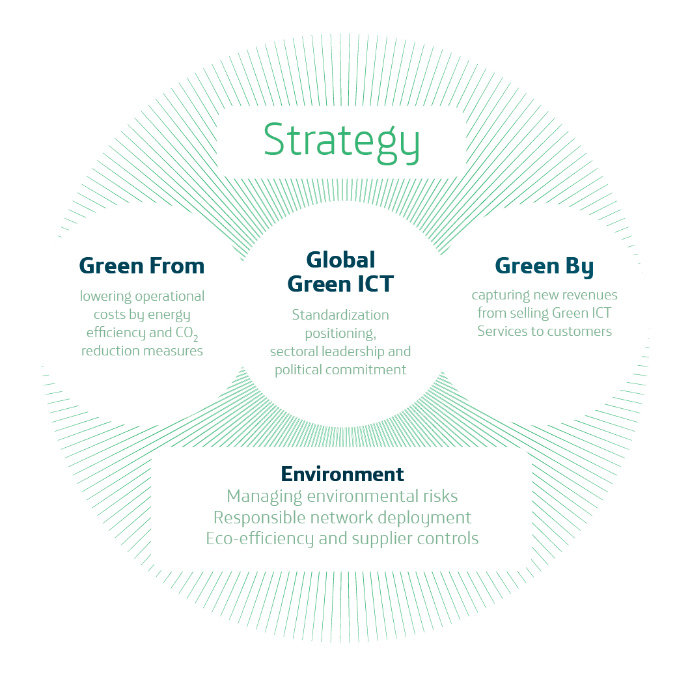
01
Green ICT & Environment in Telefónica
Environment, Energy & Climate Change Strategy
Green ICTs are:
Internal Eco-efficiency for energy, CO2, water and waste
Effective management of local and global environmental risks.
Deliver Green ICT services for efficient management of water, waste, energy, etc.

Slide 6

02
E-WASTE Management in Telefónica

Slide 7
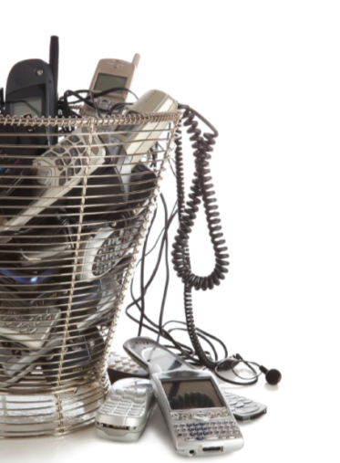
02
E-WASTE Management in Telefónica
E-Waste management Policy
To promote E-Waste management models according to local environmental legislation and principles of shared responsibility.
To manage E-waste in Telefónica operations under principles of eco-efficiency
To promote standards that reduce the generation of E-Waste and improve the eco-design of EEE for telecommunications services
To develop procurement policies for EEE for telecommunications services that facilitate their re-use and recycling at the end of its useful life.
To provide our customers environmentally responsible options when disposing their devices and provide information on responsible management of E-Waste
To control the reuse and recycling processes of e-waste management from service providers, ensuring compliance with environmental legislation and our Business Principles

Slide 8
02
E-WASTE Management in Telefónica
E-Waste sources in Telefónica and management options
Operations
Fixed and mobile networks
- RF equipment
- Antennas
- Test equipment,
- etc. .
Ofices & Shops
- PCs
- telephones
- fax, TVs
- technical service devices
Residential and corporate customers
- mobile phones
- routers
- fixed phones
- PCs
Delivery to qualified waste management suppliers
Recovery of equipment by manufacturers
Recycling and buy back programs

Slide 9
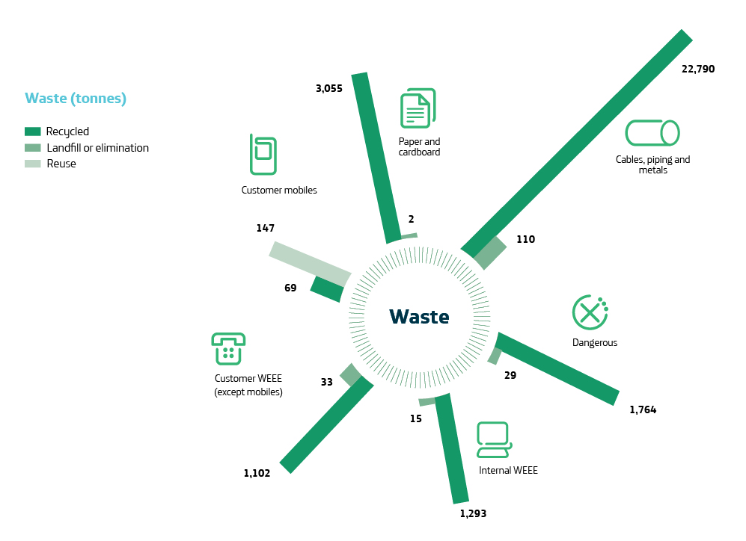
02
E-WASTE Management in Telefónica
E-Waste sources in Telefónica and management options

Slide 10


02
E-WASTE Management in Telefónica
E-Waste management challenges
Heterogeneous Environmental Regulation
→ Need to define roles & responsibilities (producers, distributors and consumers)
Qualified waste management suppliers
→ Need of e-waste management alternatives
Sustainable and eco-efficient programs
→ Need to reduce financial burden
Temporal storage of waste
→ Need of coordinated logistic programs
Environmental control to suppliers
→ Need to develop environmental audits.

Slide 11



02
E-WASTE Management in Telefónica
E-Waste management system
Reuse of EEE
Refurbish and reuse programs
Recycling programs
Moving to a more global responsibilities
From national to Regional/ Global programs
Global suppliers
All options in all countries (empowerment of e-waste management in some countries)

Slide 12

03
Importance of Green ICT Standards for
E-Waste Management

Slide 13

03
Importance of Green ICT Stantdards for E-Waste Management
Green ICT standards and e-waste management
EFICIENCY & TRANSPARENCY ON E-WASTE MANGEMENT
Promotion of eco-design, re-use and responsible management
CONSENSUS AMONG ALL PARTIES
Discussion between governments and ICT companies (manufacturers & operators)
LIFE CYCLE ANALYSIS APPROACH
Expertice on ICTs, environment and climate change

Slide 14

Thank you

