Slide 1






The organisation of WEEE collection in Catalonia
Belén Gállego Peiré

Slide 2
INDEX
The Catalan Waste Agency
Legal framework
Implementation in Catalonia
  Positive points
  Points to work on
Conclusions

Slide 3
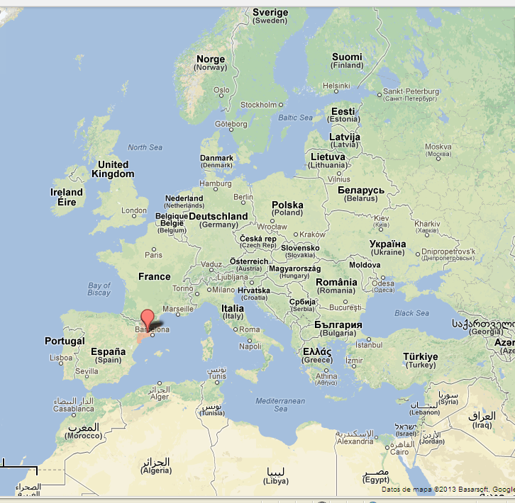
THE CATALAN WASTE AGENCY
AGÈNCIA DE RESIDUS DE CATALUNYA (ARC)
Public company attached to the Ministry of Territory and Sustainability of the Government of Catalonia, responsible for managing the waste generated throughout Catalonia.
Objectives:
to promote the reduction of waste and the danger it poses
to promote waste recycling
to minimise refuse disposal
the recovery of contaminated soils
CATALONIA
7,5 M inhabitants (2012)
Barcelona
SPAIN
Notes:
I work for the Catalan Waste Agency, a public company of the Government of Catalonia.
Catalonia is a region of the North-East of Spain, with about 7,5 milion inhabitants.
Our company is responsible for managing all the waste generated in Catalonia, including:
Industrial Municipal Construction waste
Our objectives are:
to promote the reduction of waste and the danger it poses
to promote waste recycling
to minimise refuse disposal
the recovery of contaminated soils
Our purpose is:
to prevent the impact of waste generation and management
to reduce the impact of resource use and to improve the efficiency of such use

Slide 4



LEGAL FRAMEWORK
Directive 2002/96/EC, promoting the collection and recycling of waste electrical and electronic equipment (WEEE)
Directive 2003/108/EC and Directive 2008/34/EC, amending Directive 2002/96/CE on waste electrical and electronic equipment (WEEE)
Directive 2012/19/EU on Waste electrical and electronic (WEEE)
Directive 2002/95/EC on the restriction of the use of certain hazardous substances in electrical and electronic equipment (ROHS)
Royal Decree 208/2005, on electrical and electronic equipment and the management of its waste
Corrigendum of Royal Decree 208/2005

Slide 5






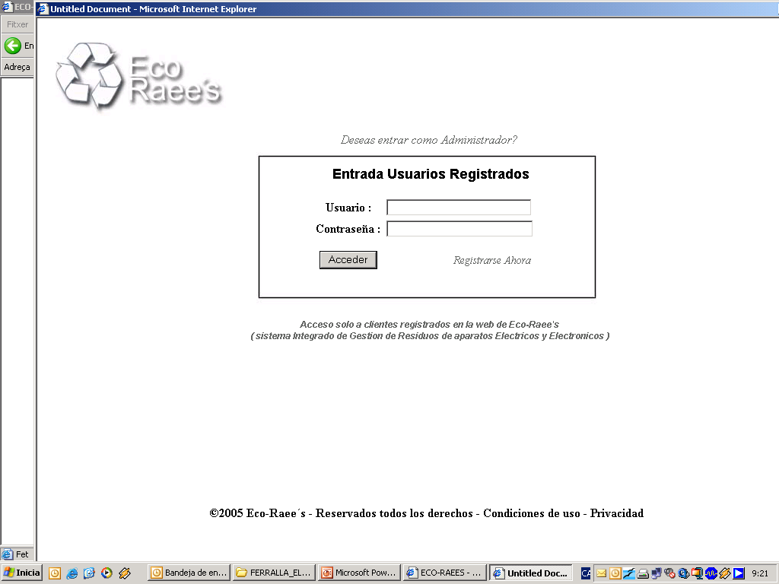


IMPLEMENTATION IN CATALONIA
Producers can choose between two procedures to guarantee separate collection and the proper treatment of WEEE:
Implementation of an individual management system: 10 systems authorised in Catalonia
Participation in one or several authorised integrated management systems (collective scheme): 9 systems authorised in Catalonia (2007) and reauthorized (2012-2017)

Slide 6
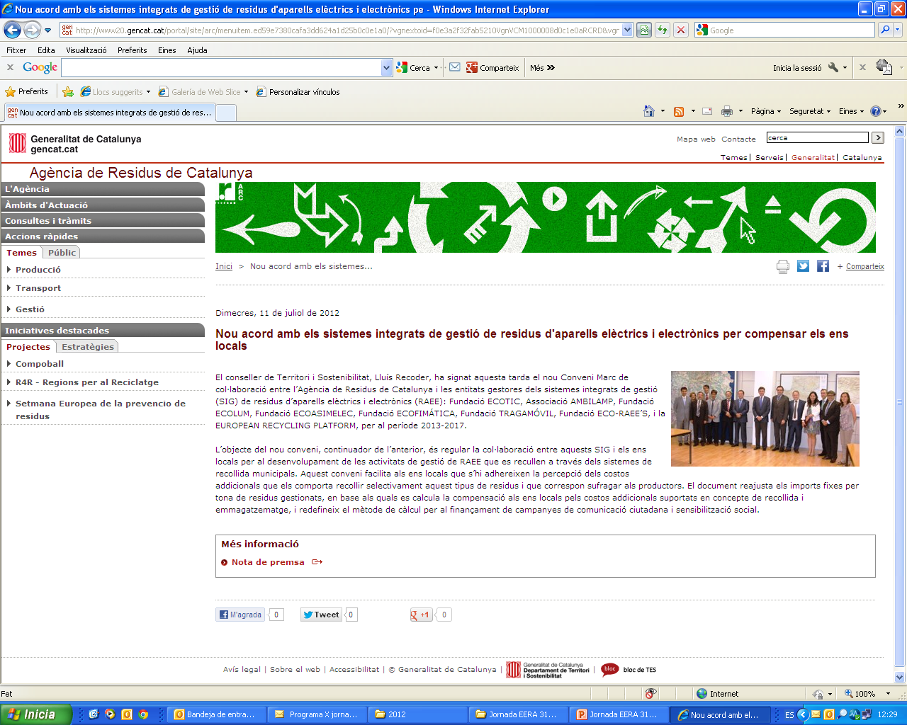
IMPLEMENTATION IN CATALONIA (LOCAL AUTHORITIES)
On 22 December 2006, the Catalan Waste Agency and the EPR systems signed a collaboration agreement.
Local authorities can voluntarily join it to help them effectively manage waste treatment by sharing in the cost of separately collecting WEEE.
There is a Monitoring Committee, with representatives from the ARC, the local authorities and the EPR systems, that surveys the development of this agreement.
A new agreement for 2013-2017 and the 2012 addenda were signed on July 2012

Slide 7
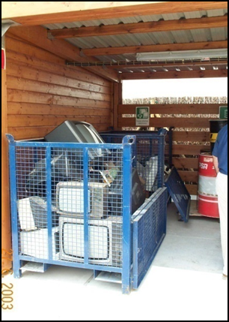
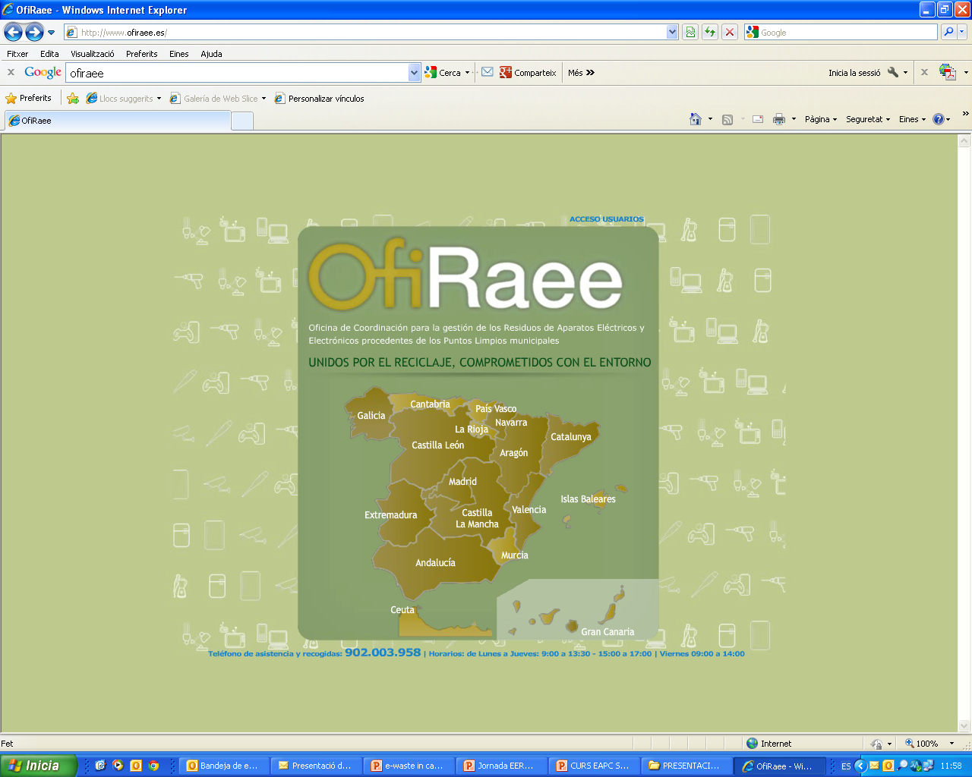
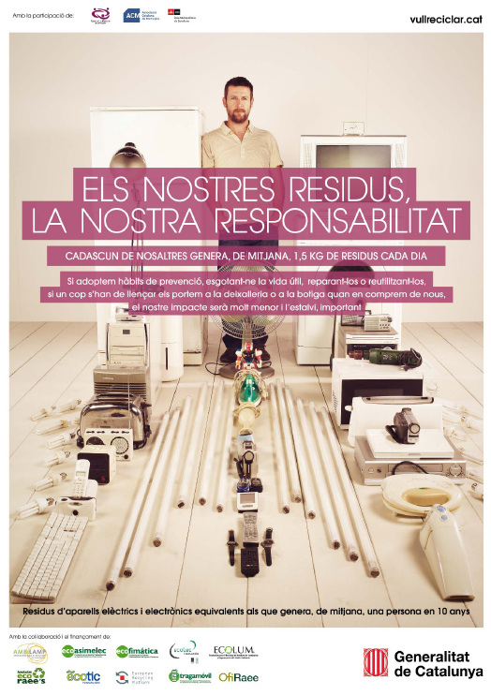
IMPLEMENTATION IN CATALONIA: POSITIVE POINTS
Full involvement of local authorities:
157 local authorities with 369 collection points
Creation of an office for the coordination of WEEE IMS:
one sole liaison for public authorities
Compensation to local authorities for the cost of WEEE collection and storage and Retroactive financial compensation from the date RD 208/2005 came into effect, for WEEE collection and treatment
(ARC and local authorities)
  Investment in communication: campaigns and local actions

Slide 8
IMPLEMENTATION IN CATALONIA: POSITIVE POINTS
Combating free-riders, in collaboration with IMS, producers’ associations and the Spanish Ministry of Agriculture, Food and the Environment (MAGRAMA):
  More than 200 requirements for companies
  111 sanctions on file
  Distribution inspection campaign
  Start of IMS collaboration with distribution: agreements with electrical appliance retailers’ associations:
    Establish logistics for collection (but scattered and unstable)
    Financial compensations
  MAGRAMA technical paper: WEEE treatment with CFC, HCFC, HFC or HC (September 2011)

Slide 9
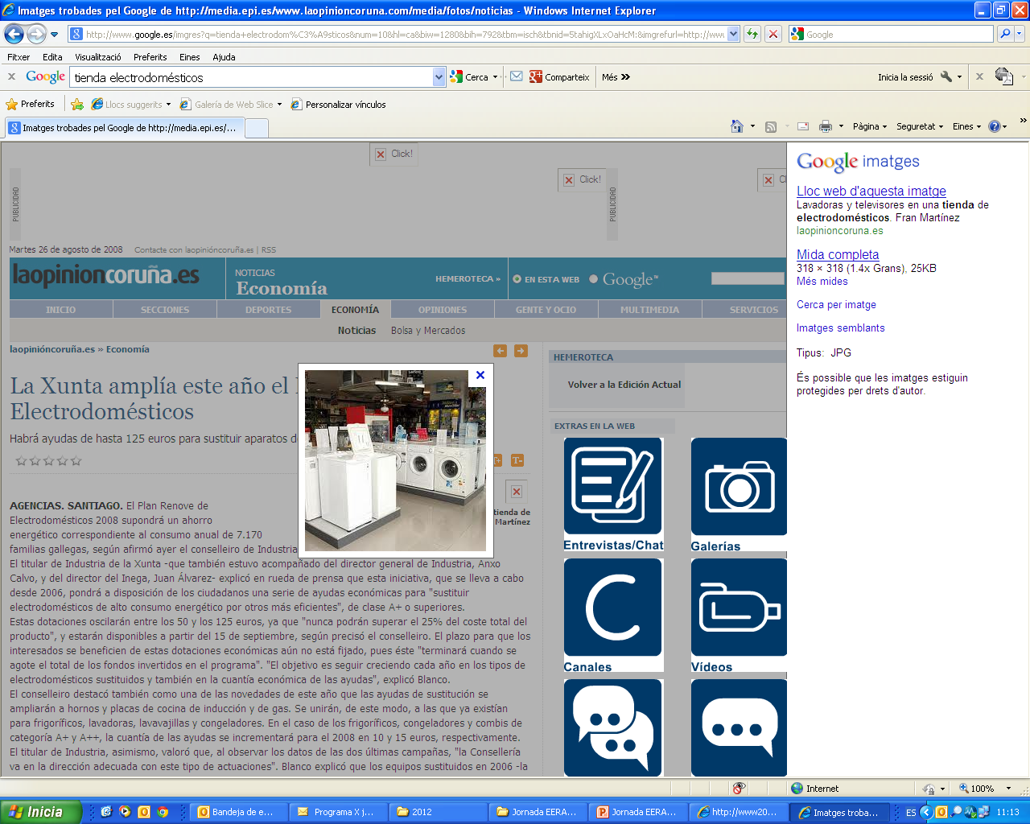
IMPLEMENTATION IN CATALONIA: POINTS TO WORK ON
Distribution’s involvement in WEEE collection: coordination with IMS
Quality of the data on WEEE collection and management:
  Annual IMS data reports
  Unreliable recovery and recycling data
  Equivalencies between fractions, categories and EWL codes
  Collection by managers outside the IMS circuit
  Traceability
Lack of WEEE treatment standards

Slide 10
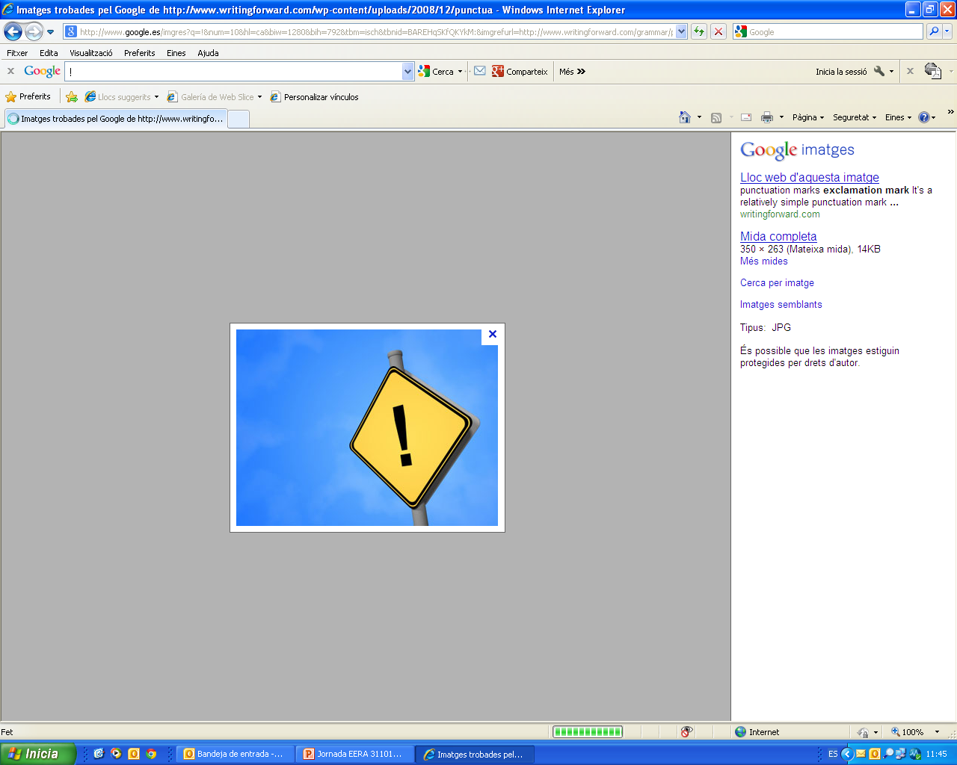
IMPLEMENTATION IN CATALONIA: POINTS TO WORK ON
Reuse of EEE and preparation for WEEE reuse:
  Lack of management procedures
  Handling of data
WEEE theft and cannibalisation at green and other collection points
The collection objectives set by legislation have not been met

Slide 11
IMPLEMENTATION IN CATALONIA: POINTS TO WORK ON
Objective : 4 kg/inh·year
Target new WEEE Directive (19/2012):
  45% (2016)
  65% (2019)

Slide 12
CONCLUSIONS
The transposition into law of the new WEEE Directive represents an opportunity to take an important step further in WEEE management in Spain
Work must be done to improve the coordination and participation of the actors involved:
  Integrated management systems (producers)
  Authorised WEEE treatment and storage plants
  Distribution
  Government: local, autonomous community and ministry

Slide 13
FOR MORE INFORMATION…
Catalan Waste Agency
Prevention and Recycling Promotion Area
c/ Dr. Roux, 80 • 08017 Barcelona
Tel. +34 935 673 300 Fax +34 935 566 068
www.arc.cat
Belen.gallegop@gencat.cat

Slide 14

Thank you

