Slide 1
Overview of ITU Activities on E-Waste
Cristina Bueti, Adviser, ITU
Flavio Cucchietti, Vice-Chairman, ITU-T Study Group 5

Slide 2
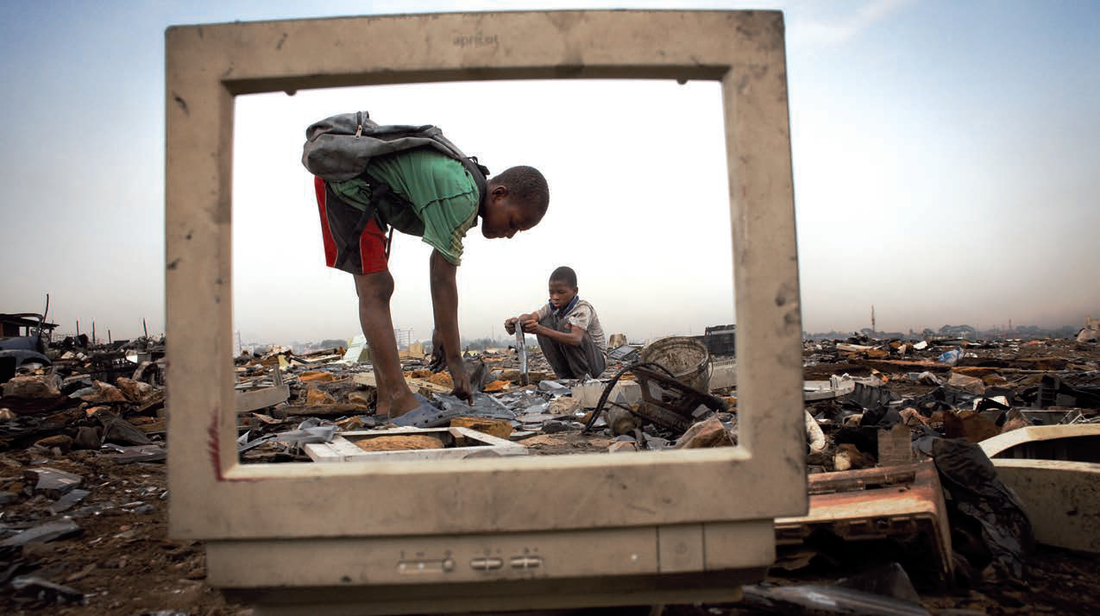
E-waste is the fastest growing waste stream
67 million metric tons of electrical and electronic equipment were put on the market in 2013
53 million metric tons e-waste were disposed of worldwide in 2013
For every one million cell phones that are recycled, 16 tons of copper, 350 kilos of silver, 34 kilos of gold and 15 kilos of palladium can be recovered
Source: United Nations University and United States Environmental Protection Agency
Notes:
In particular, many developing countries face the specter of hazardous e-waste mountains with serious consequences for the environment and public health.
A large amount of what is labeled as "e-waste" is actually not waste at all, but rather whole electronic equipment or parts that are readily marketable for reuse or can be recycled for materials recovery.

Slide 3
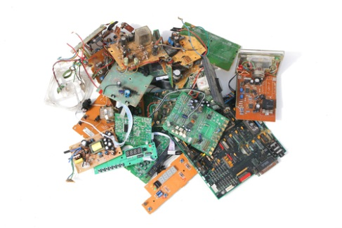
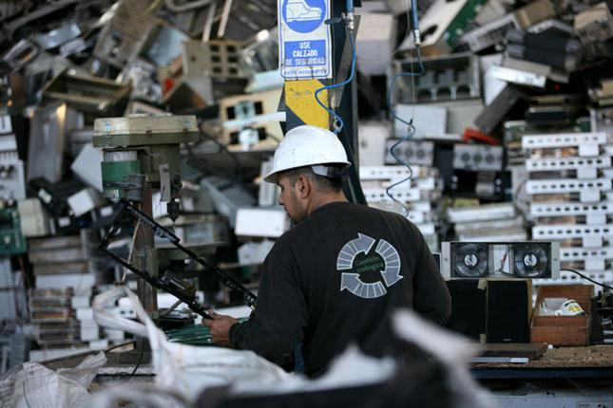
The best way to deal with e-waste is …
… avoid (or at least minimize) it!
From the manufacturing phase through:
Designing for easy disassembly and recycling
Avoiding use of heavy pollutants
Minimization on the use of resources
Regulations and standards
During the life of equipment:
Prolonging its lifetime
Designing for reuse/multiple use
At end of life:
E-waste conscious management

Slide 4
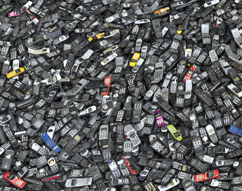
Avoid/minimize through standardization
Environmentally conscious companies have e-waste management programmes in place:
However such programmes are difficult to set up and manage
The extra cost can discourage them
As individual companies they can have little impact
Need to act soon
Regulation sometimes is complex and takes long time
Standardization can fill the gap
and lead the market

Slide 5
ITU-T Study Group 5 “Environment & Climate Change”
ITU-T SG5/WP3 work areas:
Q 13/5 - Environmental impact reduction including e-waste
Q 14/5 - Setting up a low cost sustainable telecommunication infrastructure for rural communications in developing countries
Q 15/5 - ICTs and adaption to the effects of climate change
Q 16/5 - Leveraging and enhancing the ICT environmental sustainability
Q 17/5 - Energy efficiency for the ICT sector and harmonization of environmental standards
Q 18/5 - Methodologies for the assessment of environmental impacts of ICT
Q 19/5 - Power feeding systems

Slide 6
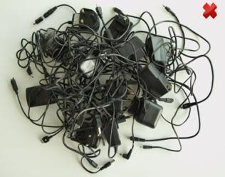
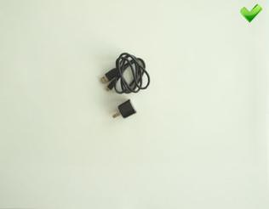
One adapter size fits all
Saves 82,000 tons of e-waste per year
Saves at least 13.6 million tonnes of CO2 emissions annually
Notes:
Rec. L.1000 provides high level requirements for a universal power adapter and charger solution that will reduce the number of power adapters and chargers produced and recycled by widening their application to more devices and increasing their lifetime. The solution also aims to reduce energy consumption. The longer life cycle and possibility of avoiding device duplication reduces the demand on raw materials and waste. The universal power adapter and charger solution is designed to serve the vast majority of mobile terminals and other ICT devices.
- “Universal power adapter and charger solution for mobile terminals and other ICT hand held devices” (Recommendation ITU-T L.1000)
- Saves 82,000 tons of e-waste per year
- Saves at least 13.6 million tonnes of CO2 emissions annually
Recommendation ITU-T L.1001 provides requirements for a universal power adapter solution (UPA) for stationary ICT devices that will reduce the number of produced power adapters by widening their application to more devices, enabling their reuse and increasing their lifetime. The solution also aims to reduce energy consumption. The longer life cycle and possibility of avoiding device duplication reduces the demand on raw materials and production of huge e-waste amount. The universal power adapter solution for ICT equipment for stationary use is designed to serve the vast majority of ICT devices.
- Consented on 12 October 2012 - NEW - “External universal power adapter solutions for ICT equipment for stationary use” (Recommendation ITU-T L.1001)
- Saves 300,000 tonnes of e-waste annually
- Reduces the energy consumption and greenhouse gas (GHG) emissions of external power supplies by between 25% and 50%

Slide 7
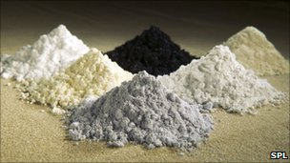
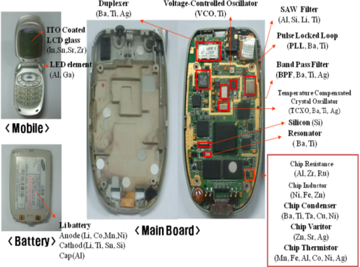
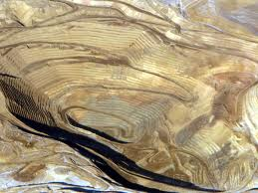
Recycling Rare Metals in ICT Products
Notes:
Rec. L.1100 provides information on the recycling procedures of rare metals in information and communication technology (ICT) goods. It also defines a communication format for providing recycling information of rare metals contained in ICT goods.

Slide 8
Research and Development

Slide 9
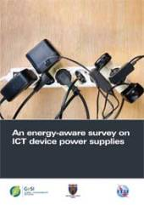
An Energy-Aware Survey on ICT Device Power Supplies
This survey reports the results of a wide analysis performed on a large set of commercially available external power supplies (more than 300 devices verified and more than 200 electrically measured) to assist the standardization activities within ITU-T Study Group 5 (SG5) (Recommendation ITU-T L.1001). Mechanical, electrical and environmental characteristics have been evaluated; correlation and statistics have also been developed.
Notes:
An Energy-aware Survey on ICT Device Power Supplies. Specifically, this document reports the results of a wide analysis performed on a large set of commercially available external power supplies (more than 300 devices verified and more than 200 electrically measured) to assist the standardization activities within ITU-T Study Group 5 (SG5) (Recommendation ITU-T L.1000, phase 2). Mechanical, electrical and environmental characteristics have been evaluated; correlation and statistics have also been developed.
The report is organized in two main parts. The first part (Sections 2 and 3) considers nameplate (e.g., voltage, current, efficiency class, etc.) and physical characteristics (e.g., weight, volumes, mains and DC voltage connector type). The second part (Sections 4 and 5) of the report shows the measured electrical features of the adapters, in terms of energy efficiency, DC voltage and Cos φ, with variable loads, together with no load measurements.

Slide 10
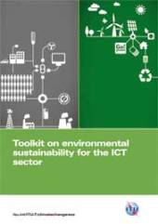
ITU Toolkit on Environmental Sustainability for the ICT Sector
Detailed practical support on how ICT companies can build sustainability into their operations and management
Ongoing contribution to ITU-T Study Group 5 which has the goal of developing global standards in this arena
Practical
support
Checklist
Standards
Support
Standardized checklist of sustainability requirements specific to the ICT sector
Notes:
The Toolkit on Environmental Sustainability for the ICT sector is an ITU-T initiative which provides plenty of detailed support on how ICT companies can build sustainability into the operations and management of their organizations, through the practical application of international standards and guidelines.
This toolkit provides a set of agreed upon sustainability requirements for ICT companies that allows for a more objective reporting of how sustainability is practiced in the ICT sector in these key areas: sustainable buildings, sustainable ICT in corporate organizations, sustainable products, end of life management, general specifications and KPIs, and an assessment framework for environmental impacts of the ICT sector.

Slide 11
Toolkit content
Document | Summary
Introduction to toolkit | A business-led perspective on the use of sustainability in ICT organizations
Sustainable ICT in corporate organizations | Sustainability issues with the use of ICT products and services
Sustainable products | Sustainability-led design principles and practice for ICT products
Sustainable buildings | Sustainability management of the construction, use and decommissioning of ICT buildings
End-of-life management | Support in dealing with the various end-of-life stages of ICT equipment
General specifications and KPIs | Environmental KPIs that can be used to manage and evaluate sustainability performance
Assessment framework | Mapping the standards and guidelines applying to the ICT industry

Slide 12
End-of-life management for ICT equipment
End-of-life management
An outline of the various EOL stages (and accompanying legislation) , and support for creating a framework for environmentally-sound management of EOL ICT equipment.
Material recovery and recycling
Clean supply chains
Offsetting and mitigation

Slide 13
End-of-life management for ICT equipment
Structure of analysis
Legal frameworks
EOL management steps
Regulatory compliance
Best practice guidance
Clean supply chains and conflict minerals
Socio-economic issues
Corporate social responsibility
Checklists
Key guidance to ensure best practices:
General Material Recovery and Recycling Facility Guidelines / minimum criteria to select a service provider
Clean Supply Chain and Conflict Minerals : An opportunity for a greener industry
Offsetting Opportunities and Mitigation : The ICT sector response to Social and Environmental issues generated by bad EOL practices
Notes:
Key Words:
Compliance – Reuse – refurbishment – Donations – Equipment testing – Trans boundary movements, poverty – development – records keeping – competition – unlawful competition –Take back schemes – Auditable processes – recovery of metals – green supply chain – Manufacturers & Recycler joint work – CSR – Offsetting – opportunities – economic growth.

Slide 14
Collaboration with over 50 partners
3p Institute for Sustainable Management
Alcatel Lucent
BBC
BIO Intelligence Service
BT
CEDARE
Climate Associates
ClimateCHECK
Cogeco Cable
DATEC Technologies
Dell
Ernst & Young
ETRI
ETNO
ETSI
European Broadcasting Union
France Telecom/Orange
Fronesys
Fujitsu
GHG Management Institute (GHGMI)
Hewlett-Packard
Hitachi
Huawei
IBI Group
Imperial College
Infosys
International Telecommunication Union (ITU)
Mandat International
MicroPro Computers
Microsoft
MJRD Assessment Inc.
National Inter-University Consortium for Telecommunications
Nokia Siemens Networks
NEC Empowered by Innovation
NTT
Panasonic
PE INTERNATIONAL AG
Research In Motion
Scuola Superiore Sant’Anna of Pisa
Step Initiative
Telecom Italia
Telecommunications Networks and Telematics Laboratory
Telecommunication Technology Committee
Telefónica
Thomson Reuters
Toshiba
United Nations Environmental Programme
United Nations Environmental Programme Basel convention
United Nations University
University of Genova
University of Zagreb
Verizon
Vodafone Ghana

Slide 15
Raising Awareness

Slide 16
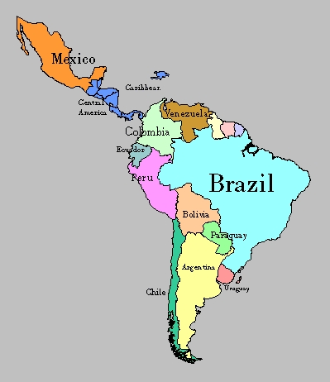
E-Waste Actions in Latin America
El Salvador, 19-21 March 2013
Quito, 13 August 2013
Key actions:
Raise awareness on the dangers of e-waste;
Encourage the consideration of e-waste management in the design of ICT policy;
Adopt strategic policies, international standards and regulatory approaches that are sensitive to local context;
Encourage concerted cooperation in handling e-waste at the national, regional and international level.

Slide 17
Upcoming workshop and meetings
Greening the Future: Bridging the Standardization Gap on Environmental Sustainability Colombo, Sri Lanka, 3-4 October 2013
ITU/CITEL Workshop on Environmentally sound management of E-waste Mendoza, Argentina, 9 October 2013
ITU-T Study Group 5 meeting Lima, Peru, 2-13 December 2013

Slide 18
E-Waste … the solution!
Need of an integrated waste management approach to:
generate decent employment,
curb health problems,
cut greenhouse gas emissions and
recover a wide range of valuable metals including silver, gold, palladium, copper and indium – by turning an e-challenge into an e-opportunity.

Slide 19
Links & Additional Information
ITU-T/SG5 “Environment & Climate Change”
http://www.itu.int/ITU-T/studygroups/com05/index.asp
ITU-T and Climate Change http://www.itu.int/ITU-T/climatechange
ITU Symposia & Events on ICTs and Climate Change http://www.itu.int/ITU-T/worksem/climatechange

Slide 20
Thank YOU greenstandard@itu.int

