Slide 1
International coordination to measure the ICT sector: Producing statistics to inform E-waste policies
Scarlett Fondeur Gil, Division on Technology and Logistics, UNCTAD

Slide 2
E-waste trends – the ICT sector
Growing production and international trade of ICT goods + faster obsolescence = growing e-waste worldwide
Exports of ICT goods 11% of total merchandise exports in 2011 - mobile phones, smartphones, laptops, tablets, integrated circuits, etc
South–South is 40% of global flows in ICT goods – mainly intermediate goods
Country concentration in hardware production (7 of top 10 in Asia), but not in consumption

Slide 3
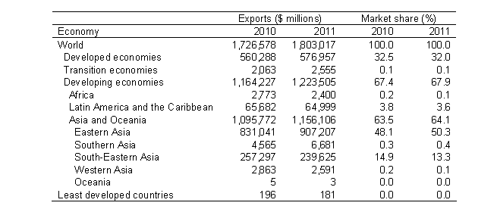
E-waste trends – the ICT sector
ICT goods exports by level of development and geographical region, 2010 and 2011

Slide 4
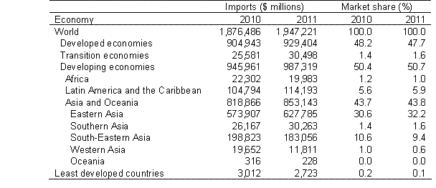
E-waste trends – the ICT sector
ICT goods imports by level of development and geographical region, 2010 and 2011
Notes:
Regional ICT goods imports composition by main product categories, 2011

Slide 5
E-waste data - ICT sector
UN COMTRADE statistics on the international trade in ICT goods:
Based on OECD definition of ICT goods of 2010 (CPC rev 2 converted in HS 2007).
Change from 2003 list (based on HS 2002) means limited comparability in time series
Tables available at unctadstat.unctad.org
ICT Sector definition based on ISIC Rev. 4
Not all countries have made the transition from ISIC Rev 3.1

Slide 6
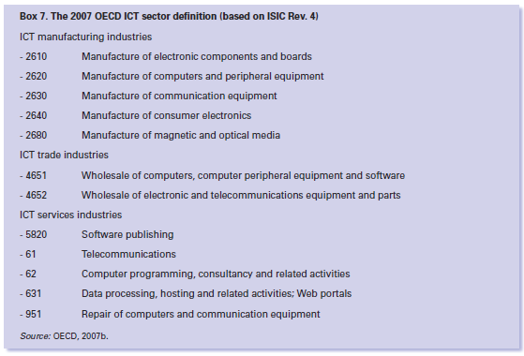
E-waste data - ICT sector
Goods and services
ICT goods relevant to production
ICT services relevant to imports, also require ICT goods

Slide 7
E-waste data – Harmonization
Good starting points:
UNU-55 classification has been used to compile harmonized e-waste statistics (StEP ADDRESS project)
Partnership on Measuring ICT for Development Task Group on e-Waste (TGEW)
«An international measurement framework for e-waste»
On the Partnership:
It aims to improve the availability and quality of internationally comparable ICT statistics, for informed policy-making
Partners: ITU, OECD, UNCTAD, OECD, UIS, World Bank, UN regional commissions (ECA, ECLAC, ESCAP, ESCWA), Eurostat, UNDESA, UNEP/SBC, UNU-ISP
Other entities engaged in Task Groups
Notes:
StEP ADDRESS e-waste quantification projects:
E-waste volumes in West Africa countries(EMPA), Characterizing transboundary flows from the US (MIT/ NCER), The Future Flows (Netherlands), Country studies (Italy, Belgium, France)
The Partnership is a response to the World Summit on the Information Society (WSIS) request to produce official statistics to monitor the information society. Since 2004, it provides a framework for the coordination of activities carried out by international and regional organizations involved in ICT measurement.
Work:
Ongoing definition of a core list of ICT indicators and methodologies to collect these indicators. The list is endorsed by the United Nations Statistical Commission
Capacity-building and advisory services for national statistical offices in developing countries
Collecting and disseminating ICT statistics
Partners:
International Telecommunication Union, Organization for Economic Cooperation and Development, United Nations Conference on Trade and Development, Organization for Economic Cooperation and Development, UNESCO Institute for Statistics, World Bank, Economic Commission for Africa , Economic Commission for Latin America and the Caribbean, United Nations Economic and Social Commission for Asia and the Pacific, United Nations Economic and Social Commission for Western Asia, Statistical Office of the European Communities, United Nations Department of Economic and Social Affairs, United Nations Environmental Programme/Secretariat of the Basel Convention on e-Waste, and United Nations University Institute for Sustainability and Peace

Slide 8
E-waste statistics - Looking forward
Challenges:
Multiple sources of data
Lack of a single internationally agreed classification of e-waste, difficult to assess the «e», and second-hand trade
Increasing complexity of waste stream
To do:
International consultation on practical use of UNU-55, including discussion with stakeholders, such as industry (for ex. repair and maintenance)
Further exploit existing trade statistics to assess e-waste movements
Develop indicators on market for e-goods, resulting e-waste and its management
Link e-waste statistics to national and international policy:
Environmental, economic, ICT for development
Through raising awareness of issues and disseminating the framework

Slide 9
E-waste statistics and policy
E-waste data allows countries to make decisions on:
Managing e-waste:
Treatment standards and infrastructure vs. costs
Establishing and harmonizing regulatory frameworks
Cost, environmental protection
Developing a sustainable ICT sector while protecting the environment
Seizing economic opportunities: jobs, recycling, «greening» foreign investment
Establishing public-private cooperation

Slide 10
Thank you
emeasurement@unctad.org
ict4d@unctad.org
Unctad.org/ict4d
Measuring-ict.unctad.org
Twitter: @ICT4DatUNCTAD

