Slide 1



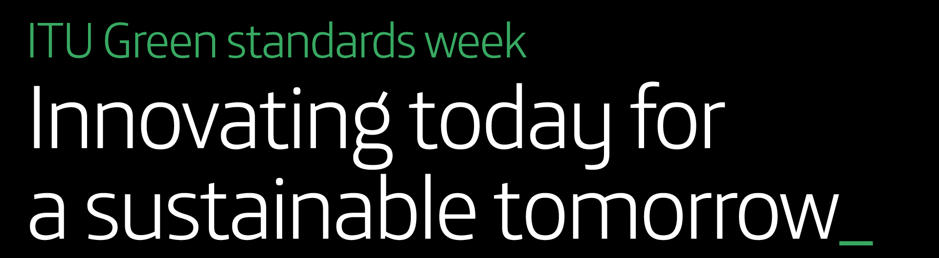


Quantification and Qualification of the E-waste Challenge
Federico Magalini

Slide 2
HOW to quantify WEEE? …and WHY?
Contain toxic substances
Other relatively harmless
Contain concentration of valuable resources
Some are heavy, other light,…
UNU-55 classification: Links to existing statistical classifications
Relevant for policy making
ADDRESS the size of the problem/opportunity
CN
(345)
Ocad3E
FRA 2013
(74)
Prodcom
(165)
Recupel
BEL 2012
(36)
Ecodom
ITA 2011
(41 B2C only)
Wecycle
NLD 2013
(71)
WEEE Directive 2003 (10)
UNU Keys (55)
with 183 subkeys + 660 product types
WEEE Forum (17)
Key Figures < 2012
WEEE Dir. Recast 2012 (6+1)
WEEE Forum (7)
> 2013 Key

Slide 3
EEE & WEEE Life-Cycle
1
Production & Trade EEE
National EEE Placed on Market
Stock EEE
HH and B2B
Life-time Profiles
WEEE Collection
WEEE Processing
Formal
Informal
3
Export
Waste Bin
2
3 Main Pillars to estimate WEEE Generated

Slide 4
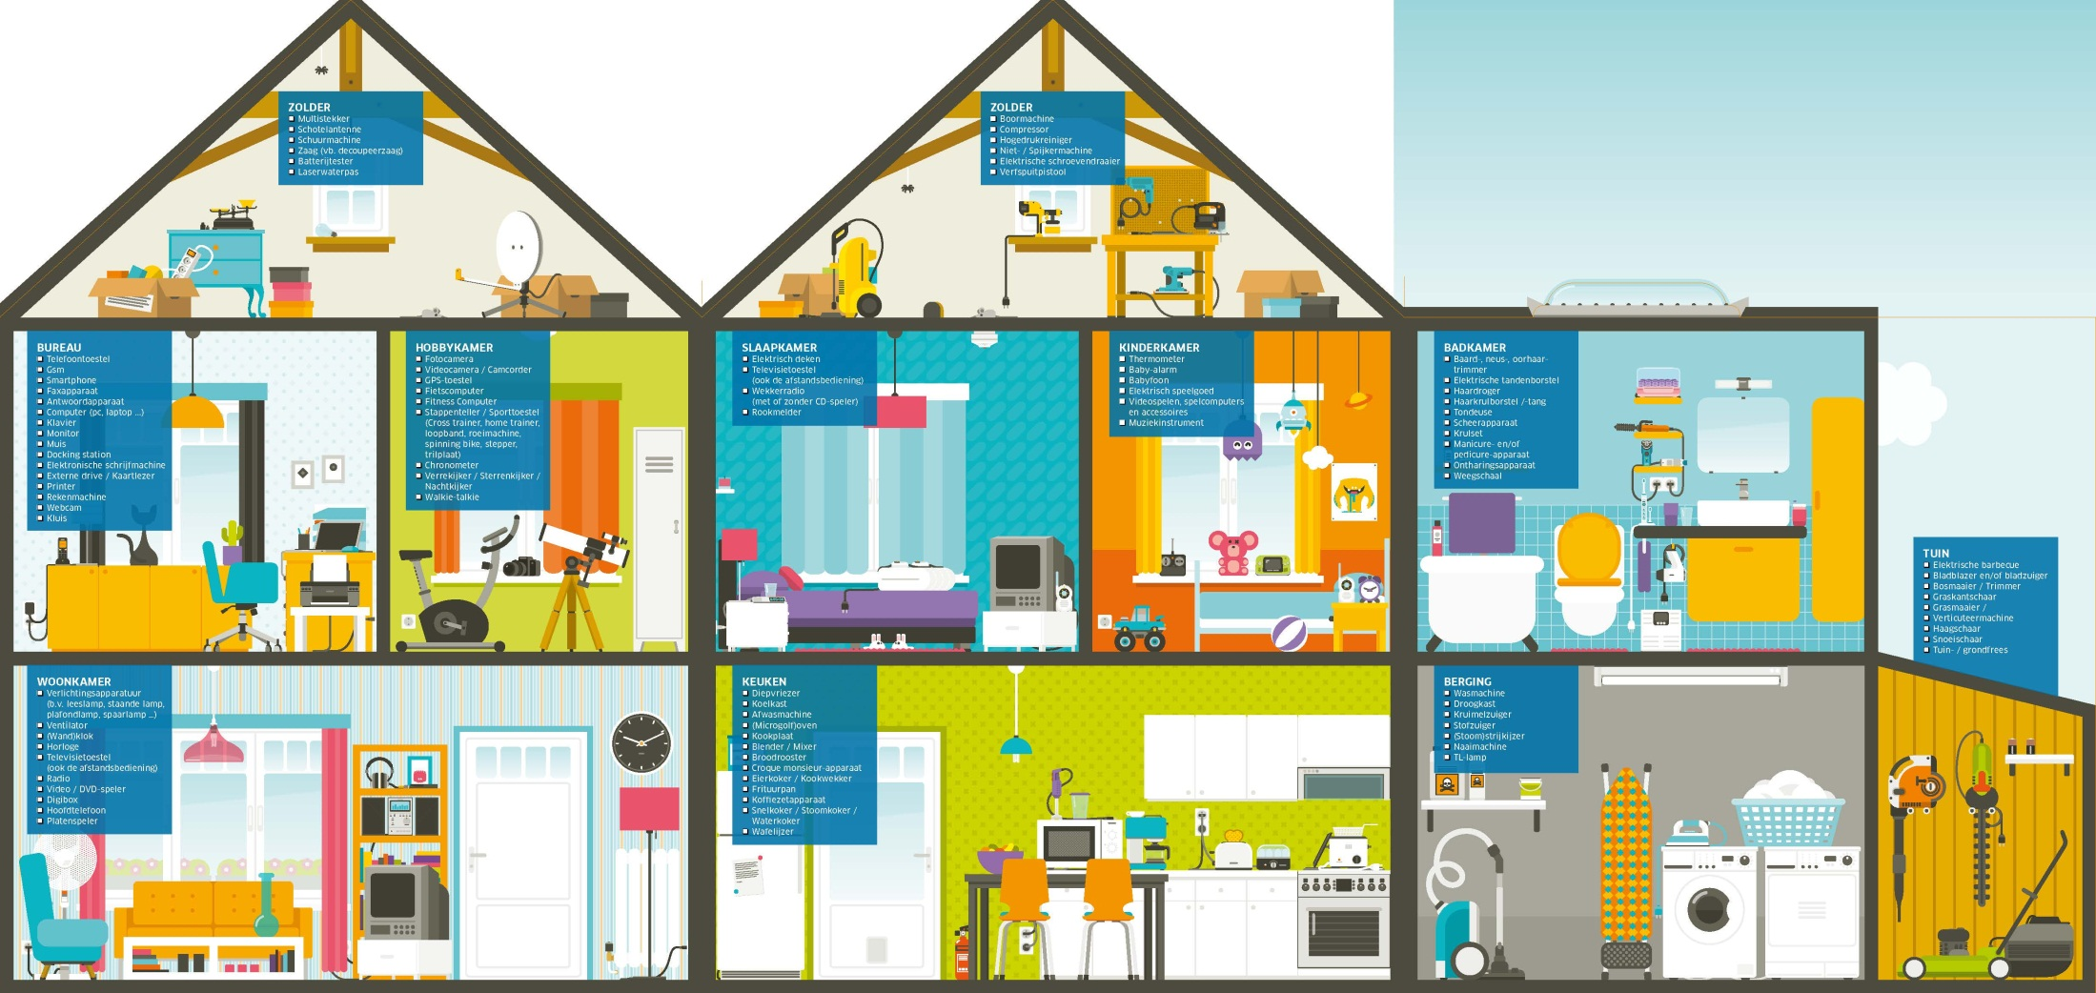


Stock EEE & Life-time Profiles
Stock EEE (data BEL)
Life-Time Profiles (data ITA)
Inertia effect of past PoM
Influence average weight
Saturated Markets
DIFFERENT Products, Markets, Generation
Attic:
1.0 Central Heating/ boiler
0.03 Sunbeds
2 Other Lamps
1 Energy saving lamp
2 TL lamps
3 Luminaires
Work/ hobby room
6.0 Mice, keyboards, external drives, etc.
0.8 Desktops 0.8 Laptops/tablets
1.1 Printers 1.4 Phone sets
3.5 Mobile phones 0.4 CRT Monitors
0.7 LCD Monitors 1.1 Cameras
2 Other lamps 1 Energy saving lamps
3 Luminaires 0.2 Exercise equipment
Sleeping room Kids room
0.9 CRT TVs 2 Other lamps
2 Other lamps 1 Energy saving lamp
1 Energy saving lamps 3 Luminaires
3 Luminaires 5.2 Electr. Toys
1 Smoke alarm 0.5 Game Consoles
0.7 Smoke alarms
Bath room
5.9 Shavers, elec. toothbrushes hairfohns, etc.
2 Other lamps
1 Energy saving lamps
3 Luminaires
1.3 Thermometers/ bloodpressure meters
More influence of PoM on Generation
Saturated Markets
Living room
0.07 Aircons 5 Small households appliances: Clocks, adapters, chargers, etc.
2.2 Remote Controls, headphones, etc.
2.2 Radio’s/Mp3 4.0 Audio/HiFi compon. 1.9 DVD/ VCRs 2.3 Speaker sets
0.9 LCD TV’s 4 Other lamps
2 Energy saving lamps 6 Luminaires
Kitchen
0.6 Dishwashers 0.8 Ovens/furnaces
1.1 Ventilators/ hoods 1.0 Magnetrons
1.4 Fridges 0.1 Icemakers, etc.
6.8 Small kitchen appliances: Blenders, mixers, frying pans, cooking plates, grills, toasters, etc
2.0 Coffee/ water cookers 2 Other lamps
1 Energy saving lamp 3 Luminaires
Scullery Garden/garage
1.0 Washing mach. 2.2 Other lamps
0.6 Dryers 3.7 Energy sav. lamps
0.6 Freezers 3.2 Luminaires
3.9 Irons, scales, 6.6 Drills, lawn adapters, etc. mowers, saws,
1.6 Vac. cleaners hedges, high pressure
2.8 TL lamps cleaners, etc.
Total:
79 EEE + 47 Lamps/Luminaires per HH (B2C)
36 EEE per HH (B2B)
Total Stock = 263 kg/inh.

Slide 5





EEE & WEEE
EEE Placed on Market: 2000-2015
WEEE Generated: 2000-2015
34,7 Mt
59 Mt
74,9 Mt
24,9 Mt
44 Mt
57,5 Mt
2000
2010
2015
8%
15%
19%
4%
6%
7%
25%
20%
17%

Slide 6
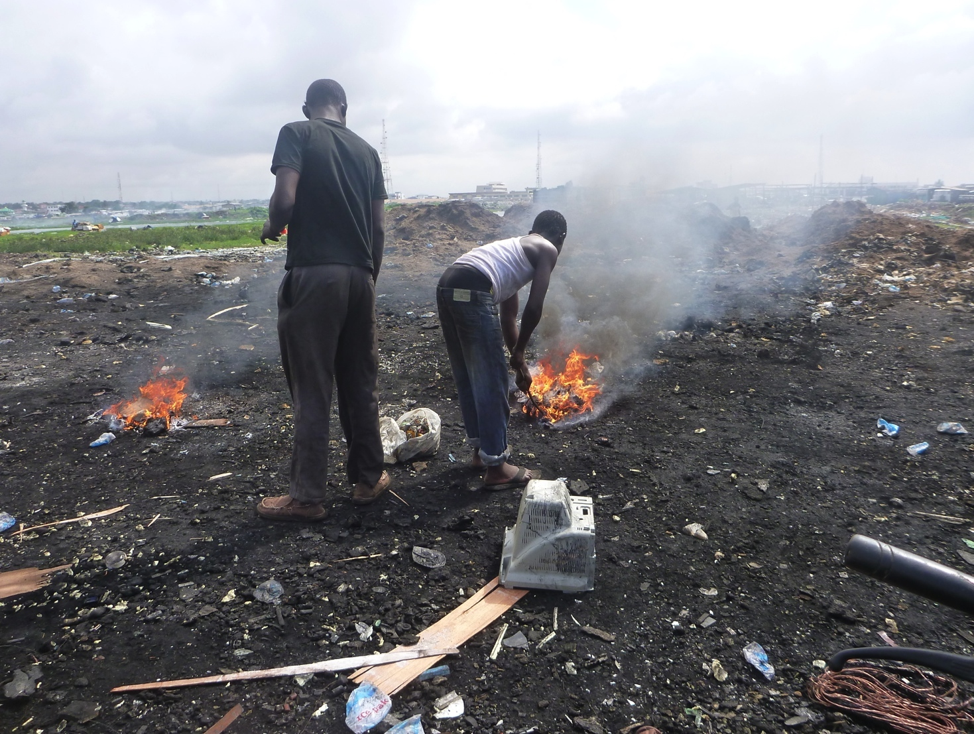
Where are WEEE
Survival Imperative
Lacking Technologies
Waste Resources
Lacking Legislative Framework
Human Health Consequences
Polluting Environment
Environmental
Preventing fair local business
Economic
Social
Capacity Building Needed

Slide 7










E-waste Academy 2014
WHO
WHERE
WHY
WHEN
Sponsors 2014
Organized by
Policy Makers
Governmental Officials
Recyclers
Refurbishers
Collectors
…
Form all over the world
El Salvador
hosted by Basel Convention Regional Centre for the Central America Sub-region including Mexico
Platform for exchange of best practices
Discuss & share policy development and approaches
Foster interactive atmosphere of knowledge sharing
Get feedback & advice from e-waste experts and policymakers
Timeline:
1 August 2013
Call for Applications Open
15 October 2013
Call for Applications Closed
31 January 2014
Confirmation participants
31 March - 4 April 2014
EWAM in El Salvador

Slide 8

Thank you

