Slide 1
Overview of ITU-T Study Group 5 “Environment and Climate Change”

Slide 2
ITU-T Resolution 73 on ICTs, the Environment and Climate Change Revised and consented at World Telecommunication Standardization Assembly (Dubai, 2012)
Recognizes that ICTs play a vital role in tackling environmental challenges;
Resolves to promote the use of ICTs as cross-cutting tool to assess and reduce GHG emissions, optimize energy and water consumption, minimize e-waste and improve its management;
Supports studies on, inter alia, green data centers, smart buildings, green ICT procurement, cloud computing, energy efficiency, smart transportation, smart logistics, smart grids, water management, adaptation to climate change and disaster preparedness, and reduction of GHG emissions;
Encourages internal and external collaboration to move forward the environmental global agenda.

Slide 3
ITU-T New Resolution 79 on E-Waste Consented at World Telecommunication Standardization Assembly (Dubai, 2012)
ITU-T Resolution 79 urges ITU to:
Contribute to alleviate the negative impact of e-waste on the environment and health;
Pursue and strengthen the development of ITU activities in regard to handling and controlling e-waste from ICT equipment and methods of treating it:
Best practices,
Recommendations, methodologies and other publications,
Guidance for policy makers;
Assist developing countries, which are the countries that suffer most from the hazards of e-waste without being the most responsible;
Collaborate with all relevant stakeholders.

Slide 4
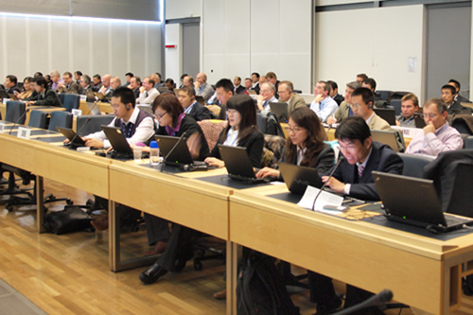
ITU-T Study Group 5

Slide 5
Terms of Reference
Next meeting:
Lima, Peru, on
2-13 Dec 2013
Study Group 5 is responsible for studies:
on ICT environmental aspects of electromagnetic phenomena and climate change;
related to electromagnetic compatibility (EMC), to safety and to health effects connected with electromagnetic fields produced by telecommunication installations and devices, including cellular phones.
Study Group 5 is lead SG for:
Environment and climate change
Electromagnetic compatibility and electromagnetic effects

Slide 6
Structure of ITU-T Study Group 5
ITU-T SG5
“Environment and climate change”
Q 12 Terminology
WP1/5
Damage prevention and safety
WP2/5
Electromagnetic fields: emission, immunity and human exposure
WP3/5
ICT and climate change
5 Questions
6 Questions
7 Questions

Slide 7
Overview of
Working Party 3/5 “ICT and climate change”

Slide 8
Working Party 3/5 “ICT and climate change”
WP3/5 is responsible for studies relating to ICT, environment and climate change, development of methodologies for evaluating the ICT effects on climate change and publishing guidelines for using ICTs in an eco-friendly way.
Work areas:
Q13/5 - Environmental impact reduction including e-waste
Q14/5 - Setting up a low cost sustainable telecommunication infrastructure for rural communications in developing countries
Q15/5 - ICTs and adaptation to the effects of climate change
Q16/5 - Leveraging and enhancing the ICT Environmental sustainability
Q17/5 - Energy efficiency for the ICT sector and harmonization of environmental standards
Q18/5 - Methodologies for the assessment of environmental impact of ICT
Q19/5 - Power feeding systems

Slide 9
Highlights on Deliverables of WP3/5
Important green ICT standards have been developed by SG5 WP3. These are namely:
Recommendation ITU-T L.1000: Universal power adapter and charger solution for mobile terminals and other hand-held ICT devices
Recommendation ITU-T L.1001: External universal power adapter solutions for stationary information and communication technology devices
Recommendation ITU-T L.1100: A method to provide recycling information of rare metals in ICT products
Recommendation ITU-T L.1200 : Direct current power feeding interface up to 400V at the input to telecommunications and ICT equipment
Recommendation ITU-T L.1300: Best practices for green data centres
Recommendation ITU-T L.1310: Energy efficiency metrics and measurement for telecommunication equipment
Recommendation ITU-T L.1400 : Overview and general principles of methodologies for assessing the environmental impact of information and communication technologies
Recommendation ITU-T L.1410 : Methodology for environmental impacts of Information and Communication Technologies (ICT) goods, networks and services
Recommendation ITU-T L.1420 : Methodology for environmental impacts of Information and Communication Technologies (ICT) in organizations
Recommendation ITU-T L. 1430 : Methodology for assessment of the environmental impact of information and communication technology greenhouse gas and energy projects (consented)
Notes:
Rec. L.1000 provides high level requirements for a universal power adapter and charger solution that will reduce the number of power adapters and chargers produced and recycled by widening their application to more devices and increasing their lifetime. The solution also aims to reduce energy consumption. The longer life cycle and possibility of avoiding device duplication reduces the demand on raw materials and waste. The universal power adapter and charger solution is designed to serve the vast majority of mobile terminals and other ICT devices.
Rec. L.1001 provides requirements for a universal power adapter solution (UPA) for stationary ICT devices that will reduce the number of produced power adapters by widening their application to more devices, enabling their reuse and increasing their lifetime. The solution also aims to reduce energy consumption. The longer life cycle and possibility of avoiding device duplication reduces the demand on raw materials and production of huge e-waste amount. The universal power adapter solution for ICT equipment for stationary use is designed to serve the vast majority of ICT devices.
Rec. L.1100 provides information on the recycling procedures of rare metals in information and communication technology (ICT) goods. It also defines a communication format for providing recycling information of rare metals contained in ICT goods.
Rec. L.1200 specifies the direct current (DC) interface between the power feeding system and ICT equipment connected to it. It also describes normal and abnormal voltage ranges, and immunity test levels for ICT equipment to maintain the stability of telecommunication and data communication services. The specified interface is operated from a DC power source of up to 400 V to allow increased power consumption and equipment power density, in order to obtain higher energy efficiency and reliability with less material usage than using a lower voltage such as -48 VDC or AC UPS power feeding solutions.
Rec. L.1300 describes best practices aimed at reducing the negative impact of data centres on the climate. It is commonly recognized that data centres will have an ever-increasing impact on the environment in the future. The application of the best practices defined in this Recommendation can help owners and managers to build future data centres, or improve existing ones, to operate in an environmentally responsible manner. Such considerations will strongly contribute to a reduction in the impact of the information and communication technology (ICT) sector on climate change.
Rec. L.1310 contains the definition of energy efficiency metrics test procedures, methodologies and measurement profiles required to assess the energy efficiency of telecommunication equipment.
Metrics and measurement methods are defined for telecommunication network equipment and small networking equipment.
These metrics allow for comparisons of equipments within the same class e.g. equipments using the same technologies.
Comparisons of equipments in different classes are out of the scope of this Recommendation.
Rec. L.1400 presents the general principles on assessing the environmental impact of information and communication technologies (ICT) and outlines the different methodologies that are being developed:
• Assessment of the environmental impact of ICT goods, networks, and services
• Assessment of the environmental impact of ICT projects
• Assessment of the environmental impact of ICT in organizations
• Assessment of the environmental impact of ICT in cities
• Assessment of the environmental impact of ICT in countries or group of countries.
This Recommendation also provides some examples of opportunities to reduce the environmental load due to ICT.
Rec. L.1410 deals with the assessment of the environmental impact of information and communication technology (ICT) goods, networks and services. It is organized in two parts:
Part I (clause 5) – ICT life cycle assessment: framework and guidance.
Part II (clause 6) – Comparative analysis between ICT and a reference product system (baseline scenario); framework and guidance.
Part I deals with the life cycle assessment (LCA) methodology applied to ICT goods, networks and services (ICT GNS). Part II deals with comparative analysis based on LCA results of an ICT GNS product system and a referenced product system.
This Recommendation provides specific guidance on energy and greenhouse gas (GHG) impacts.
Rec. L.1420 presents the methodology to be followed if an organization intends to claim compliance with this Recommendation when assessing its information and communication technology (ICT) related energy consumption and/or greenhouse gas (GHG) emissions.
This Recommendation can be used to assess energy consumption and GHG emissions generated over a defined period of time for the following purposes: for assessment of related impact from ICT organizations or for assessment of impact from ICT related activities within non-ICT organizations.
Rec. L.1430 is intended as a complement to ISO standard ISO 14064-2 and the Project Protocol of the Greenhouse Gas Protocol (GHG Protocol).
This Recommendation provides guidance for the application of a specific methodology to assess the environmental impact of information and communication technology (ICT) greenhouse gas (GHG) projects and ICT energy projects. The proposed methodology is specifically directed at the quantifying and reporting of GHG emission reductions and/or removal enhancements, energy consumption reductions, and the enhancement of energy generation and energy storage in ICT GHG projects and ICT energy projects.
An ICT GHG project uses mainly ICT goods, networks and services and is designed to reduce GHG emissions or increase GHG removals. These GHG reductions are quantified by comparison between the environmental impact of a project activity and a corresponding baseline scenario.
An ICT energy project uses mainly ICT goods, networks and services to reduce energy consumption and improve energy efficiency in project activity scenarios.
From the ICT perspective, this Recommendation takes into account considerations based on existing project quantification guidelines, and aims at covering ICT GHG and/or ICT energy project activities within both the ICT and the non-ICT sectors.
This Recommendation recognizes the importance of project validation and verification for the credibility of project results but does not enforce the validation and verification procedures to be applied. It is expected that such procedures be determined by the selected GHG programme, national regulation, internal policy of the project proponent, or the request of intended users.
ISO 14064-2 (2006): Greenhouse gases -- Part 2: Specification with guidance at the project level for quantification, monitoring and reporting of greenhouse gas emission reductions or removal enhancements.
The GHG Protocol Initiative was jointly convened in 1998 by the World Business Council for Sustainable Development (WBCSD) and the World Resources Institute (WRI): http://pdf.wri.org/ghg_project_accounting.pdf

Slide 10
ITU-T Methodologies
Common set of methodologies for the assessment of ICT carbon footprint
Without, it will be impossible to provide meaningful comparisons
Helps to establish the business case to go green
3 Recommendations published - available on the ITU-T website:
L.1400 Overview and general principles
L.1410 Environmental impact of ICT goods, networks and services
L.1420 Environmental impact of ICT in organizations
L.1430 Environmental impact of ICT projects (consented in February 2013)
3 Recommendations under preparation:
L.1440 Environmental impact of ICT in cities (consent expected in 2013)
L.1450 Environmental impact of ICT in countries (consent expected in 2014)
Developed in cooperation with UNFCCC Secretariat, EC and over
40 other organizations etc..
Among 10 international methodologies to have been pilot-tested in Europe’s bid to establish and converge around a common international framework to assess the energy and emission footprint of the ICT sector.
Notes:
These methodologies aim at providing accurate and reliable tools for assessing the environmental impact, which will generate statistics that governments and regulators can rely on to gauge the benefits that green ICTs can achieve for social and economic welfare.
Rec. L.1400 presents the general principles on assessing the environmental impact of information and communication technologies (ICT) and outlines the different methodologies that are being developed:
• Assessment of the environmental impact of ICT goods, networks, and services
• Assessment of the environmental impact of ICT projects
• Assessment of the environmental impact of ICT in organizations
• Assessment of the environmental impact of ICT in cities
• Assessment of the environmental impact of ICT in countries or group of countries.
This Recommendation also provides some examples of opportunities to reduce the environmental load due to ICT.
Rec. L.1410 deals with the assessment of the environmental impact of information and communication technology (ICT) goods, networks and services. It is organized in two parts:
Part I (clause 5) – ICT life cycle assessment: framework and guidance.
Part II (clause 6) – Comparative analysis between ICT and a reference product system (baseline scenario); framework and guidance.
Part I deals with the life cycle assessment (LCA) methodology applied to ICT goods, networks and services (ICT GNS). Part II deals with comparative analysis based on LCA results of an ICT GNS product system and a referenced product system.
This Recommendation provides specific guidance on energy and greenhouse gas (GHG) impacts.
Rec. L.1420 presents the methodology to be followed if an organization intends to claim compliance with this Recommendation when assessing its information and communication technology (ICT) related energy consumption and/or greenhouse gas (GHG) emissions.
This Recommendation can be used to assess energy consumption and GHG emissions generated over a defined period of time for the following purposes: for assessment of related impact from ICT organizations or for assessment of impact from ICT related activities within non-ICT organizations.
Rec. L.1430 is intended as a complement to ISO standard ISO 14064-2 and the Project Protocol of the Greenhouse Gas Protocol (GHG Protocol) .
This Recommendation provides guidance for the application of a specific methodology to assess the environmental impact of information and communication technology (ICT) greenhouse gas (GHG) projects and ICT energy projects. The proposed methodology is specifically directed at the quantifying and reporting of GHG emission reductions and/or removal enhancements, energy consumption reductions, and the enhancement of energy generation and energy storage in ICT GHG projects and ICT energy projects.

Slide 11
Direct current power feeding interface up to 400V at the input to telecommunications and ICT equipment
Recommendation ITU-T L.1200 specifies direct current power feeding with interface direct current 260V to 400V at the power input to ICT equipment which can offer many potential benefits:
simple power chain
low maintenance
modularity and power scalability
high reliability
high energy efficiency (gain of 5 to 20% energy consumption compared to different existing best in class powering solutions)
low cost at same performance level
Notes:
Recommendation ITU-T L.1200
This Recommendation specifies a LVDC current interface at the power input of ICT equipment obtained from a power source of up to 400 Volts (260-400VDC voltage range) , which allows higher energy efficiency and reliability than can be achieved using low voltage power feeding solutions. The recommendation defines a power feeding system applicable to ICT equipment compliant with L.1200 in locations equipped with these power sources such as: telecommunication centres; radio base stations; data centres; and customer premises.
Additionally, the LVDC interface will simplify the use of renewable energy sources producing LVDC output such as photovoltaic generators or some fuel cell systems.
A gain of 5 up to 20% of energy consumption has been assessed and measured in existing sites by several certified experiments compared to existing powering solutions.

Slide 12
Focus Group on Smart Sustainable Cities

Slide 13
Focus Group on Smart Sustainable Cities:
Main tasks and deliverables:
Defining the role of ICTs in environmentally sustainable smart cities, and identifying the ICT systems necessary to the development of a Smart Sustainable City;
Collecting and documenting information on existing smart city initiatives and technical specifications, focusing in particular on the identification of standardization gaps;
Identifying or developing a set of Key Performance Indicators (KPIs) to gauge the success of smart-city ICT deployments;
Establishing relationships and liaison mechanisms with other bodies engaged in smart-city studies and development;
Identifying future smart-city standardization projects to be undertaken by its parent group, ITU-T Study Group 5;
Developing a roadmap for the ICT sector’s contribution to Smart Sustainable Cities, providing cohesion to the development and application of technologies and standards.
Established at SG5 meeting in Geneva, 29 January to 7 February 2013
As an open platform for smart-city stakeholders
1st meeting held on 8 May 2013 in Turin, Italy
Notes:
The FG–SSC will to assess the standardization requirements of cities aiming to boost their social, economic and environmental sustainability through the integration of information and communication technologies (ICTs) in their infrastructures and operations.
The FG–SSC will analyze ICT solutions and projects that promote environmental sustainability in smart cities and will identify best practices which could facilitate the implementation of such solutions in cities. It will develop a standardization roadmap taking into consideration the activities currently undertaken by the various standards developing organizations (SDOs) and forums. This “Focus Group on Smart and Sustainable Cities (FG – SSC)” will leverage the role of the ICT sector to foster the growth of smart and sustainable cities worldwide.
Chairman - Silvia Guzman, Telefónica
Vice-Chairmen - Pablo Bilbao, Federation Argentina de Municipios
- Flavio Cucchietti, Telecom Italia
- Sekhar Kondepudi, National University of Singapore
- Nasser Saleh Al Marzouqi, UAE
- Franz Zichy, USA
- Ziqin Sang, Fiberhome Technologies Group

Slide 14
Focus Group on Smart Water Management

Slide 15
Focus Group on Smart Water Management:
Main tasks and deliverables:
Collect and document information on national, regional and international smart water management initiatives; reporting on current activities and technical specifications.
Specify the roles to be played by ICTs in smart water management.
Develop a list mapping key stakeholders involved in the area of ICTs and smart water management.
Develop Key Performance Indicators (KPIs) to assess the impact achieved through the use of ICTs in water-management systems.
Develop a set of methodologies for estimating the impact of ICTs on water conservation.
Identify water-management ICT applications and services with the potential to ensure interoperability and the benefits of economies of scale.
Draft technical reports that address standardization gaps and identify new standardization work items to be taken up by its parent group, ITU-T Study Group 5 (Environment and climate change).
Established by the ITU-T TSAG meeting in Geneva, 4-7 June 2013
Will work in close collaboration with the FG-SSC
Notes:
The Focus Group on Smart Water Management (FG-SWM) was established by the ITU-T TSAG meeting in Geneva, 4-7 June 2013.
The FG-SWM is expected to carry out the following specific tasks:
Collect and document information on national, regional and international smart water management initiatives; reporting on current activities and technical specifications.
Specify the roles to be played by ICTs in smart water management.
Develop a list mapping key stakeholders involved in the area of ICTs and smart water management.
Develop Key Performance Indicators (KPIs) to assess the impact achieved through the use of ICTs in water-management systems.
Develop a set of methodologies for estimating the impact of ICTs on water conservation.
Identify water-management ICT applications and services with the potential to ensure interoperability and the benefits of economies of scale.
Draft technical reports that address standardization gaps and identify new standardization work items to be taken up by its parent group, ITU-T Study Group 5 (Environment and climate change).

Slide 16
Raising Awareness

Slide 17
Upcoming Workshop and Events
ITU Workshop on Smart Sustainable Cities in Latin America 30 July 2013, São Paulo, Brazil
ITU Workshop on E-Waste 13 August 2013, Quito, Ecuador
ITU Workshop on Human Exposure to Electromagnetic Fields (EMFs) 14 August 2013, Quito, Ecuador
Greening the Future: Bridging the Standardization Gap on Environmental Sustainability 3-4 October 2013, Colombo, Sri Lanka

Slide 18
3rd ITU Green Standards Week
To bring together leading specialists in the field, from top policy-makers to engineers, designers, planners, government officials, regulators, standards experts and others.
To raise awareness of the importance and opportunities of using ICT standards to build a green economy.
Programme:
16/09: ITU, UNEP, UNU, CEDARE Workshop on E-waste
17/09 (morning): Forum on Greening Mobile Devices: Building Eco-Rating Schemes
17/09 (afternoon): Meeting of the Focus Group on Smart Sustainable Cities
18/09: High Level Segment on Smart Sustainable Cities
19-20/09: 3rd Workshop on Submarine Communications Networks For Climate Monitoring and Disaster Warning
20/09: Meeting of the ITU/WMO/UNESCO -IOC Joint Task Force on Submarine Communications Networks For Climate Monitoring and Disaster Warning
SEE YOU IN MADRID, on 16-20 September 2013

Slide 19
Links
ITU-T/SG5 “Environment & Climate Change”
http://www.itu.int/ITU-T/studygroups/com05/index.asp
ITU-T and climate change http://www.itu.int/ITU-T/climatechange

Slide 20
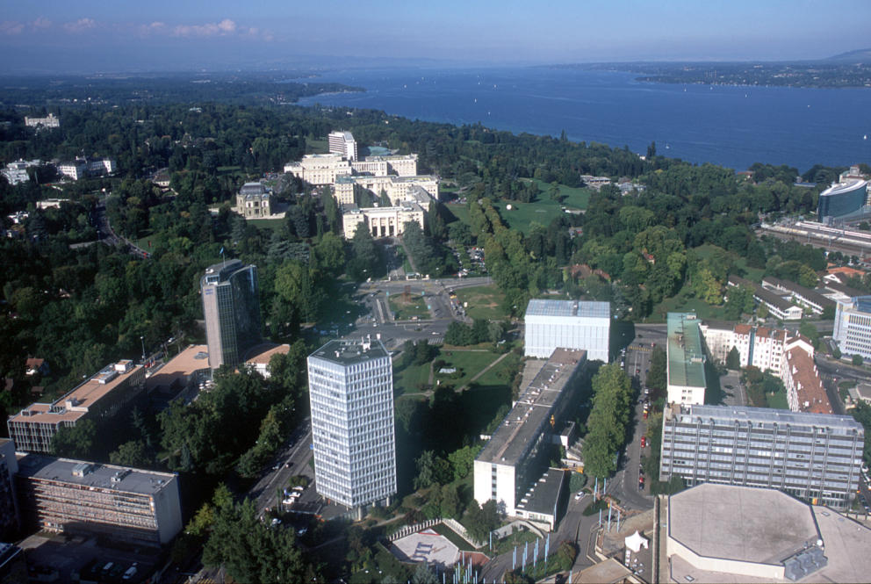
Thank YOU
tsbsg5@itu.int

