Slide 1
Promoting sustainable ewaste management systems in developing countries
World Summit on the Information Society Forum 2016
Klaus Tyrkko
Unit Chief UNIDO
k.tyrkko@unido.org

Slide 2
How to establish a sustainable E-Waste Management system?

Slide 3
General UNIDO E-Waste concept
UNIDO helps build and consolidate local capacities to promote sustainable e-waste recycling industries, through the whole life cycle of electric and electronic devices, to recover efficiently valuable resources, while generating quality jobs and caring about the environment and health.
Distribution&
Consumption
Collection
Pre-Processing
End-Processing
Disposal
Supporting green industries that safeguard the environment and create quality jobs
Promoting partnerships for knowledge exchange and technology transfer
Helping countries develop their e-waste management systems and strategies based on the whole recycling chains and life-cycle
Enhancing North-South, South-South and triangular cooperation and knowledge sharing

Slide 4
Key pillars of sustainable e-waste management
§
$

•

Policy& Legislation
Business& Financing
Technology & Skills
Monitoring & Control
Marketing &Awareness
EXAMPLES
Planning
Dismantling
Facility
General information on E-waste
PILOT PHASE
General
assessment
Exploring partnerships
Direct action
Supporting
Existing SME´s
TA for
operators
IMPLEMENTATION
Import ban on ODS fridges
Midterm solutions
Strict purchasing
policies
Establish
dismantling/
recycling facility
Develop
Independent
Auditing body
Supporting
competition
Awareness
campaign
Longterm solutions
Sustainable self-finace scheme
Certification of
facility
(int. standards)
Legislation on E-Waste
Sustainable
Auditing system

Slide 5
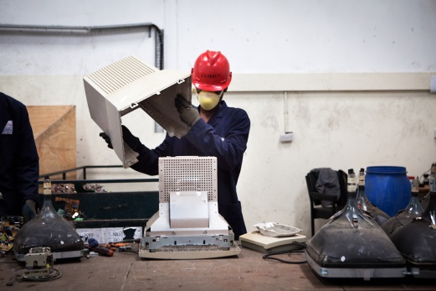
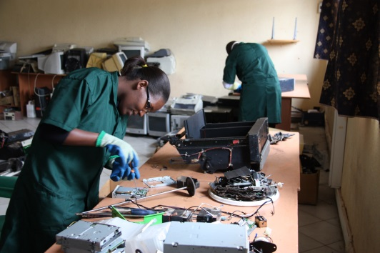
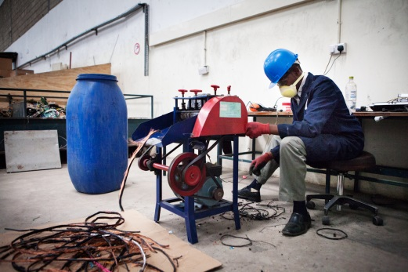
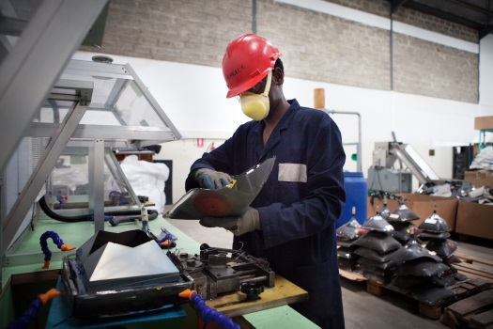
Key elements of UNIDOs approach
Detailed inventory of existing volumes and ongoing initiatives
Design of collection and processing schemes
Set-up / up-scale of national e-waste treatment options, including the establishment of sustainable business models
Connection to downstream markets on national, regional and international level in accordance with international conventions, e.g. Basel Convention
Policy and legislation development or enhancement, including collection strategies and financing mechanisms
Capacity building, training and awareness-raising
Notes:
UNIDO promotes the establishment of sustainable recycling industries in developing countries to build local capacity and to ensure sustainable treatment of e-waste along the whole recycling chain.

Slide 6

Process of E-Waste Flows
INPUT
TREATMENT
OUTPUT
Manual
Dismantling
Further
Treatment
Downstream
Options
Collection
Receiving
Individuals
(via Collection Points)
B2B
(Companies/
Organizations)
Informal Sector
(Scavengers,...)
SCREENS (TV, CRTs, LCDs..)
Hot Wire –Separation (Lead glass screen)
STORAGE
Weighing
Sorting
Pre-Processing
Storing
Transport
TRANSPORT:
LAMPS
Decon-tamination
Hg-Lamps
Local
White Goods
(Fridges,...)
Degasification (CFCs)
Regional/
Cross-
national
Small WEEE
Cable-
Stripping
Refurbishment
Plastic Shredder
Batteries
Inter-
national/ Oversea
Legend:
WEEE
Pb, Acids,...
Fractions (non-hazardous)
FACILITY
Hazardous fractions/ waste

Slide 7
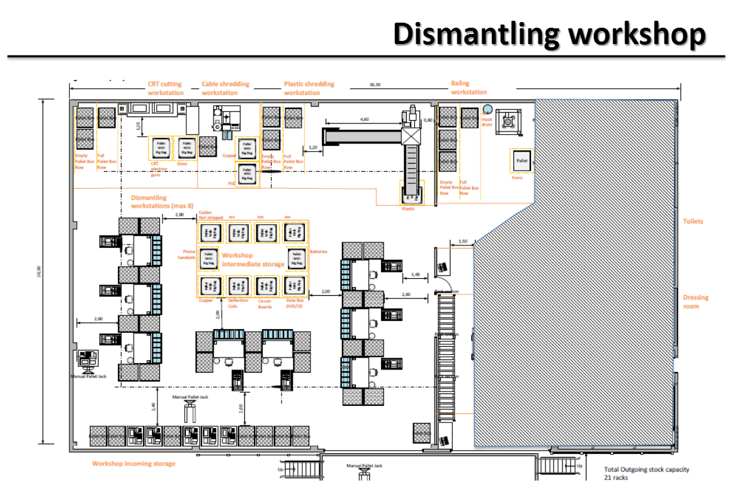
Example: Ethiopia
Project Site: Akaki/Addis Ababa
CRT Cutting
Cable Shredding
Plastic Shredding
IntermediateStorage
Dismantling workstation

Slide 8
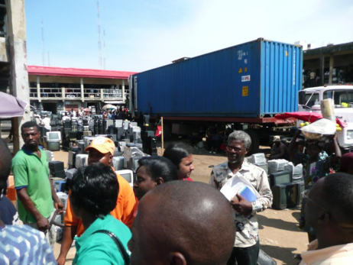
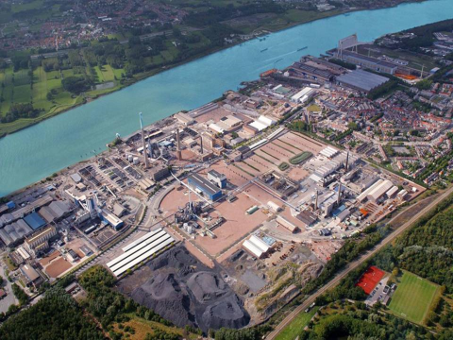
Downstream Markets
OUTPUT
Identify environmentally and socially sound potential local,
regional and international buyers
  Non-hazardous outputs: national/ regional markets
  Hazardous outputs: international smelters
Analyze the purchasing conditions and business models of
potential buyers and their branches
Take into account:
- Quality and contamination of material outputs
- International conventions on hazardous waste transport
- Administrative and legal restrictions
- Local and World market prices

Slide 9
Revenues/ Costs of Manual WEEE Dismantling (USD/year)

Slide 10
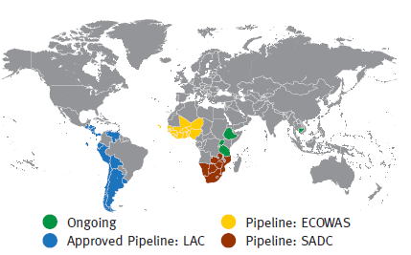
UNIDO E-Waste management portfolio
Ongoing:
Uganda: Establishment of a manual dismantling facility for WEEE
Tanzania: Component on E-waste management (One UN Programme)
Ethiopia: E-waste Management Project
Cambodia: Creating job opportunities & effective e-waste management
Pipeline:
Regional e-waste project for Latin America
Regional e-waste project for ECOWAS
Regional e-waste project for SADC

Slide 11

Thank you for your attention!

