Slide 1
WORK WITH E-waste: challenges and opportunities
David Seligson
Head of Unit
Manufacturing, mining and energy unit
Sectoral Activities Department
ILO

Slide 2
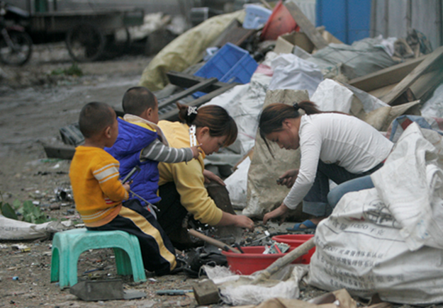
Labour & employment implications in e-waste
E- waste recycling chain often a mix of formal and informal
Complex value chain
Labour-intensive→ potential for employment
Often employ poor and marginalized, including women and children
Can be dangerous
Photo: Alex Hofford

Slide 3
ILO & e-waste: interventions
Linkage to labour standards
E.g. core labour standards, Chemical convention, OSH conventions
Promotion of Decent Work principles
E.g. No child labour, improved safety, higher incomes
Encouraging formalization of sector
Capacity building & training (e.g. OSH)
Green jobs
Entrepreneurship
Cooperatives

Slide 4
ILO & e-waste: progress
Working papers:
The global impacts of e-waste: addressing the challenge (2012)
Tackling informality in e-waste management: The potential of cooperative enterprises (2014)
The Labour, Human Health and Environmental Dimensions of E-waste Management in China (2015)
Country level activities (China, Serbia)
Cooperation within PACE

Slide 5
Thank you!
David Seligson
seligson@ilo.org

