Slide 1
E-WASTE: PROTECTING THE HEALTH OF CHILDREN
Dr Maria Neira
Department of Public Health, Environmental
and Social Determinants of Health
World Health Organization
Notes:
Note:
The agenda is at the end but may also be positioned in the beginning.
Slide 5 and 10 can be left out in order to shorten the presentation.

Slide 2
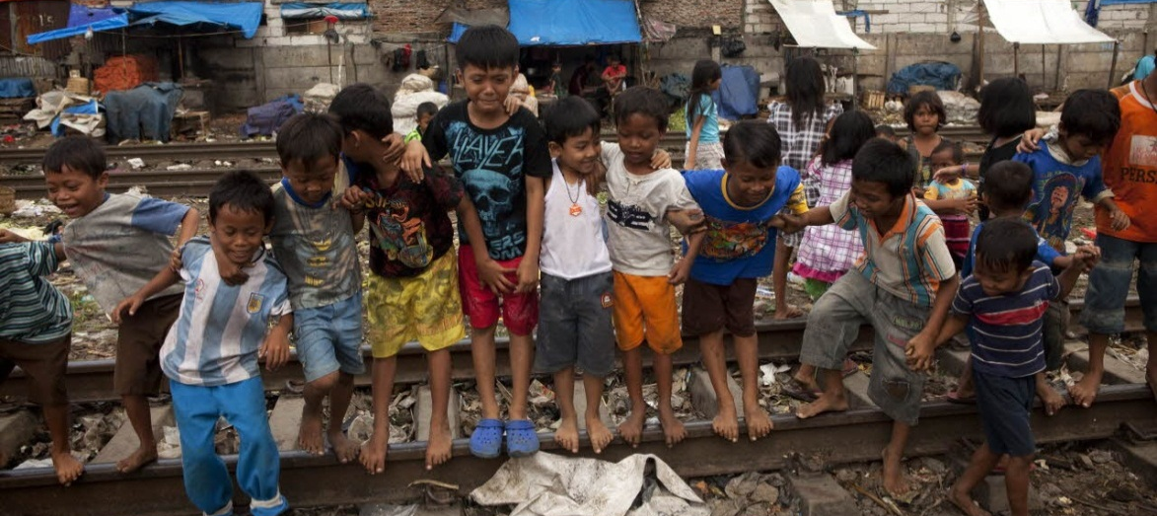
WHY E-WASTE AND CHILD HEALTH?
E-waste materials are not only a source of environmental contamination but may also pose significant human health risks if improperly managed
WHO
Notes:
Picture: WHO (photo library)

Slide 3
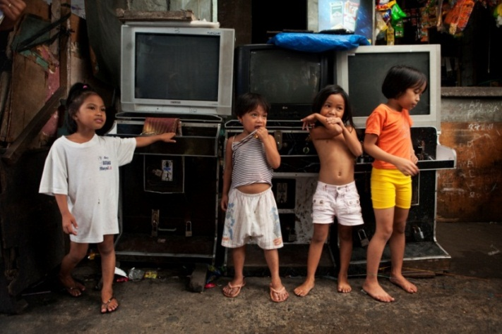
WHY E-WASTE AND CHILD HEALTH?
A systematic review led by WHO and WHO collaborating centres looking at health outcomes related to e-waste exposure, showed that increases in spontaneous abortions, stillbirths, and premature births, and reduced birth weights and birth lengths are associated with exposure to e-waste
WHO

Slide 4
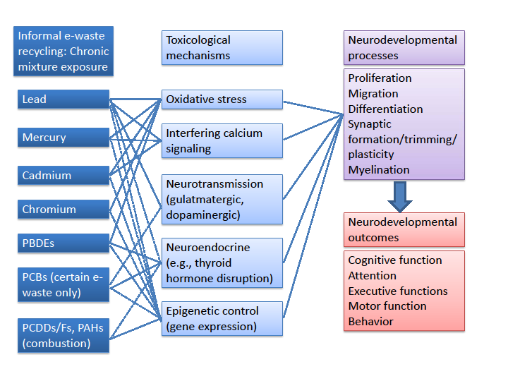
PROTECTING CHILDREN'S BRAINS FROM MULTIPLE NEUROTOXICANTS
Chen A et al.: Developmental neurotoxicants in e-waste: an emerging health concern. Environmental Health Perspectives (2010)
119(4):431–438; doi: 10.1289/ehp.10024
Notes:
Neurotoxic interaction among many of the e-waste activities emissions.
Ref:
Chen A, Dietrich KN, Huo X, Ho S (2010) Developmental neurotoxicants in e-waste: an emerging health concern. Environmental Health Perspectives, 119(4):431–438.
Figure: Chen A, Dietrich KN, Huo X, Ho S (2010) Developmental neurotoxicants in e-waste: an emerging health concern. Environmental Health Perspectives, 119(4):431–438; doi: 10.1289/ehp.10024.
(NOTE ON COPYRIGHTS http://www.ncbi.nlm.nih.gov/pmc/articles/PMC3080922/ )“This is an Open Access article: verbatim copying and redistribution of this article are permitted in all media for any purpose, provided this notice is preserved along with the article's original DOI”).

Slide 5
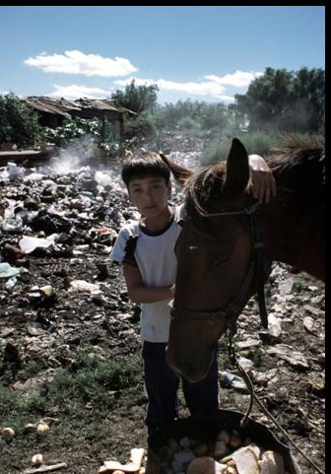
Child Health and E-Waste – Exposures Latin America – An Inter-Agency report
Child workers engaged in e-recycling
Secondary exposures of children
Home-based family workshops
Parental take-home exposures
Schools, homes, play areas near dump sites (that include e-waste)
Breastfeeding and transplacental exposures
Contaminated water and foods
Ceppi, Corra
In Uruguay: 24 % of children with blood lead levels higher to 5 µg/dl – burning of cables in neighboring area
Notes:
References:
Lundgren K. 2012. The global impact of e-waste: addressing the challenge . Geneva : Programme on Safety and Health at Work and the Environment (SafeWork), Sectoral Activities Department (SECTOR), Geneva, International Labour Office (ILO).
Song Y, Wu N, Han J, Shen H, Tan Y, Ding G, Xiang J, Tao H & Jin S. 2011. Levels of PCDD/Fs and DL-PCBs in selected foods and estimated dietary intake for the local residents of Luqiao and Yuhang in Zhejiang, China. Chemosphere, 85:329–34.
World Health Organization (WHO). 2006. Environmental Health Criteria 237: Principles for evaluating health risks in children associated with exposure to chemicals. Geneva, World Health Organization (WHO).
Manhart A. 2007. Key social impacts of electronics production and WEEE-recycling in China. Freiburg, Germany, Öko-Institut e.V., Institut für angewandte Ökologie, Institute for Applied Ecology.
Photos: WHO

Slide 6
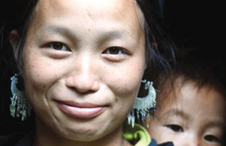
WHY DO WE NEED TO ACT NOW
SDG Goal 3: Ensure healthy lives and promote well-being for all at all ages.
Target 3.9: By 2030, substantially reduce the number of deaths and illnesses from hazardous chemicals and air, water and soil pollution and contamination.
SDG Goal 12: Ensure sustainable consumption and production patterns.
Target 12.4: By 2020, achieve the environmentally sound management of chemicals and all wastes throughout their life-cycle, in accordance with agreed international frameworks, and significantly reduce their release to air, water and soil in order to minimize their adverse impacts on human health and the environment.

Slide 7
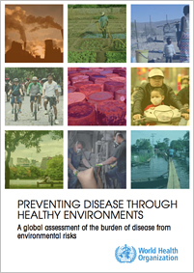
WHY DO WE NEED TO ACT NOW?
New estimates: 12.6 million people died as a result of living or working in an unhealthy environment in 2012 – nearly 1 in 4 global deaths. Children and older adults are the most affected
World Health Assembly 2016: Role of health sector in the sound management of chemicals
Green economy and health
Urban health
National Environmental Health Action Plans

Slide 8
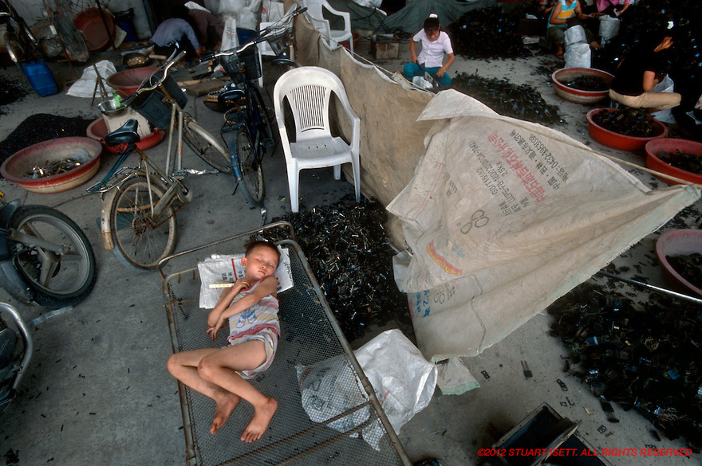
AIM OF THE WHO INITIATIVE
To advance the work towards better defining the exposures and related factors that can lead to health risks and allow identification of measures to protect children and other vulnerable populations from environmental health risks in e-waste

Slide 9
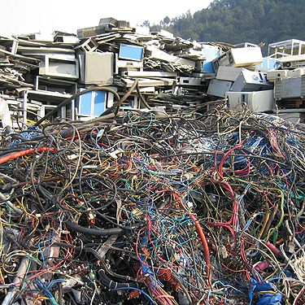
E-WASTE & CHILD HEALTH
WHO, WHO collaborating centers have identified through an initial consultations (2013, 2016) urgent gaps
identifying needs at local level
communicating the problem to health actors
developing training methods and tools for health professionals
encouraging specific research about e-waste
gathering interested stakeholders to move this issue forward around interventions that can improve the health of those affected.

Slide 10
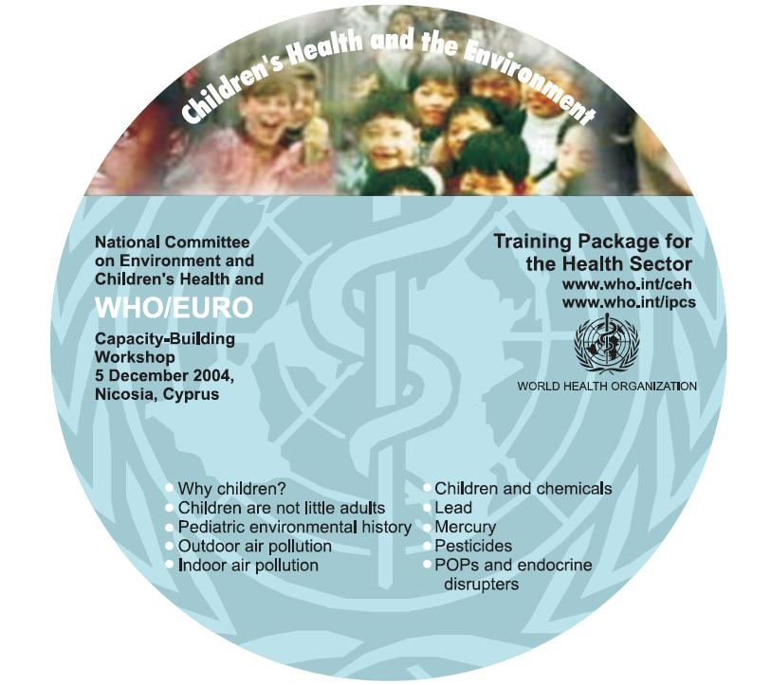
TASKS ACCOMPLISHED
Tools for reaching the health sector
Development of an e-waste and child health “train the trainers” peer-reviewed module of the WHO Training Package on Children's Environmental Health for health professionals (WHO CC Uruguay)
Technical information
Series of publications on child health, including a systematic review
Developed with collaborating centers and health partners
Information dissemination
through WHO website, WHO/UNEP, newsletter, survey, reports
Notes:
As most of you know… not going to focus on the reasons for training and sectors involved (NURSES), WHO one pager available
What is the WHO Training Package for Health Care Providers?
A collection of over 30 modules with internationally harmonized information and peer-reviewed materials to enable health care workers to be trained, and also to become trainers of their peers and colleagues. The over 50 modules with internationally harmonized information and peer-reviewed materials to enable health care workers to be trained, and also to become trainers of their peers and colleagues. modules include extensive notes and references, and case studies. These will be supported by self-evaluation tools, backed up by manuals and guidelines. A selected team of experienced professionals from over 15 countries, the International Pediatric Association (IPA), and selected NGOs are participating in its preparation.
CDs
At each training event, the participants are encouraged and given support and instructions to continue with the "train the trainers" method. Once they are back home, they are expected to develop training activities and inform their peers and the community about CEH. All participants are given a CD with all the modules and instructions on how to use them and organize events to bring back home and help them in their future training activities. They are also encouraged to keep WHO informed about their CEH activities.

Slide 11
NEXT STEPS
Communications: raising awareness on health impacts
Networking with relevant stakeholders to protect health
Bringing health to interventions by
Strengthening the monitoring of exposure to e-waste, and related health impacts particularly among children and workers
Providing information for the protection vulnerable populations from e-waste health impacts
Increasing capacity of the health sector to manage risks related to e-waste and work multi-sectorally

Slide 12
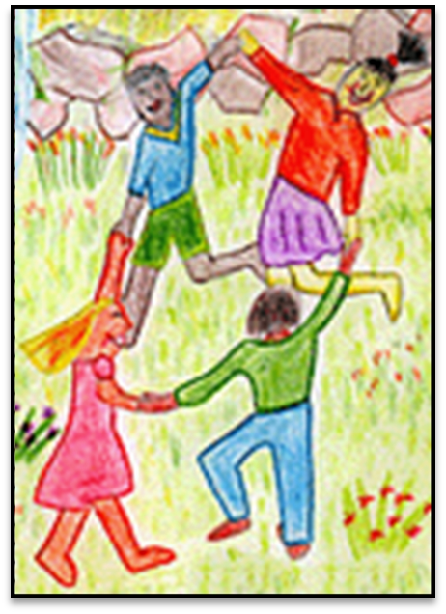
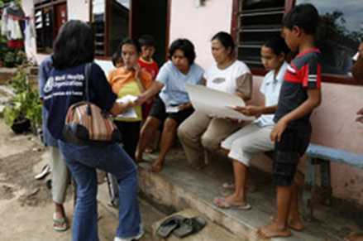
WORKING TOGETHER TO PROTECT THE HEALTH OF OUR CHILDREN

Slide 13
APPENDIX

Slide 14
WHO resources
Main publications of WHO and WHO network of collaborating centres on children's environmental health on e-waste and child health
Grant K et al. Health consequences of exposure to e-waste: a systematic review on health effects of e.waste. The Lancet. http://www.thelancet.com/pdfs/journals/langlo/PIIS2214-109X(13)70101-3.pdf
Bruné MN et al. Health effects of exposure to e-waste. Lancet Global Health. Vol1, 2, e70, August 2013 http://www.thelancet.com/journals/langlo/article/PIIS2214-109X(13)70020-2/fulltext?rss=yes
Heacock M et al . E-Waste and Harm to Vulnerable Populations: A Growing Global Problem. Environ Health Perspect. 2015 Sep 29. http://www.ncbi.nlm.nih.gov/pubmed/26418733
Perkins D et al. E-waste: a global hazard., Ann Glob Health. 2014 Jul-Aug;80(4):286-95.
http://www.ncbi.nlm.nih.gov/pubmed/25459330
Sustainable Management of Waste Electrical and Electronic Equipment in Latin America. ITU in collaboration with WHO and many UN partners.2015

Slide 15
WHO resources
Websites
• WHO e-waste and child health website http://www.who.int/ceh/risks/ewaste/en
• e-waste and child health network website. WHO’s collaborating centre, Children’s Environmental Health Program, Brisbane - https://www.qcmri.uq.edu.au/chep/e-waste-network.aspx includes the Geneva Declaration on e-waste and child health
Newsletter
WHO/UNEP Children's Environmental Health monthly newsletter with specific section on e-waste (and child health)
http://www.who.int/heca/infomaterials/hecanet/en/
Initial UNU/WHO survey
http://www.step-initiative.org/files/step/_downloads/UNU%20&%20WHO%20Survey%20on%20E-waste%20and%20its%20Health%20Impact%20on%20Children%20-%205%20August%202013.pdf

