Slide 1

Sustainable management of E-waste
Cristina Bueti
Advisor
ITU-T
05 May 2016

Slide 2


Who are we?

Slide 3

ITU-T’s environmental programme
Develop international standards to protect the environment
Assist countries to develop policies and implement standards on climate change adaptation and mitigation
Help companies becoming more sustainable and socially responsible
Research and development on areas which include e-waste, energy efficiency and smart sustainable cities.
Raise awareness on role of ICT in tackling environmental challenges
Using ICTs to protect the environment

Slide 4
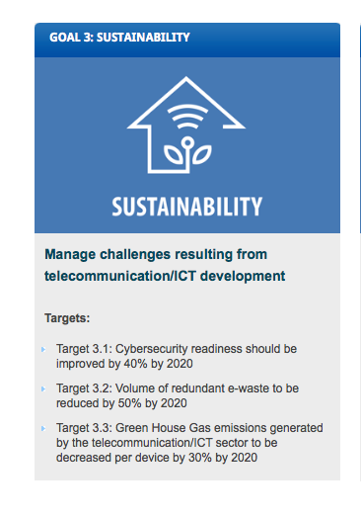
Connect 2020 Agenda Environmental Sustainability Targets
Target 3.2: Volume of redundant e-waste to be reduced by 50% by 2020
Target 3.3: Greenhouse Gas Emissions (GHG) generated by the telecommunication/ICT sector to be decreased per device by 30% by 2020

Slide 5




Study Group 5: Environment and Climate Change
WP1/5
Damage prevention and safety
WP2/5
Electromagnetic fields: emission, immunity and human exposure
WP3/5 ICT and Climate Change
Lead Study Group
Environment and Climate change
electromagnetic compatibility and electromagnetic effects
4 Questions
6 Questions
7 Questions

Slide 6


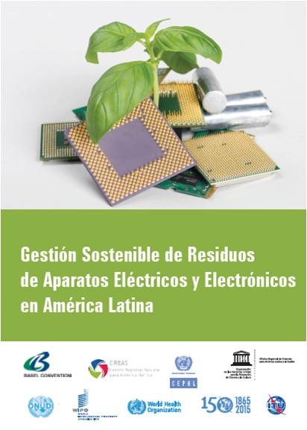
Recycling of rare metals in ICT products
Power supply series
Circular economy
ITU-T L.1000
ITU-T L.1001 ITU-T L.1002 (draft)
ITU-T L.1005
ITU-T L.1100
ITU-T L.1101
Notes:
Recommendation ITU-T L.1000: Universal power adapter and charger solution for mobile terminals and other hand-held ICT devices:
Saves 82,000 tons of e-waste per year
Saves at least 13.6 million tonnes of CO2 emissions annually
Recommendation ITU-T L.1001: External universal power adapter solutions for stationary information and communication technology devices:
Saves 300,000 tons of e-waste per year
Reduces the energy consumption and greenhouse gas (GHG) emissions of external power supplies by between 25% and 50%

Slide 7
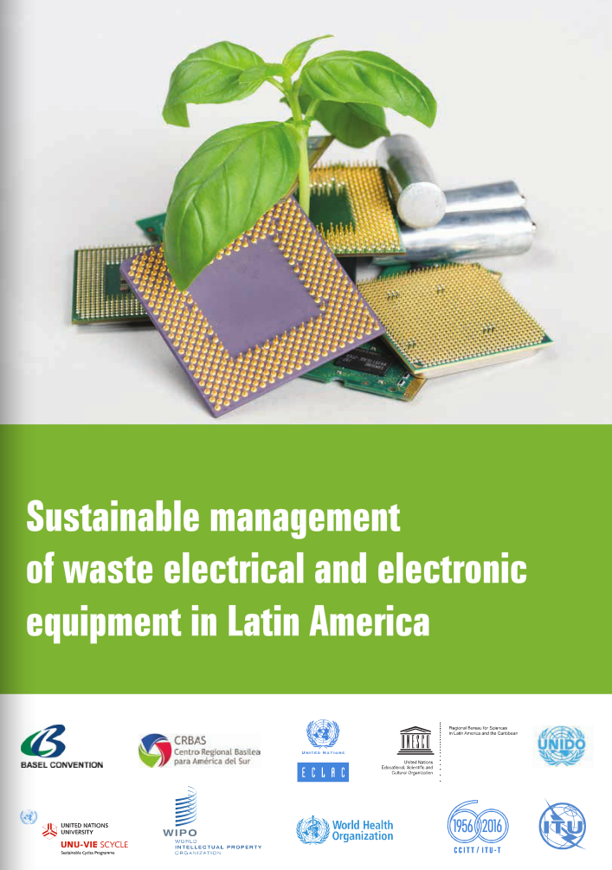









Sustainable Management of Waste Electrical and Electronic Equipment in Latin America
Main objectives:
To provide an overview of WEEE management in Latin America
To identify challenges for sustainable management
To outline a joint roadmap for future implementation

Slide 8




Brief Overview
Country | National Regulation on e-waste | Public Policies | International Commitment | E-waste management technologies*
Argentina
Bolivia
Brasil
Chile
Colombia
Ecuador
Paraguay
Perú
Uruguay
Venezuela
*This is based on information available on identified patenting activity in these countries.

Slide 9

10 Key Steps (1-5)
Identify sources of e-waste generation and account for management volumes.
Deepen the analysis at the country level, including aspects such as key actors, social framework, cultural boundaries, etc.
Base e-waste management in the region on a definition that covers the entire life cycle of EEE.
Develop a preventive policy of WEEE management in order to avoid environmental and health risks. Learn from international initiatives (ITU-T Study Group 5, PACE and Step).
Establish initiatives for more effective project implementation and to strengthen e-waste sustainable management alliances.
Notes:
1- Identify sources of e-waste generation and account for management volumes. Countries should rely on international standards and uniform models of e-waste accounting flows. This will allow them to measure technological capacities and to measure the sustainable management of e-waste in the present and the future.
2- Perform a detailed and comparable analysis about the situation of e-waste throughout the region. This includes qualitative information, the identification of key actors and the applicable social framework, cultural boundaries, technological availability, etc.
3- Base e-waste management in the region on a definition that covers the entire life cycle of EEE. This includes everything from components that have been discarded by their owner to e-waste without the intention of reuse by its owner.
4- Develop a preventive policy of WEEE management in order to avoid environmental and health risks. It is advisable to propose collection systems with efficient technologies, informed by experiences in other countries. In this regard, the guidelines developed by various international organizations and platforms, such as ITU-T Study Group 5, the Step Initiative or PACE, can provide the necessary guidance.
5- Foster closer cooperation between actors and stakeholders. This cooperation should occur at the global, transcontinental, national and local levels with the goal of facilitating learning from the experiences of other countries and actors to take advantage of the lessons learned and to avoid making the same errors. Such cooperation requires the development of a greater number of initiatives that promote the advancement and implementation of policies and projects, as well as the establishment or strengthening of effective partnerships for sustainable management of EEE and e-waste.

Slide 10

10 Key Steps (6-10)
Develop international cooperation and partnerships for sustainable management of EEE and e-waste; including alternative management across borders.
Focus activities not only on recycling, but also on the repair and reuse of EEE. Policies and strategies should promote the eco-design of EEE to extend the shelf life of the products, thus contributing to the reduction of e-waste generation.
Make further efforts to raise consumers’, businesses’ and policymakers’ awareness of e-waste.
Develop a high level of coordination between existing initiatives and those under development.
Increase technological availability for the efficient management of e-waste.
Notes:
6- Develop international cooperation and partnerships for sustainable management of EEE and e-waste. These are essential to ensure proper treatment of EEE at the end of its useful life. In the short term, the region has to invest heavily to develop the necessary infrastructure for the proper and efficient management of hazardous and scarce metal components in EEE and e-waste. Therefore, eco-efficient management alternatives should be evaluated between countries.
7- Focus activities not only on recycling, but also on the repair and reuse of EEE. Policies and strategies should promote the eco-design of EEE to extend the shelf life of the products, thus contributing to the reduction of e-waste generation.
8- Make further efforts to raise consumers’, businesses’ and policymakers’ awareness of e-waste.
9- Develop a high level of coordination between existing initiatives and those under development. This avoids unnecessary duplication of activities and efforts and optimizes the use of existing scarce resources.
10- Increase technological availability for the efficient management of e-waste. It is important to promote innovation and technology transfer through the efficient identification of new alternatives or the adoption of existing technologies elsewhere. To achieve this, it is important to assess the economic implications of some alternatives and to identify the mechanisms that measure their implementation progress. Tools, such as the analysis of patent information contained in patents registry or technology databases, can facilitate the implementation and monitoring of technological processes in the medium and short term.

Slide 11

Thank you
ITU-T, Environment and Climate Change http://itu.int/go/tsg05
tsbsg5@itu.int

