Slide 1
Ubiquitous Network for e-Health
ITU Workshop on
“E-health services in low-resource settings: Requirements and ITU role”
(Tokyo, Japan, 4-5 February 2013)
Prof. Heung-Kook Choi
Department of Computer Engineering Inje University, Korea
cschk@inje.ac.kr

Slide 2
Contents
1. Background
2. The Existed Applications
3. Introduction of Our System
4. Program Contents
5. Conclusions
6. Program Demonstration <avi>
Q & A

Slide 3
1. Background
Advanced information communication
technology
Advent of aging era
Chronic disease management
Increasing smartphone users
IT based u-healthcare applications

Slide 4
2. The Existed Applications
Q-Care Self-managing Service
Diabetes Management Notebook
iCare-D

Slide 5
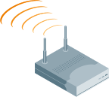
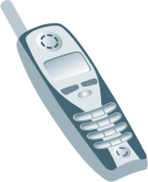
3. Introduction of Our System
LAN
Remote
WLAN
Branch Mobility Controller
AAA Server
Clinic
Internet
Firewall
LAN Switch
Mobility Controller
DSL/ Cable
Home Office
Access
Point
Hospital

Slide 6
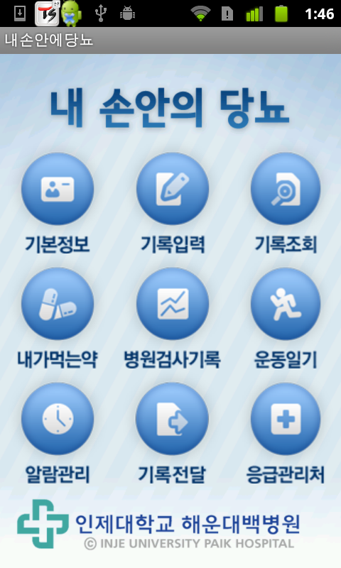
3. Introduction of Our System
Menu Screen
Diabetes in My Hand
Basic Information, Input Record, Record Inquiry
My Medicine, EMR, Exercise Diary
Alarm Management, Record Communication,
Urgent Management
Haeundae Paik Hospital of Inje University

Slide 7
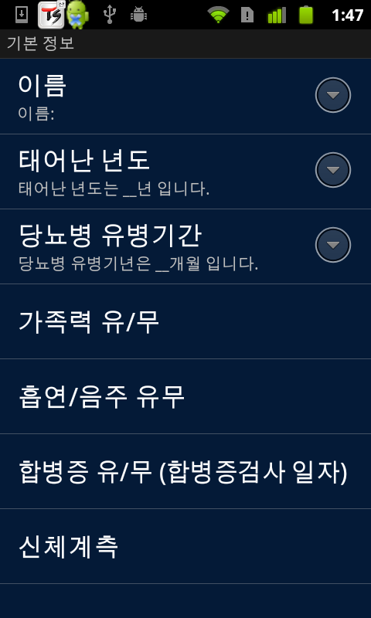
3. Introduction of Our System
Basic Information
Name
Birthdate
Diabetes Disease Duration
Family History ?
Smoking/drinking?
Complications Y/N?
Anthropometric Data

Slide 8
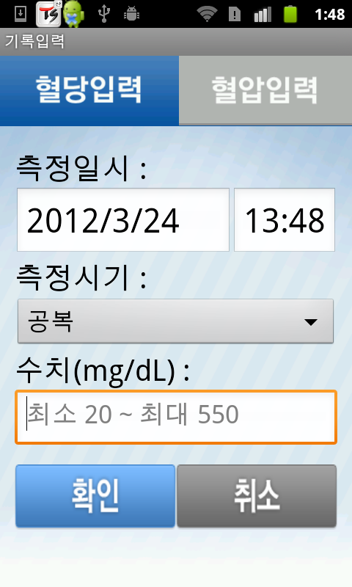
4. Program Contents
Input Blood Sugar
Input Blood Sugar; Input Blood Pressure
Date for Measurement
Time Interval for Measurement
Empty Stomach
Numerical Value
Confirmation; Cancellation

Slide 9
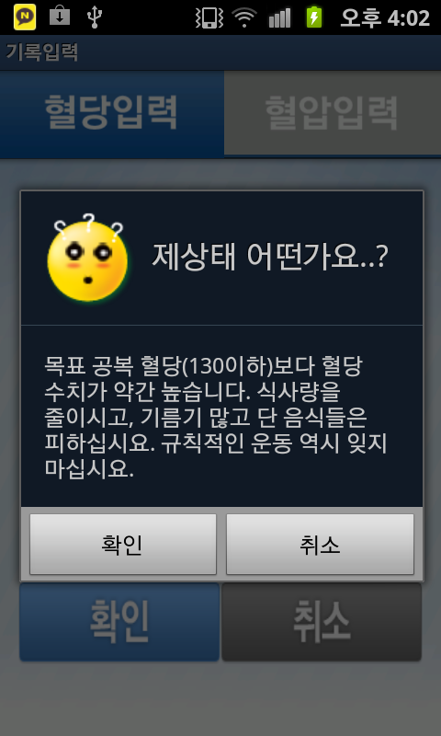
4. Program Contents
Input Blood Sugar
Input Blood Sugar, Blood Pressure
What is my status?
Higher blood sugar levels than your goal
fasting glucose. Cutting down on food intake
and avoid greasy foods. Do not forget regular
Excise too.
Confirmation; Cancellation

Slide 10
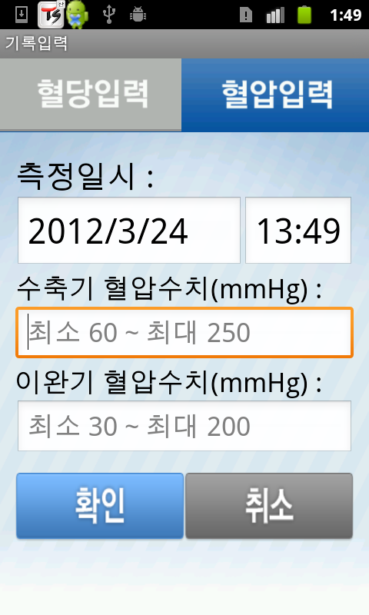
4. Program Contents
Input Blood Pressure
Record Input
Input Blood Sugar, Blood Pressure
Measurement Date
Systolic Blood Pressure Value
Diastolic Blood Pressure Value
Confirmation; Cancellation

Slide 11
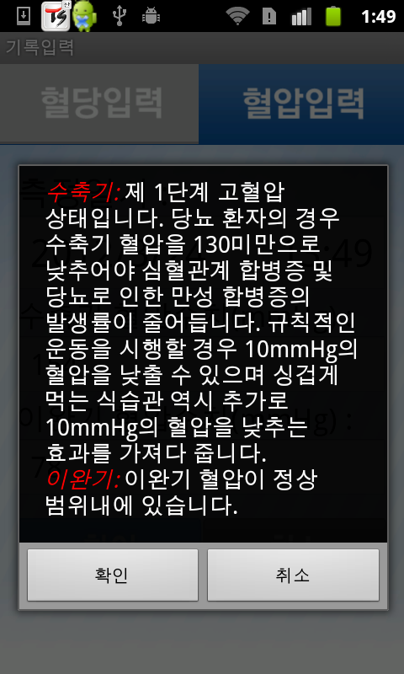
4. Program Contents
Input Blood Pressure
Input Blood Sugar, Blood Pressure
Systolic: Hypertension status is the first step. Diabetic patients should be lowered the systolic blood pressure less than 130 to reduce due to the incidence of chronic complications of diabetes and cardiovascular complications. When performed regular exercise can lower the blood pressure of 10 mmHg. Polite eating habits that can reduce the effects of 10 mmHg brings additional also. Diastolic: Diastolic blood pressure within the normal range.
Confirmation; Cancellation

Slide 12
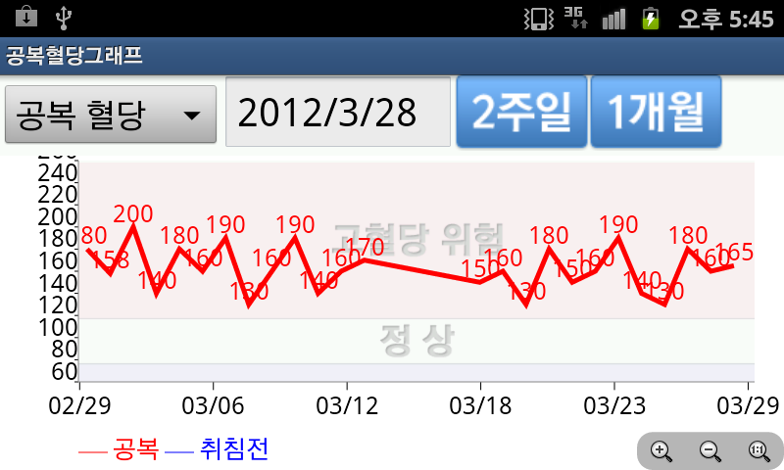
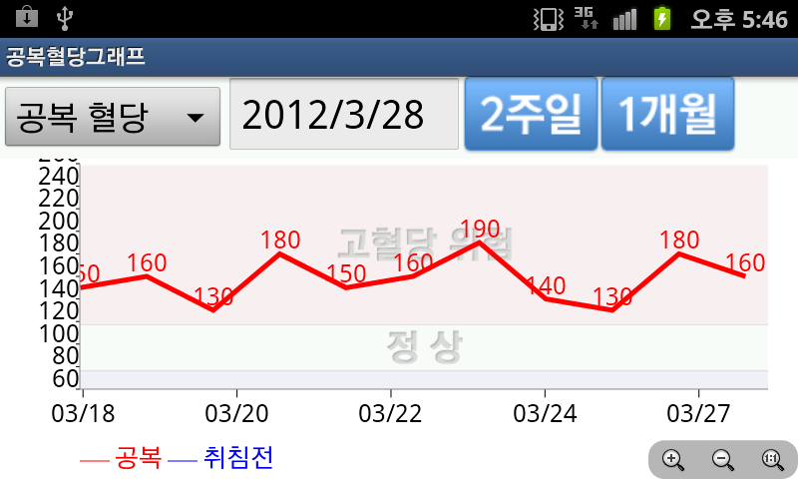
4. Program Contents
Check-Blood Sugar
Blood Sugar Graph of Daybreak
Daybreak, 2 weeks, 1 month
---daybreak ---before bed
Blood Sugar Graph of Daybreak
Daybreak, 2 weeks, 1 month
---daybreak ---before bed

Slide 13
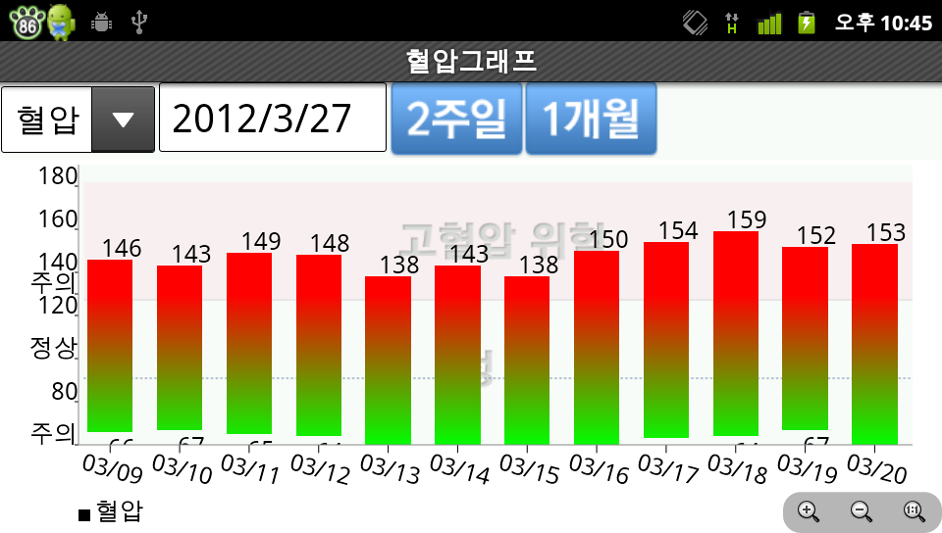
4. Program Contents
Check-Blood Pressure
Blood Pressure, Date,
2 weeks;1 month

Slide 14
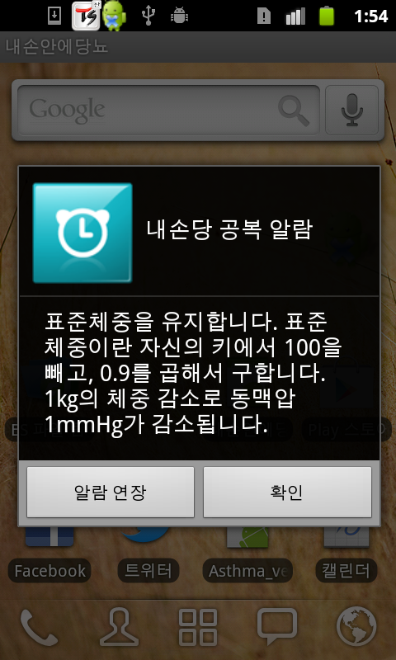
4. Program Contents
Alarm
Before Breakfast Alarm in My Hand
Maintain the standard weight. Standard weight: (Height-100) x 0.9 1kg weight loss, arterial blood pressure
is reduced 1mmHg

Slide 15
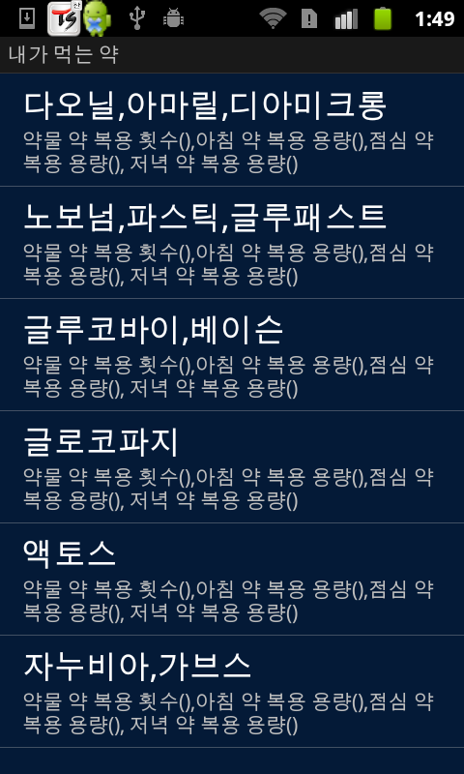
4. Program Contents
My Medicine Taking
Daonil Tab., Amaryl Tab., Diamicron Tab.
Novonorm Tab., Glufast Tab.
Glucobay Tab., Basen Tab.
Glucophage Tab.
Actos Tab.
Janivia Tab., Garves Tab.

Slide 16
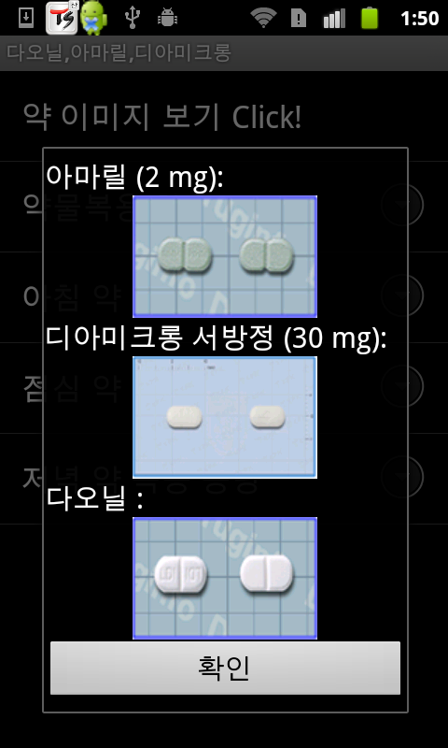
4. Program Contents
My Medicine Taking
Daonil Tab., Amaryl Tab., Diamicron Tab.
Image for Tablet Click!
Amaryl Tablets
Diamicron Tablets
Daonil Tablets
Confirmation

Slide 17
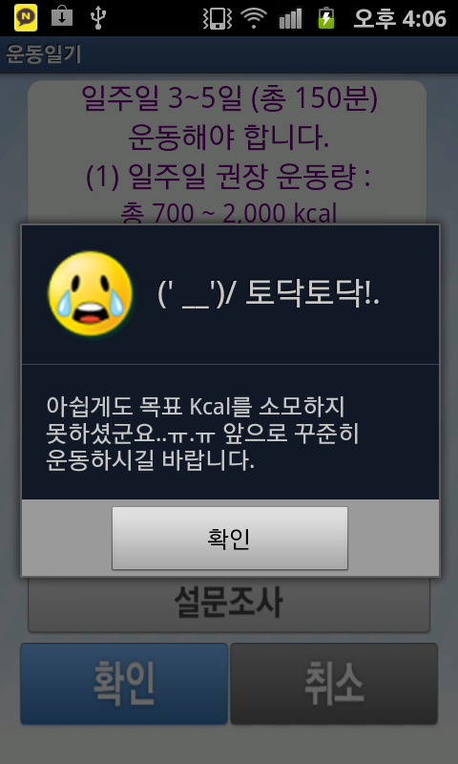
4. Program Contents
Exercise Journal
Exercise Journal
Need to exercise 3~5 days (total 150 minutes)
a week.
Recommendation the momentum for a week
total 700~2,000 kcal
(‘—’)Patted Patted!.
Unfortunately, the goal of kcal consumed did
not see. Forward, steady movement, please.
Confirmation
Survey
Confirmation Cancellation

Slide 18
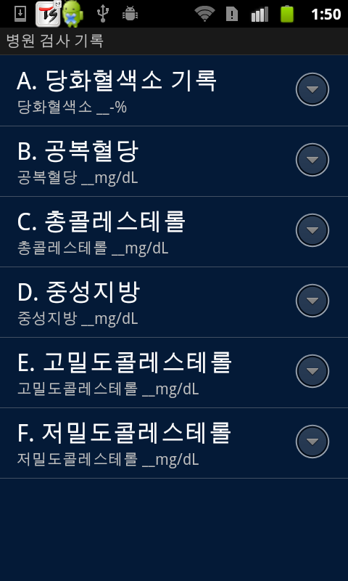
4. Program Contents
Patient Record
Check-up Record of Hospital
A. Glycated hemoglobin Record
B. Fasting plasma glucose
C. Total cholesterol
D. Triglyceride
E. High-density cholesterol
F. Low-density cholesterol

Slide 19
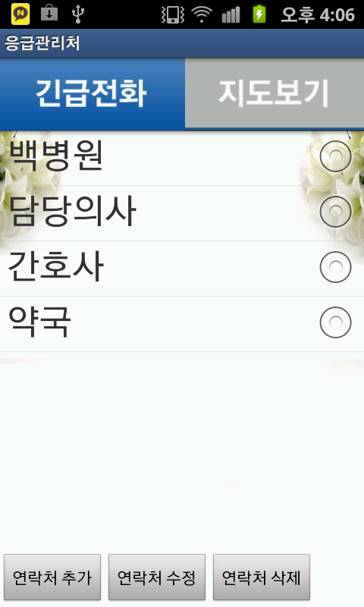
4. Program Contents
Emergency Contact
Emergency Contact
Emergency Telephone, Map View
Paik Hospital
Doctor
Nurse
Drugstore
Add to Contacts, Edit Contacts, Delete a Contact

Slide 20
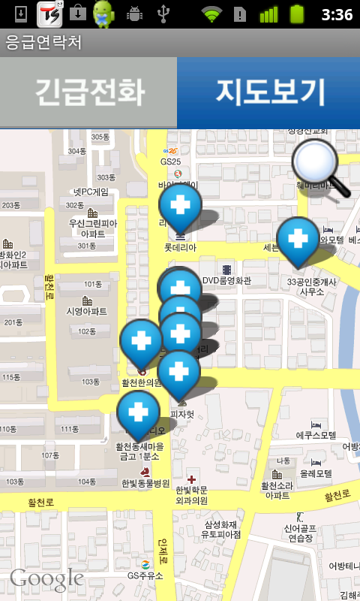
4. Program Contents
Emergency Contact
Emergency Contact
Emergency Telephone, Map View

Slide 21
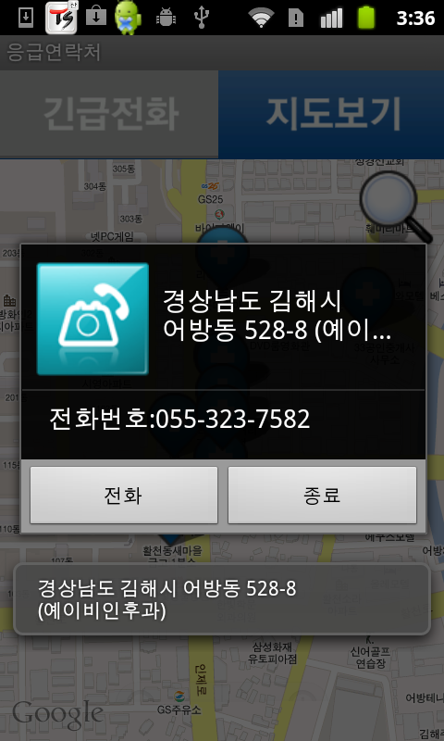
4. Program Contents
Emergency Contact
Emergency Contact
Emergency Telephone, Map View
Gyeongnam Gimhaesi
Obangdong 528-8 (Ye…
Telephone Number: 055-322-7582
Telephone, End
Emergency Telephone, Map View

Slide 22
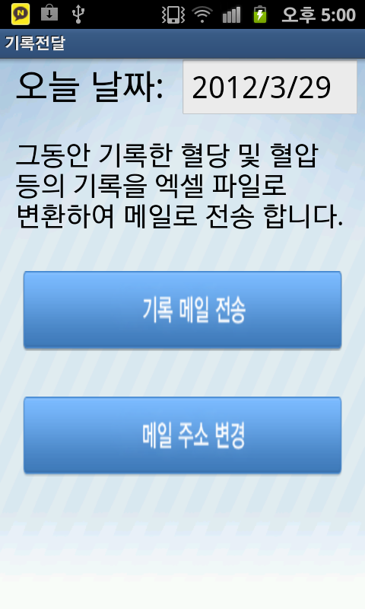
4. Program Contents
Record Delivery
Recorded Delivery
Today’s Date: 2012/3/29
Meanwhile, the record blood sugar and
blood pressure, such as the records are
converted into an Excel file.
Then sent to it by e-mail.
Record-mail transmission
Change the e-mail address

Slide 23
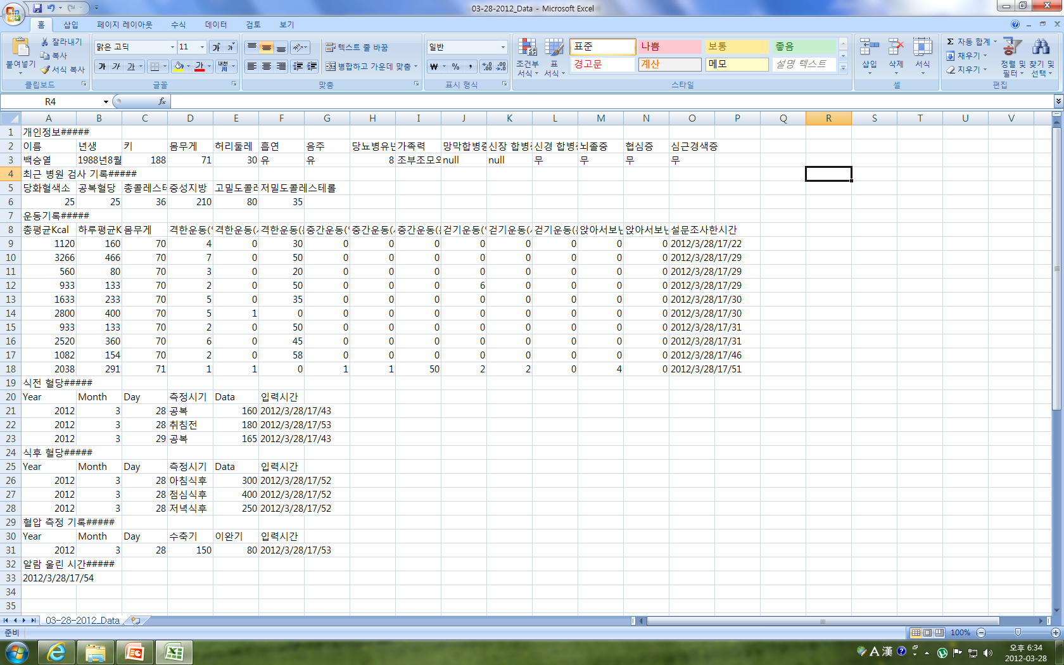
4. Program Contents
Record Delivery

Slide 24
5. Conclusions
Convenience
Cost and Time Saving
Awareness
Patient record can see directly to query their status. Trying to query their status by the monitor directly.
Recently, patient record and the dose of drug can see directly.
You can easily find the hospital around.
More systematic management can be diabetes whenever blood glucose and blood pressure reading the comment.
Do not forget to measure blood pressure and blood sugar by alarm.
Implementation of
U-healthcare:
Patient can get the levels of blood sugar and blood pressure directly of the doctor without to visit hospital.

Slide 25
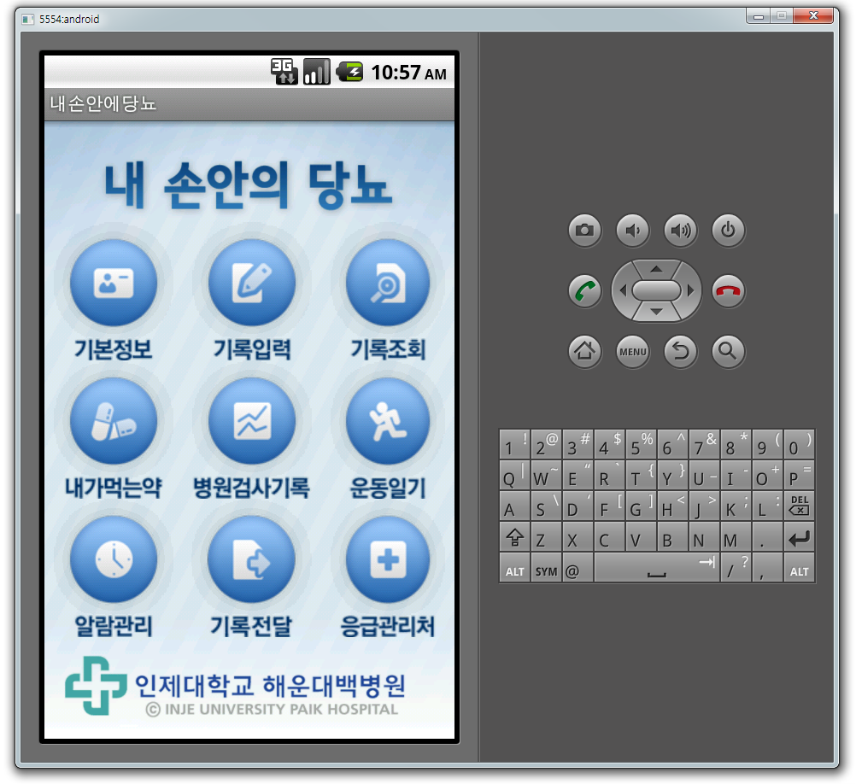
6. Program Demonstration
Diabetes in My Hand
AVI
<Award of Student Competition>

Slide 26
Thank You !

