Slide 1

GramHealth: An affordable and usable healthcare system for unreached community
ITU Workshop on "E-health services in low-resource settings: Requirements and ITU role”
February 4-5, 2013, Tokyo, Japan
Ashir Ahmed
Director, Global Communication Center Project, Grameen Communications, Bangladesh
Associate Professor, Department of Advanced Information Technology, Kyushu University, Japan

Slide 2
Agenda
GramHealth
UnReached People
Affordable and Usable Healthcare System
Portable Clinic and GramHealth : Experimental Results and Comments

Slide 3
The Unreached Community
The Unreached | Category
3 billion people live on less than $2.50/day | Poverty
1 billion people unable to read | Education
1.5 million children die of diarrhea each year | Health
1.6 billion people live without electricity | Energy
・・・ | ・・・
How can we change these facts?

Slide 4
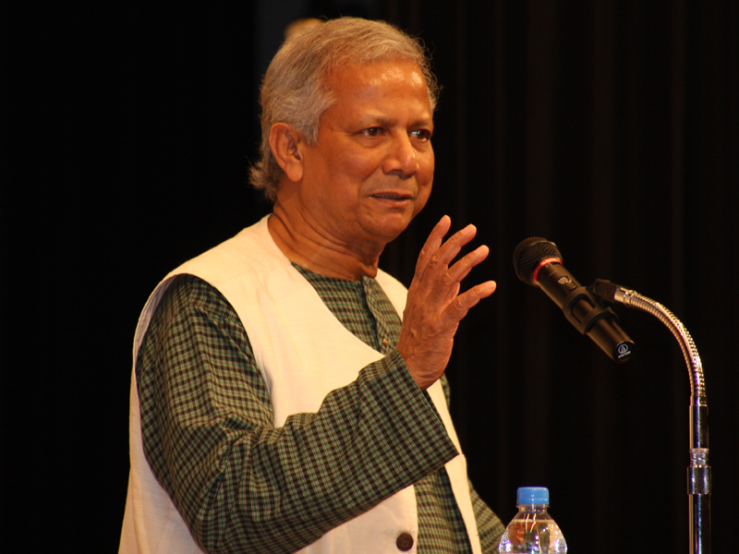
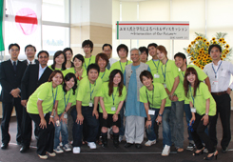
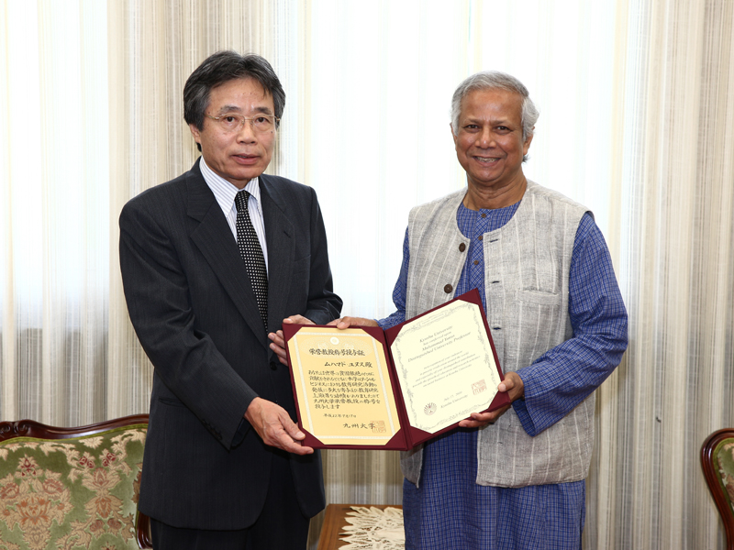
Muhammad Yunus
Was awarded Nobel Peace Prize in 2006.
Contributed to solve poverty issue.

Slide 5
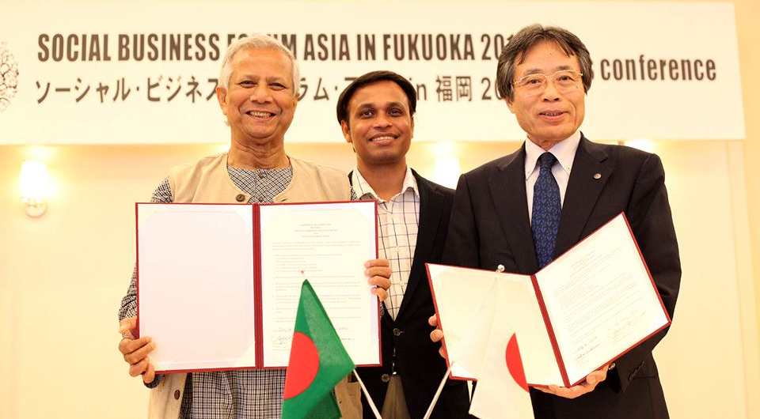


Collaboration with Grameen Since 2007
Development of Technologies based on Social Needs
Social Business to provided social services to the target community in a business way
Healthcare is a focused area of joint-research

Slide 6
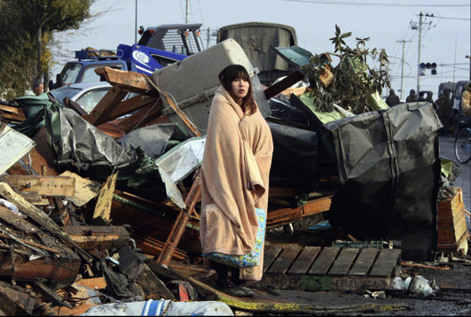
Unreached: Beyond the BOP
100 M
２ Billion
Purchase Power Parity (daily)
Socio-economic
  Low income, Low skills
  Compromised infrastructure
  Under developed countries
Natural Disasters
  Low/high income, low/ high skills
  Compromised infrastructure
  Both developed and developing countries
Political
  Low/High income, Low/high skills
  Compromised infrastructure
  Both developed and developing countries
$５
4 Billion People
69% of World Population
BOP
$２
$１
Commonality and Variability
Charity:Business
Reverse Innovation
Notes:
Last year, scientists revealed that it was in fact the chicken that came first, not the egg. And the same applies here: that it is the people that come first, not the technology. Regardless of how well-designed or technologically sound the tool, if people aren’t already using that tool then they won’t turn to it in a time of disaster. It is not just that people need to know of a technology, but they really need to have it already integrated into the way they communicate and share for adoption to take hold during a crisis.

Slide 7
E-Health services in low-resource settings

Slide 8
Low-resource setting
Doctors don’t want to stay in villages
Quality hospitals don’t sustain without a stable income
Transportation cost is bigger than treatment cost

Slide 9






Bangladesh case: Health Consultancy over mobile phone since early 2000
CDR
GSM Net
Patient @Home
Doctors @Call Center
A patient calls a hotline number.
The call is redirected to a call center doctor.
The patient-doctor conversation starts.
The doctor provides three types of services.
The conversation is archived in CDR
Notes:
Voice only service

Slide 10


Two Case studies
  2-a) Remote Health consultancy over mobile phone
 | 789 Service | Tele health 10600
Provider | GrameenPhone (a mobile phone operator) | JBFH (a hospital)
Calls per day | 15,000 calls | 500 calls
Call center doctors | 200 doctors / three shifts | 10-15 doctors / three shifts
Price | 5 cents per minute | Free for farmers
Notes:
Case-1: 789 Service by GrameenPhone (a mobile phone operator)
15,000 calls per day, 200 doctors in 3 shifts
5 cents per minute
Case-2: Tele health 10600 JBFH* (a hospital)
500 calls per day (in 2009)
Free for farmers
Small call center with 3-5 doctors/shift

Slide 11
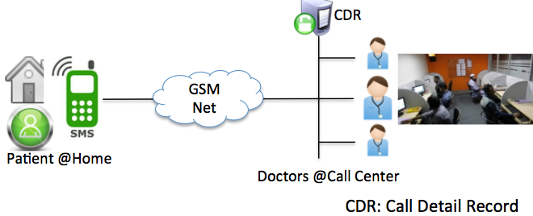
Amazing Facts from Doctor-Patient conversation analysis
2-a) Remote Health Consultancy over mobile phone
33% patients are females
→ Solves another social prolem of female
Observed Item | Results (n=400)
(a) Caller | Patient: 60%, Relatives: 40%
(b) Age distribution of the patient | 0-10 years: 29%, 11-20 years: 15% 21-30 years:24%, 31-40 years:17% 41-50 years: 9%, 50+ years: 7 %
(c) Sex | Male: 67%, Female: 33%
(d) Location | Rural: 30%, Urban: 70%
(e) Call completion | Complete: 68%, Incomplete: 32%
(f) Time of call | Day (8:00-15:30): 57 % Evening (15:30-23:00): 18% Night (23:00-8:00): 25%
(g) Time occupancy of a single call | Introduction phase: 8%, Diagnosis phase: 27%, Advice phase: 67%
(h) Consultancy about | Disease related: 79%, Preventive healthcare related: 21%
(i) Type of advices | Prescribed medicine: 54% , Advice: 28%, Referred to specialist/hospital: 17%,
(j) Patients | Follow up: 17%, New: 83%
(k) Major diseases consulted | Gastro-intestinal: 22%, Respiratory: 17%, Reproductive:10%, skin: 10%
Data Source: Tele health 10600 (Case-2)
Duration: December, 2009
Total Records: 10000
Selected Records: 400
17% follow up patients
→Popular !!!
10

Slide 12
Advantages and Technical Challenges
Social and Business Aspect
  Female patients can stay anonymous for female diseases. Amazing Privacy!!
  Access to basic healthcare by millions of unreached patients
Technical Challenges
  Bad quality of communications. Incomplete calls.
  Doctors cannot see to past records for repeated patients
  Doctors can not make a good clinical decision, no diagnostic tools at the patient side to provide health data

Slide 13
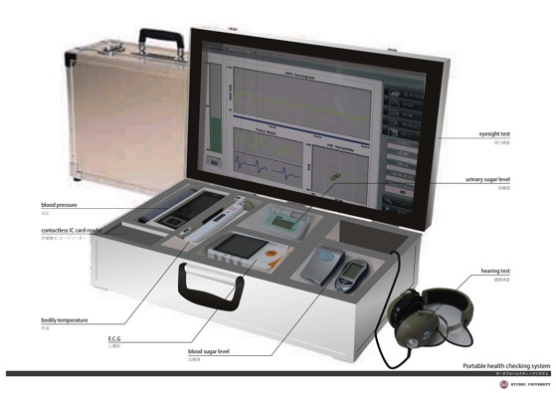

Our response to the technical challenges
Solutions by Portable Clinic (a health check up box)
a. Diagnostic tools (one set for one community)
b. Broadband Internet (Not GSM)
Portable Clinic
Challenges
a. No diagnostic tools
b. Bad quality of communications
c. No Patient ID management mechanism
d. Difficulties to access to past clinical records
Solution by GramHealth (a Web based PHR)
c. Unique patient ID and Phone number
d. Universal access to PHR
GramHealth
PHR: Personal Health Record
Notes:
Difficulties to access to past clinical records

Slide 14
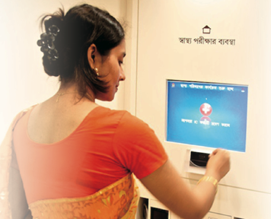
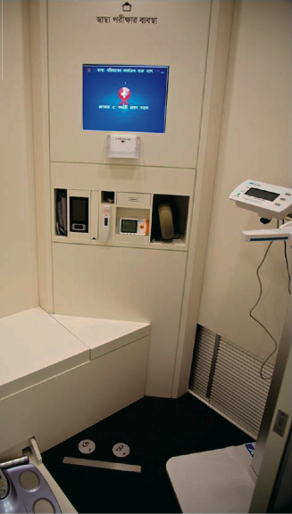
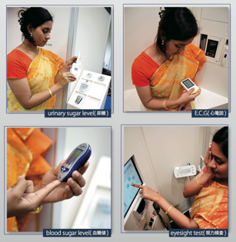
Grameen and KU: Towards One Community One Clinic
3,000 USD
Affordable?

Slide 15










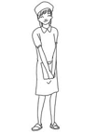

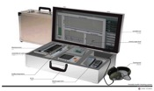
Can we make it more efficient? Portable?
Phase 1: System design of a clinic booth using traditional devices and SW tools
(a) $3000 “Clinic Booth” with existing devices
(d) FHR
Viewer
Urban doctor
Rural Patients
Diagnostic Tools
(b) FHR
Interfaces
Patients visit
clinic
Cell Phone
(c) FHR Application Server
Phase 2: Develop a cost effective portable clinic
Proposed $300 “Portable Clinic”
Rural Patients
Clinic visits
patients

Slide 16
Affordable ($300?) Portable Clinic

Slide 17
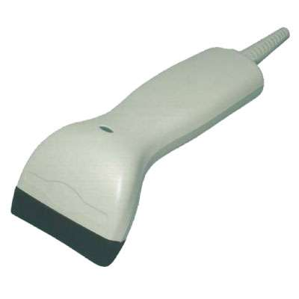

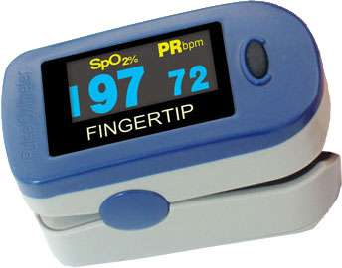

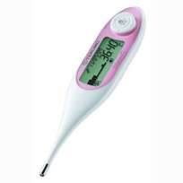
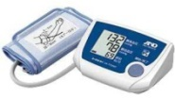
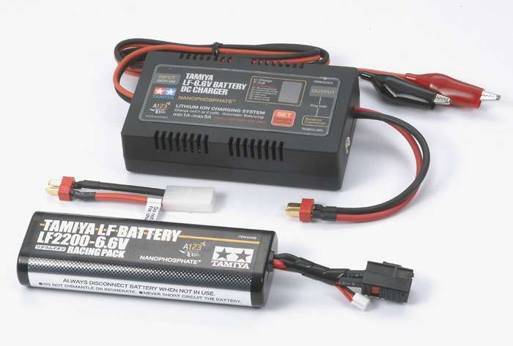
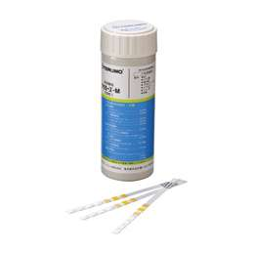
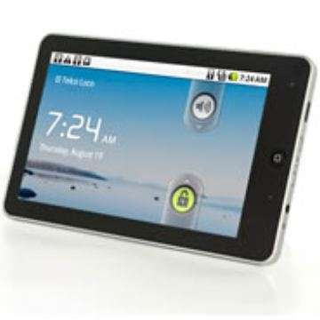
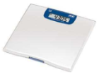


The prototype used in field
Low cost vs. Accuracy
Barcode reader
Name cards
with barcode
Measure
(Height, Waist, Hip)
Pulse oximeter
(Oxygen in blood)
Blood sugar meter
Thermo
meter
Urine tester tape
（protein, sugar）
Blood pressure
Buttery
Mobile modem
Paper
and pen
Weight scale
Android terminal

Slide 18
Accuracy of the sensors: Concept of Triage to convince the patient
Risky
Safe
 | Green | Yellow | Orange | Red
Blood Pressure (mmHg) | <140 mmHg | 140≦ <160 mmHg | 160≦ <180 | 180≦
 | <90 mmHg | 90≦ <100 mmHg | 100≦ <110 | 110≦
Blood Sugar | <100mg/dl | 100≦ <126mg/dl | 126≦ < 200mg/dl | ≧200mg/dl
Postprandial Blood Sugar | <140mg/dl | 140≦ <200mg/dl | 200≦ < 300mg/dl | ≧300mg/dl
Urine test
…
SpO2 | ≧96% | 93≦ <96% | 90≦ <93% | <90%

Slide 19
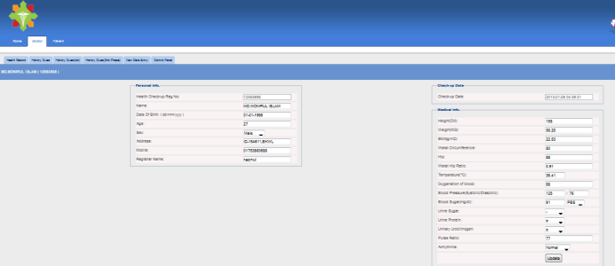
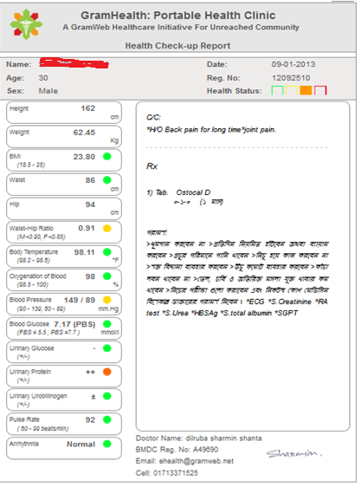
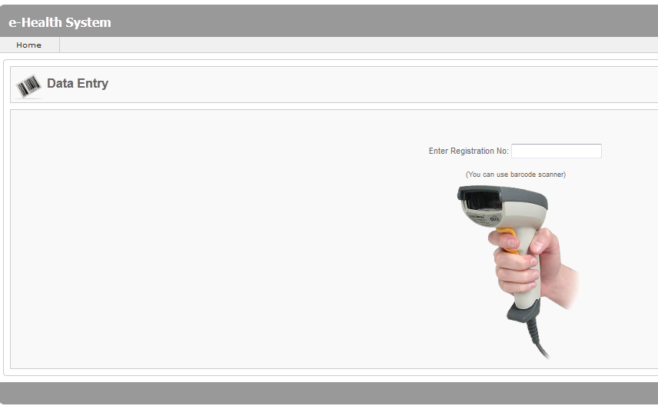
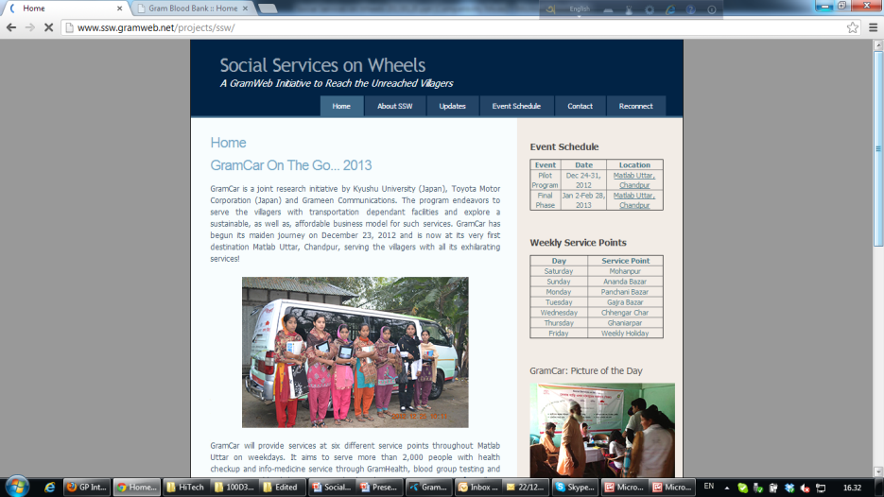
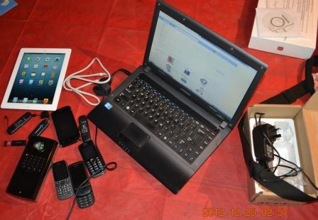

Slide 20
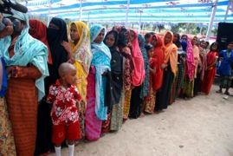
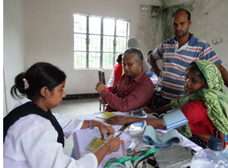
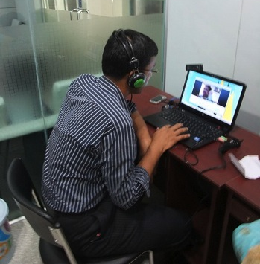
PHR collection for preventive healthcare
Patients’ Advantages:
-Access to quality healthcare from home
-Saves travel time and cost
Health Care Guideline
Patients in Village
Doctors in Urban Area
Triage
Internet
Triage
2. Health
checkup
1. Registration
3. Tele
Consultancy
4. Prescription & Suggestion
Doctors’ Advantages:
-Saves (>70%) doctor-time →Can see more patients
-Immediate access to health records →Better clinical decision

Slide 21



Portable Clinic in KU-Grameen
FHR
Internet
Lady Health
Worker
Doctors @Hospital
Patient @Home
Energy and communication problem
Similar to disconnected (due to natural disasters) areas?

Slide 22


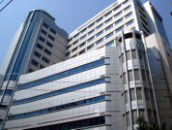





Nomadic and Portable
GramHealth
Village-1
Internet
Village-2
Village-3
Doctors @Hospital

Slide 23
BigData in GramHealth
GramHealth
DB
Conversation Data
Vital Data
Clinical Data
Triage
Health care Guideline
Prescription Data
1. Registration
2. Health
checkup
Triage
3. Tele
Consultancy
4. Prescription & Suggestion
15,000 records by March, 2013
Collaborator: N. Nakashima, Kyushu University

Slide 24
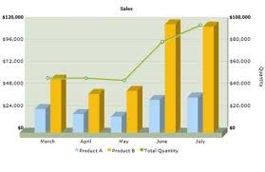
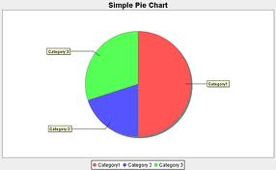
Data Variability and Trends
  4. What’s next? Healthcare BigData?
PHR
Structured
Prescription
Semi-Structured
Un-Structured
Analysis of BigData will produce Trending
-Disease pattern
-Geographical distribution
-Cohort characteristics
Conversation
GramHealth DB→BigData
Invaluable resource for the Data mining researchers

Slide 25
Collaboration Opportunities
Developing Countries
Japan
Leap frog Technology
Local Orgs
(NGO, Industries)
Our Lab
Research Orgs
(Academia, Industry)
Unmet Needs
Projects
Joint Experiment
Technology Development
Social Problems
Prototype
Business Model
UnReached People
Product Development
Social Business Venture

Slide 26
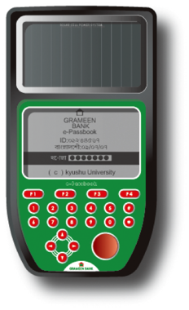
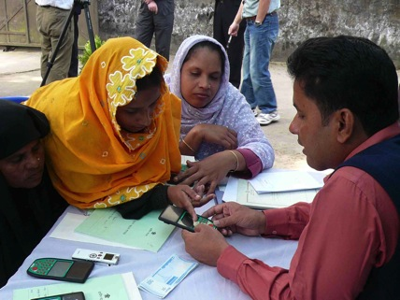
Can we keep the FHR a the patient side?
An Electronic gadget for -
-MFI (Micro Finance Institution)
-FHR (Family Health Record)
-Electronic Money Transfer
-Future options

Slide 27
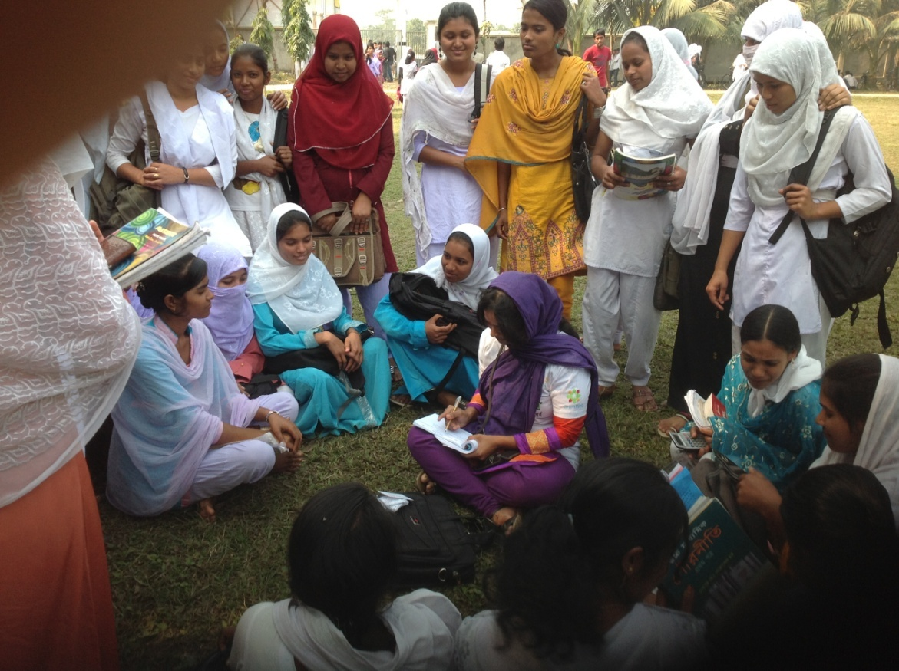
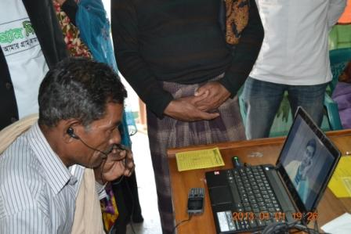
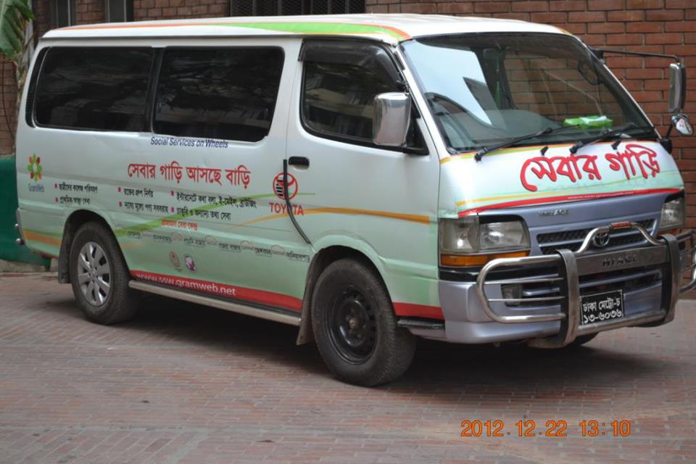
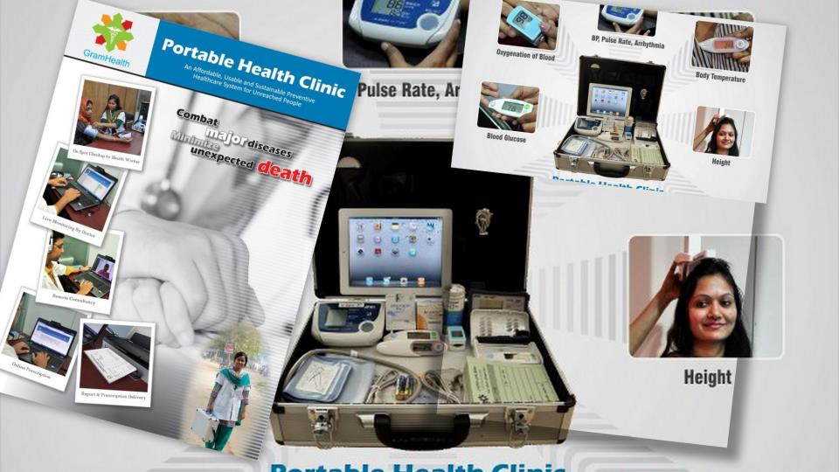
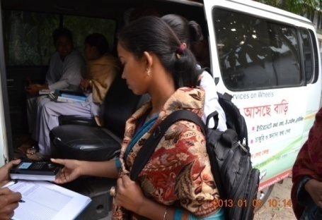



Slide 28
Conclusion
Technology to be developed based on the community needs
Charity aspect vs. Business aspect
Engagement with the local community
Role of academia to connect the community and industry

Slide 29
Thank you

