Slide 1
E-Health, The Uganda Situation
By
Dr.Birabwa-Male Doreen
Deputy Executive Director
Mulago National Referral Hospital

Slide 2
Introduction
Uganda is a small country of 236,000sq km in the Eastern part of Africa
Population is about 34million
One of the fastest growth rate of 3.7%
Independence 1962
More than 60 districts

Slide 3
Introduction
2 National referral Hospitals, Mental Health
13 Regional Referral Hospitals
More than 20 district hospitals
Many PNFP facilities
Health Centre IV, III and II

Slide 4
introduction
About 25 ministries
MoH and ICT are some of them
The Uganda Communications Commission(UCC)
undertook the e-health project
Other initiatives from OPM
Commitment to fully establish e-health
The journey has just began
Good prospects

Slide 5
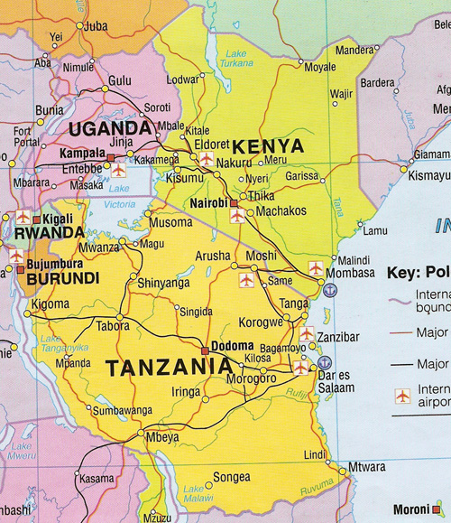
Map of East Africa

Slide 6
Mulago NRH
Mulago is the National Referral and Teaching Hospital For Makerere College of Health Sciences
Situated In the Northern Part of Kampala City, which is the Capital City
It came into existence in 1923 and 1960
Bed capacity is 1600 beds

Slide 7
Mulago
Clinical Services Division
Medical Doctors, Nurses, Pharmacy, Laboratory and other Paramedical Staff
Support Staff Department which includes HR, Accounts, IT, Customer Care, Stores, Engineering, Medical Records, Catering, Transport and Administration

Slide 8
Mulago
The hospital is therefore very big and busy
I am Deputy Executive Director for two years now
I am a Paediatric Surgeon by training and therefore a Clinician previously

Slide 9
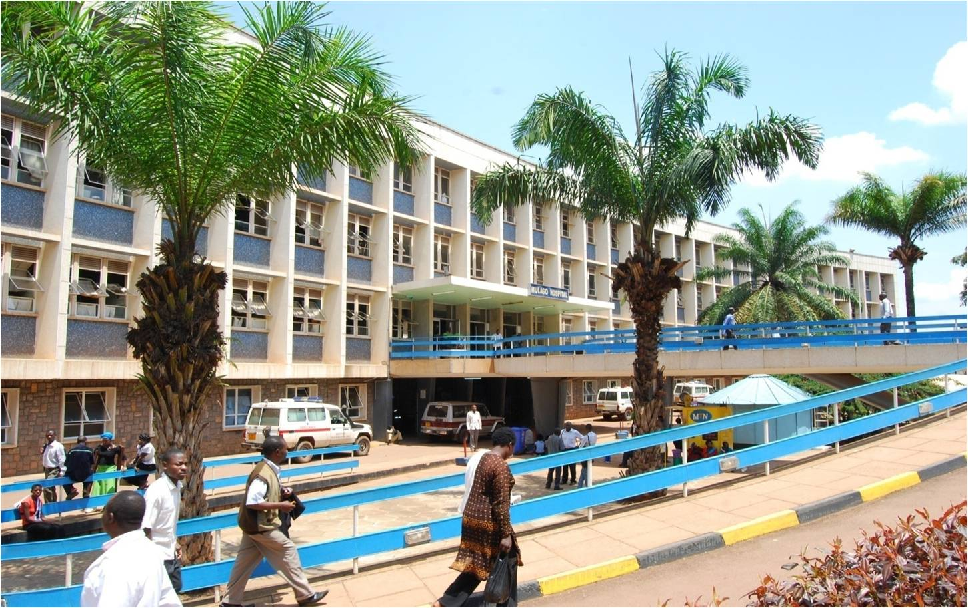
Mulago Hospital

Slide 10
Understanding e-health
The use of available systems and methods to facilitate health service delivery
Application in any department
Supply chain management
Referral and counter-referrals
Tele consultations
Tele conferencing

Slide 11
understanding
Accessing international information
Attending international conferences

Slide 12
E-health in Uganda
Government Project to Enhance e-health in Uganda
Started 2012 for 5 yrs
Executed jointly by the MoH and UCC
Work with local beneficiaries who are in the districts
Regional referral Hospitals, district Hospitals and Health Centre IVs

Slide 13
E-health
Focus is on
1) Health management Information System(HMIS)
2)Telemedicine(basic and Advanced)
Will eventually cover
53 districts
103 health facilities(53 Hospital and 69 Health Centre IVs)

Slide 14
E-health
The establishment consists of:
Resource Centre at the MoH Hdq.
computer centres at the beneficiary facilities
Local Area Network
Fibre-optic network
Telemedicine equipment
Solar Power equipment
National Grid connection

Slide 15
e-health
Web Cameras
Digital Cameras
Scanners

Slide 16
E-health
Software:
Internet connectivity
Data point at each facility
e-HMIS by MoH
E-office services
Tele software
Local connectivity

Slide 17
E-health
Expected out-put
Virtual linkage to the MoH resource centre, District Health Hdq, other hospitals
Accessibility of the MoH portal
e-CMEs
Online Medical Journals
e-libraries
e-consultations

Slide 18
E-health
Eventually the community will be empowered with e-learning
Easier communication between the community and health facilities
Harmonize referrals
Improved patient Care
Well informed health workers

Slide 19
e-health
Management of the project:
MoH
Uganda Communications Commission(UCC)
Steering Committee from both
Selected provider

Slide 20
e-health
Funding:
MoH
UCC
Beneficiary Facilities
Local Government
ICT budget for maintanance and operational costs

Slide 21
e-health
Other support:
M&E
Supervision
Bridging gaps
Computer Applications
Space and security
Hardware

Slide 22
e-health
Other applications
e-infrastructure development
e-records management
unique patient ID
drugs and stock management
stakeholders networking

Slide 23
Mulago National Referral Hospital
Situated in the Northern part of Kampala
Capital City of Uganda
National Referral and Teaching Hospital for MakCHS and other institutions around it
Founded in 1913 and 1962
Bed capacity of 1,650
No of staff is 3,000
Therefore big and very busy hospital

Slide 24
Mulago NRH
Top management
Clinical Services Division
Surgical
Medical
Paediatrics
Obstetrics and Gynaecology
Diagnostics
Deputy Executive Director, in charge of Clinical Services

Slide 25
Mulago
Support staff
Administration
Accounts
Human Resources
Stores
Customer Care
Security
Procurement
ICT

Slide 26
Mulago NRH
Existing Services
Medical Records
Supplies and Drugs
Human Resources
Telemedicine
Customer Care
Finances

Slide 27
Medical Records
Patient Records are not computerised centrally
Some decentralised data
Birth and Deaths
Initiative of UNICEF and Registrar General
Restricted access at various points
Hard copies can be printed

Slide 28
Supplies and Drugs
This system has been computerised and is working well
Initiative by Uganda Govt. through OPM
IICS
Able to monitor availability of drugs, expiries, movement
Restricted access depending on need
Will computerise Patients’ data

Slide 29
Human Resources
Computerised data
Includes biometrics
Centralised in Public service
Restricted Access
Clean Pay rolls
Better management of attrition
Initiative of GoU through the World Bank
Exercise is on-going

Slide 30
Telemedicine
Project by GoU through MoH
Linked to India
Effort to link up with other centres
Tele-conferencing is accessed through the MakCHS, very good equipment
It is yet to be efficiently utilised

Slide 31
Customer Care
SMS platform
Call Centre
Information to Clients about Hospital Services
Feed back for any help

Slide 32
Finances
This is an IFMIS
Centrally managed at the MoF
No Cheques
Electronic vouchers and money transfer
Country wide
Very restricted access

Slide 33
Challenges
Not yet embraced e-health
Need to synchronise activities to avoid duplication
Fundamental change in attitude
Lack of skills
Lack of hardware and software
Security for hackers and thefts
Unreliable National grid power
Financing

Slide 34
Thanks
Opportunity
Listening to me

