Slide 1
  Joint ITU-D/ITU-T Workshop on e-Health
  ITU Activities on e-Health
Tokyo, Japan
Feb 4-5 2013
Sameer Sharma
(sameer.sharma@itu.int)
Senior Advisor, ITU Regional Office for Asia and the Pacific

Slide 2

ITU Structure & Functions
Founded in 1865
Leading UN Special Agency for ICTs
HQs in Switzerland
Three sectors (ITU-T, ITU-D, and ITU-R)
4 Regional Offices & 7 Area Offices
193 Member States, 545 Sector Members, 161 Associates, and 33 Academia
ITU-T
Efficient, right-time production of international telecommunication standards
ITU-D
ITU-R
Established to help spread equitable, sustainable and affordable access to ICT.
Managing the international radio-frequency spectrum and satellite orbit resources
ITU TELECOM
Brings together the top names from across the ICT industry & ministers and regulators for a major exhibition, a high-level forum & a host of other opportunities
Notes:
2
2

Slide 3

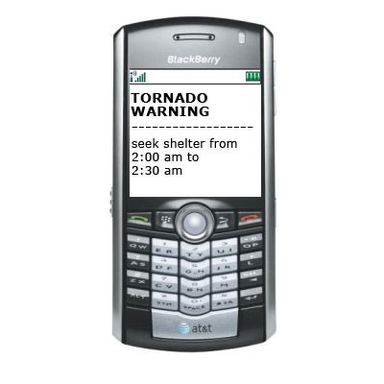
e-Applications: A Priority for ITU
The ITU Plenipotentiary Conference 2010 in Guadalajara, Mexico adopted a new Resolution that calls on ITU to give priority consideration to the expansion of telecommunication/ICT initiatives for e-health. (Resolution PP-183, Guadalajara, 2010)
Resolutions on e-health and e-government were adopted at the World Telecommunication Development Conference in 2012 on Improving access to healthcare services by using information and communication technologies. (Resolution WTDC-65, Hyderabad, 2010) and on More effective adoption of e-government services (Resolution WTDC-74, Hyderabad, 2010)
New WTSA-12 Resolution 88 on ICT applications and standards for improved access to e-health services (Dubai, Nov. 2012) calls for a concerted effort in ITU-T towards e-health standardization in coordination with WHO and SDOs working in this domain, as well as promotion of e-health in the regions.
Notes:
ITU-D’s ICT Applications and Cybersecurity Division has responsibility for implementation of Programme 3: Identified e-health, e-government and e-environment as the three priority domains for the ICT applications area

Slide 4
Where are the main obstacles for the implementation of eHealth ?”
Lack of Government Policy related to eHealth.
Lack of Technical Guidelines on how to start the implementation of eHealth services.
Lack of financial resources for promotion, training and implementation.
Lack of information on eHealth Economy and successful eHealth implementations in other countries.

Slide 5
Need for e-Health Standardization
With a growing, ageing, population in the 21st century, it is clear that one of the areas where ICTs can help make the greatest difference is in the provision and delivery of healthcare
ICTs are now understood to play a pivotal role in increasing efficiency and quality in delivery of health care, and reducing risk and suffering, particularly among the most vulnerable communities in developing countries
In e-health unfortunately standardized solutions are rare
Interoperability is a key determinant of e-Health’s efficient and equitable rollout
This is not an area where we can afford to have costly squabbles over proprietary technologies
International standards will bring down costs, increase access, and improve efficiencies

Slide 6
Facilitating e-health Standardization
ITU-T Focus Group on M2M Service Layer was established to develop technical reports to support the progress on M2M APIs and protocols. E-health is one of the study cases to be investigated.
ITU-T Study Group 17 completed work on ITU-T X.1080.1 (E-Health and world-wide telemedicine - Generic telecommunication protocol), to provide wide-area communication, where communication can be usefully undertaken as structured messages.
ITU-T Study Group 13 is progressing to draft new "Requirements and network capabilities for EHM-health monitoring services", to describe requirements for supporting e-Health monitoring services, and to specify corresponding network capabilities.
ITU-T Study Group 16 is working in transposing Continua Health Alliance Guidelines into an ITU-T Recommendation as well as in developing a new Recommendation on e-health data exchange services. Approval of both standards is expected before 1st quarter 2014.
6

Slide 7
e-Health Standardization Challenges
Healthcare industry has an enormous installed base of legacy systems based on proprietary technologies.
e-health systems inherently involve “big data”, massive quantities of data, including multimedia diagnostic images, patient codes, test results, research samples, insurance identifiers, financial codes.
e-health standards do not address one unified area of technology but hundreds upon hundreds of areas. Some involve standardization at the content level, such as patient data, diagnostic images, and medical research.

Slide 8
e-Health Standardization Challenges
Other areas of standardization must address a wide range of devices, software systems such as mobile apps, database management systems, and process management.
Another enormous area involves e-health infrastructure and network management such as telecommunication systems, security, and identification and authentication.
Finally, the e-health standards arena is difficult because it involves, to a certain extent, competing or at least overlapping standards initiatives taking place in different institutions.

Slide 9

ITU Facilitating e-health Standardization: Standards and e-Health
ITU’s Standardization Sector has released a Technology Watch Report that looks to the future of e-health.
The report observes that e-health development will require more universal e-health interoperability standards, and strategies to overcome technical infrastructure barriers and address privacy, security, and other legal requirements.
The report is available: http://www.itu.int/en/ITU-T/techwatch/Pages/ehealth-standards.aspx
9
Notes:
The scoping study:
-Provides an initial outline of a general methodology for implementing ICTs in health
-Aims to help developing countries avoid costly errors
-Intends to enhance the efficiency of health systems and ultimately support the sustainable and effective use of such services

Slide 10
ITU Facilitating e-health Standardization: e-Health Standards and Interoperability
Rapid advancements in development of e-health standards must accompany three trends :
  Advancements in healthcare delivery via mobile and wireless e-health technologies;
  Personalized medicine, including personal health records, medical diagnostic devices, and biometric records; and
  Interactive healthcare via social media and Web 2.0 applications.
Institutions developing standards in e-health CEN/TC 251, DICOM, HL7, ISO/TC 215, ISO/IEEE 11073 and, in particular, the work ITU-T
http://www.itu.int/dms_pub/itu-t/oth/23/01/T23010000170001PDFE.pdf
10
Notes:
The scoping study:
-Provides an initial outline of a general methodology for implementing ICTs in health
-Aims to help developing countries avoid costly errors
-Intends to enhance the efficiency of health systems and ultimately support the sustainable and effective use of such services

Slide 11

ITU-WHO : Non-Communicable Diseases (NCDs)
57 million total deaths of which 36 million are due to NCDs in 2008
The cost of scaling up NCD prevention and control is US$ 11.4 billion (an overall cost of US$ 170 billion over the period 2011-2025)
A full 64% of all mobile phone users can now be found in the developing world. Furthermore, estimates show that by 2012, half of all individuals in remote areas of the world will have mobile phones
“This is the 2nd health issue ever to be addressed at a special meeting of the United Nations General Assembly. We should all work to meet targets to reduce NCDs. WHO's best buys serve as excellent guidance.” Ban Ki-moon • UN Secretary-General • 19 September 2011 • High-level Meeting on NCDs •New-York
Cancer
Diabetes
Chronic
Respiratory
Diseases
Cardiovascular
Diseases
Other NCDs
Physical inactivity
Unhealthy
diets
Obesity
Tobacco
use
Harmful use of alcohol
Malnutrition
11

Slide 12

WHO-ITU Collaboration :
Facilitating National e-health Planning
A “National e-Health Strategy toolkit” was
Developed that consists of a methodology &
set of resources to guide country decision
makers to develop their national e-Health
strategy and roadmap.
The toolkit published recently in 2012
The toolkit will be followed by rollout activities
to disseminate it and to work with countries towards having
a national approach to using ICT for Health.
12

Slide 13
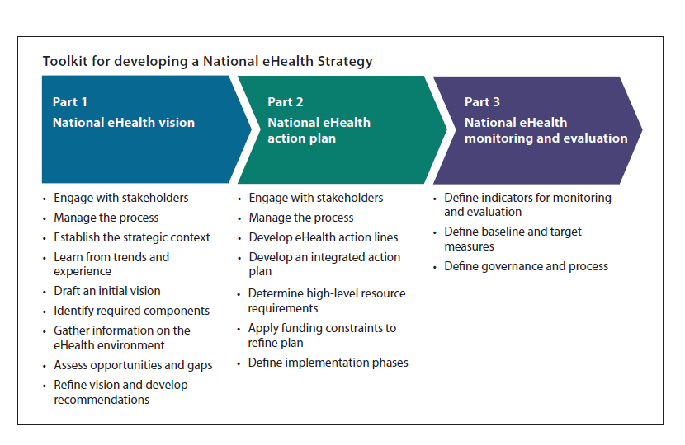
National eHealth Strategy Toolkit
The “National eHealth Strategy Toolkit” is a resource for developing or revitalizing a country’s eHealth strategy.
The Toolkit provides a framework and method for the development of a national eHealth vision, action plan and monitoring framework.
Available at: http://www.itu.int/ITU-D/cyb/app/e-health.html
Notes:
Part 1 develops a national eHealth vision that responds to health and development goals. It explains why a national approach is needed, what the plan will achieve, and how it will be done
Part 2 lays outs an implementation roadmap that reflects country priorities and the eHealth context. It structures activities over the medium term, while building a foundation for the long term.
Part 3 establishes a plan to monitor implementation and manage associated risks. It shows the progress and the results of implementation and aids in securing long-term support and investment.

Slide 14

Facilitating e-health Infrastructure Planning
A report entitled Scaling e-Health services in step with ICT transformation was published to provide guidance to e-Health planners on which e-Health services can be deployed immediately with available infrastructure and which additional services can be added as the infrastructure is transformed.
The report is available at: http://www.itu.int/ITU-D/cyb/app/e-health.html
14
Notes:
The scoping study:
-Provides an initial outline of a general methodology for implementing ICTs in health
-Aims to help developing countries avoid costly errors
-Intends to enhance the efficiency of health systems and ultimately support the sustainable and effective use of such services

Slide 15


Wireless Broadband Initiative
ITU and WHO have been working together with the ICT industry on the African Health Infoway (AHI), as part of ITU’s Wireless Broadband Initiative.
WHO will coordinate the development and installation of computer systems, while ITU facilitates the deployment of infrastructure in countries in collaboration with national telecommunication carriers, and other technology partners
Expected outcomes :
  Develop and deploy wireless networks
  Guarantee capacity for schools and hospitals
  Train local experts and build human capacity
  Develop ICT Applications: e-health, e-education, e-government
15
Notes:
We are launching an ambitious initiative to expand broadband access in Africa
Each partner has an important role to play:
Industry will develop networks, allocating some capacity for public use
Governments will handle permits, licenses, policy and regulation
And, ITU will assist countries with project management, capacity building

Slide 16
Organizing eHealth Events
How e-Science Can Help to Solve Pressing Societal Challenges: Fostering a Global Effort to Develop a Worldwide e-Infrastructure forComputational Neuroscientists to Fight Alzheimer's Disease, Geneva, 20 February 2012
Geneva Health Forum: 18-20 April
Joint ITU-WHO Workshop on e-Health Standards and Interoperability, Geneva, 26-27 April 2012
National eHealth strategy Development Country Experience and Next Steps, 25-26 July 2012, Geneva, WHO Headquarters
ITU Experts Group Meeting on m-Health: Towards Better Care, Cure and Prevention in Europe, 25-26 September 2012, Geneva
eHealth track at ITU Telecom World, Dubai, October 2012
Participated in 4 regional workshops for the Commission on Information And Accountability for Women’s and Children’s Health
16

Slide 17
Conclusions
National strategy , vision and leadership MUST for achieving comprehensive e-Health objectives
Development of Interoperable standards for e-Health is a very challenging but CRITICAL requirement
Universal standardization, through private industry collaborations or government standards policies, is a necessary precursor for any of these e-Health advancements for : Technical Interoperability, Economic Efficiency & Public Accountability
ITU Initiatives for e Health include:
  Specific emphasis on health in National Broadband Plans
  Interoperable standards for e-Health
  Move from pilots to scalable , sustainable e-Health strategy
Notes:
17

Slide 18

I
THANK
U
ITU : http://www.itu.int
ITU Asia Pacific : http://www.itu.int/ITU-D/asp/CMS/index.asp
E mail: sameer.sharma@itu.int

